Slide 1

SMART INDIA HACKATHON 2026
CrossSight: City-wide ANPR Intelligence Platform
Problem Statement ID – SH26127
Problem Statement Title – City-Wide AI Engine for Multi-Camera ANPR Trajectory Tracking and Urban Traffic Analytics
Theme – Smart Automation
PS Category – Software
Team ID – 134754
Team Name – CrossSight

Slide 2



CrossSight – City-wide ANPR Intelligence Platform
CrossSight
Proposed Solution
Detailed explanation of the solution
How it addresses the problem
Innovation and uniqueness
Central platform that ingests license-plate reads from a city-wide camera network
Two-stage reader: YOLOv9 finds plates, an India-tuned CCT model reads them
Trajectory reconstruction, traffic analytics and real-time alerts
GIS control-room dashboard; MVP runs end to end today
Turns isolated camera reads into one searchable, city-wide vehicle history
Auto-flags watchlist, cloned-plate, convoy, loitering, geofence and wrong-way events
Congestion, bottleneck and origin–destination insights for planners
OCR fine-tuned on Indian plates: 72.7% exact match vs 35.4% for current existing model
Improved characters identification to 92.6%
Indian plate-format decoding picks the most probable valid plate
Privacy by design: role-based access, case IDs, audit log

Slide 3
TECHNICAL APPROACH
CrossSight
Methodology and process flow
1 Capture
Video frames from city wide camera networks
2 Detect and read
-YOLOv9 plate detector -Crop
-CCT OCR (india-v1),
Indian format biasing
eg. BR>BZ
3 Stream
Plate reads published to Redpanda topic anpr.reads.v1
4 Process, store
Ingest, analytics, alerts workers write to ClickHouse, PostGIS, Redis, MinIO
5 Serve
FastAPI and Next.js dashboard with live WebSocket
Technologies to be used
Vision / OCR
FastALPR on ONNX Runtime
YOLOv9-s-608 detector
CCT OCR, india-v1 (4.6 MB)
GPU with CPU fallback
Backend
Python 3.11
FastAPI, JWT and roles
uv, Docker Compose
Streaming
Redpanda (Kafka API)
Ingest, analytics and alerts workers
Data stores
ClickHouse: reads, analytics
PostGIS: alerts, zones
Redis: last seen
MinIO: evidence crops
Frontend
Next.js dashboard
GIS heatmap, live alerts
WebSocket live feed

Slide 4
FEASIBILITY AND VIABILITY
CrossSight
Feasibility
Challenges and strategies to overcome them
72.7%
Indian plates read exactly
92.6%
characters correct
Potential challenge | Strategy
Look-alike characters (O/0, 8/B, 6/G, 1/I) still cause misreads | Indian format decoding, more fine-tuning on own-camera crops with fast-plate-ocr, multi-frame voting
Blur, night and weather degrade reads | CLAHE and a quality gate are in place; plug a deblur / super-resolution model into the Enhancer
India model is India-only and forgets many foreign plates | Use the global model for other regions; select the model per deployment
City-wide scale, Vahan registry check is stubbed | Flink or Rust consumers, sharded ClickHouse, edge OCR; implement RegistryClient.lookup(plate)
Plates are personal data; demo logins only | Production auth; case IDs, audit log, RBAC, 30-day retention and k-anonymity enforce accountability
< 5 ms
OCR time per plate (GPU)
~50 ms
per image, CPU only
India-tuned OCR: 35.4% with the existing model, 72.7% after fine-tuning
Runs on GPU or CPU; GPU self-test falls back to CPU

Slide 5






IMPACT AND BENEFITS
CrossSight
Impact on the target audience
Benefits of the solution
Control-room operators and police
One live GIS view with real-time alerts, evidence and an acknowledge, dispatch, close workflow
Crime Management
Faster response to watchlisted, cloned and wrong-way vehicles; privacy safeguards protect citizens
Investigators
Trajectory search across all cameras; impossible-hop flags expose cloned plates
Economic
Reuses existing cameras on an open-source stack; data-driven planning targets spend where congestion is worst
City planners and analysts
Flow, speed, congestion, bottleneck and origin–destination insights without plate-level access
Traffic
Finding bottlenecks and congestion hot spots helps cut idling time, fuel use and emissions

Slide 6
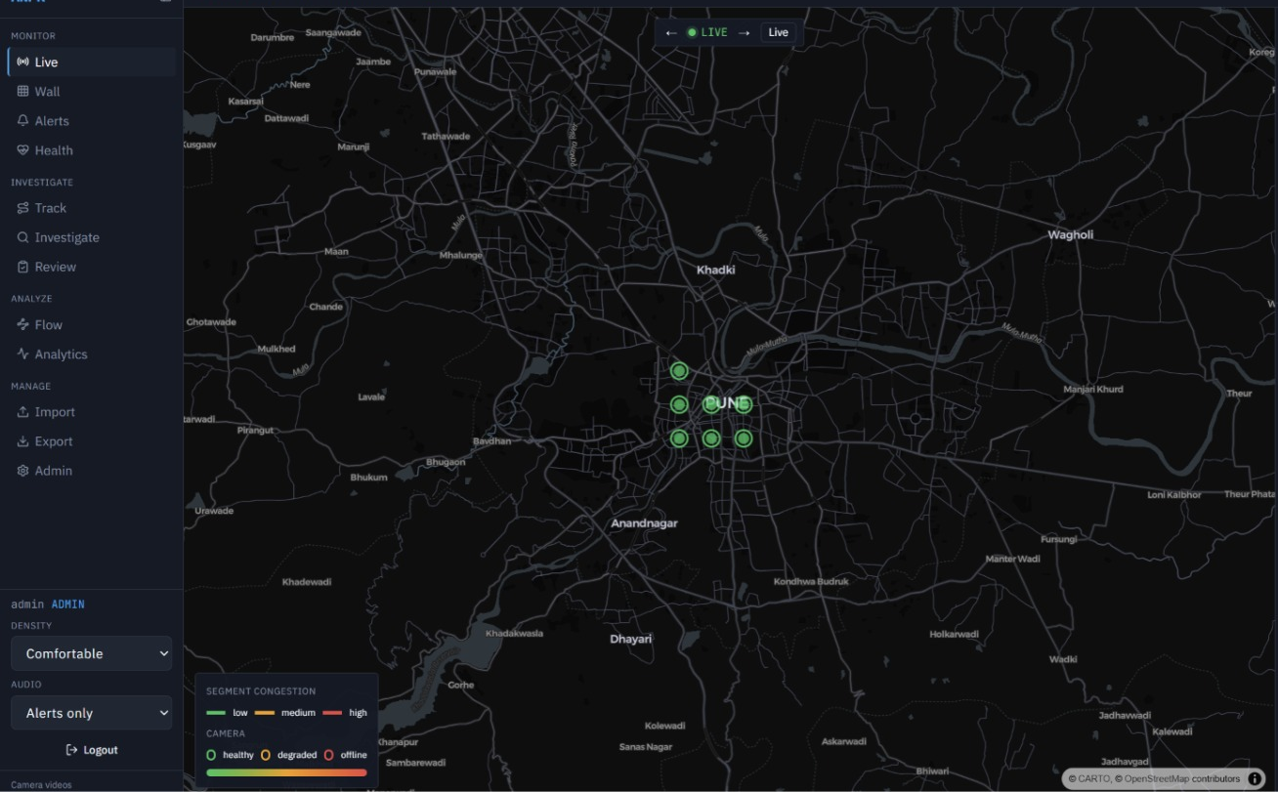
RESEARCH AND REFERENCES
CrossSight
Benchmarked on OpenALPR (444 photos, EU, Brazil, US): plate found 100%, read exactly 90.8%, ~22 ms median on GPU
Global model reads only 35.4% of Indian plates; India-tuned model with format decoding reaches 72.7% exact, 92.6% of characters
Remaining errors are look-alike characters, not plate detection
Privacy: plates are personal data, so access, case IDs, audit log and retention are controlled
PlateOCR: detect and read pipeline - PlateOCR
PlateOCR research and benchmark notes - RESEARCH
FastALPR (detector + OCR framework) - fast-alpr
Fast-plate-ocr (fine-tuning CCT models) - fast-plate-ocr
OpenALPR end-to-end benchmark - benchmarks

