Slide 1
SIMULATION STUDY
XtraFlow
Fuel-weighted traffic signals
A locked comparison on mixed Indian traffic. Same demand, 8 controllers, 4 demand patterns. Not a field deployment. Live demos: SUMO side-by-side + YOLO camera clips.
4
5
2
scenarios
test seeds, scored once
live clips to play
github.com/couder-04/XtraFlow
Simulation-based estimate; assumed traffic mix
Notes:
Open on energy, not on travel time. Say out loud that this is a simulation before the first percentage. Scope: 5 test seeds (1–5). Source label: Simulation-based estimate; assumed traffic mix. Demo order later: results/demo/demo.mp4, then results/demo/yolo/yolo_story.mp4.

Slide 2
TALK MAP
What you will see
Numbers first from the locked TEST. Clips last — they illustrate, they do not replace the headline.
01
02
03
04
05
Idea
Locked TEST
Live · SUMO
Live · YOLO
Limits
Adaptive pressure vs fixed timing; fuel weights are a small add-on.
Same demand, fair baselines, full figure gallery on disk.
Side-by-side: fixed timing vs XtraFlow on one seed.
Camera mosaic with GO/WAIT story, then per-cam overlays if asked.
Detection miss, unscored grid, oracle TEST, next field steps.
XtraFlow · Simulation-based estimate
02
Notes:
Skip nothing in 01–03 for a short talk. Play both live clips. Robustness / grid / scaling are backup if asked.

Slide 3
THE PROBLEM
A stopped queue is burning fuel
Fixed green cannot see which approach is waiting, or what that wait costs.
01
02
03
Fixed green is blind
A count is the wrong unit
The question
The split stays put when one road is empty and the other is full. Webster helps the average hour. It still lags a peak that moves.
Here a truck idles at 2.8× a car, a two-wheeler at 0.54×. Treating them as one vehicle spends green on the wrong queue.
If the signal weighs each vehicle by idle fuel, do fuel, CO₂, delay, and queues fall — inside hard green, yellow, and all-red limits?
LEFT-HAND TRAFFIC · ONE FOUR-ARM JUNCTION
Assumed mix · two-wheelers 40% · cars 30% · trucks 15% · autos 10% · buses 5%
XtraFlow · Simulation-based estimate
03
Notes:
The mix is assumed until observed counts are supplied. Do not present it as a city survey. Idle-fuel ratios are measured in SUMO, not guessed.

Slide 4
THE CONTROLLER
Weigh the queue by the fuel it burns
Idle-fuel weights are a small add-on on top of adaptive pressure (about 0–2% vs count-only on TEST).
Weights come from a 60-second probe of fuel burned while the vehicle is stopped. Emission classes are assumed. Autos and cars share a class in this run, so they share a weight.
Two-wheeler
0.54×
Auto
1.00×
Car
1.00×
Chosen on validation only
Look back 150 m. Count moving vehicles at 0.50. Switch only past hysteresis 0.25. Scenario: .
Bus
2.00×
Truck
2.77×
TIMING THAT STAYS IN FORCE
15 s
90 s
3 s
2 s
120 s
Min green
Max green
Yellow
All-red
Must serve
XtraFlow · Simulation-based estimate
04
Notes:
Explain hysteresis: the new phase must beat the current pressure by the tuned margin. Must-serve forces a switch so a waiting approach is not ignored. Weights file: results/weights.json. Tuned parameters: results/tuned_params.json, validation seeds only.

Slide 5
HOW A DECISION IS MADE
See the queue. Score the fuel. Keep the timing.
The signal never skips yellow or all-red, and it cannot hold green past the cap.
01
02
03
See
Score
Measure
Detectors on each approach, or a camera. A YOLO overlay demo is on a later slide — input feasibility, not a fuel-saving result. Locked TEST scores still use the oracle detector; detector-miss noise for robustness stays assumed (15% in the smoke check).
Each queued vehicle is scaled by its idle-fuel weight. Moving vehicles count at the tuned fraction. The phase changes only after minimum green, and only if the gain clears hysteresis.
Fuel and CO₂ come from SUMO on every completed trip. Waiting and queues use the same seed the other controllers saw. The test set was not used to pick the settings.
XtraFlow · Simulation-based estimate
05
Notes:
Play the YOLO story after the side-by-side SUMO demo (yolo_story.mp4). Say clearly: YOLO is input feasibility; headline fuel numbers are oracle TEST. Do not claim a field detector result.

Slide 6
THE EXPERIMENT
Same cars for every controller
Settings are frozen before the test. 5 test seeds (1–5). A seed is one hour of the same demand, replayed.
TRAIN
VALIDATION
TEST
1000 – 1049
2000 – 2019
1 – 5
Reinforcement-learning baseline only
Settings chosen here, then frozen
5 locked seeds in raw_runs.csv
Low demand
Shifting
Peak, one-sided
Balanced
150 veh/h on every approach.
The heavy axis swaps every 20 min. 680 against 200 veh/h.
North–south 720 veh/h. East–west 180.
480 veh/h on every approach.
Compared with Fixed time, Tuned fixed, Webster, Actuated, Queue pressure, Max-pressure, Count only. PPO was trained to the config budget and is not in this TEST table.
Sublane probe used. Full-demand stability under that setting is not re-claimed here.
XtraFlow · Simulation-based estimate
06
Notes:
Same seed means identical demand. Test seeds are the ones stored in results/raw_runs.csv. Sublane use is the used_sublane field in results/sublane_fallback.json. RL note: Time cut. This zip is the 200000-step model. It was not scored on VALIDATION or TEST, so rl_ppo is not in raw_runs.csv.

Slide 7
TEST SET
Small edge vs the strongest baseline (0.3–1.9%)
Fuel vs best tuned baseline is only 0.3–1.9% (5 paired seeds; Holm p=1). Large cuts are vs fixed / Webster / actuated, not class fuel weights.
Low demand
Shifting
Peak, one-sided
Balanced
1.9%
1.1%
0.7%
0.3%
0.5 – 3.0
0.6 – 1.7
-0.4 – 1.8
-0.4 – 1.0
vs Max-pressure
vs Max-pressure
vs Max-pressure
vs Max-pressure
vs legacy fixed 14.1%
vs legacy fixed 13.2%
vs legacy fixed 17.5%
vs legacy fixed 7.9%
Mean fuel is lower than the best baseline in every scenario. Some 95% intervals still cross zero — read the interval, not only the point estimate.
XtraFlow · Simulation-based estimate
07
Notes:
Primary headline vs best of fixed_tuned / actuated / queue_pressure / maxpressure is only 0.3–1.9% (n=5; Holm p=1). The 8–17% cuts are vs fixed / Webster / actuated. Published maxpressure ≡ queue_pressure (downstream was ~0); re-run after occupancy fix. Numbers are from results/headlines.json.

Slide 8
THE HONEST COMPARISON
Versus strong adaptive controllers, the edge is small
Against max-pressure / queue_pressure the cut is 0.3–1.9% (and those two matched bit-for-bit in this publish). Legacy fixed is the easy win.
Scenario
vs legacy fixed
vs tuned fixed
vs actuated
vs max-pressure
Low demand
14.1%
12.1%
10.7%
1.9%
12.7 – 15.5
11.4 – 12.8
9.0 – 12.4
0.5 – 3.0
Shifting
13.2%
17.0%
8.5%
1.1%
12.3 – 14.3
15.1 – 18.9
7.8 – 9.2
0.6 – 1.7
Peak, one-sided
17.5%
9.6%
8.5%
0.7%
14.4 – 20.3
8.0 – 11.2
6.6 – 10.0
-0.4 – 1.8
Balanced
7.9%
7.6%
4.8%
0.3%
6.7 – 9.1
6.7 – 8.4
4.3 – 5.3
-0.4 – 1.0
Versus max-pressure: 0.3% to 1.9%. Some intervals still cross zero. Versus the count-only ablation: 0.1% to 2.0%. PPO is trained but not scored in this TEST table.
XtraFlow · Simulation-based estimate
08
Notes:
Read the paired intervals on this slide from the loaded comparison table. Do not add a verdict that is not in those intervals. RL is a baseline trained with the budget in rl_selection.json.

Slide 9
WHAT CHANGES
Shorter waits, shorter queues, less CO₂
Peak, one-sided on the locked test. Completed trips match fixed time (1,801).
FUEL / VEHICLE
MEAN WAIT
MEAN QUEUE
CO₂
0.151 L
37.0 s
17.5 veh
679 kg
0.125 L
18.4 s
9.0 veh
560 kg
from fixed time
from fixed time
from fixed time
from fixed time
WAITING TIME ON THE OTHER SCENARIOS
Low demand
27.2 s to 16.2 s
41% shorter
Shifting
32.2 s to 18.8 s
42% shorter
Balanced
30.0 s to 21.8 s
27% shorter
XtraFlow · Simulation-based estimate
09
Notes:
Levels are means from results/tables/summary_mean_std.csv. The fuel percentage on the previous slide is the mean of paired percent cuts, which is not identical to the percent gap between these two means. Waiting cuts are percent gaps between means. Say that if someone mixes the two.

Slide 10
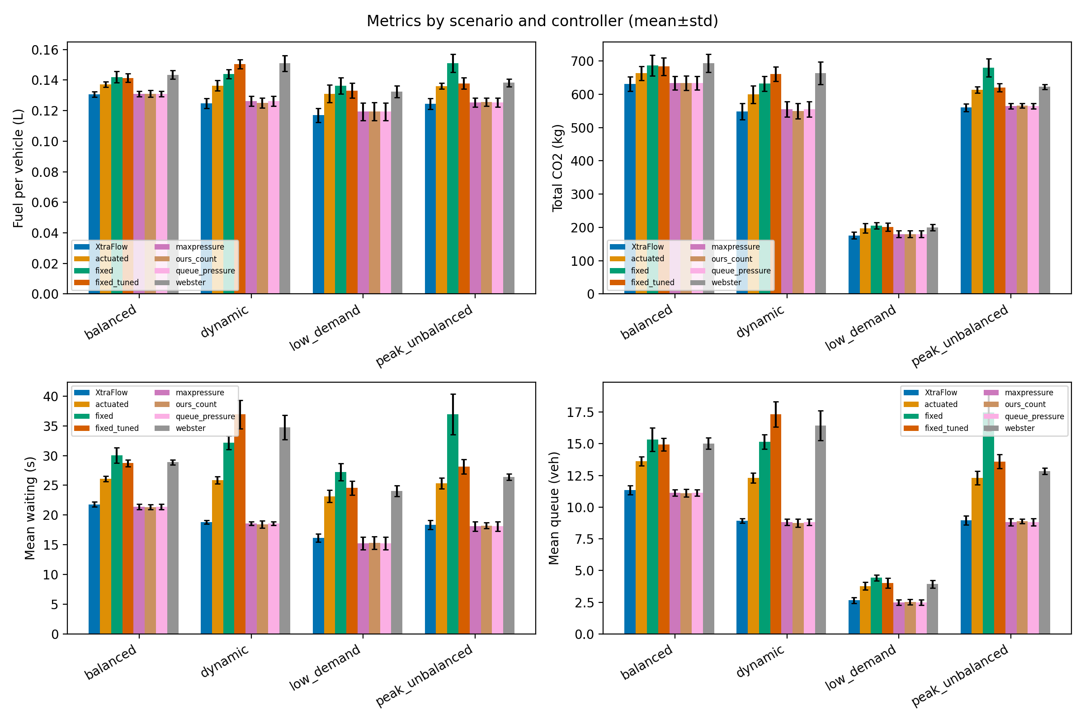
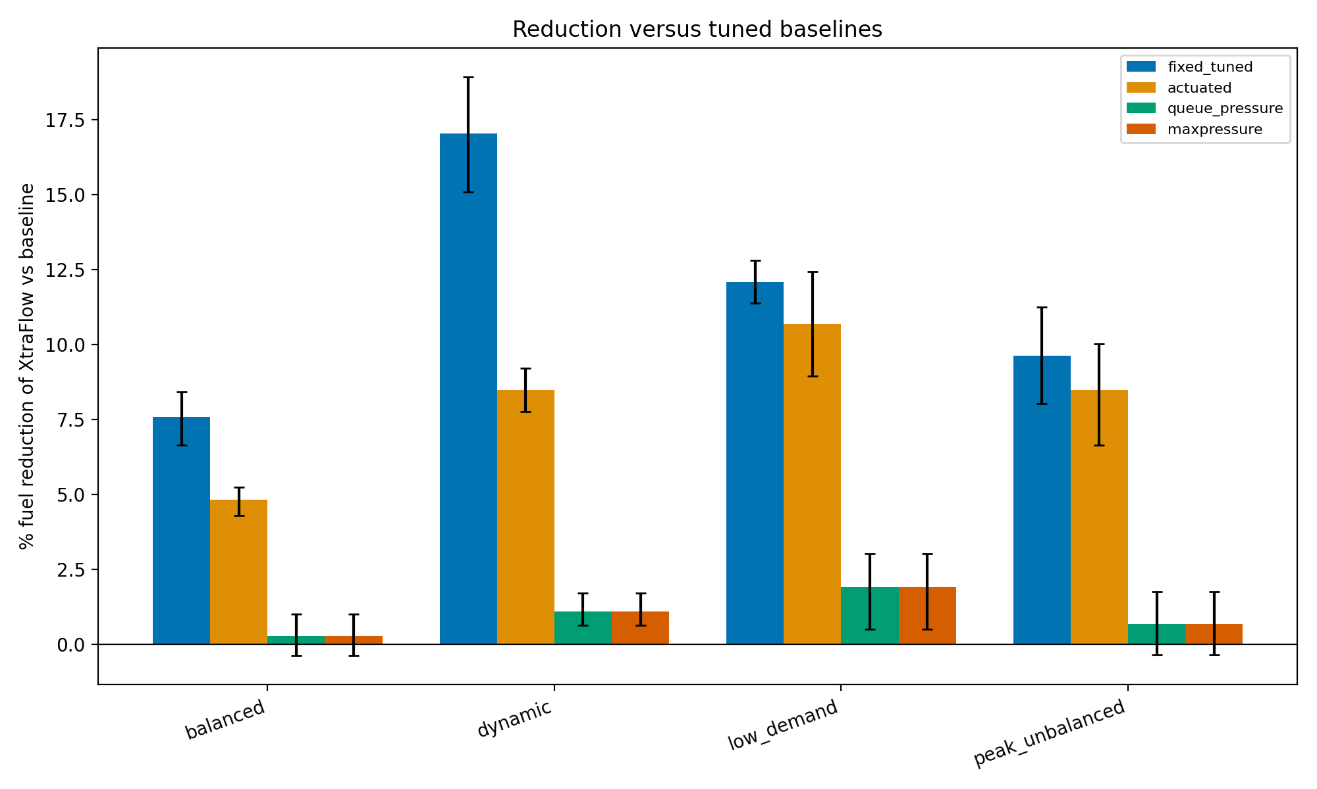
FIGURES
Metrics by controller · Fuel cut vs baselines
Regenerated from results/ by analyze.py and the study scripts.
METRICS BY CONTROLLER
FUEL CUT VS BASELINES
Fuel, CO₂, wait, and queue (mean±std)
Paired % reduction versus tuned baselines
XtraFlow · Simulation-based estimate
10
Notes:
PNGs live in results/figures/. Do not describe a trend that is not visible in the figure. RL / grid / extrapolation slides inherit the same caveats as STATE.md.

Slide 11
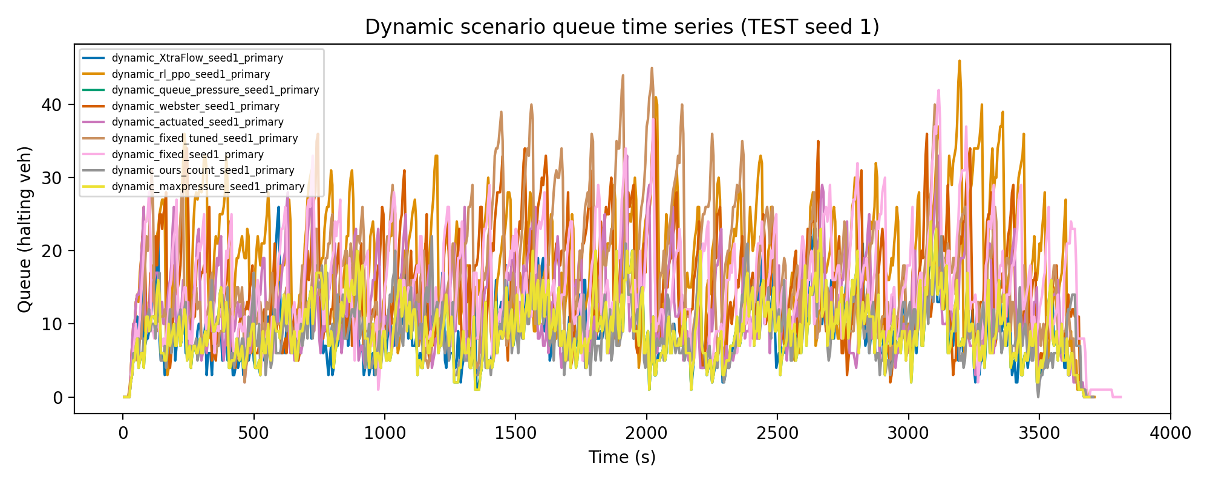
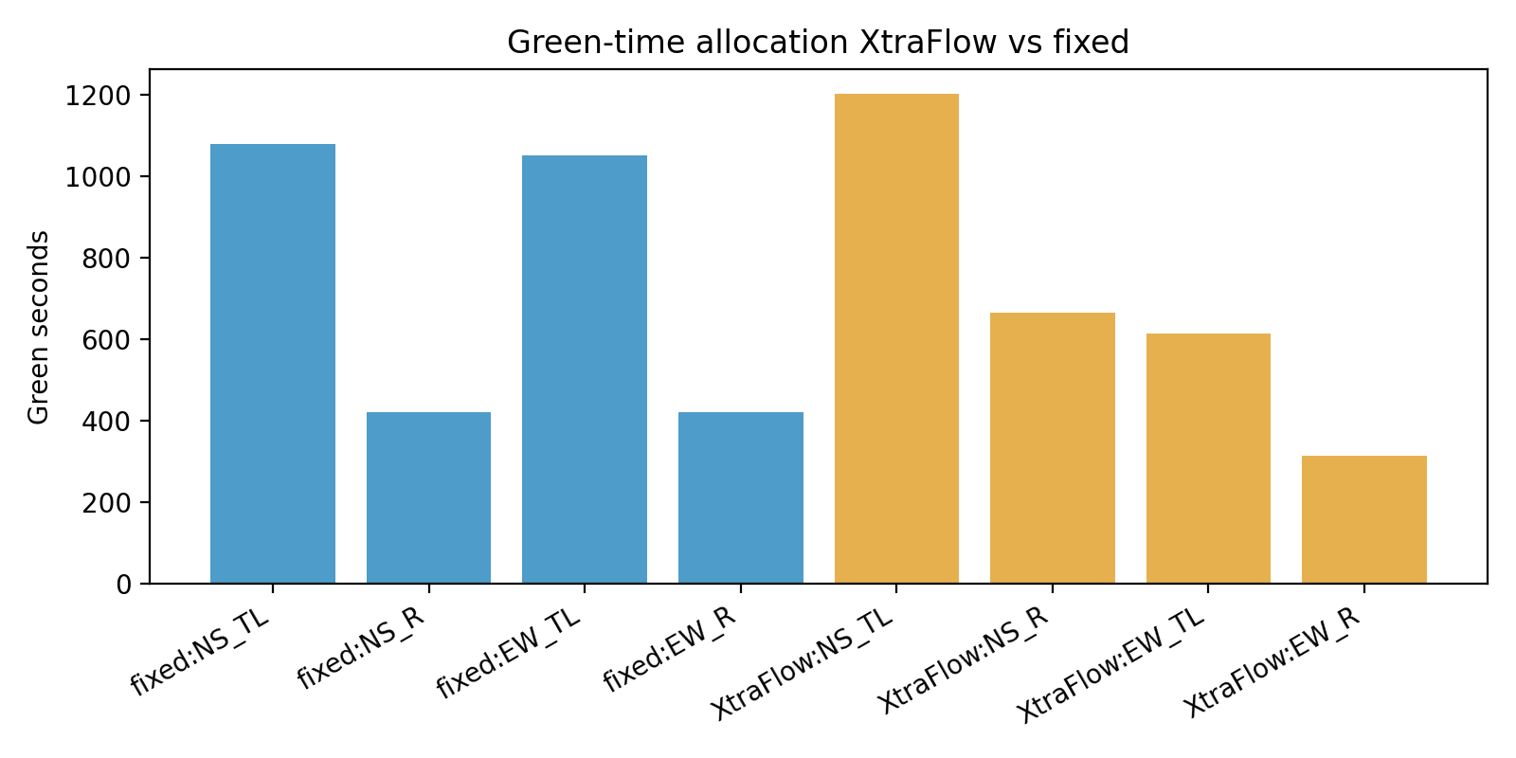
FIGURES
Dynamic queue series · Green allocation
Regenerated from results/ by analyze.py and the study scripts.
DYNAMIC QUEUE SERIES
GREEN ALLOCATION
Queue time series on the dynamic scenario
XtraFlow green share versus fixed timing
XtraFlow · Simulation-based estimate
11
Notes:
PNGs live in results/figures/. Do not describe a trend that is not visible in the figure. RL / grid / extrapolation slides inherit the same caveats as STATE.md.

Slide 12
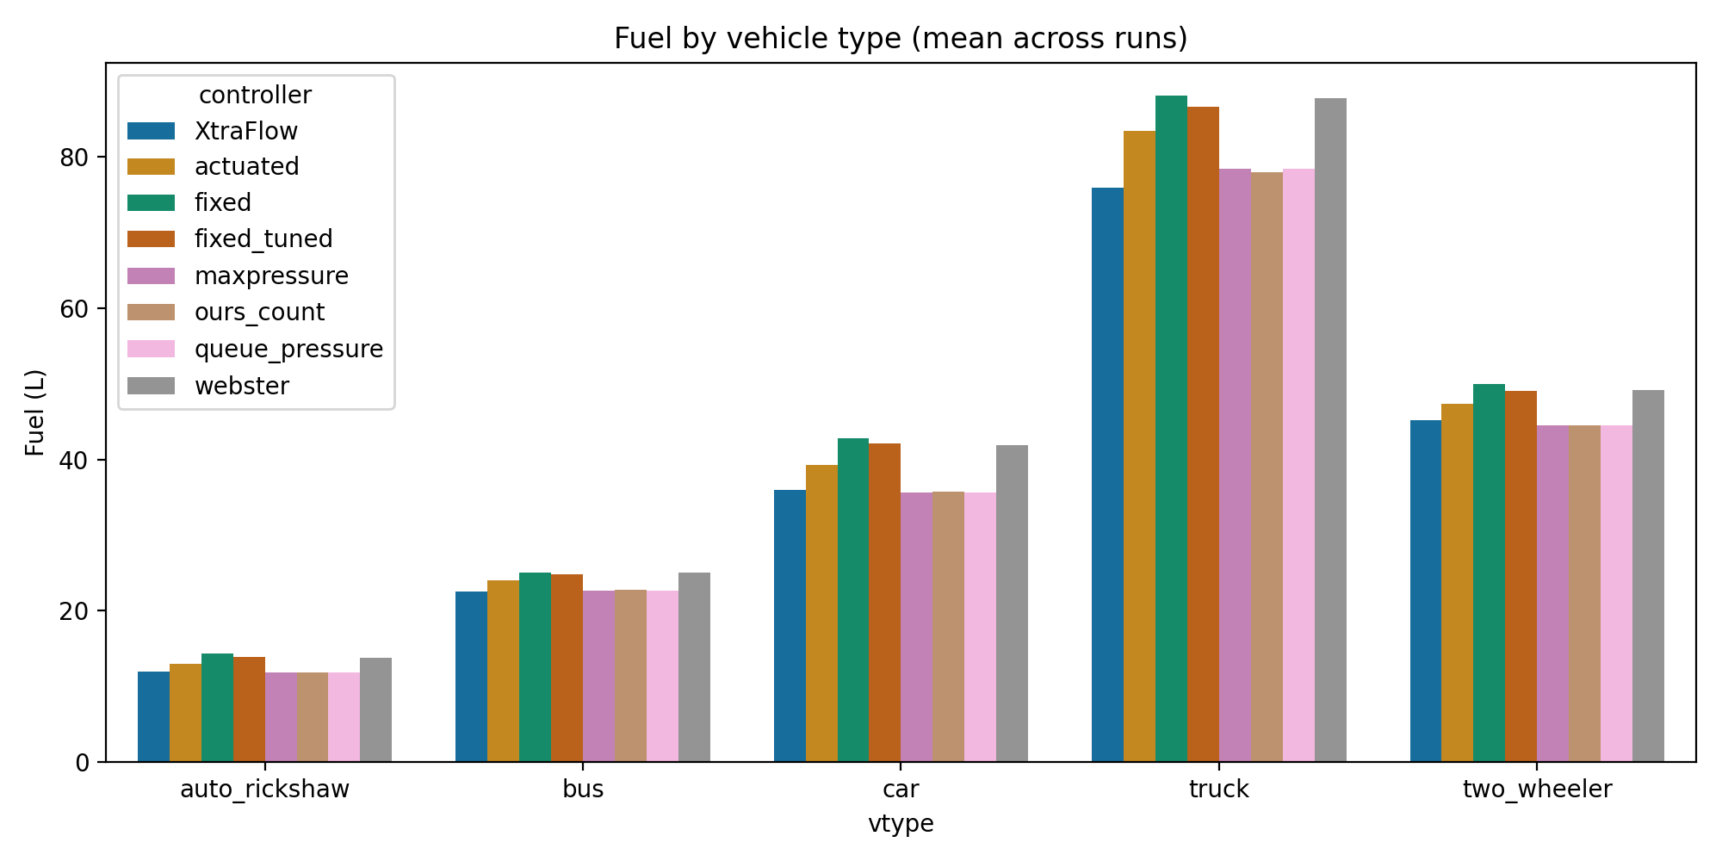
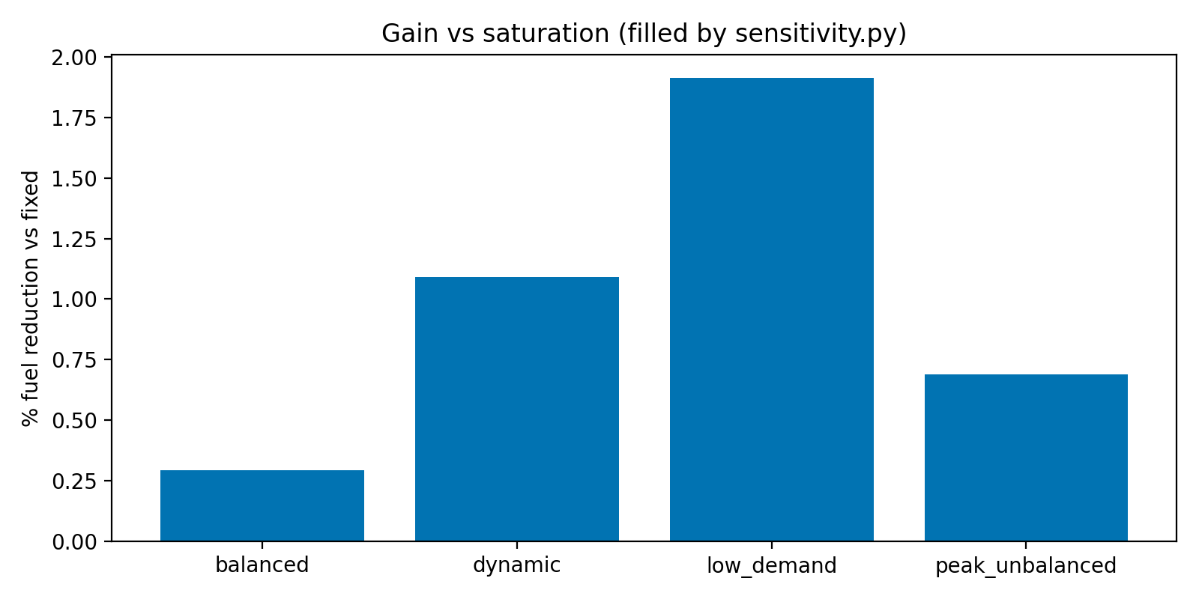
FIGURES
Fuel by vehicle type · Gain vs saturation
Regenerated from results/ by analyze.py and the study scripts.
FUEL BY VEHICLE TYPE
GAIN VS SATURATION
Mean fuel split across the assumed mix
Fuel gain versus demand multiplier proxy
XtraFlow · Simulation-based estimate
12
Notes:
PNGs live in results/figures/. Do not describe a trend that is not visible in the figure. RL / grid / extrapolation slides inherit the same caveats as STATE.md.

Slide 13
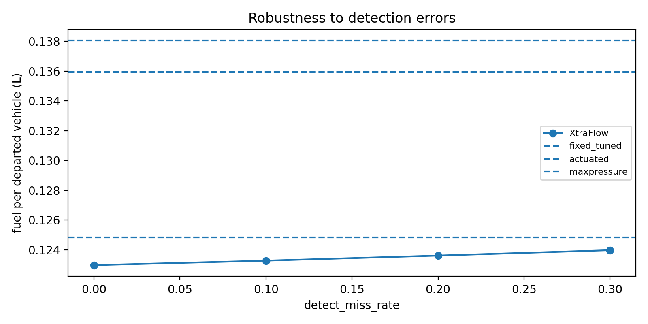
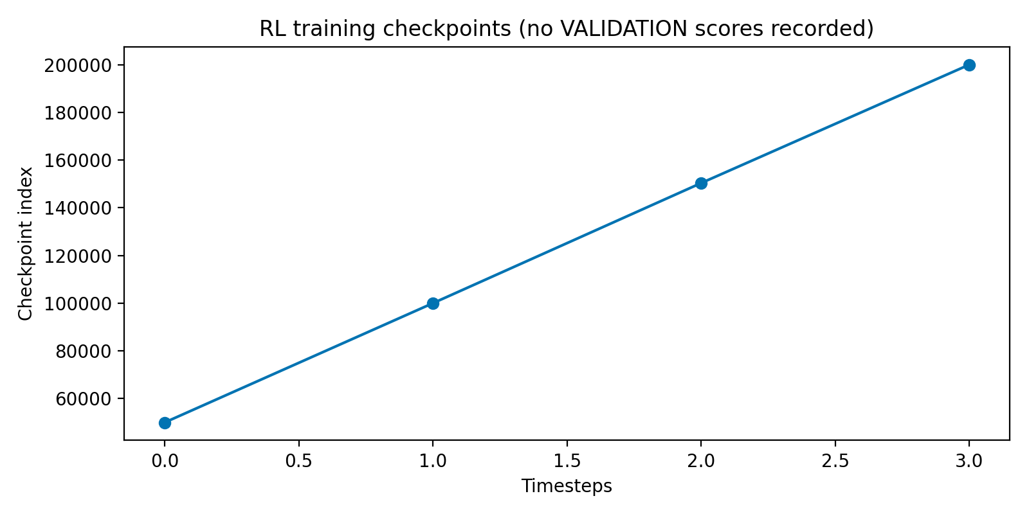
FIGURES
Detection-miss robustness · RL training
Regenerated from results/ by analyze.py and the study scripts.
DETECTION-MISS ROBUSTNESS
RL TRAINING
Fuel under rising detector miss rates
PPO training curve (unscored on TEST)
XtraFlow · Simulation-based estimate
13
Notes:
PNGs live in results/figures/. Do not describe a trend that is not visible in the figure. RL / grid / extrapolation slides inherit the same caveats as STATE.md.

Slide 14
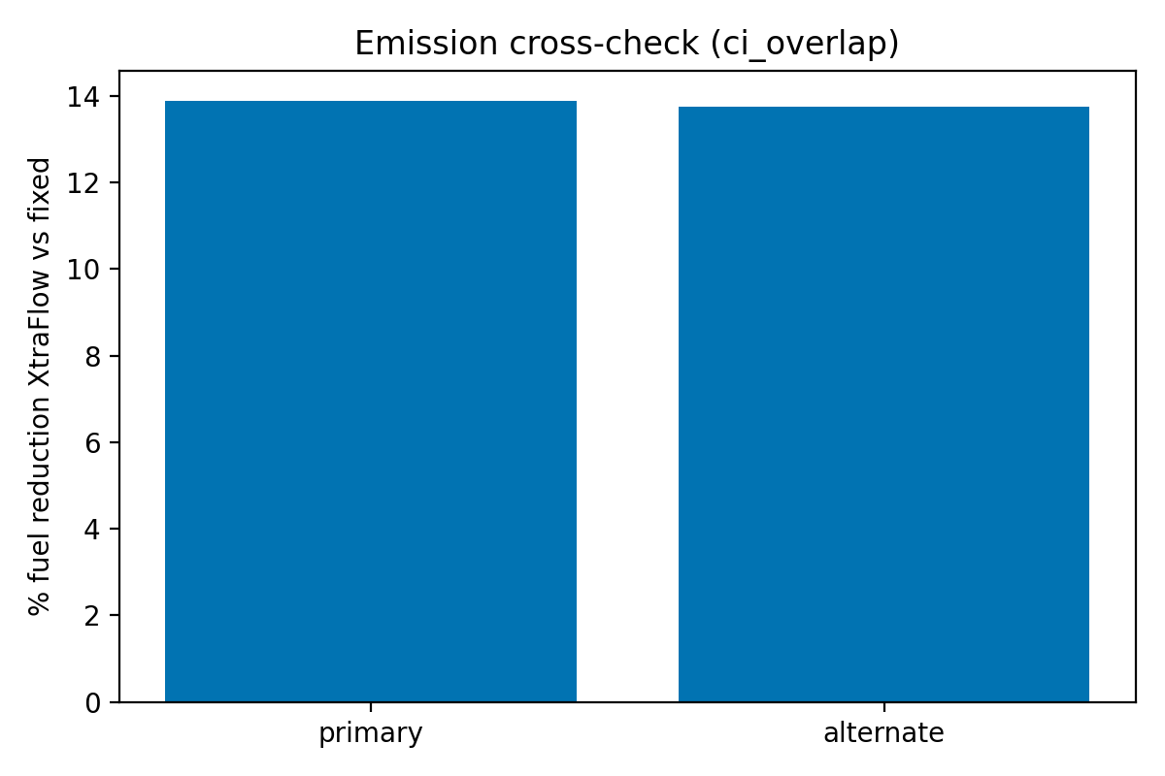
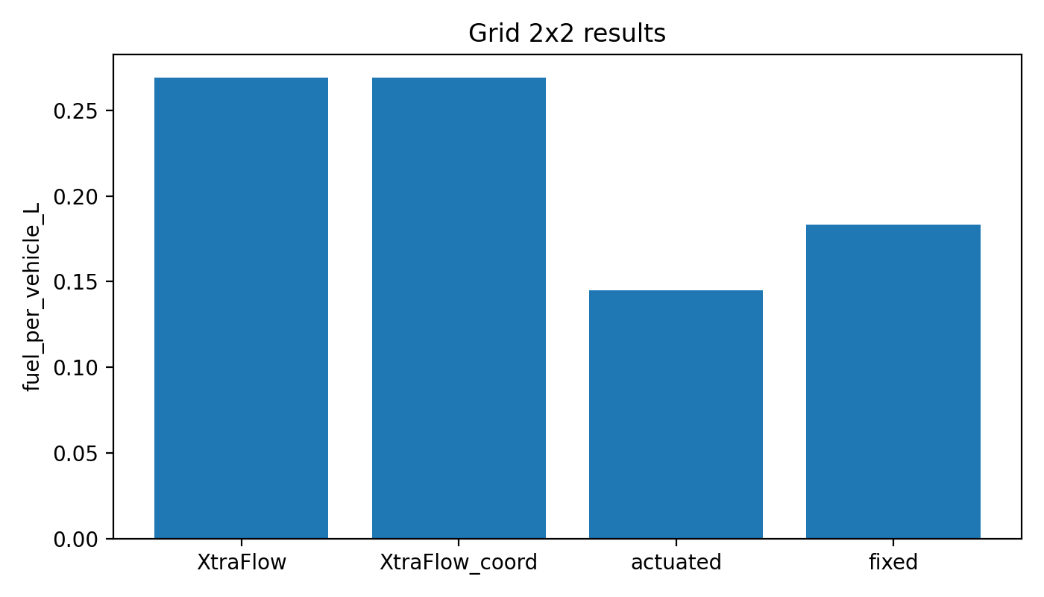
FIGURES
Emission cross-check · 2×2 grid
Regenerated from results/ by analyze.py and the study scripts.
EMISSION CROSS-CHECK
2×2 GRID
Primary vs alternate emission classes
Grid sweep (unscored TLS caveat applies)
XtraFlow · Simulation-based estimate
14
Notes:
PNGs live in results/figures/. Do not describe a trend that is not visible in the figure. RL / grid / extrapolation slides inherit the same caveats as STATE.md.

Slide 15
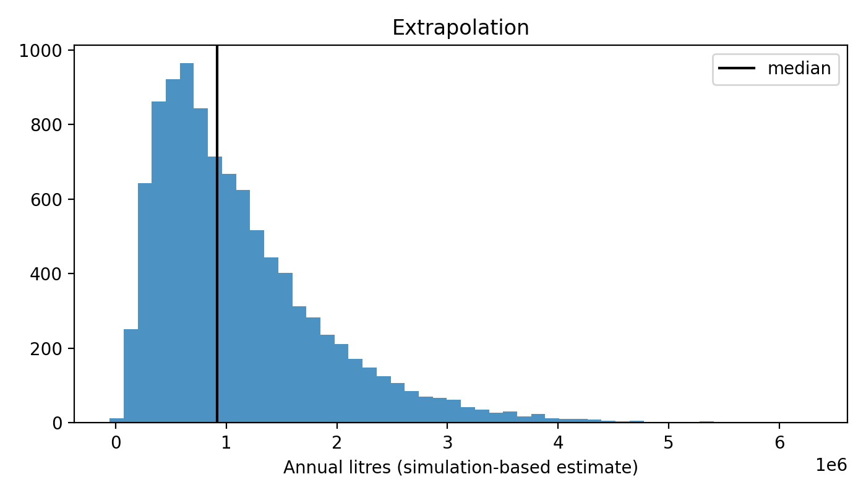
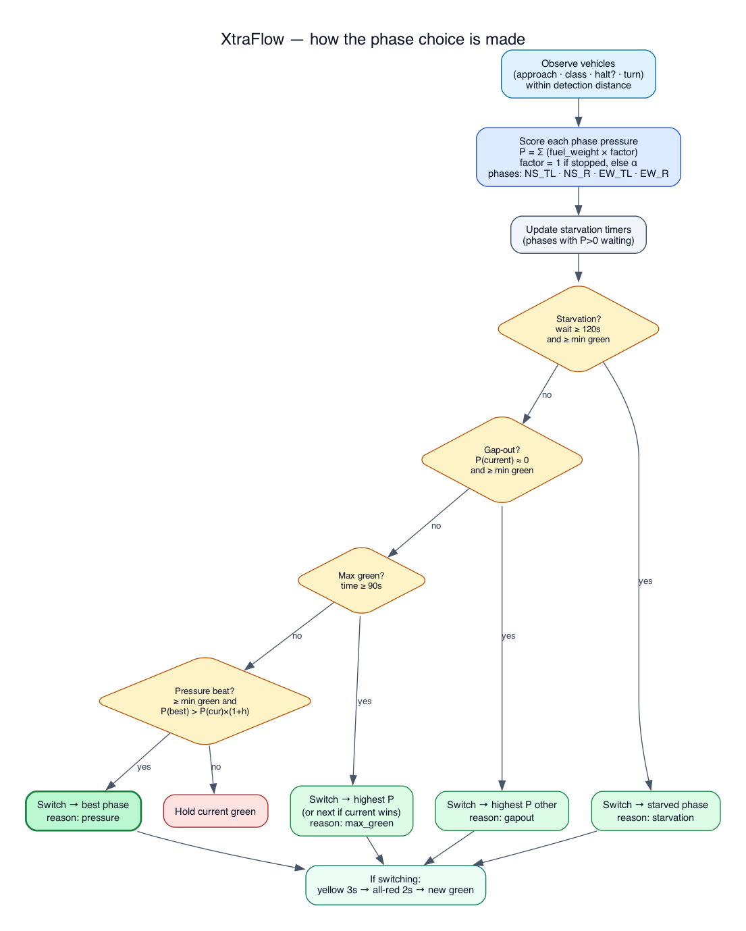
FIGURES
Extrapolation · Phase choice sketch
Regenerated from results/ by analyze.py and the study scripts.
EXTRAPOLATION
PHASE CHOICE SKETCH
Placeholder scaled fuel / INR range
How fuel-weighted pressure picks a phase
XtraFlow · Simulation-based estimate
15
Notes:
PNGs live in results/figures/. Do not describe a trend that is not visible in the figure. RL / grid / extrapolation slides inherit the same caveats as STATE.md.

Slide 16
LIVE CLIP 1 · CONTROL
Fixed timing on the left. XtraFlow on the right.
One seed, same arrivals. Qualitative demo — the fuel numbers are on the previous slides.
WHAT TO SAY
PLAY NOW
results/demo/demo.mp4
1. Same cars on both sides.
Open the file in a video player beside the deck. Same demand seed: legacy fixed versus XtraFlow. Do not treat the clip as a percentage claim.
2. Left is fixed green.
3. Right is fuel-weighted pressure.
4. Watch which approach gets green when the queue is heavy.
Next: YOLO story clip — GO/WAIT on four cameras.
XtraFlow · Simulation-based estimate
16
Notes:
Open results/demo/demo.mp4 (or demo.gif) while presenting. Then advance to the YOLO story slide and play yolo_story.mp4. Say that the SUMO demo is qualitative; the headline numbers are on the previous slides.

Slide 17
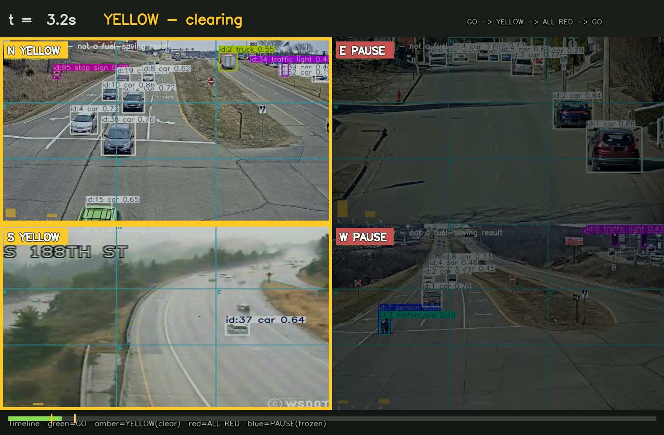
LIVE CLIP 2 · PERCEPTION
Play the YOLO story: GO / WAIT on four cameras
Input feasibility — not a fuel-saving result
PLAY NOW
results/demo/yolo/yolo_story.mp4
1. Green = that axis moves. Red = wait.
2. Phase picks the highest fuel-weighted pressure.
3. Four independent corridor cams — not one junction.
4. Not the locked SUMO fuel headline.
CLIP STATS (PROXY — NOT TEST)
mean ~15 veh across cams · peak 24 · idle-fuel proxy vs fixed 22% on this clip only
XtraFlow · Simulation-based estimate
17
Notes:
Play results/demo/yolo/yolo_story.mp4 full-screen. Say: GO/WAIT is illustrative from detector counts; published fuel is oracle SUMO TEST. Next slide has mosaic + per-cam overlays if you want to linger.

Slide 18
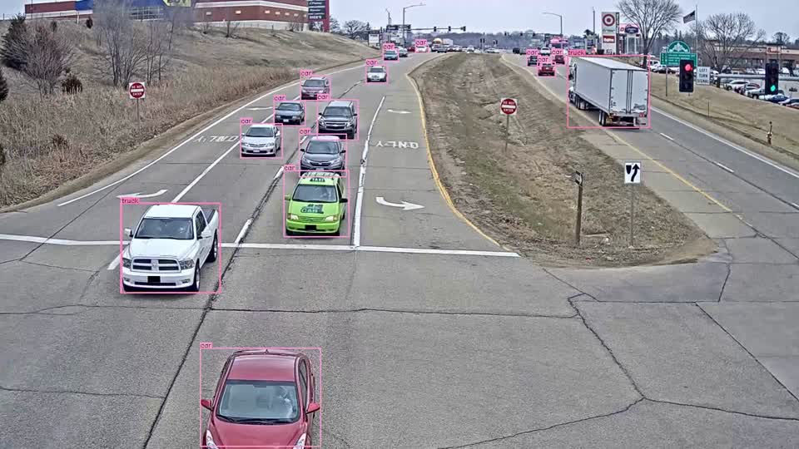
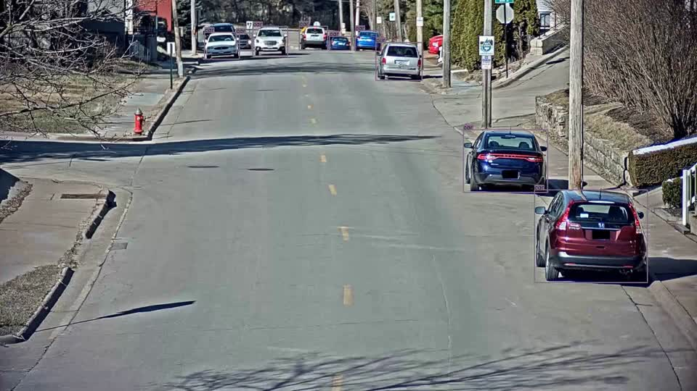
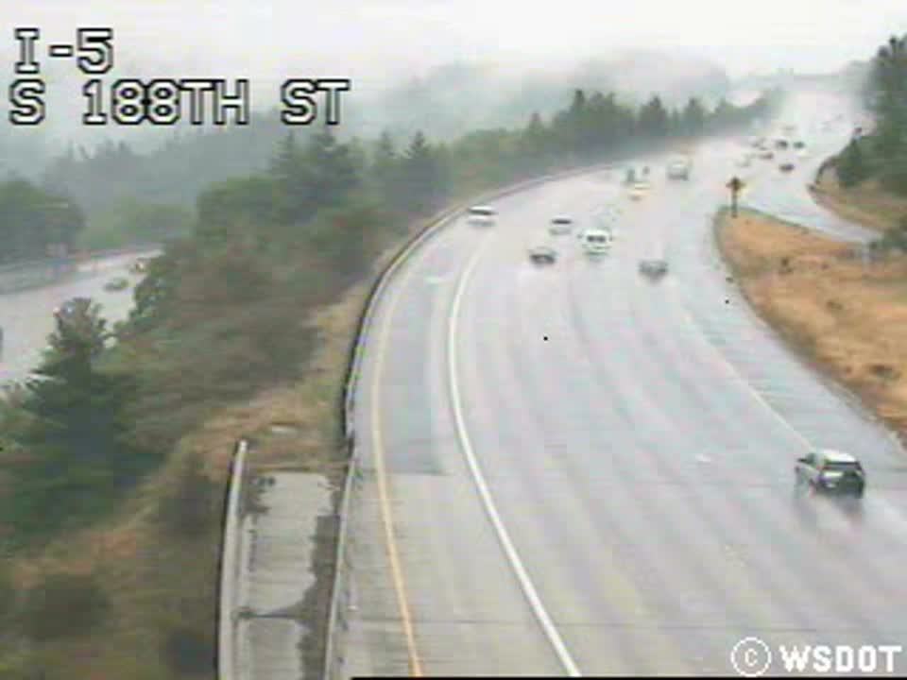
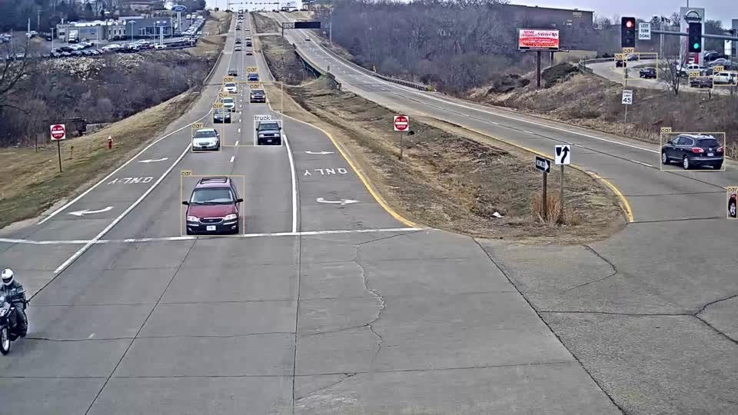
LIVE CLIP 2B · OPTIONAL
Mosaic and per-camera overlays
Play if someone asks how each approach looks. Same caveat: input feasibility only.
N · Straight multi-lane (Zenodo cam_10)
E · Straight street (Zenodo cam_16)
PLAY THESE
● Mosaic (2×2)
results/demo/yolo/yolo_mosaic.mp4
● Primary overlay
results/demo/yolo_overlay.mp4
● Cam N
S · I-5 S @ 188th St (WSDOT)
W · Divided arterial (Zenodo cam_11)
results/demo/yolo/overlay_N.mp4
● Cam E
results/demo/yolo/overlay_E.mp4
● Cam S
results/demo/yolo/overlay_S.mp4
● Cam W
results/demo/yolo/overlay_W.mp4
ATTRIBUTION
Four independent corridor cameras mapped to N/E/S/W for a mosaic. Not synchronized approaches of one intersection. S is true southbound one-way highway; N/E/W are Zenodo arterial cams.
Mixed research CCTV — straight / one-way corridors · Zenodo DOI 10.5281/zenodo.3986141 (CC BY 4.0); Seattle I-5 trafficdb (WSDOT / Chan–Vasconcelos)
XtraFlow · Simulation-based estimate
18
Notes:
Optional. Prefer yolo_story on the previous slide for the talk. Use mosaic or one overlay only if asked. Do not claim a synchronized field site.

Slide 19
IF THE CAMERA MISSES
At the highest miss rate, mean fuel is under the reference lines
Peak, one-sided. 3 seeds. Vehicles are dropped from the detector at random.
0% missed
10% missed
20% missed
30% missed
0.123
0.123
0.124
0.124
litres / vehicle
litres / vehicle
litres / vehicle
litres / vehicle
± 0.002 · n=3
± 0.002 · n=3
± 0.001 · n=3
± 0.001 · n=3
SAME SEEDS, NO MISSES
0.123 L
0.136 L
XtraFlow
Actuated
Every miss level on this slide has lower mean fuel than every reference line. Noise-model point (see noise_model.json) is 0.125 L.
XtraFlow · Simulation-based estimate
19
Notes:
Means are grouped from results/robustness.json. Do not describe the curve as flat unless the loaded means say so. The noise-model source field is empirical only when labels exist.

Slide 20
WHERE IT DOES NOT TRANSFER
The 2×2 grid was not scored in this publish
A corridor result is only quoted from results/grid_results.json after a successful sweep.
NO NUMERIC GRID CLAIM
2x2 grid not scored in this time-cut run. duarouter path was fixed, but the single-intersection tls.add.xml does not provide programs for the grid TLS ids, so SUMO aborts.
Do not scale the single-junction result to a city.
XtraFlow · Simulation-based estimate
20
Notes:
Read results/grid_results.json. If rows and summary_means are empty, say the grid was not scored. Label: simulation-based estimate; assumed traffic mix.

Slide 21
BESIDE THE HEADLINE
Safety: Fewer conflicts. Emissions: Intervals overlap.
Both lines are the verdict fields in the loaded JSON, not a fixed sentence.
SAFETY
EMISSIONS MODEL
PERCEPTION
Fewer conflicts
Intervals overlap
YOLO demo ready
Time-to-collision conflicts from the simulator. A model count, not a crash record.
Primary model 13.9%. Alternate model 13.7%. The reduction shrinks. It does not flip.
Camera overlays exist under results/demo/yolo/. They are input feasibility only. Locked TEST fuel still uses the oracle detector. Robustness miss rates remain assumed until labeled video replaces the noise model.
XtraFlow · Simulation-based estimate
21
Notes:
Safety verdict comes from results/safety.json. Emission cross-check is HBEFA3 versus PHEMlight on a smaller seed set than the main test; quote both percentages. YOLO demo does not replace the oracle TEST claim.

Slide 22
SCALING
Per vehicle is measured. Per year is a range.
The wide bar is the assumed city size, not uncertainty in the junction test.
MEASURED VS BEST BASELINE (SCENARIO-WEIGHTED)
Why the bar is wide
0.001 L saved / vehicle
Junctions
5th – 95th percentile of that mean: 0.001 – 0.002 L
50 – 1,000
Vehicles / peak hour
800 – 2,200
IF THAT SAVING IS MULTIPLIED OUT
Peak hours / day
3 – 7
0.3 million litres
2.7 million litres
Days / year
0.9 million litres
250 – 330
median of the scaled draws
Rupee value uses a placeholder price, so it is not shown.
CO₂ median 2,296 tonnes · 629 tonnes – 6,640 tonnes
XtraFlow · Simulation-based estimate
22
Notes:
Lead with the per-vehicle litres. The annual figure multiplies that saving by the ranges on the right, Monte Carlo from config.yaml. The price in fuel.price_inr_per_L is a placeholder. Quote the extrapolation label: simulation-based estimate, not a deployment result.

Slide 23
BEFORE A STRONGER CLAIM
XtraFlow
Smarter signals should burn less fuel.
01
02
03
Count the junction
Film the queue
Score the corridor
Replace the assumed flows with observed demand before quoting a site.
YOLO overlays are a feasibility demo. Replace assumed detector-error with labeled site video.
Quote a grid result only from results/grid_results.json after a successful sweep.
This deck: 8 controllers · 5 test seeds (1–5) · oracle detector unless camera mode is on. · YOLO demo included
github.com/couder-04/XtraFlow
Simulation-based estimate; assumed traffic mix
XtraFlow · Simulation-based estimate
23
Notes:
Close on the three conditions. Demo order was: SUMO side-by-side, YOLO story, optional overlays. Do not end on the annual litre range. The headline comparison is in results/headlines.json.

