Slide 1
Functionally Annotating the Candida auris Genome
Skyler Sung
NHGRI, Translational and Functional Genomics Branch, Microbial Genetics Section, Segre Lab

Slide 2
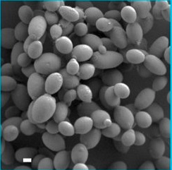
Background
Why study C. auris?
39% mortality rate
Quickly spreads in healthcare settings
Resistant to multiple antifungal classes
Persists on human skin & healthcare surfaces
1 µm
C. auris biofilm imaged with electron microscopy
Horton et al. Candida auris Forms High-Burden Biofilms in Skin Niche Conditions and on Porcine Skin. mBio. 2020
Chicago outbreak
First cases in 2016
Colonized up to 86% of residents in ventilator-capable skilled nursing facility (vSNF)
Notes:
Image: scanning electron microscope 3kV. Skin washed w/ DPBS & EtOH → incubated w/ C. auris sweat media for 24 hr

Slide 3
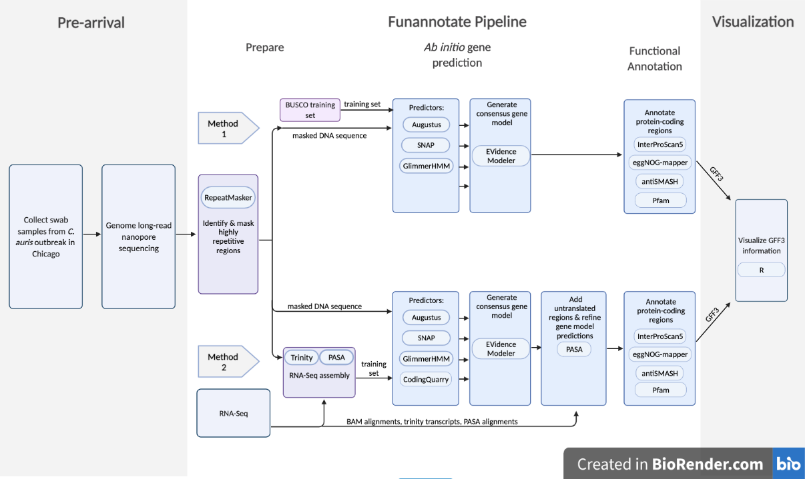
Methods: Funannotate genome-only

Slide 4
Methods: Funannotate w/ RNA-seq data

Slide 5

What can the output tell us?
How do our annotations compare to the NISC annotation?
Does RNA-Seq data improve our annotation?
How do our annotations compare to those in NCBI GenBank?

Slide 6
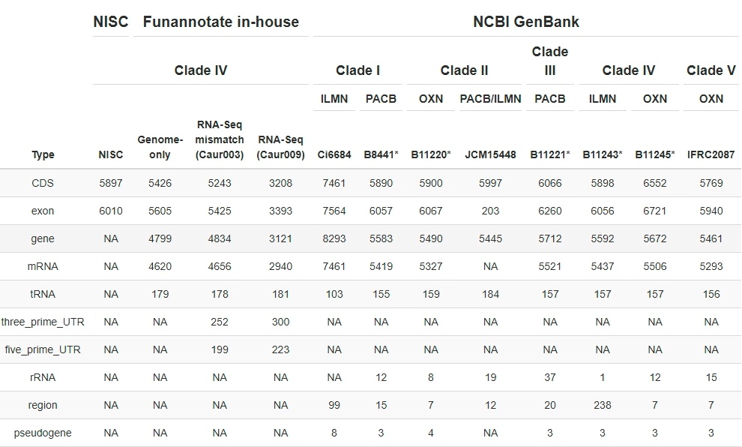

Funannotate (genome-only) underestimating CDSs

Slide 7
RNAseq data is undercutting performance

Slide 8
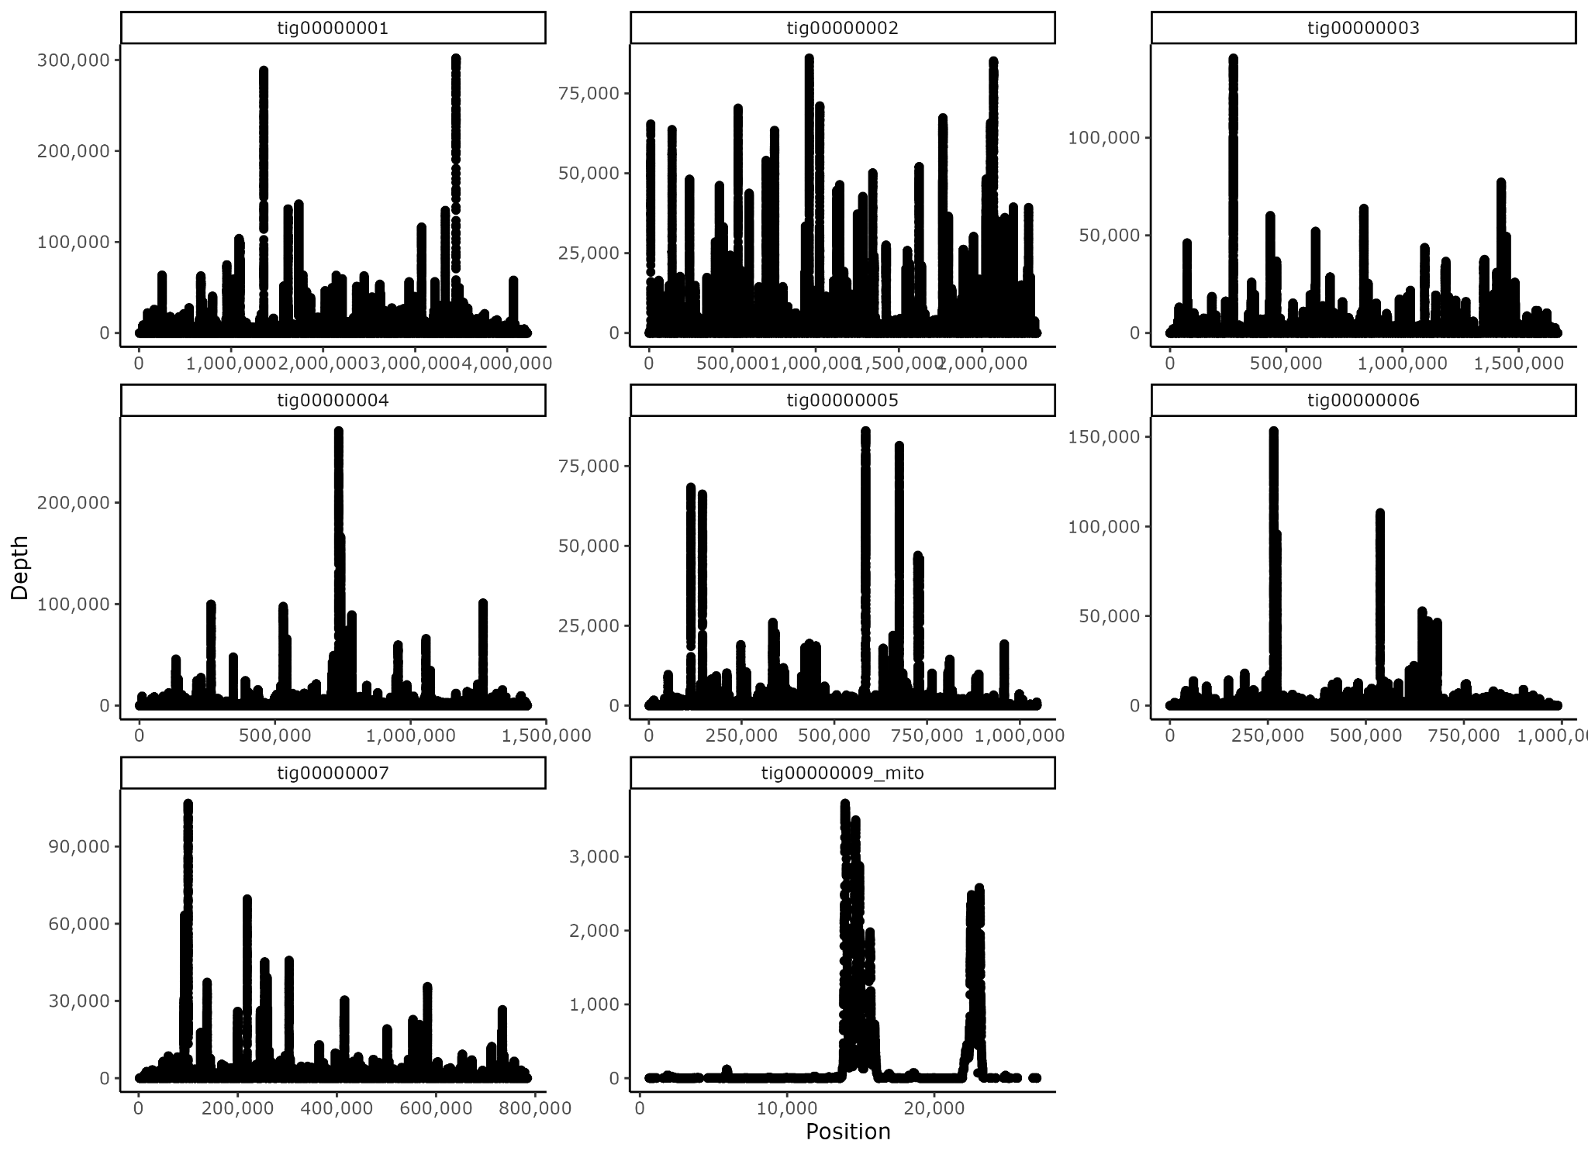
Readmapping: Coverage is not the problem
Caur009
Depth summary for chromosomes:
Median depths (163 - 400)
> 90% mapping

Slide 9
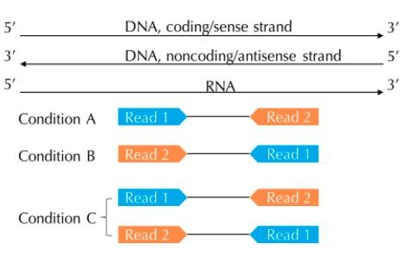
Strandedness in RNASeq tool parameters
IV
(A) Forward-stranded: R1 aligns to RNA strand
(B) Reverse-stranded: R2 aligns to RNA strand
(C) Unstranded: R1 sometimes aligns & R2 sometimes aligns to RNA strand
Notes:
https://littlebitofdata.com/en/2017/08/strandness_in_rnaseq/

Slide 10
Funannotate annotations inconsistent with GenBank’s
* Cuomo Lab @ Broad

Slide 11
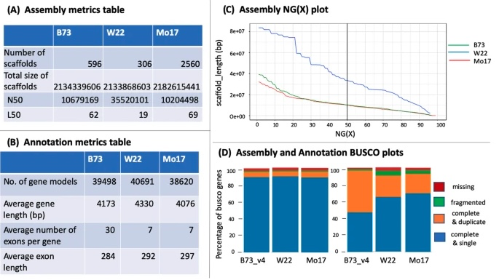
Current Direction
Metrics of annotation quality
GenomeQC?
Pam @ NISC
Stranded models w/ multiple RNAseq inputs
Adding scripts to the Github
Preparing for summer student poster presentation (August 5, ~1:50 PM)
Notes:
https://bmcgenomics.biomedcentral.com/articles/10.1186/s12864-020-6568-2

Slide 12
Acknowledgements
Julie Segre - PI
Ryan Blaustein
Qiong Chen
Sean Conlan
Clayton Deming
Payal Joglekar
Shih-Queen Lee-Lin
Nashwa M Ahmed
Diana Proctor
Lukian Robert
Sara Saheb Kashaf
Heidi Kong & Lab
IV
Some of my favorite OITE+ events
Grad School Week Panels
Exploring Our Self-Talk: Cognitive Distortions and Imposter Fears
Talking Science: Designing and Delivering Successful Oral Presentations
JC Neurodegenerative Diseases: Bench to Bedside

Slide 13
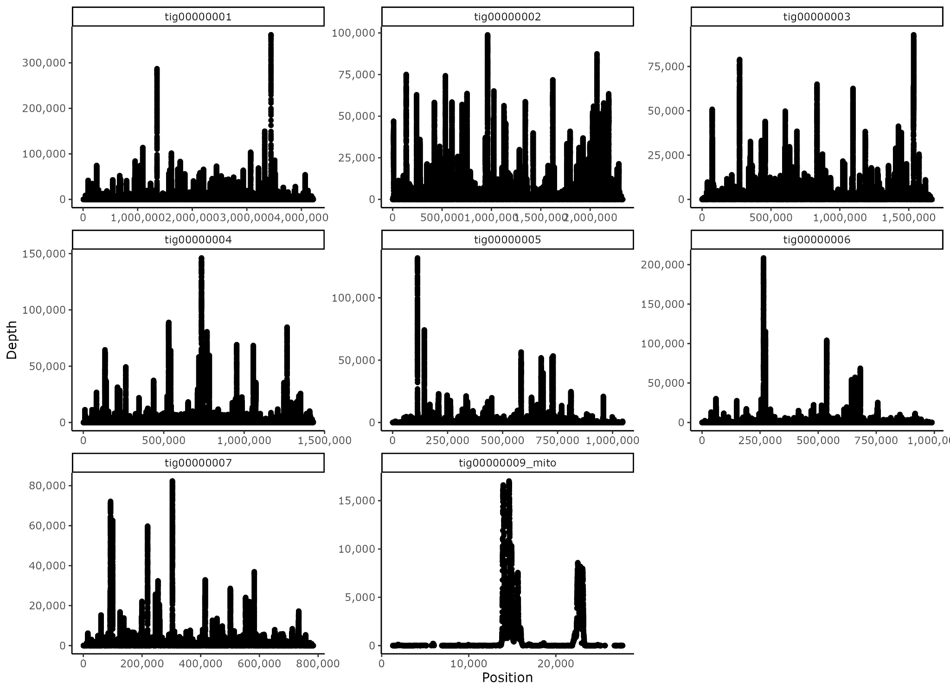
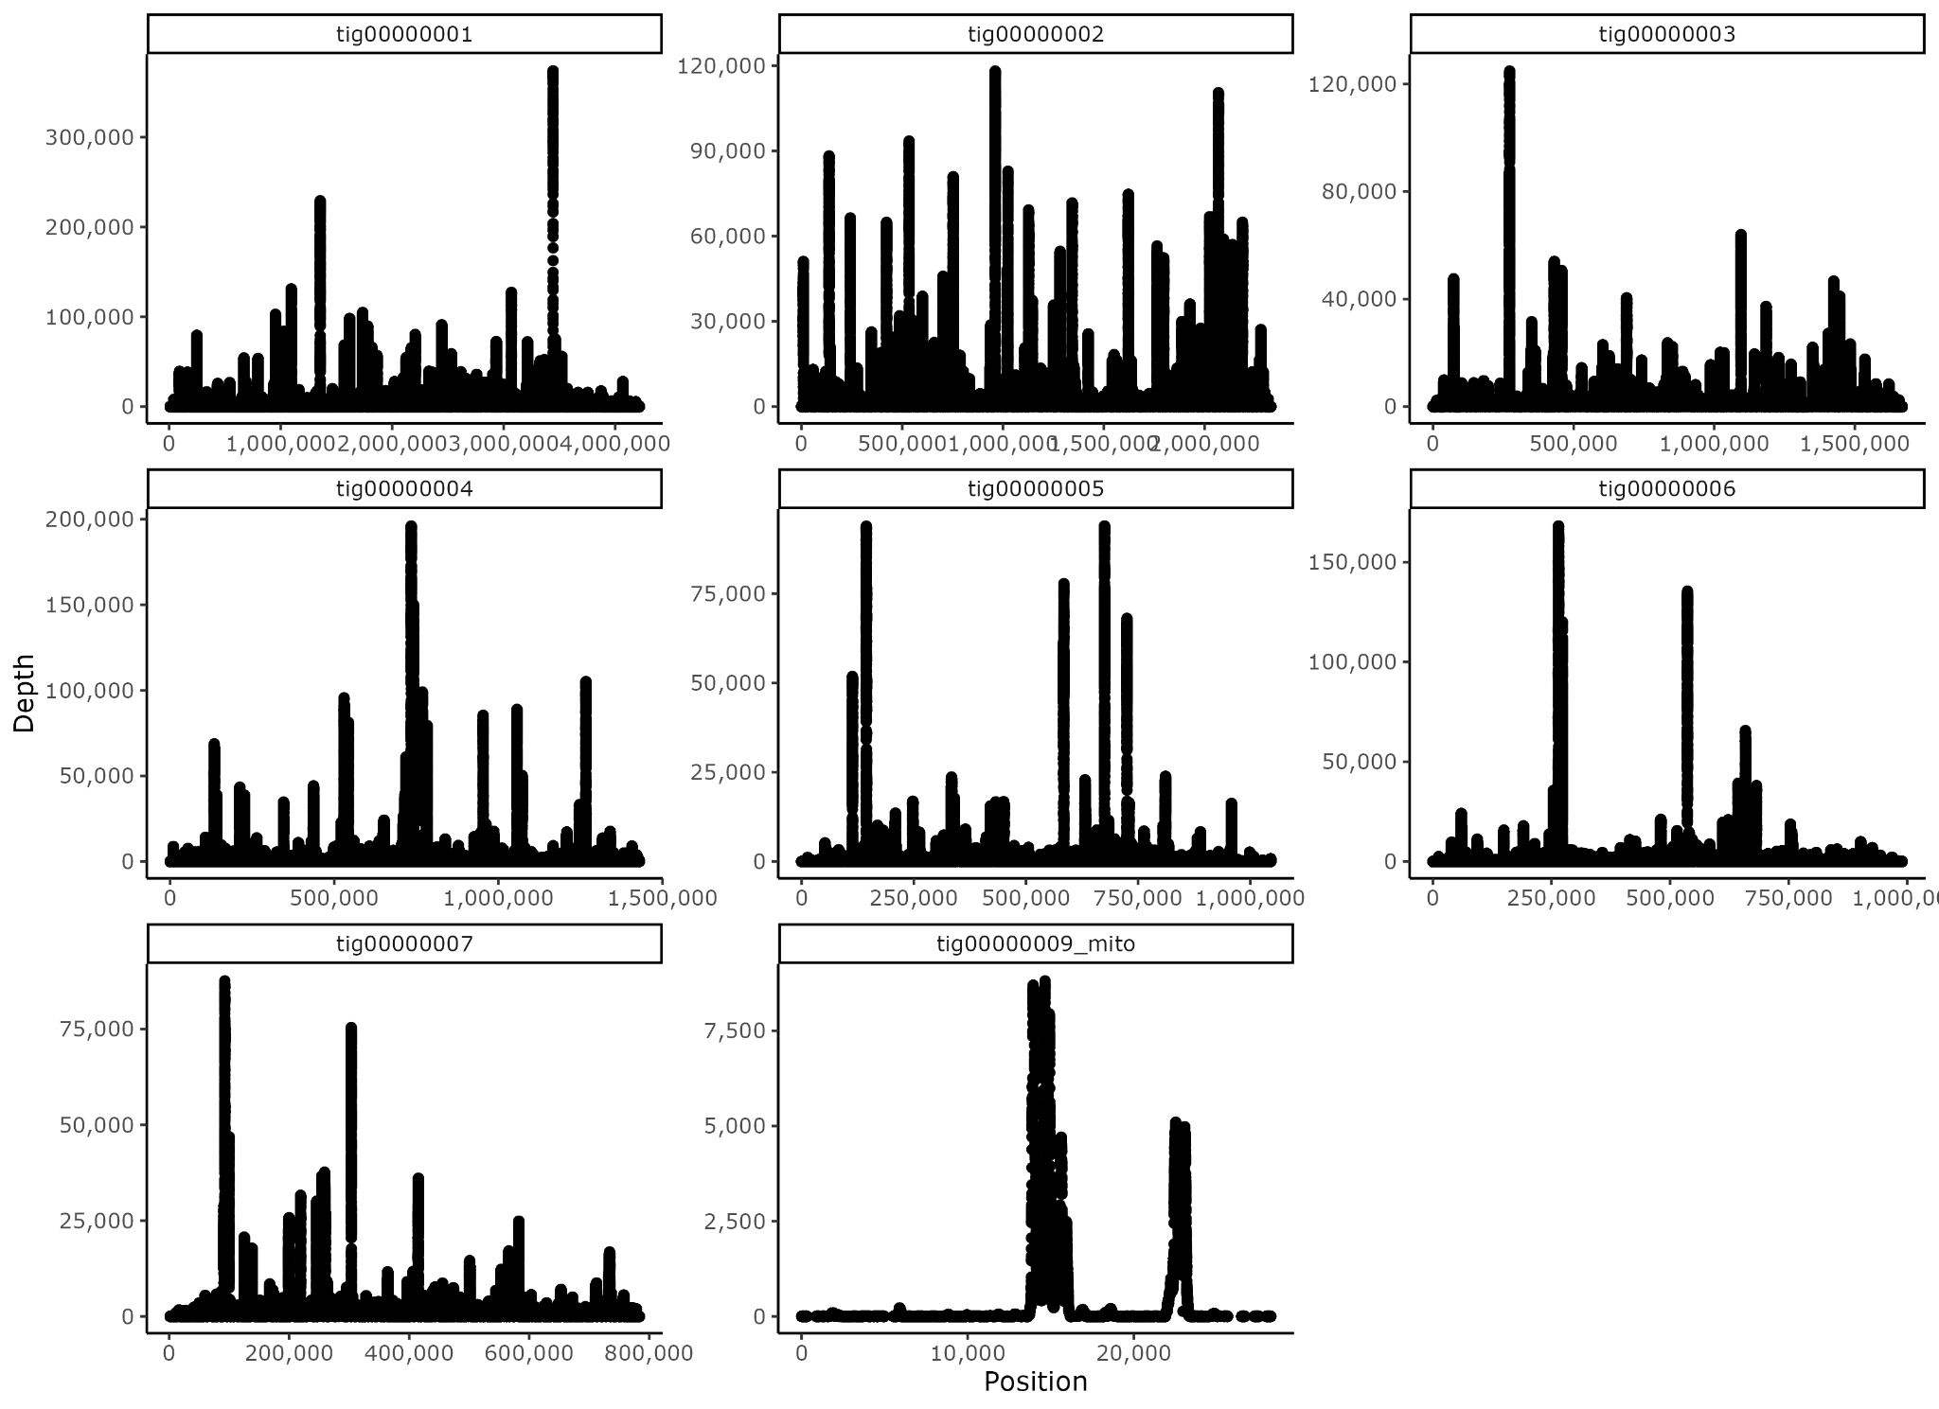
Supplementary Data (Depth plots Caur007-009)
Caur007
Caur008
Caur009
IV

Slide 14
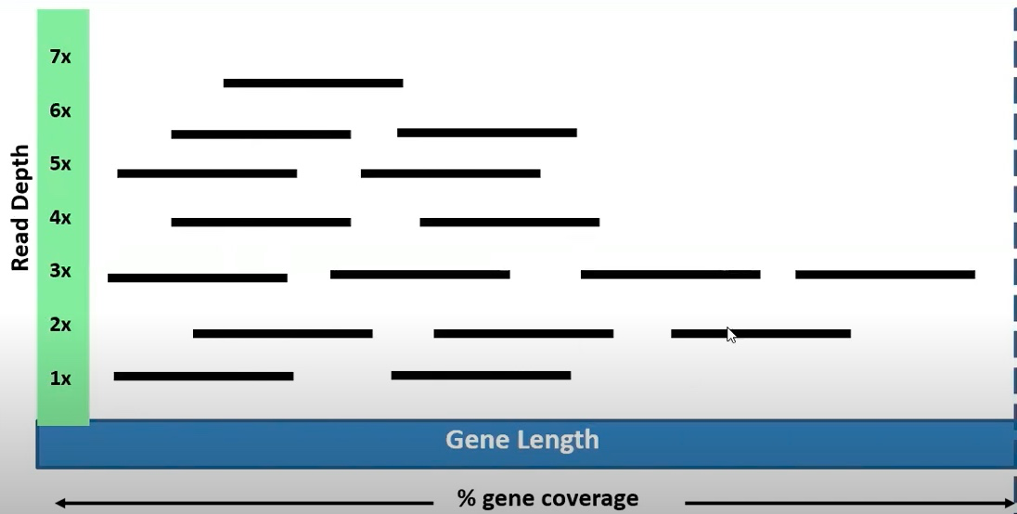
Supplementary Data (depth diagram)
IV
Notes:
Depth: # times a nucleotide/region is sequenced (higher confidence in that read)

