Slide 1


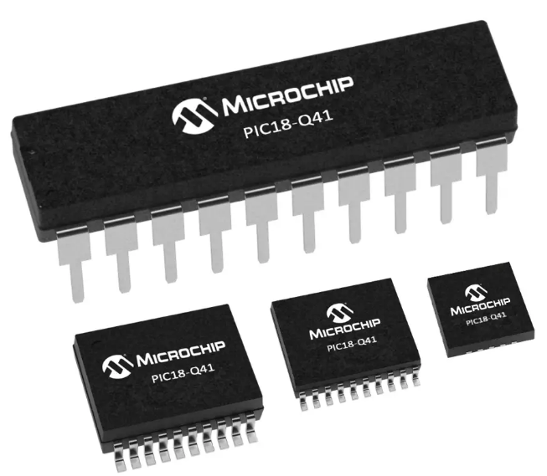
Microcomputer Architecture and Interfacing
Lecture0: Introduction & Syllabus

Slide 2
Outline
Definition of Embedded Systems
Examples
Microprocessors and Microcontrollers
PIC Microcontrollers

Slide 3
Embedded Systems
An embedded system is a computer system designed to perform one or a few dedicated functions (often real time).
Hardware and Software expected to function without human intervention.
Respond, monitor, control external environment using sensor and actuators.
In contrast a general-purpose computer, such as a PC is designed to be flexible and to meet a wide range of end-user needs.

Slide 4
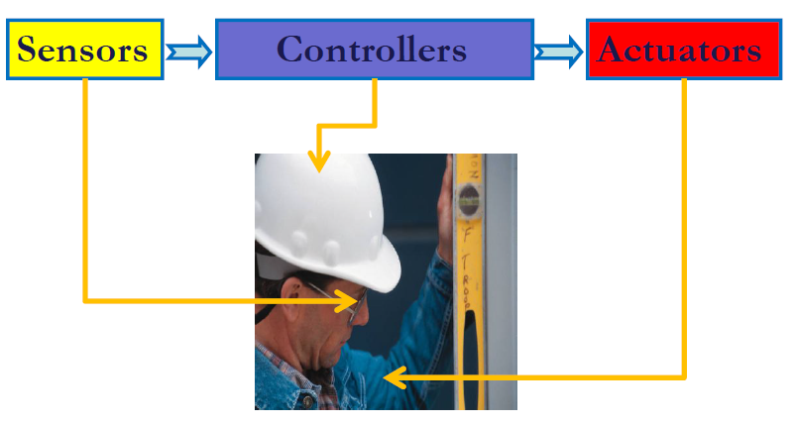
Why a microcontroller is needed?

Slide 5
Why a microcontroller is needed?

Slide 6
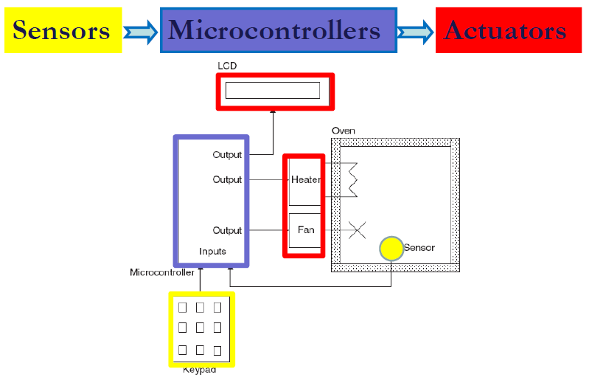
Why a microcontroller is needed?

Slide 7
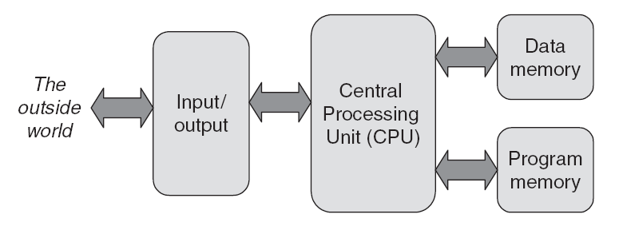
Microprocessors & Microcontrollers

Slide 8
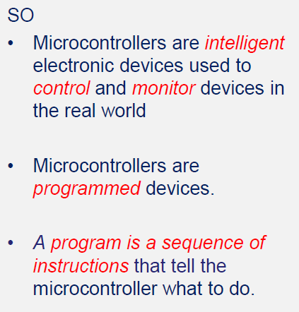
Embedded Systems

Slide 9
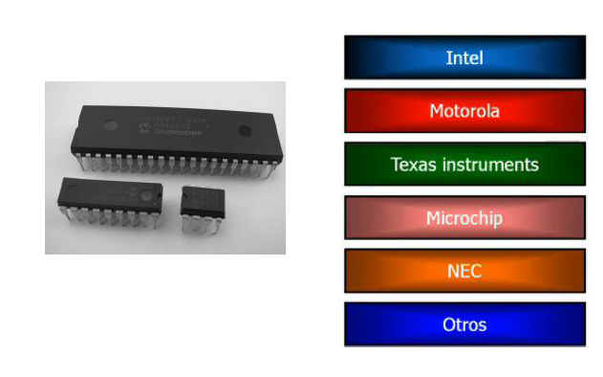
Variety of Microcontrollers

Slide 10
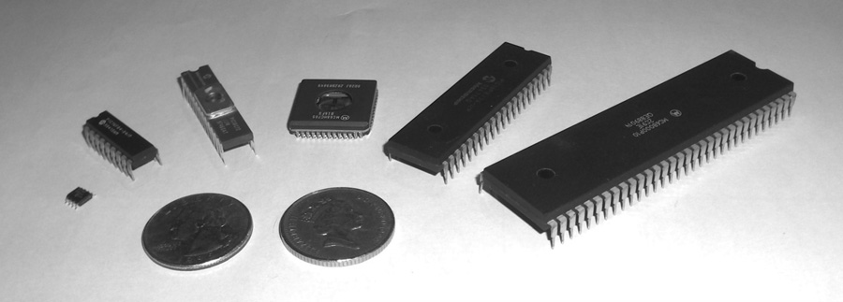
Microcontroller Packaging & Appearance
From left to right: PIC 12F508, PIC 16F84A, PIC 16C72, Motorola 68HC05B16, PIC 16F877, Motorola 68000
Notes:
EEPROM vs. Flash
1.Flash is just one type of EEPROM
2.Flash uses NAND type memory while EEPROM uses NOR type
3.Flash is block-wise erasable while EEPROM is byte-wise erasable
4.Flash is constantly rewritten while other EEPROMs are seldom rewritten
5.Flash is when large amounts are needed while EEPROM is used when only small amounts are needed
Read more: Difference Between EEPROM and Flash | Difference Between http://www.differencebetween.net/technology/hardware-technology/difference-between-eeprom-and-flash/#ixzz74NguOa1i
http://www.differencebetween.net/technology/hardware-technology/difference-between-eeprom-and-flash/

Slide 11
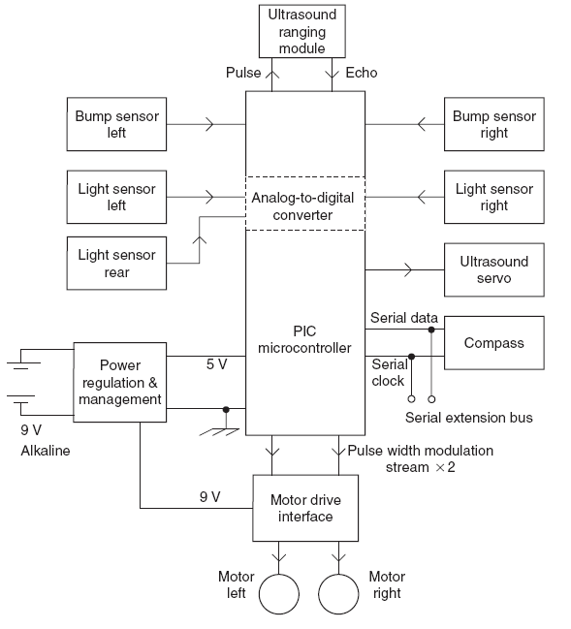
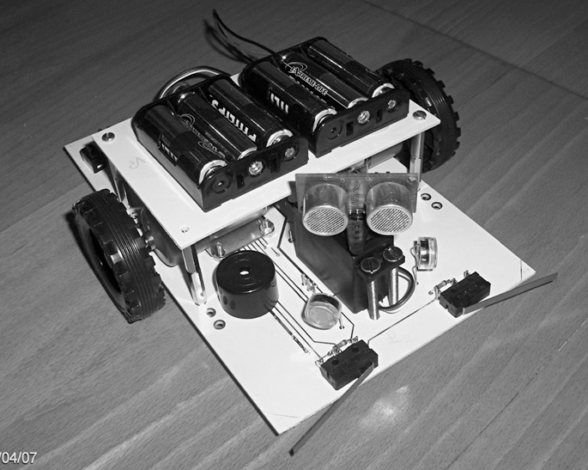
Embedded Systems
Example: Autonomous Guided Vehicle

Slide 12
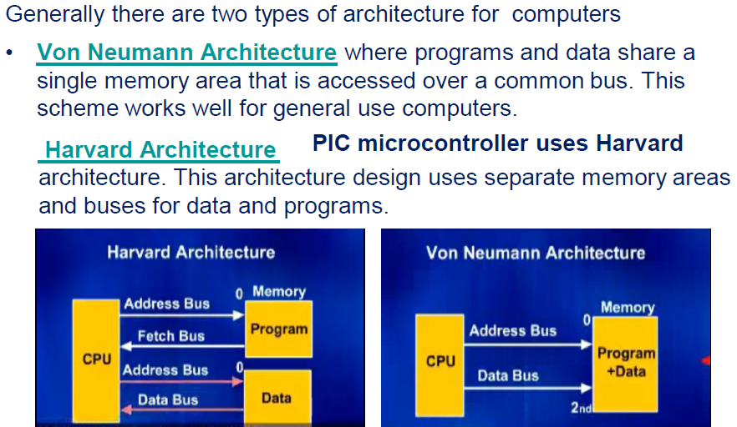
Architecture for computers
Notes:
Von Neumann Architecture where programs and data share a single memory area that is accessed over a common bus. This scheme works well for general use computers.
Harvard Architecture Vs PIC microcontroller uses Harvard architecture. This architecture design uses separate memory areas and buses for data and programs.

Slide 13
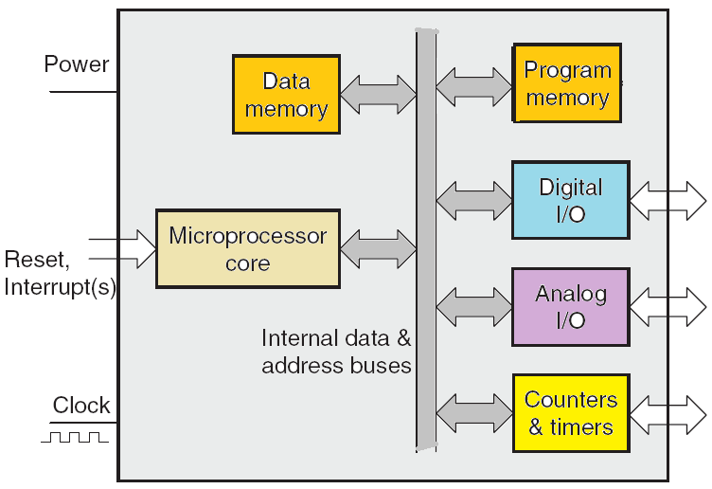
Microcontrollers: MCUs

Slide 14
Instruction Set: CISC vs. RISC
In the early days work was done in assembly language. CPU designers tried to make instructions that would do as much work as possible.
This design philosophy was named Complex Instruction Set Computer (CISC).
With the advent of higher level languages, led to Reduced Instruction Set Computer (RISC), simple compiler, simpler assembly coding.
PIC microcontroller uses RISC which is faster than CISC.
Notes:
https://www.electronicsforu.com/resources/eeprom-difference-flash-memory
Flash uses NAND-type memory, while EEPROM uses NOR type.
Flash is block-wise erasable, while EEPROM is byte-wise erasable.
Flash is constantly rewritten, while other EEPROMs are seldom rewritten.
Flash is used when large amounts are needed, while EEPROM is used when only small amounts are needed.

Slide 15
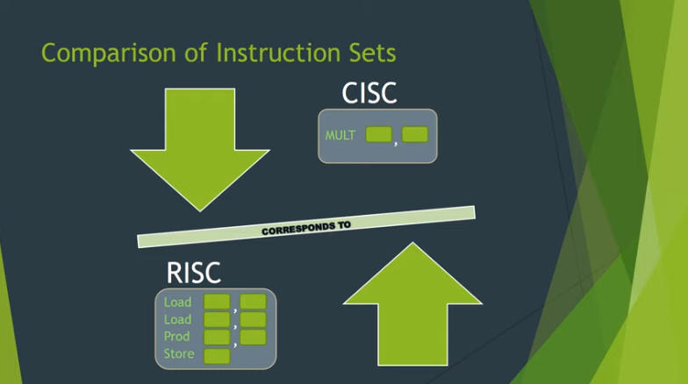
Instruction Set: CISC vs. RISC
For more … watch
https://www.youtube.com/watch?v=_EKgwOAAWZA
Notes:
https://www.electronicsforu.com/resources/eeprom-difference-flash-memory
Flash uses NAND-type memory, while EEPROM uses NOR type.
Flash is block-wise erasable, while EEPROM is byte-wise erasable.
Flash is constantly rewritten, while other EEPROMs are seldom rewritten.
Flash is used when large amounts are needed, while EEPROM is used when only small amounts are needed.

Slide 16
PIC Microcontroller
Peripheral Interface Controller (PIC) was originally designed by General Instruments
In the late 1970s, GI introduced PIC® 1650 and 1655 – RISC with 30 instructions.
PIC was sold to Microchip
Features: low-cost, self-contained, 8-bit, Harvard structure, RISC, etc.
https://ww1.microchip.com/downloads/en/DeviceDoc/PIC18(L)F2X-4XK22-Data-Sheet-40001412H.pdf
Notes:
MPS stands for Microcontroller Prototyping System
https://slidetodoc.com/chapter-2-microcontroller-architecture-pic-18-f-family/
https://www.slideserve.com/ira/microcontroller-architecture-pic18f-family

Slide 17
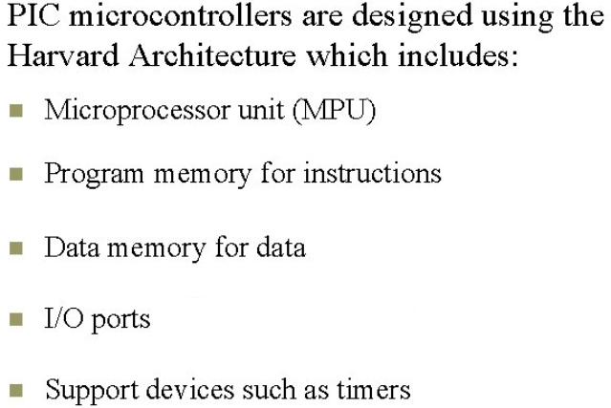
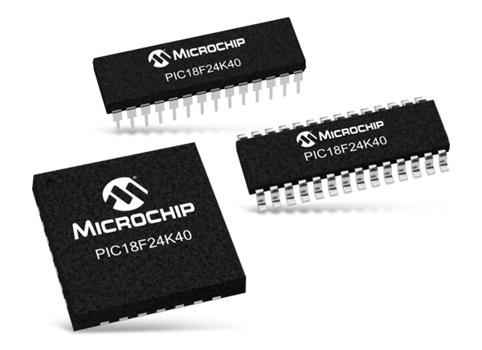
PIC 18F Microcontroller Family
Notes:
MPS stands for Microcontroller Prototyping System
https://slidetodoc.com/chapter-2-microcontroller-architecture-pic-18-f-family/
https://www.slideserve.com/ira/microcontroller-architecture-pic18f-family
https://microcontrollerslab.com/8-bit-pic-microcontrollers-family/

Slide 18
Syllabus
Office Hours
Textbook
Snow Days Policy
Lab/inLab
Lecture Required Technology
Friday Quizzes
How to calculate your grade?
Grades

