Slide 1


Microcomputer Architecture and Interfacing
Lecture 01: Overview
Objective:
Embedded Development Process, Numbering Systems

Slide 2
Overview
The word-size is the maximum number of bits a processor operation can complete in a single instruction.
8-bit processors are reserved for simple tasks
16-bit are reserved for signal processing applications.
32-bit reserved for general purpose and high performance applications.
We will be working with the Microchips PIC 18F26K22 8-bit microcontroller.

Slide 3
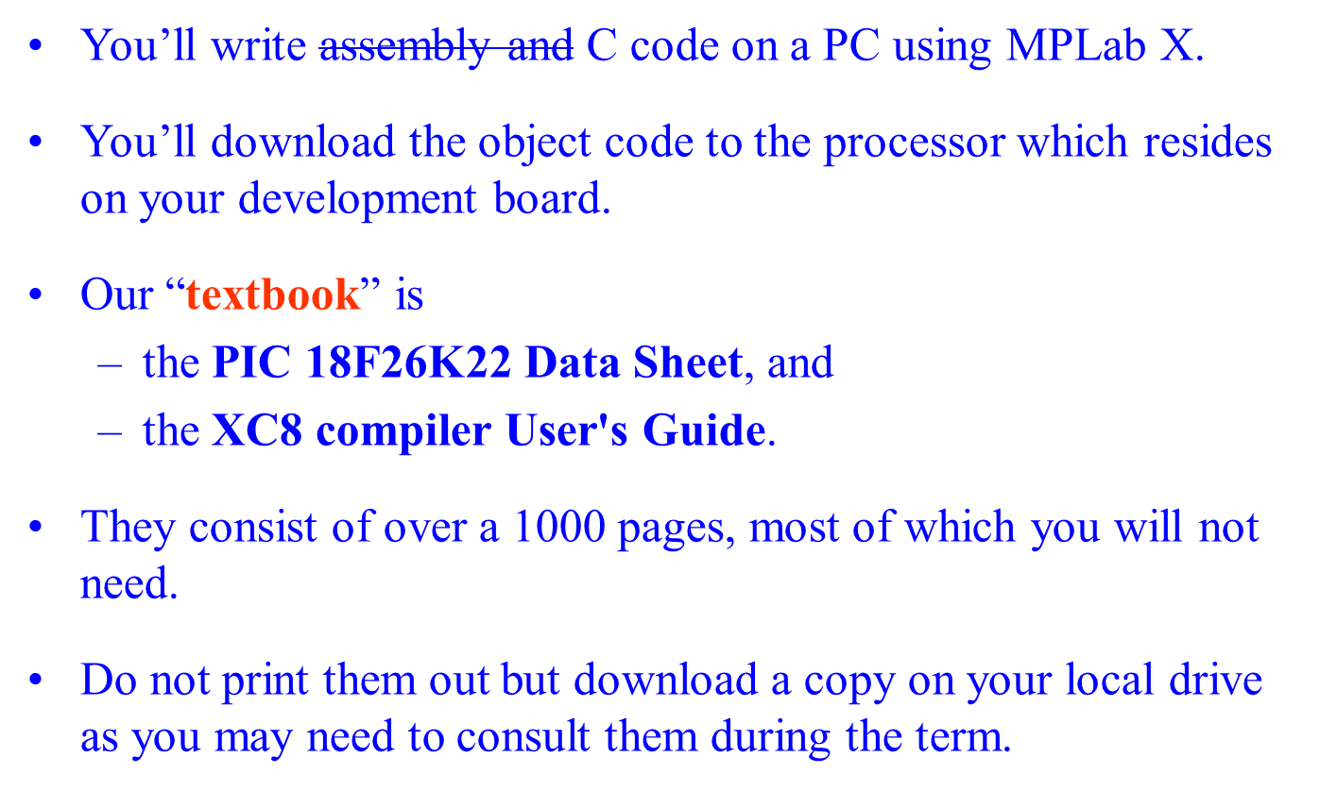
Overview

Slide 4
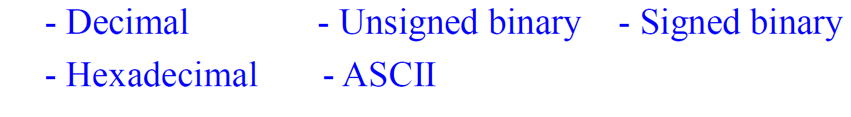
Codes
Microcontrollers encode all sorts of information using bits.
We interpret bits according to some set of rules.
We will use the following codes:
ASCII = American Standard Code for Information Interchange.
It is a numerical representation of a character such as 'a' or '@' or an action of some sort.

Slide 5
ASCII
It allows computers to understand & represent text, facilitating communication between different devices and systems.
ASCII assigns a unique numeric value to each character, such as letters, numbers, punctuation marks, and control characters.
It ensures that different systems can interoperate & be compatible.
It allows developers to design interfaces that both humans and computers can understand.
It was originally developed for teleprinters, or teletypewriters.

Slide 6

ASCII Code

Slide 7
Conversions
Perform the following conversions assuming a 4-bit word size.
Binary | hex | decimal | representation
0b1010 | 0xA | 10 | unsigned
0b1010 | 0xA | -5 | signed
0b1100 | 0xC | 12 | unsigned
0b1100 | 0xC | -4 | signed
0b1101 | 0xD | -3 | signed
0b0110 | 0x6 | 6 | unsigned

Slide 8
Conversions
The ASCII represents character codes needed to present text on terminal devices like monitors.
Find ASCII table (online): to perform the following conversion.
ASCII | hex | decimal
'3' | 0x33 | 51
Space | 0x20 | 32
X | 0x58 | 88

Slide 9
Data Types
The C language allow representing values using data types with different numbers of bits.
A guiding principle: use the smallest data type sufficient to meet the needs of the problem being solved.
Representation | Width | Min | Max | Alias
unsigned | 8-bit | 0 | 255 | uint8_t
signed | 8-bit | -128 | 127 | int8_t
unsigned | 16-bit | 0 | 2¹⁶-1 | uint16_t
signed | 16-bit | -2¹⁵ | 2¹⁵-1 | int16_t
unsigned | 32-bit | 0 | 2³²-1 | uint32_t
signed | 32-bit | -2³¹ | 2³¹-1 | int32_t
Notes:
Embedded Software vs Application Software
An embedded software developer should know the hardware he is working on. ... A software developer works on applications that is totally shielded from the hardware it runs on and the software developer does not have to know much or in fact anything about the hardware his program would execute on.

Slide 10
Data Types
Representation | Width | Min | Max | Alias
unsigned | 8-bit | 0 | 255 | uint8_t
signed | 8-bit | -128 | 127 | int8_t
unsigned | 16-bit | 0 | 2¹⁶-1 | uint16_t
signed | 16-bit | -2¹⁵ | 2¹⁵-1 | int16_t
unsigned | 32-bit | 0 | 2³²-1 | uint32_t
signed | 32-bit | -2³¹ | 2³¹-1 | int32_t
Take a look at Table 5.3 and 5.4 in the XC8 Compiler Manual.
We will stick with the alias' in the right-most columns.
In this class we do not need to use floating point types.

Slide 11
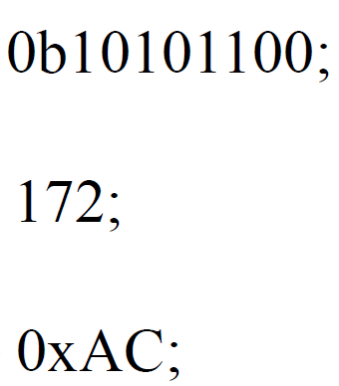
Radix or Base
It denotes the number of symbols used to represent quantities.
We primarily work with: binary, decimal and hexadecimal.
C provides prefixes to describe constant values in different bases.
Example: the following three lines of C-code describe three different variable declarations in these three different radix.
      uint8_t binVar =
      uint8_t decVar =
      uint8_t hexVar =

Slide 12
Radix or Base
Example: the following three lines of C-code describe three different variable declarations in these three different radix.
      uint8_t binVar = 0b10101100;
      uint8_t decVar = 172;
      uint8_t hexVar = 0xAC;
Radix is only a convenience for humans; the PIC stores all three of binVar, decVar and hexVar in binary inside the memory.
You can initialize variable using ASCII equivalent characters surrounded by single quotes. Here is a legal variable declaration.
char asciiVar = 'X';
What you get if you use the declaration uint8_t asciiVar = 'X’; ?

Slide 13
Radix or Base
uint8_t binVar = 0b10101100;
uint8_t decVar = 172;
      uint8_t hexVar = 0xAC;
Radix is only a convenience for humans; the PIC stores all three of binVar, decVar and hexVar in binary inside the memory.
You can initialize variable using ASCII equivalent characters surrounded by single quotes. Here is a legal variable declaration.
char asciiVar = 'X';
You could make use the declaration
uint8_t asciiVar = 'X';
This won’t convey the intention of the declaration, that asciiVar is being used to store character information not a numerical value.
Notes:
The result of this declaration would be to initialize asciiVar with the ascii code for the letter 'X' which is decimal 88.
I could have legally made the declaration uint8_t asciiVar = 'X';,
but this declaration would not have conveyed the intention of the declaration, that asciiVar is being used to store character information not a numerical value.

Slide 14
Test your understanding
Complete the following table assuming an 8-bit word size.
Binary | Hex | Decimal | Representation
0b10010011 | 0x93 | 147 | unsigned
0b10010011 | 0x93 | -109 | signed
0b10000101 | 0x85 | 133 | unsigned
0b10000101 | 0x85 | -123 | signed
0b01100110 | 0x66 | 102 | unsigned
0b10011010 | 0x9A | -102 | signed
Determine the ASCII codes for each letter in "Blaster". Represent the ASCII code in decimal.
B = 66 l = 108 a = 97 s = 115 t = 116 e = 101 r = 114

Slide 15
Test your understanding
Determine the best C data type for the following variables which needs to describe an element of the Domain.
For example, to describe the age of a person, you would first need to determine the range of ages (0:122). So the smallest data type which can accommodate this range is “unsigned int”.
Also, we only use signed types when we represent negative values
Variable domain | Data type
Age of a person (years) | uint8_t
Numbered day of the year | uint16_t
Weight of a human (pounds) | uint16_t
Temperature in Golden Co (Celsius) | int8_t
Number of gerbils in a pet store | uint8_t
Elevation of a location in Continental US (feet) | int16_t

