Slide 1


Microcomputer Architecture and Interfacing
Lecture 02: Operations
Objective:
C data types, declarations, arithmetic, and logic operations

Slide 2
Operations
Operands are the data values being manipulated and the operation defines how the operands are manipulated.
The execution of a C operation generates a result that depends, in part, on the data type of the operands.
The operands and operators are combined into expressions.
There are several types of operations and operands common to many of the C programs we write.
Lets examine some C construct to alias data types and make our programs self documenting and more readable.

Slide 3
typedef
C provides a way to provide an alias to a data type using the keyword typedef.
This keyword allows to rename a data type.
It is common on large projects where code is shared across hardware and software platforms.
The following declarations are made outside main in the area you generally use for global variables and include statements.
The main difference between Global and local variables is that:
global variables can be accessed globally in the entire program,
whereas local variables can be accessed only within the function in which they are defined.
Notes:
The main difference between Global and local variables is that:
global variables can be accessed globally in the entire program,
whereas local variables can be accessed only within the function in which they are defined.

Slide 4
typedef
The following declarations are made outside main in the area you generally use for global variables and include statements.
These declarations are automatically included in the XC8 compiler whenever you put #include <stdint.h> at the top before main.
typedef unsigned char uint8_t;
typedef signed char int8_t;
typedef unsigned int uint16_t;
typedef signed int int16_t;
typedef unsigned long uint32_t;
typedef signed long int32_t;
Notes:
#include is a way of including a standard or user-defined file in the program and is mostly written at the beginning of any C/C++ program.
This directive is read by the preprocessor and orders it to insert the content of a user-defined or system header file into the following program.

Slide 5
Main, variable declaration and assignment
Every C program starts running at the beginning of a code module (a function) called “main”:
void main(void) {Every line of code after this and up to the closing }
void main(void) {
uint8_t x = 100;
uint8_t z;
z = x + x;
}
After declare main, declare variables, which should be placed at the top of main before any of the expressions.
C is "typed language": requires declaring data type for any variable.
The variables x and z are stored in 8-bits unsigned binary numbers.
The variable declaration uint8_t x = 100; initializes the variable x.
Z will be 200 and that still fit in 8-bits unsigned binary number.

Slide 6
Overflow and modular arithmetic
If you perform an operation on data which yields a result that exceed the range of the word-size you have generated an overflow condition.
A hypothetical computer has a uint3_t data type (a 3-bit word size).
A 3-bit integer can only represent values from [0 … 7] inclusive.
The adder for our imaginary machine has 3 full adders (3-bit adder).
When add 1 to 7, the 3-bit adder cannot generate the value 8 because it has a 4-bit representation, 0b1000.
The 3-bit adder keeps the least significant 3-bits from the sum 7+1, yielding a result of 0.
You need to be on the look-out for invalid answers.

Slide 7
C arithmetic operations
every expression is terminated with a semicolon
variable are declared before any expressions
variables can be assigned an initial value in their declaration
Comments are denoted with the "//" symbol
expression are on the right side of the "=" sign
the value of the expression is assigned to the variable on the left side of the "=" sign

Slide 8
C arithmetic operations
void main(void) {
uint8_t x = 25;
uint8_t y = 15;
uint8_t z = 10; /
// comments will contain variable values after expression is executed
z = x + y; // z = 40
z = x - y; // z = 10
z += x; // z = 35
z = x++; // z = 25, x = 26
// expressions which generate overflow
z = y - x; // z = 15 - 26 = -11 rolls to 256 - 11 = 245
z = x * y; // z = 26*15 = 390 mod 256 = 134, remember x=26!
// expressions which invoke operator precedence
z = 3*(x + y); // z = 3*(26+15) = 123
} // end main

Slide 9
Operator Precedence
It tells how to evaluate an expression where there is ambiguity about the order in which operators are applied to the operands.
The list from Microchips website is reproduced below.
You need to look at more details and examples on the website or the PDF document.

Slide 10
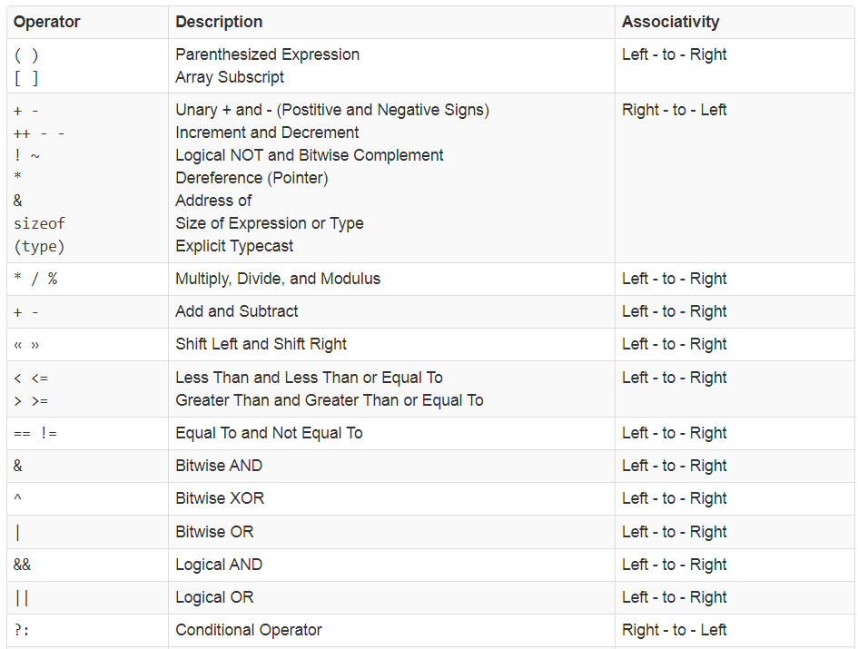

Slide 11
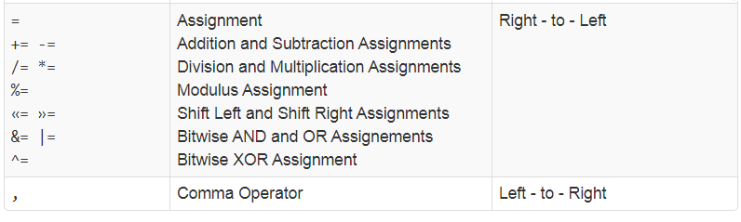
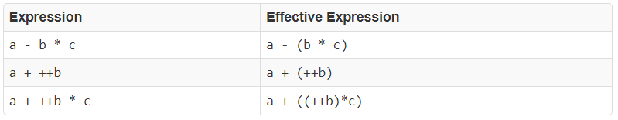
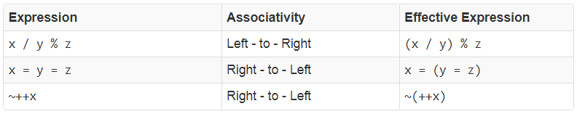
When expressions contain multiple operators, their precedence determines the order of evaluation as shown in the following examples

Slide 12

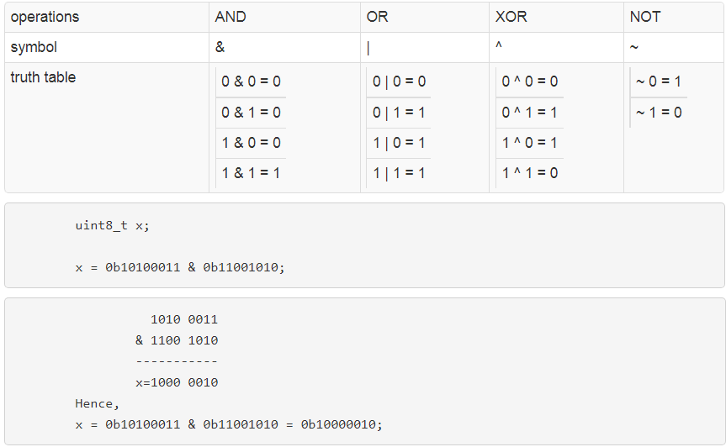
C bitwise logical operations

Slide 13
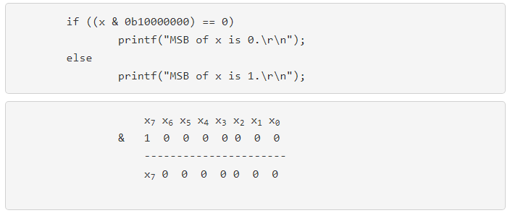
C bitwise logical operations
\n Newline (Line Feed)
\r Carriage Return: it is a control character used to reset a device's position to the beginning of a line of text.
The result of "(x & 0b10000000)" is either equal to 1000 0000 if x₇ is 1 or 0000 0000 if x₇ is 0.
Notes:
\n Newline (Line Feed)
\r Carriage Return: it is a control character used to reset a device's position to the beginning of a line of text.

Slide 14
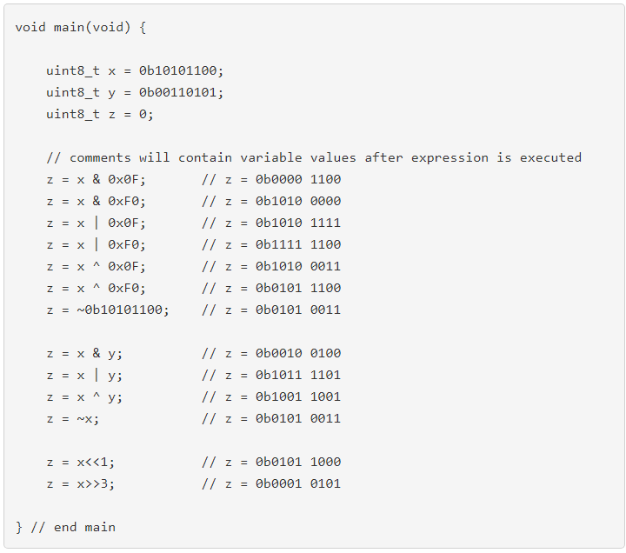

Slide 15
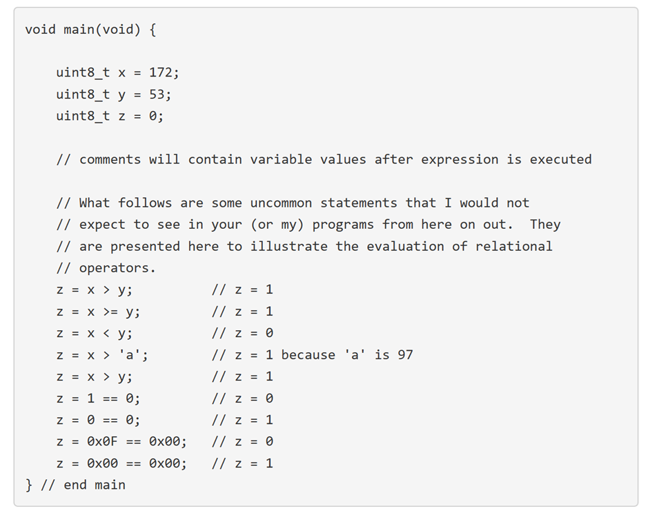

Slide 16
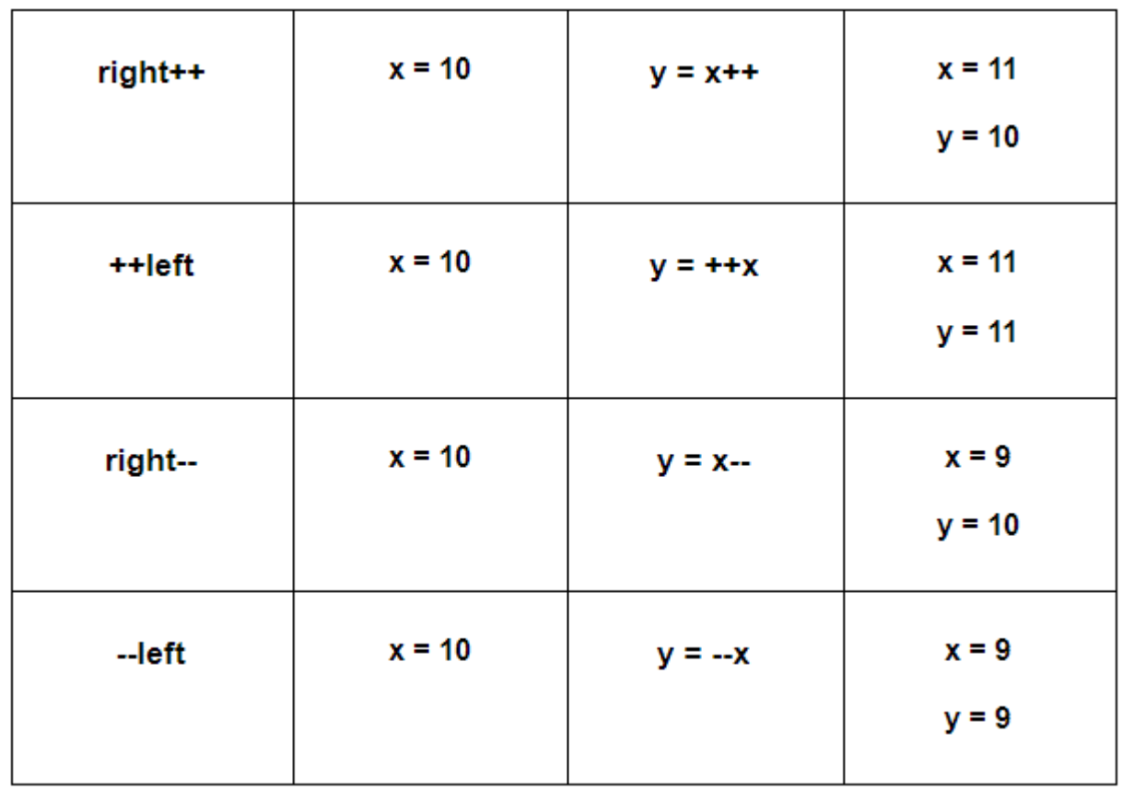
Test your understanding

Slide 17
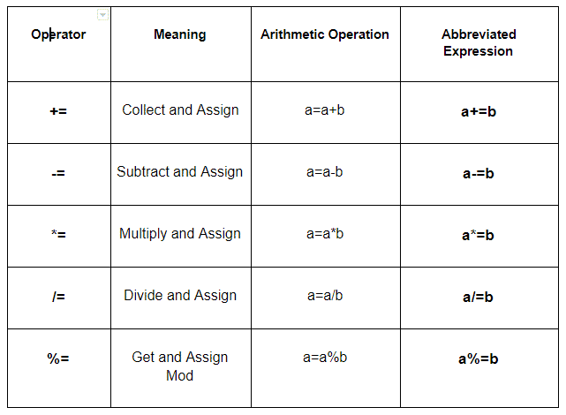
Test your understanding

