Slide 1


Microcomputer Architecture and Interfacing
Lecture 03: C conditional statements
Objective: C conditionals with signed, unsigned operands, and logical operators.

Slide 2

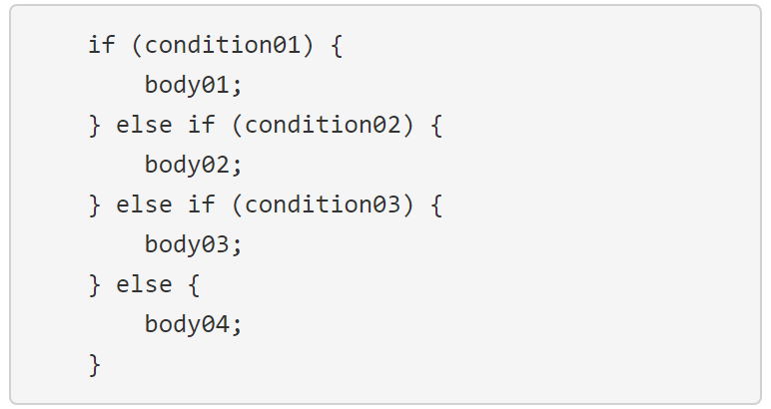
Conditional Statements
General form of an if-then-else statement.
Let's examine the structure and how that structure is executed by a computer one line at a time from top to bottom.
The first thing that a computer does when it sees this if-then-else structure is to evaluate condition01.
All the conditions in the if-then-else structure must be expression involving variables and operators from a previous lecture.
A condition is evaluated by looking up the values for the variables and applying operations to the operands until the condition is reduced to a single value.
Notes:
The first thing that a computer does when it sees this if-then-else structure is to evaluate condition01.
All the conditions in the if-then-else structure must be expression involving variables and operators from a previous lecture.
A condition is evaluated by looking up the values for the variables and applying operations to the operands until the condition is reduced to a single value.

Slide 3
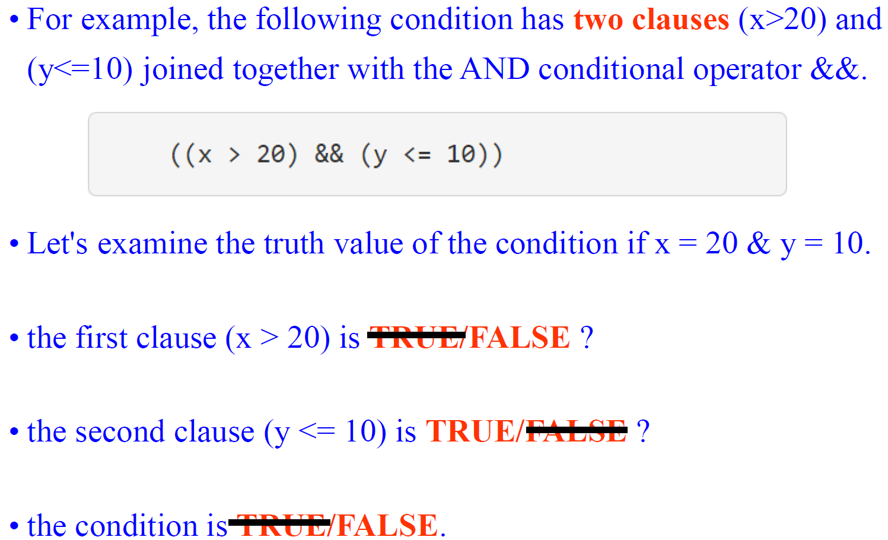
Conditional Statements

Slide 4
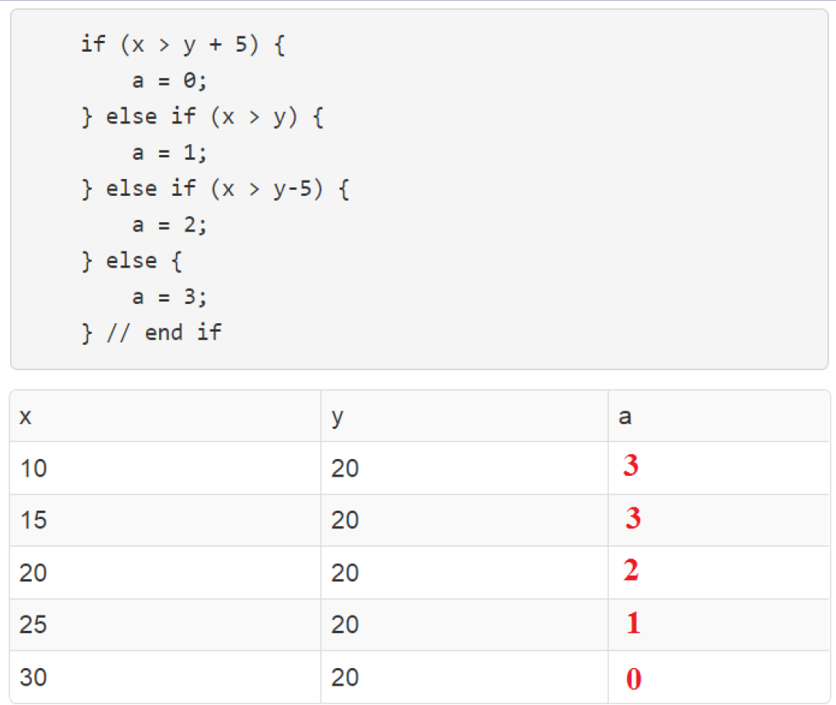
How an if-then-else statements work?

Slide 5
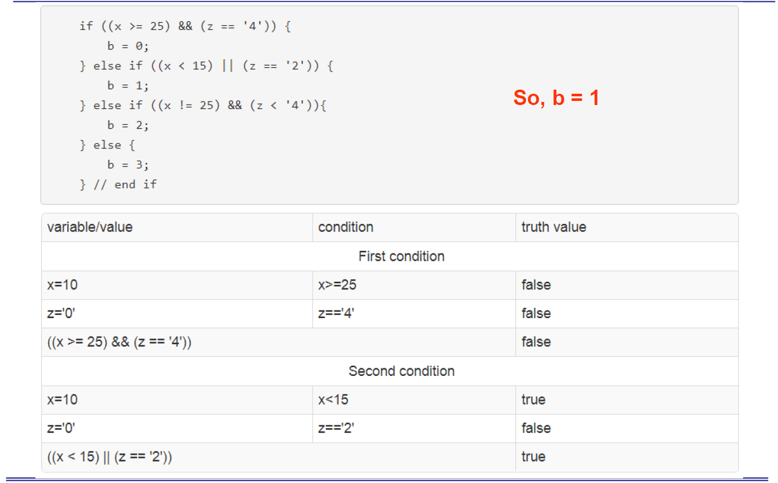
if-then-else statements w/ two clauses

Slide 6
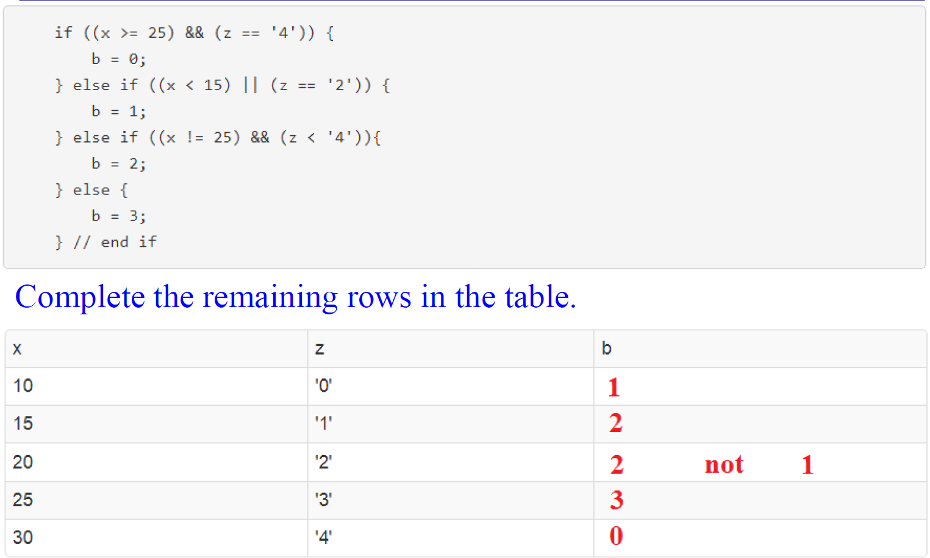
if-then-else statements w/ two clauses

Slide 7
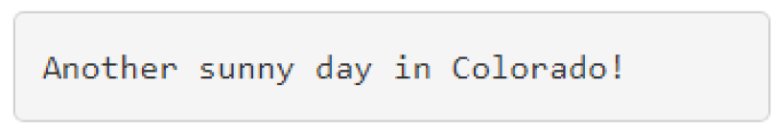
Printf
The simplest call to printf is where the argument to printf is a string of text surrounded by quotes.
The text inside the quotes is sent to the terminal, writing whatever message you need to send to the user.
For example, the
printf("Another sunny day in Colorado!\r\n");
Would generate the output:
Notes:
https://www.geeksforgeeks.org/difference-between-c-and-c/

Slide 8
Printf
Escape characters "\r\n"
printf("Another sunny day in Colorado!\r\n")
The "\r" is a carriage return, causes the current cursor location to move all the way to the left on the current line.
The "\n" is a new line character causing the current cursor location to move down one row on the terminal without changing the left/right position of the current cursor location.

Slide 9
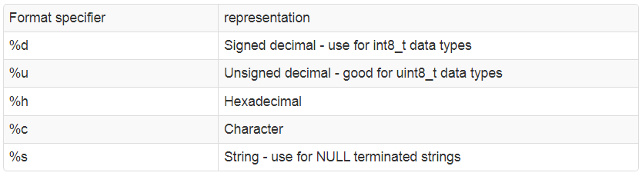
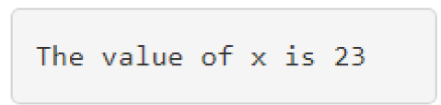
Printf
When we want printf to print the value of a variable, we modify the string to include format specifiers.
Specifiers consist of "%" followed by a letter allow choosing how the variable is represented. Here is some of them:
x = 23;
printf("The value of x is %u\r\n",x); When this statement is executed. The terminal would display

Slide 10
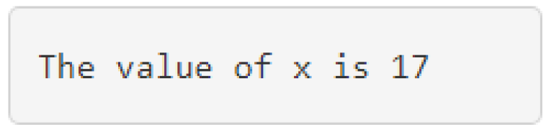
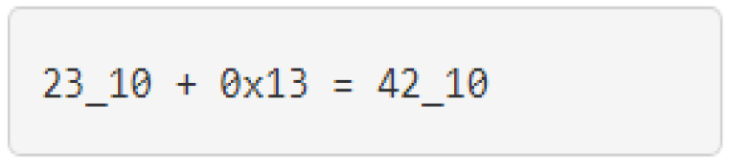
Printf
x = 23;
printf("The value of x is %x\r\n",x); When this statement is executed. The terminal would display
printf("%d_10 + 0x%x = %d_10\r\n",x,19,x+19); When this statement is executed. The terminal would display
The formatting code "%s" can be used to print null terminated strings (check the lecture on canvas).

Slide 11
Switch/Case
The switch/case structure is used to check if a variable is equal to one of many potential values.
Each value is called a case and has a body consisting of zero or more statements.
(Almost) always a case ends with a "break" statement, to jump out of the switch statement without checking any other cases.
A special case called "default" is executed if no other case to be executed.

Slide 12
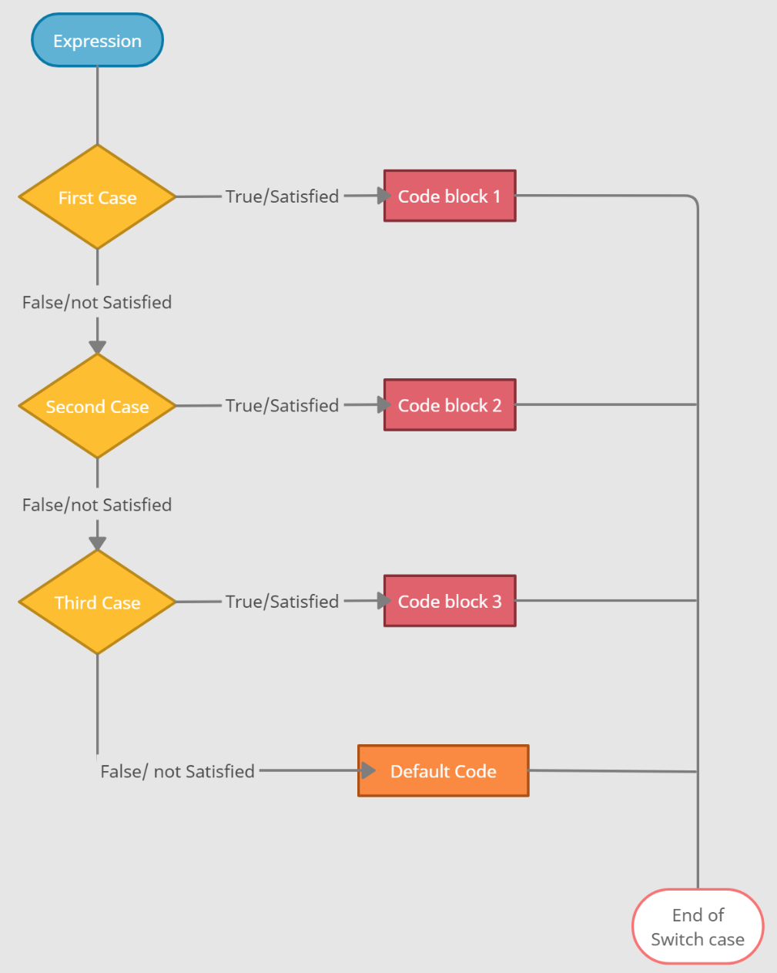
Switch/Case

Slide 13
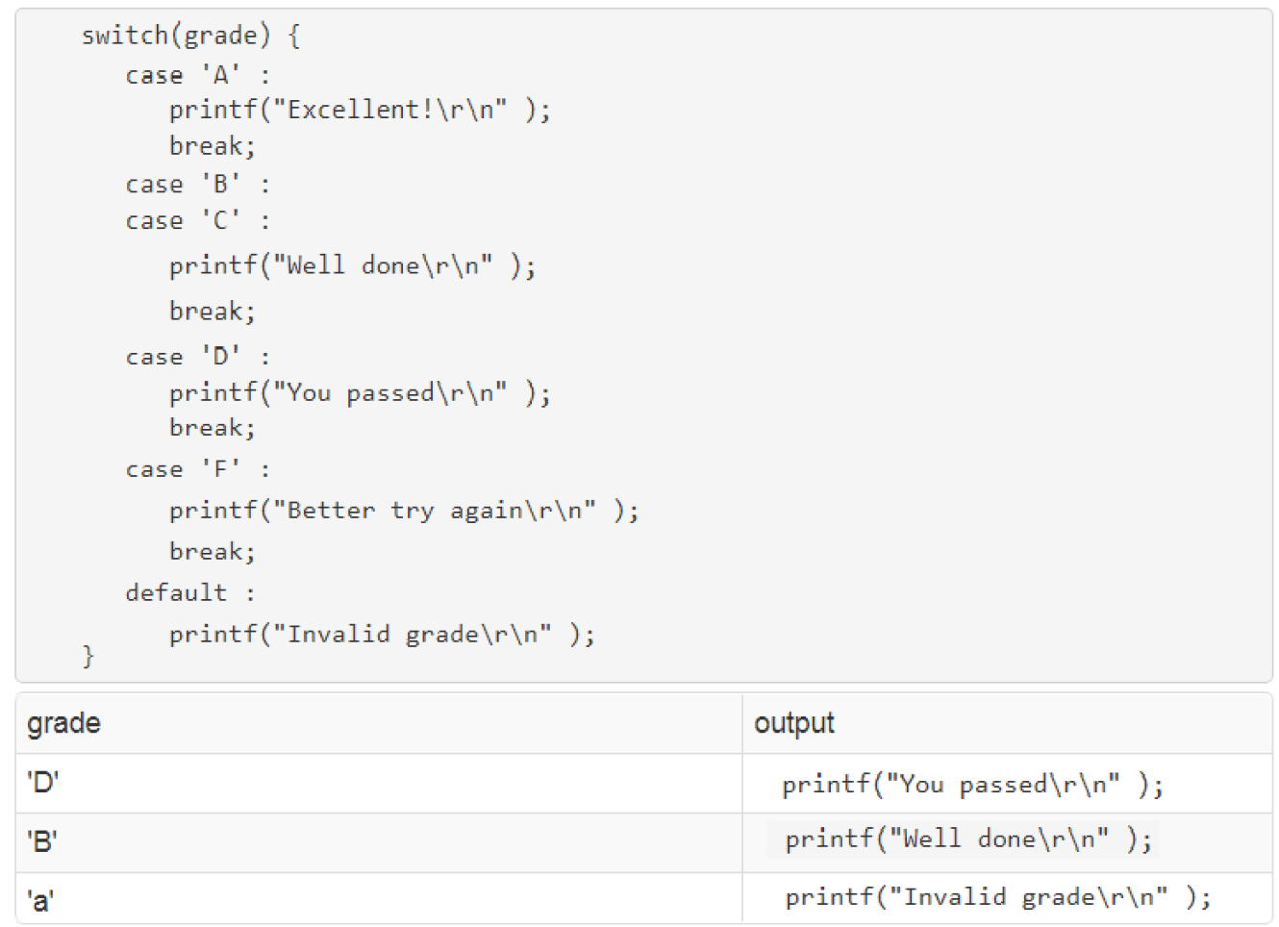
Switch/Case

Slide 14
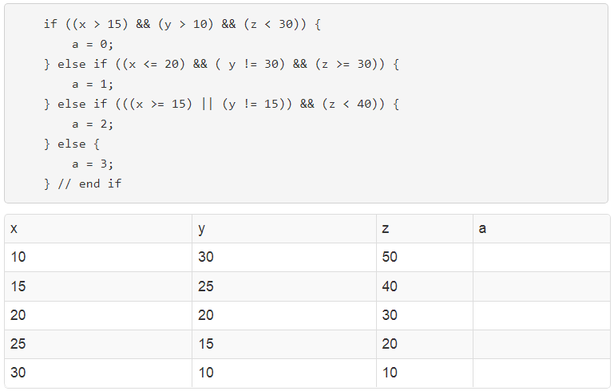
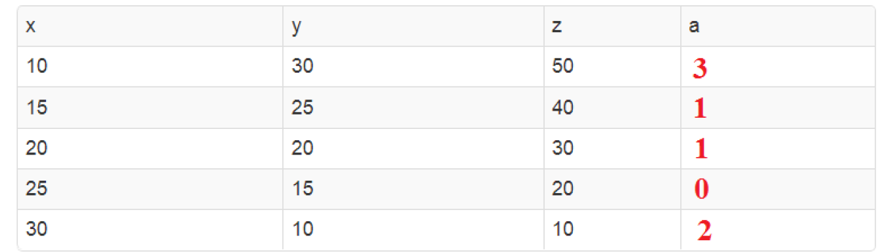
Test your understanding
Use the following if/then structure to complete the table below

Slide 15
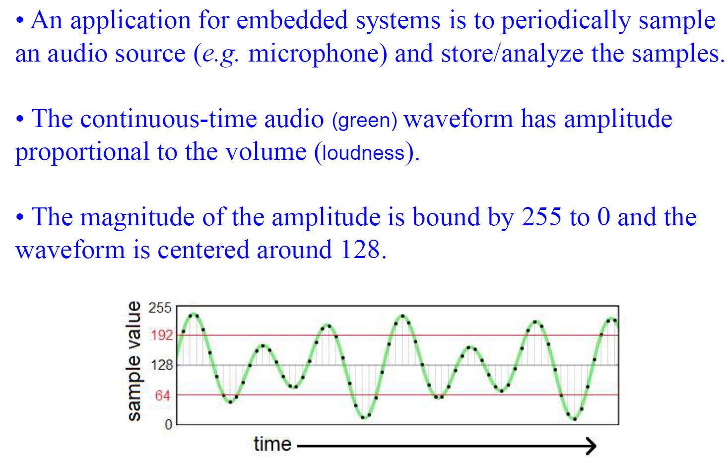
Test your understanding

Slide 16
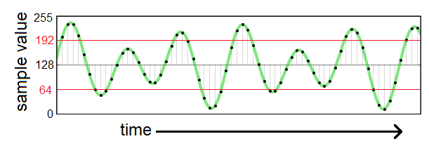
Test your understanding
The range of values and centering at 128 is a result of the hardware and ADC in the MCU.
Assume that whenever the audio waveform goes above 192 or below 64, the sound is "loud".
The dots on the audio wave are the sampled values.

Slide 17
Test your understanding
Your task is to write if-then statement to determine if the current sample is considered loud and to print a message if it is.
Assume that the current sample is being held in a variable called currentSample.
if ( (currentSample > 192) || (currentSample<64) )
printf ( "The volumne is loud.\r\n“ ) ;

