Slide 1


Lecture 04:
C looping statements
Objective:
C looping structures, for and while
Notes:
https://www.sitesbay.com/cprogramming/c-for-loop

Slide 2
Looping Statements
Loops repeat the execution of a collection of statements until some condition is met.
We examine two of the looping structures in C:

Slide 3
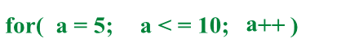
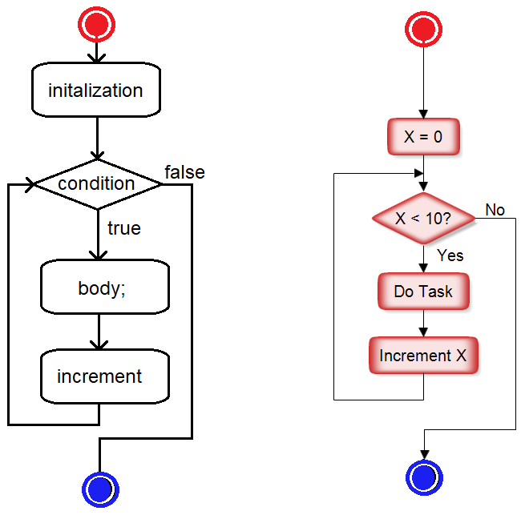
For-loops
It is used when you need a counting variable (loop variable) along with iteration. It has 3 components separated by semicolons.
Flow Diagram

Slide 4
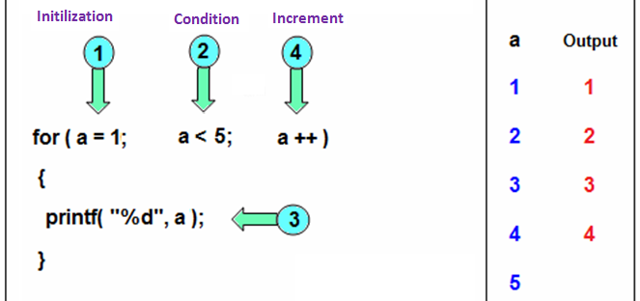
For-loops
(1) The initialization statement is executed only once, when the for-loop is first entered.
(2) If the condition is true, the body (3) is executed, otherwise the loop is terminated.
(4) The increment statement is executed at the end of the loop, after the body has been executed.

Slide 5
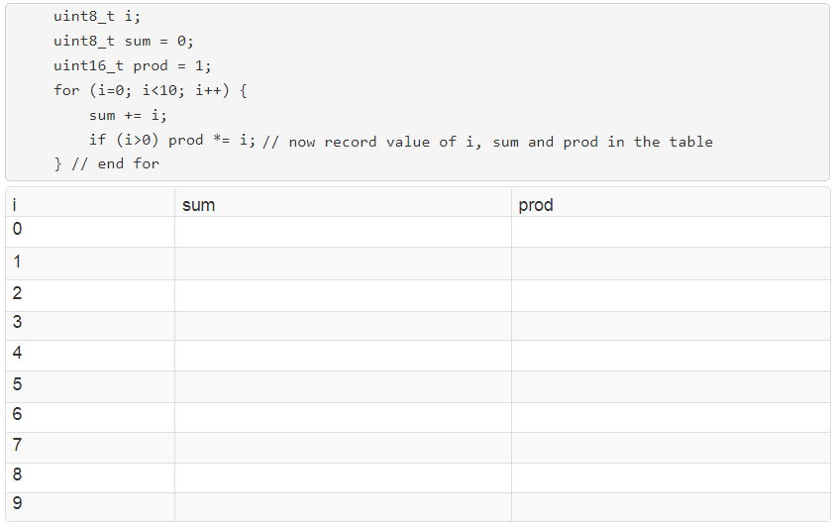
For-loop Example
Let's explore the operation of another for-loop example. Fill in the table with the values of the 3 values indicated in the program.

Slide 6
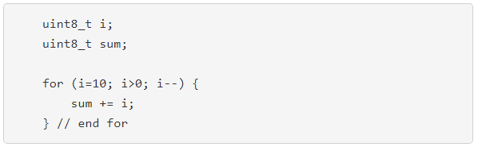
Count down loops
Some times we need an index variable goes from a large to a small value. It is common when working w/ arrays.
What would the value of sum after execution of this code snippet?

Slide 7

Infinite loops/Superloop
This loop has no initialization, condition or increment statements.
The condition field is assumed to be TRUE.
Our computer is embedded into an application and has nothing else to do expect the application we designed it into.
For example, in a vending machine, we design our program as an infinite loop, checking for money, dispensing beverages and then going back to check for money.

Slide 8
Vending machine Example
We will use this structure example in many of our programs, the super-loop.
It is an infinite loop contains a set of tasks performed over and over again.

Slide 9
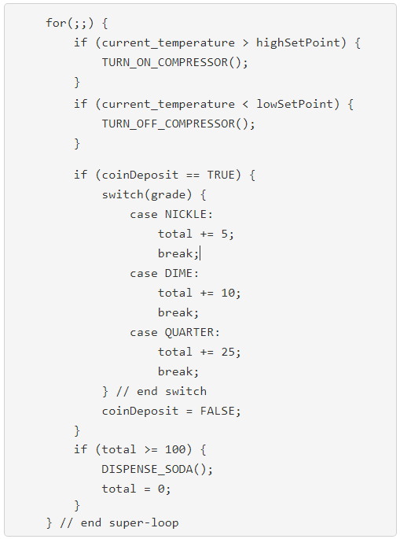
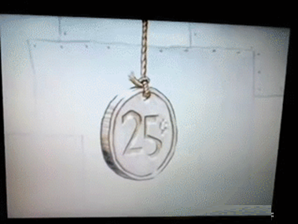
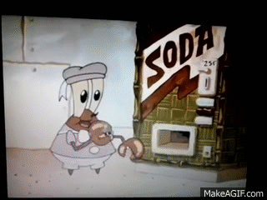
Vending machine
It's easy to read through this list of tasks and figure out what the machine is doing.
The machine is doing one thing at a time.
Later, we’ll add interrupts to the loop so the MCU does another things at the same time.

Slide 10
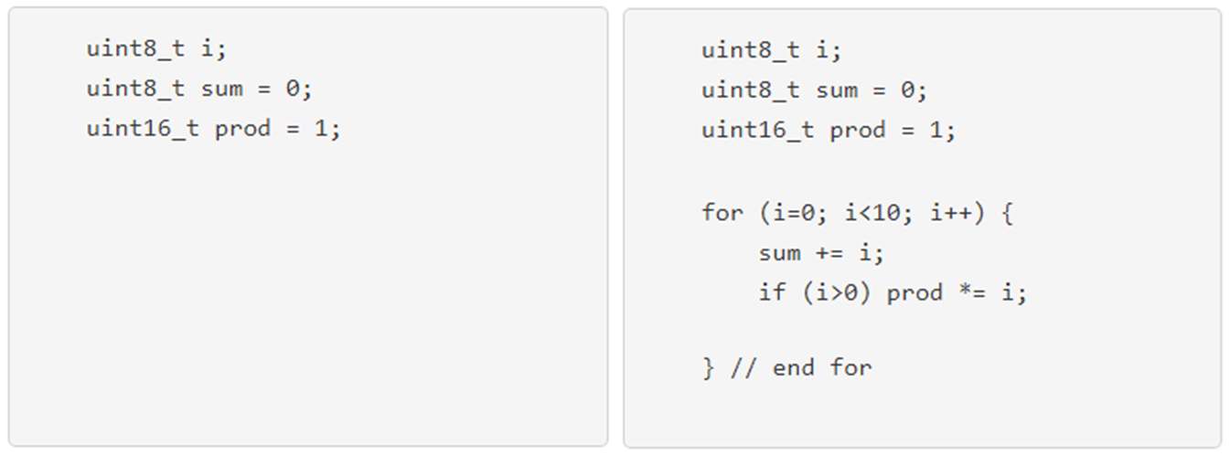
While loops
More simple than for-loop: a single condition while true allows a body to execute.
e.g. a while loop produces same iterative behavior as for-loop.
A loop like has a little practical use as this structure is more naturally realized using a for-loop.

Slide 11
Delay loops
There is a very important use of while-loop; it is to wait for some event to happen.
Example (Lab02): controlling an LED with a push button.
we connect our push button to the PIC and associate this button w/ variable called "buttonPressed".
- buttonPressed = ……… when the user ……… on the push button.
- buttonPressed = ……… when the user is ……… ……… the button.
2. we connect an LED to the PIC and associate this LED w/ variable called "LED".
- When the variable ……… ………, the LED will turn ………….
- When the variable ……… ………, the LED will turn …………..

Slide 12
Delay loops
We need to recognize that the MCU is executing the instructions millions of times faster than a user can press/release the button.
Here is a delay loop that you’ll see many times.
Line 1: turns the LED off. It is a good idea to put indicators like LEDs into a known initial state at the start of a program.
Lines 2-6: form an infinite loop; i.e. the computer will forever be checking the state of the ……. and turning the LED …. and …...

Slide 13
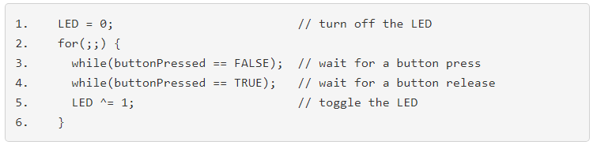
Delay loops
Line 3: a while-loop executes while the button is ……. ……..
It executes millions of times before the button is pressed.
The PIC is running at 64 MHz.
Line 4: a while-loop executes while the button is ……. ……..
It executes millions of times before the user releases the button.
The program waits until the button is released before continuing.
Line 5: ……… ……… the state of the LED after the button has been pressed and then released.

Slide 14
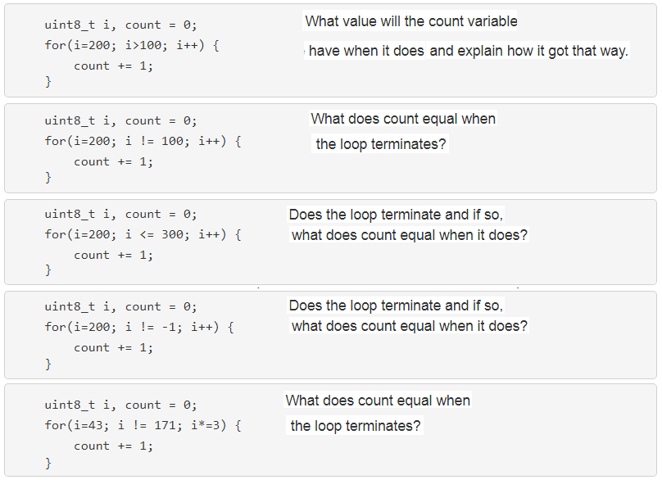
Test your understanding

Slide 15
Test your understanding
I would just drop it in a compiler and see when or if it terminates. However, we should math it out to understand what is going on.
Every time the loop executes, i is multiplied by 3 and only the least 8-bits are kept (why?).
Keeping the least significant 8-bits is equivalent to a modulus operation.

Slide 16
Test your understanding
count i
0 43
1 129
2 131
3 137
4 155
5 209
6 115
7 89
8 11
9 33
10 99
11 41
12 123
13 113
14 83
15 249
16 235
count i
17 193
18 67
19 201
20 91
21 17
22 51
23 153
24 203
25 97
26 35
27 105
28 59
29 177
30 19
31 57
32 171

Slide 17
Test your understanding

Slide 18
Test your understanding
42
The compiler provides the following warning:
arithmetic.c:42: warning: (764) mismatched comparison
arithmetic.c:42: warning: (757) constant conditional branch

