Slide 1


Lecture 05: Arrays
Objective:
Understand the syntatic structures for uninitialized and initalized 1 and 2-D arrays and how to read and write arrays.
Notes:
https://www.sitesbay.com/cprogramming/c-for-loop

Slide 2
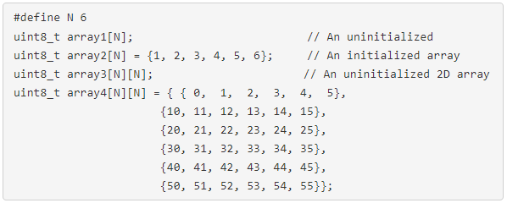
Declaring arrays
The array is arrangement of related collection of information.
Arrays needs to be declared w/ name, length & optional initial values.
The length which requires a new structure: the square bracket.
#define N 6. A way to declare a constant through program. It allows you to type in "N" everywhere to describe the size of the array.
Notes:
This is particularly helpful in complex programs where you might need to change the size of the array.
If you define the size of the array using a #define then you can simply modify this value, recompile your code, download it and you are done.
If you use the constant "6", you would need to hunt down all occurrences and replace them with the new size.
Zero index not one:
https://www.educative.io/answers/why-does-array-indexing-in-cpp-start-from-0-instead-of-1

Slide 3
Declaring arrays
Declaration for array1 creates an array of 6 elements, each element being a distinct uint8_t. This is an uninitialized array, you should assume that the values in the array are some random garbage junk values. Do not assume that uninitialized variables have a 0 value.
Declaration for array2 creates an array of 6 elements, each element being a distinct uint8_t. This is an initialized array, with each array element getting one of the 6 provided values starting with element 0.

Slide 4
Declaring arrays
Declaration for array3 creates a 2D array of 6x6 elements, each element being a distinct uint8_t.
Declaration for array4 creates an 2D array of 6x6 elements, each element being a distinct uint8_t. It is an initialized with each element getting one of the 36 provided values starting with element 0,0.

Slide 5
Declaring arrays
Embedded C has static memory.
The consequence of this is that the size of an array cannot be changed during the execution of your program.
MATLAB uses dynamic memory allowing you to change the size of the array during the execution of a program.
MATLAB has a host of sophisticated memory management programs running concurrent with your MATLAB program to enable dynamic memory.

Slide 6

Reading/Writing Array Values
Working with arrays allow reading/writing one value at a time.
You need to provide the name of the array along with the index.

Slide 7
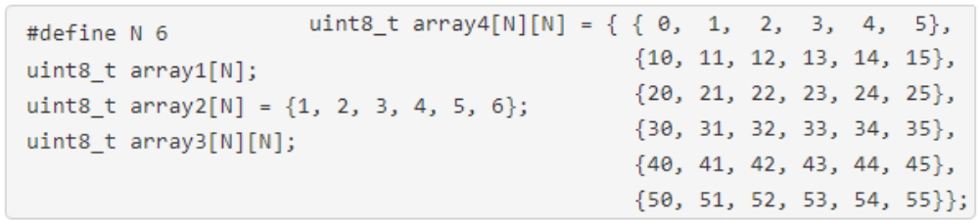
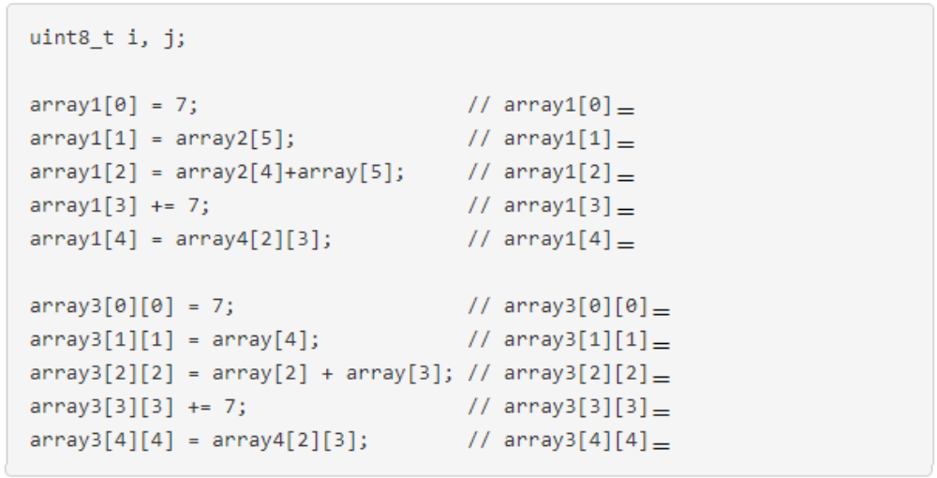
Reading/Writing Array Values

Slide 8
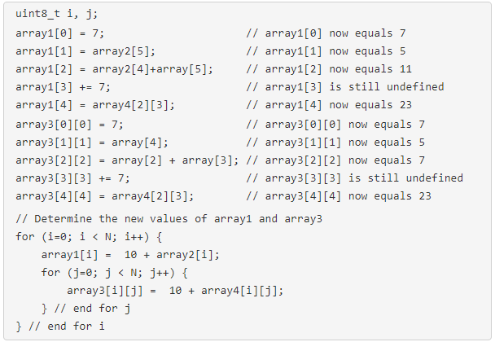
Reading/Writing Array Values

Slide 9
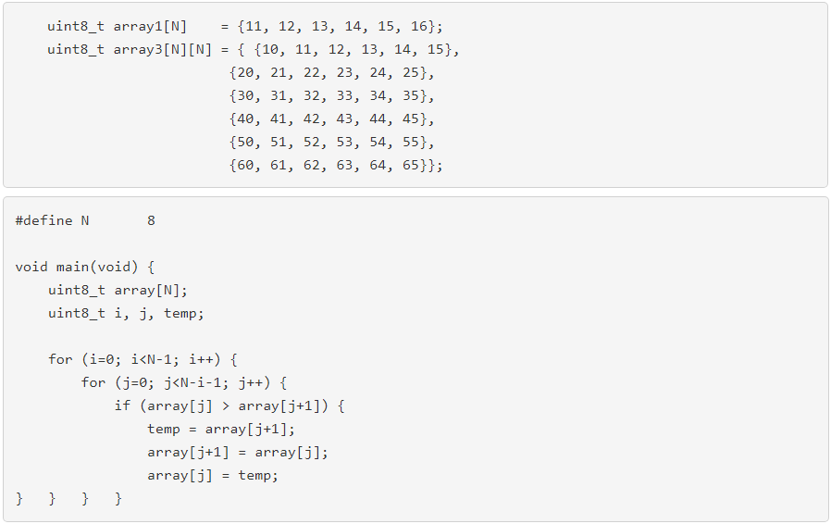
Initializing 1D/2D Array - Sorting Array
2D arrays: the 1st index is the row and the 2nd the column.
All indexing starts at 0.
After this code is executed array1 and array3 have the following values.
Sorting Array:
While our C compiler has a built in function qsort, the following code sorts an array as well.

Slide 10
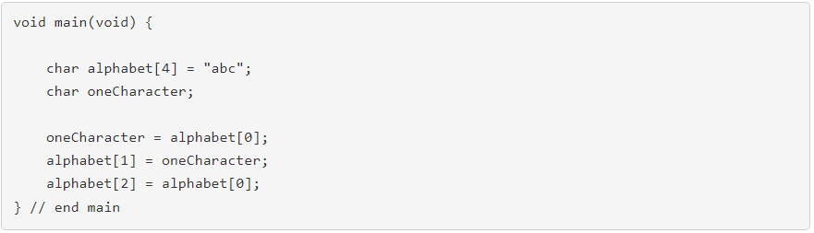
Character Strings
Strings are a convenient way to pack together characters and are represented in the memory as a a NULL terminated array of characters.
The ASCII code assigns numerical codes to typographic characters.
'a' is assigned decimal code 97, 'b' is 98 and 'c' is 99.
Single ASCII character is set-off using single quotes, strings are surrounded by double quotes.

Slide 11
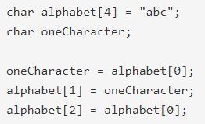
Character Strings
String is typed char, and its length is given by the number in brackets after its name.
The number of characters in the initial value must be at most, one less than the length of the string.
The string alphabet in the code is an array
holds the numbers 97, 98, 99 (the ASCII)
The first element of the array is, by
convention, the first letter in the string.
So, alphabet[0] = ‘…..’
After the code execution, alphabet = “……”.
Notes:
This is particularly helpful in complex programs where you might need to change the size of the array.
If you define the size of the array using a #define then you can simply modify this value, recompile your code, download it and you are done.
If you use the constant "6", you would need to hunt down all occurrences and replace them with the new size.

Slide 12
Non-printable Character: NPC
To specify NPC, you use an ASCII escaped character: the "\" symbol followed by a decimal number.
e.g. the horizontal tab has ASCII code 9. Consequently printing a string
“Pugs\9are great!” will produce the text “Pugs are great!”
The NULL has ASCII code 0 and signify the end of a string. A string with a NULL at the end is said to be NULL terminated.
Most compilers will automatically NULL terminate strings. You need to be aware this is happening & leave room for this NPC.
This explains why alphabet in the code snippet was given 4 bytes of storage: alphabet is an array which holds the numbers 97, 98, 99, 0.
Notes:
This is particularly helpful in complex programs where you might need to change the size of the array.
If you define the size of the array using a #define then you can simply modify this value, recompile your code, download it and you are done.
If you use the constant "6", you would need to hunt down all occurrences and replace them with the new size.

Slide 13
Example
There are times when you will want to store an array of strings.
Remember: the 1st index "[3]" tells how many strings are in the array.
The 2nd index, "[5]" tells you that each string contains at most 4 character with 1 byte reserved for the NULL terminator.
Notes:
This is particularly helpful in complex programs where you might need to change the size of the array.
If you define the size of the array using a #define then you can simply modify this value, recompile your code, download it and you are done.
If you use the constant "6", you would need to hunt down all occurrences and replace them with the new size.

Slide 14
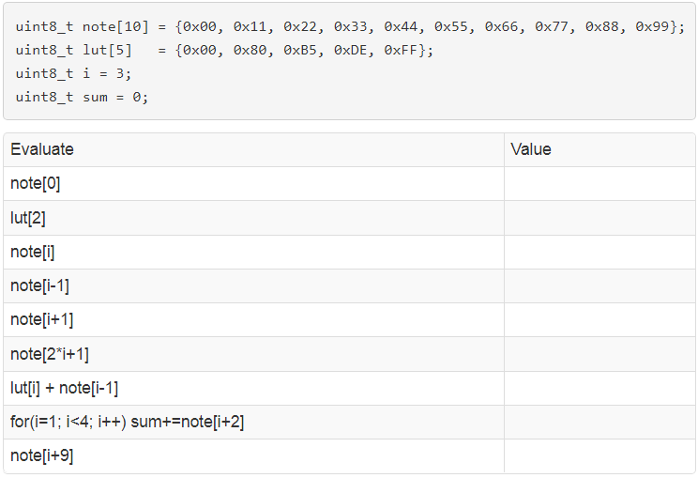
Test your understanding
Evaluate each of the expressions on the following table
Notes:
This is particularly helpful in complex programs where you might need to change the size of the array.
If you define the size of the array using a #define then you can simply modify this value, recompile your code, download it and you are done.
If you use the constant "6", you would need to hunt down all occurrences and replace them with the new size.

Slide 15
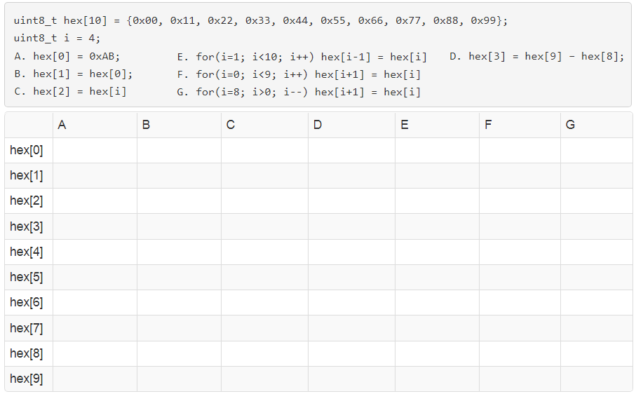
Test your understanding
Determine the effect of each of the operations on the hex array. Only fill in array entries that have changed.
Notes:
This is particularly helpful in complex programs where you might need to change the size of the array.
If you define the size of the array using a #define then you can simply modify this value, recompile your code, download it and you are done.
If you use the constant "6", you would need to hunt down all occurrences and replace them with the new size.

