Slide 1


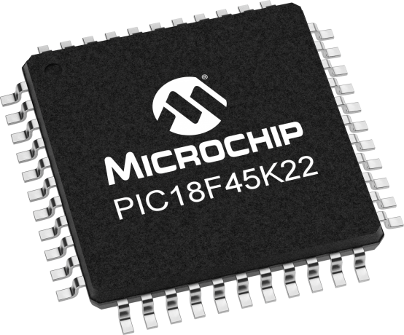
Lecture 06: Functions
Objective: Understand the syntactic structures needed to make a function call, passing input arguments and returning values.

Slide 2
Function
It encompass program functionality in a single callable format.
When you define a function, you need to consider:
  Input arguments
  Return values
  Internal code
  Local variables
  Function prototype
Function prototype tells the compiler what does the function name mean when it encounters it later on. It is identical to the first line of the function definition with:
; {

Slide 3
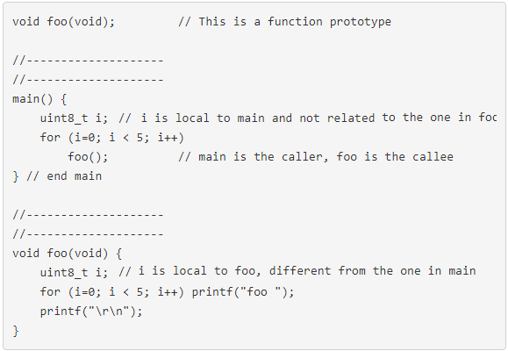
Example
A function with:
- Prototype
local variables
no input arguments
no return values.
The scope of a local variable is limited to the function in which it's defined.
In this example, main is called the caller of the function foo, and foo is called the callee.

Slide 4
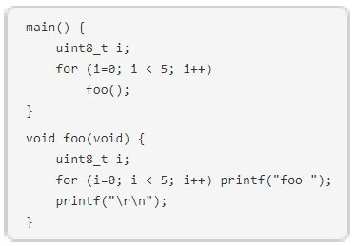
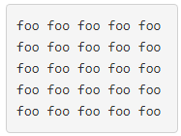
Example
Each call to the foo function prints 5 foos in the for-loop, one next to another with a space between each.
After the for-loop exits, the foo function prints a carriage-return and line feed, moving the cursor to the beginning of the next line.

Slide 5
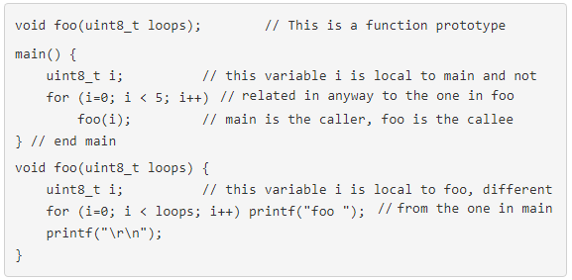
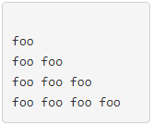
Input Arguments
The statement uint8_t loops in the declaration of foo tells the compiler that an 8-bit integer is sent from the caller to the foo function
1st line of output is a blank line.
If the value of loops is modified inside foo, the value of i in main would not be changed. In programming we say that this is a call by value.

Slide 6

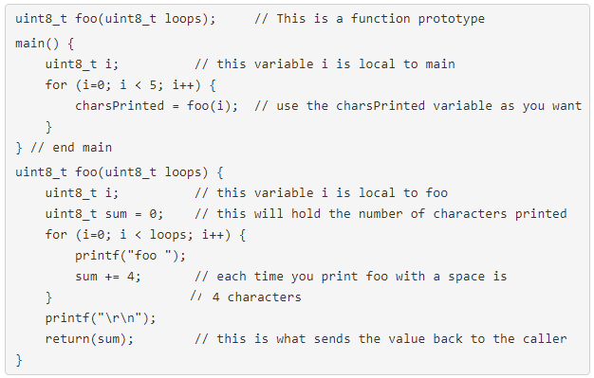
Return Values
Differences: the call, function definition & the function prototype.
The statement uint8_t in front of foo declaration tells the compiler that we will be returning an 8-bit integer to the caller using the return(sum).
While nothings is done with this value,
you can use charsPrinted like any other local variable in main.

Slide 7
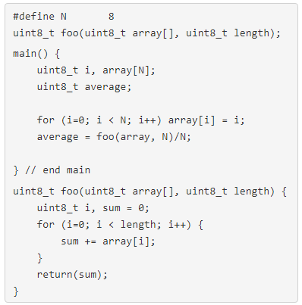
1D Arrays as input arguments
Use normal declaration notation for the array inside main.
Empty brackets in the function declaration & function prototype.
Use just the array name
in the function call.
You could change the values of the array inside the function and these changes would be communicated back to main
This is directly related to the topic of pointers, something that we will take up later in the semester.

Slide 8
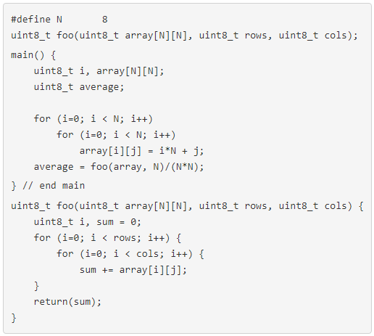
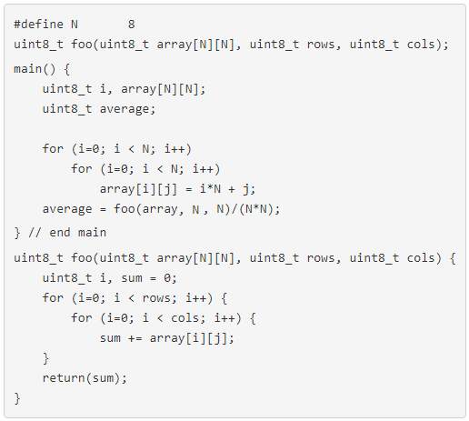
2D Arrays as input arguments
Normal declaration notation for the array in main.
Square brackets w/ r & c dimensions in the function declaration & function prototype.
Use just the array name
in the function call.

Slide 9
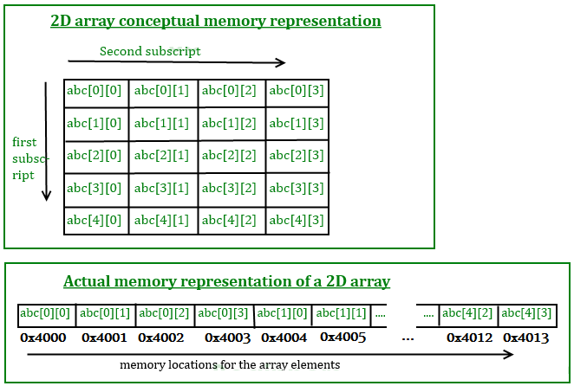
2D Arrays as input arguments
The compiler maps the indices of the 2D array into the memory address space.
The computer stores the 20 uint8_t in continuous memory locations.
Assume that the starting memory location of the array abc is 0x4000.
A reference to abc[row][column] references address:
0x4000 + row*4 + column
Notes:
https://beginnersbook.com/2014/01/2d-arrays-in-c-example/

Slide 10
Test Your Understanding
Write a function which takes as input:
an array of uint8_t,
the length of the array, and
returns the integer average of the elements.
uint8_t average(uint8_t array[], uint8_t length) {
uint8_t i; uint16_t sum = 0;
for (i=0; i<length; i++)
sum += array[i];
return(sum/length);}

Slide 11
Test Your Understanding
Write a function which takes as input:
an array of uint8_t,
the length of the array,
an integer threshold, and
returns the number of array entries greater than the threshold.
uint8_t exceedThreshold(uint8_t array[], uint8_t length, uint8_t threshold) {
uint8_t count = 0;
uint8_t i;
for (i=0; i<length; i++) {
if (array[i] > threshold) count +=1;
return(count);
}

Slide 12
Test Your Understanding
Write a function that returns the period of a sine wave stored in an array. It has an average value of 128.
Determine the period by looking for the 1st time the values in the array cross the value of 128.
This happens when we go from array[4]=168 to array[5]=122. This is a negative transition, meaning we decreased our way through 128.
Now look for the 2nd time the array crosses 128. This occurs when we go from array[13]=122 to array[14]=168. This is a positive transition, i.e. the sine wave is now increasing.
Thus there are 9 indices (index 13 minus index 4) in half the waveform. Thus this waveform has a period of 2*9 = 18 indices.

