Slide 1


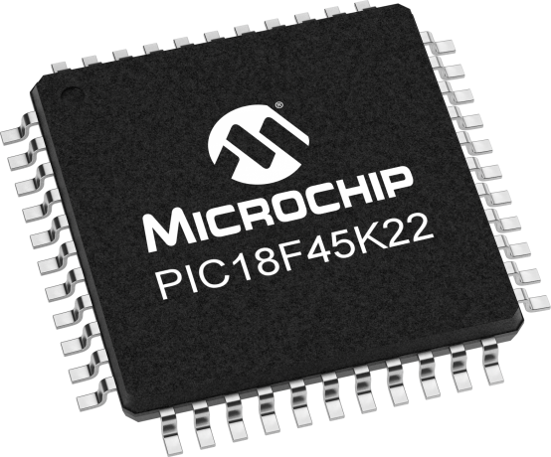
Lecture 07: Basic I/O
Objective:
Understand the relationship between electrical signals at I/O pins & the digital values contained in the PORT and LAT registers.
Understand active high and low input and output circuits using buttons and LEDs respectively.

Slide 2
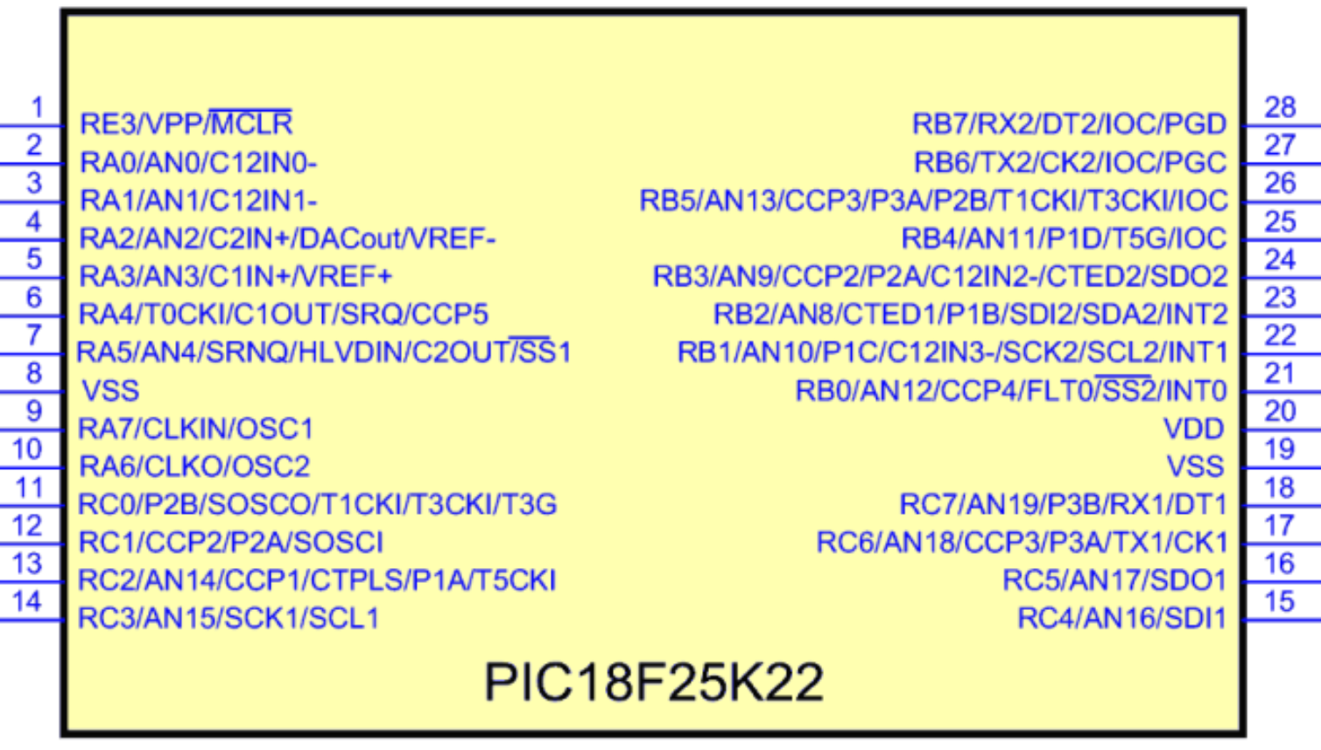
Pinout PIC18F25K22
Datasheets of Microchip mention the number as well as the pin function in the pin diagrams. Here is a good reference that is not available in the datasheet.

Slide 3
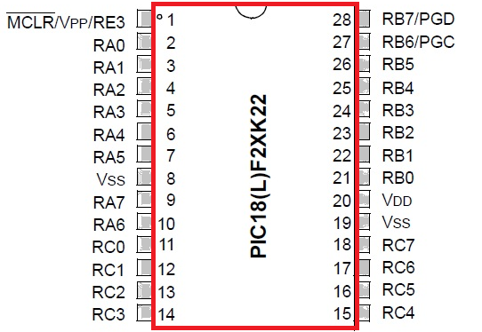
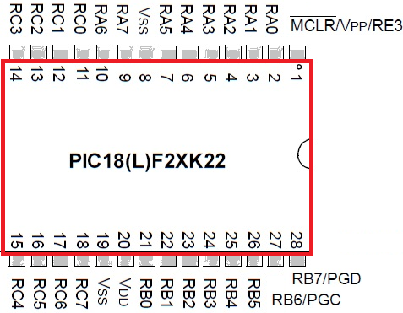
I/O pins
The PIC18F25K22 chip and the identities of pins are shown here.
It comes in 28 pin Small Outline Integrated Circuit (28-SOIC) package.
Rx# labeled pins: R stands for Register, x is the identity of the register and # is the bit within that port register
e.g , RC1 is bit 1 of the port C register. Some has several names separated with a "/" character.

Slide 4
I/O pins
Functionally multiplexed pins: several internal functions of the PIC are routed to the same pin.
e.g., the pin labeled RB7/PGD can be configured to be RB7 or the program data line (we will explore what this means later).
Using an internal multiplexer, the code chooses which functions is associated with the pin.
When a pin is configured as "Rx#", it is said to be configured as a General Purpose Input Output (GPIO).
Meaning that you can only read/write bits from/to that pin.

Slide 5
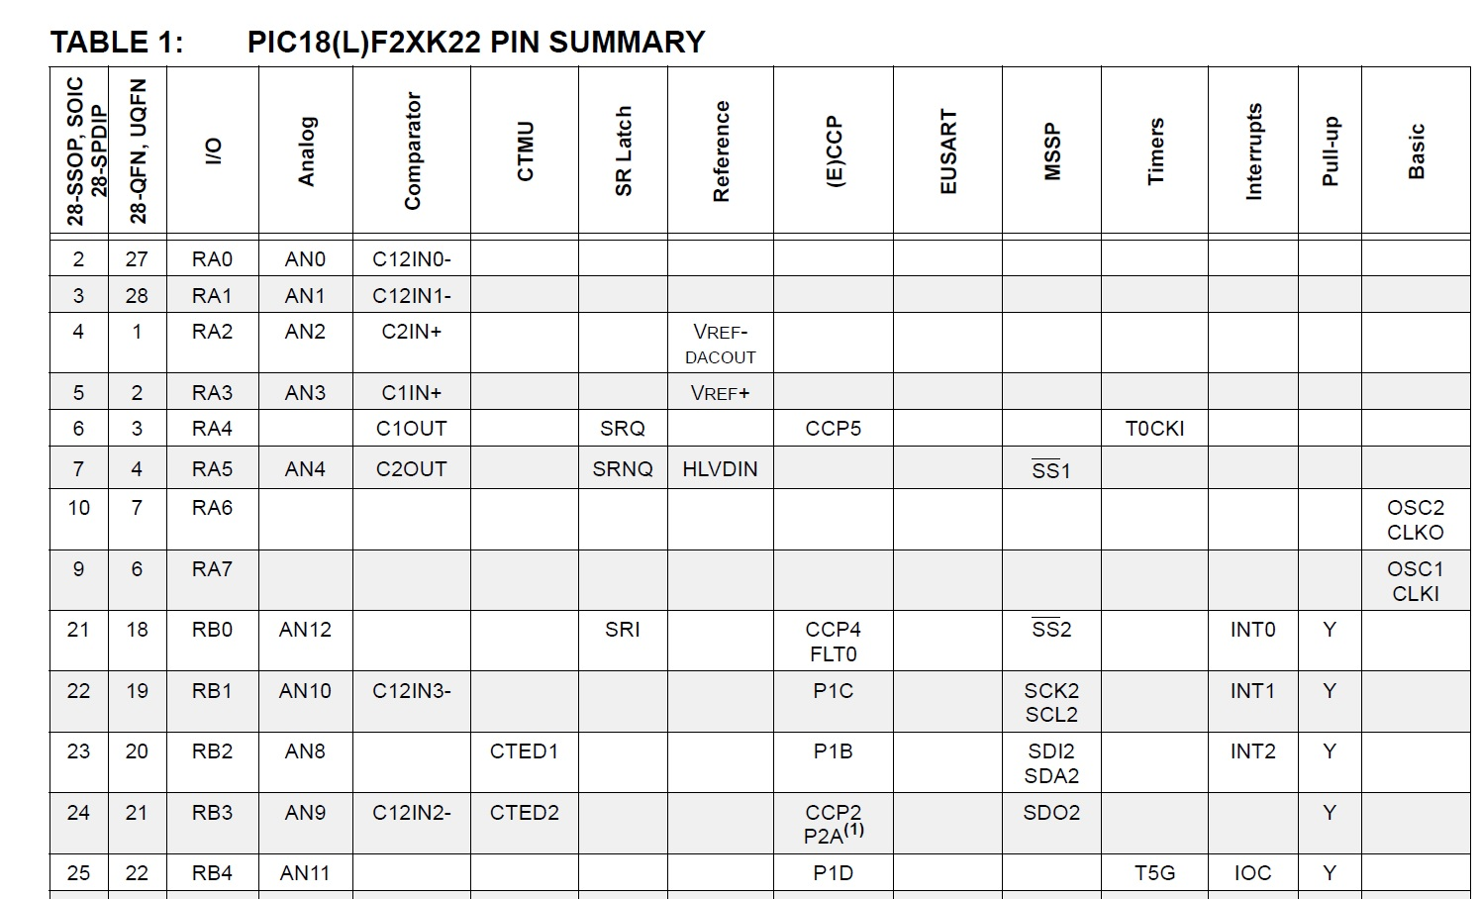
I/O pins
Table 2 in PIC18F26K22 Data Sheet: find specific I/O pin in the leftmost column and then go across the row to the find functions.

Slide 6
I/O pins
e.g., pin 2 is associated with I/O RA0, Analog AN0, (and more).
At a given instant in time, you can have only one function associated with a pin.
For now, only two columns you are expected to understand: the pin number in the 28-SOIC column and the GPIO in the I/O column.
The port pins have two configuration registers associated with each: data direction register (TRIS) & port value register (PORT).

Slide 7
The data direction register: TRIS
It determines if a pin is configured as an input or an output.
Accessing the data direction bits is simplified by the definitions in the "xc.h" include file provided by the MPLAB.
To access the data direction bit for Rx#, use TRISxbits.TRISx#
e.g. to make pin 2 (which is RA0) an output, use the following statement in your code:
TRISAbits.TRISA0 = 0;
Use 1 for input.
Note, "x" the port letter and "#" is the bit within that port.

Slide 8
A port value register: PORT
You can read a value from a pin Rx# using PORTxbits.Rx#.
You can write a value to a pin Rx# using LATxbits.LATx#.
e.g., if you wanted to write a logic 1 to pin 2, RA0, after making it an output, you would use the statement
LATAbits.LATA0 = 1;
LAT register (output latch)

Slide 9
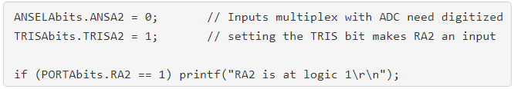
Functionally muliplex pins (w/ ADC)
The analog column in Table : you must configure inputs to be digital by clearing (assign 0) the associated analog select bit.
Example: configure PIC pin.
configure pin to digital by clearing the associated analog select bit.
configure the data direction bits
read a value from RA2
write a value to RA2

Slide 10
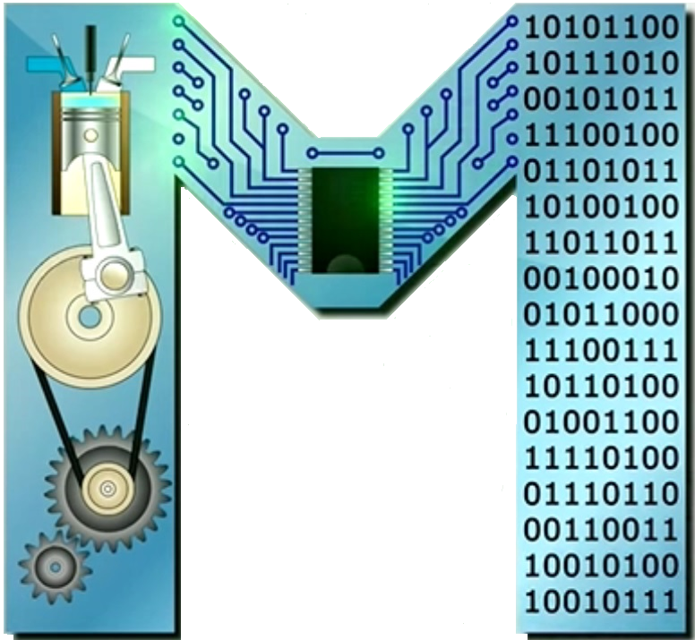
Summary
Some pins are for power,
Some pins have one function,
When a pin has more than one potential function,
  Its label contains one or more "/" characters,
  It is said to be functionally multiplexed.
A pin with no predetermined function is said to be a general purpose input output (GPIO) pin,
GPIO pins are arranged into related sets called ports,
Ports are given letters, A, B, C, …
A GPIO pin is uniquely identified by its port and number,
GPIO pins can be configured as inputs or outputs through a TRIS register

Slide 11
Summary
Writing a 0 into a TRIS bit make the corresponding pin an output,
Writing a 1 into a TRIS bit make the corresponding pin an input,
The logic levels 0 and 1 inside a program correspond to voltages outside the PIC,
The value present on a GPIO pin (configured as an input) can be read through the port value register,
The value on a GPIO pin (configured as an output) can be written through the port value register.

Slide 12
The port pins have configuration registers associated w/ them
(1) TRIS, Data Direction Register: it determines if a pin is configured as an input (=1) or an output (=0).
Use TRISxbits.TRISx#
Example:
To make pin RA0 an output:
TRISAbits.TRISA0 = 0;
(2) PORT Port value register: you can read a value from a pin Rx# using PORTxbits.Rx#
Example:
To read a value from RA2,
PORTAbits.RA2.

Slide 13
The port pins have configuration registers associated w/ them
(3) LAT: you can write a value to a pin Rx# using LATxbits.LATx#
Example:
To write a logic 1 to RA0, after making it an output, you would use the statement
LATAbits.LATA0 = 1;
(4) Input pins that are functionally multiplex w/ ADC channels:
An input is configured to be digital when its associated analog select bit is cleared (assigned 0).
Example:
Inputs is digitized using
ANSELAbits.ANSA2 = 0;

Slide 14
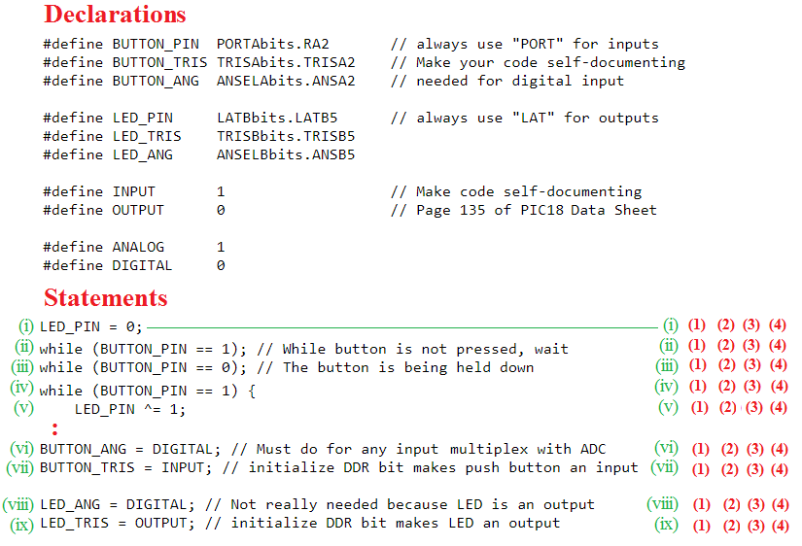
Parts copied from inLab02 code
Classify each statement as (1) or (2) or (3) or (4),
by circling one of the numbers shown to the right in red,
based on what has been defined in previous slide
Example

