Slide 1


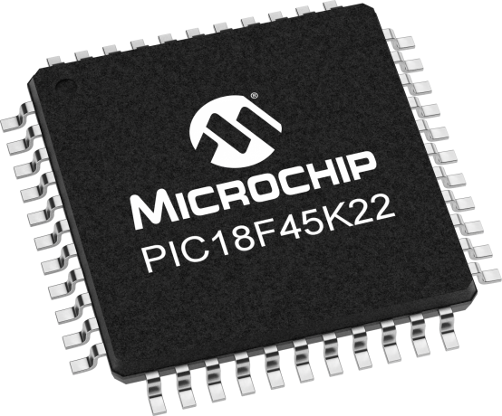
Lecture 08: GPIO
Objective:
How to generate a verity of output bit sequences using delays?
How to recognize input patters using delay structures?

Slide 2
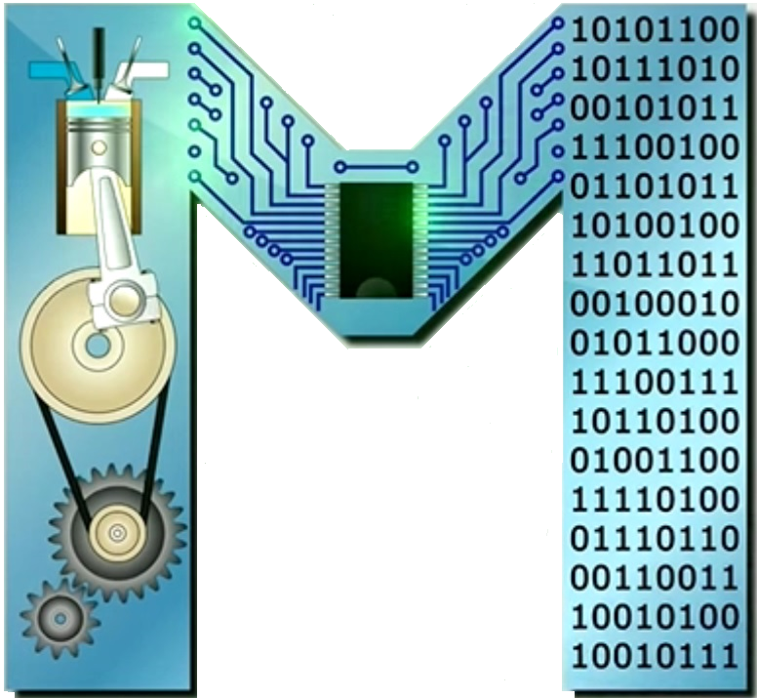
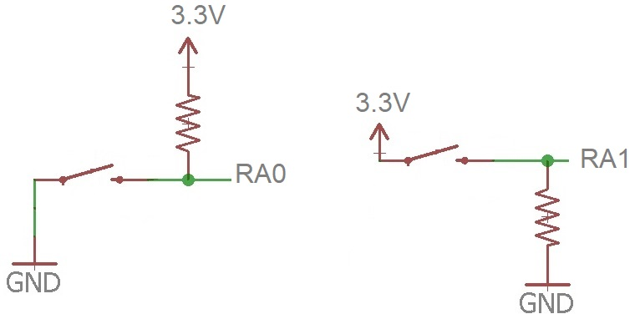
GPIO
To control of the GPIO pins, we look at three concepts: delay, manipulation of input, and manipulation of output.
The switches shown are in the open position which indicates that they are N.O.
Notes:
Reason 1:
Active low signals are used in digital circuitry to reduce errors caused due to interference(noise).
If we use active high signals interference caused due to noise is also considered as a signal, so we use active low signals to prevent errors.
Reason 2:
When driving any circuit using a micro controller it cannot provide high current to drive the device,so we connect an external power source to
the device and use active low signal as shown in the image
https://www.quora.com/What-is-the-significance-of-using-active-low-signals-in-digital-circuitry

Slide 3
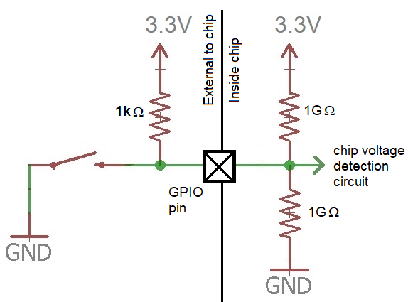
Active low switch connected to an I/O pin
The 1kΩ pull-up resistor is typical. The chip inputs are connected to a MOSFET which is modeled as a pair of (high resistance) resistors

Slide 4
Active low switch connected to an I/O pin
What voltage the "chip voltage detection circuit" sees when the button is in its N.O.?
The voltage at the "chip voltage detection circuit":
So, the chip senses ……… and registers a logic …, and when the button is closed, the pin is attached to gnd (…), registering logic …

Slide 5
Wait for button press
To synchronize the actions of the MCU to a human, we program the MCU to wait for a button press: ………………….
Assume that the push button is active high and the port pin associated with the button has been aliased to BUTTON:
#define BUTTON PORTAbits.RA0
When the button is pressed, BUTTON = …… and when it is not pressed, BUTTON = …….
Active high LED is connected to an output pin. The port pin associated with the LED has been aliased to LED:
#define LED LATAbits.LATA1
Assigning LED to 0, turn the LED ……, assigning a 1 turn it ….

Slide 6
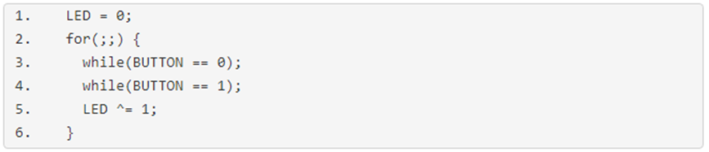
Wait for button press
Line 1 turns the LED off. It’s a good idea to know initial state.
Lines 2-6, infinite loop: The MCU will forever be checking the state of the button and turning the LED on and off.
Line 3: a while-loop executes while the button is not pressed.
s
Line 4: a while-loop executes while the button is pressed.
Line 5 toggles the LED after the button has been pressed/released.

Slide 7
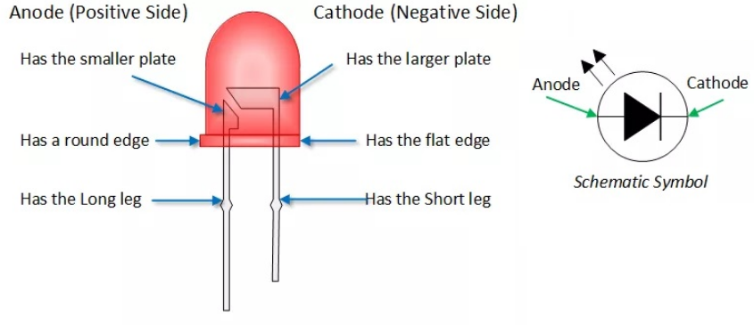
LEDs
Polarized devices produce light. The terminals of the device are not interchangeable.
To produce light, current must pass from the anode to cathode.

Slide 8
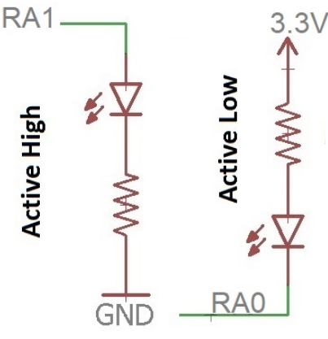
A common output device - LEDs
There are two ways that you can connect LEDs to your circuit, active high and active low.
Both RA0 and RA1 are configured as outputs.

Slide 9
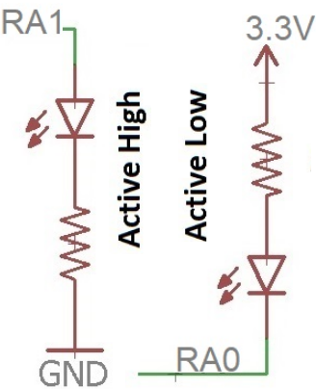
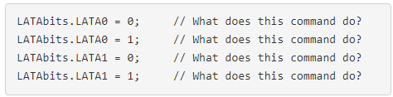
A common output device - LEDs
To turn the LEDs on or off you need to write the output latch associated with the pin: LATxbits.LATx#
This sets a latch bit which causes the associated pin to go to ……..
Clearing a latch bit cause the associated pin to go to ……….
Its value can be found by consulting the
datasheet looking up V_{f} and I_{max}. Typically 2V and 20mA.

Slide 10
Delay routine
MCUs operate on time scales of μs, while we operate on a time scale of seconds.
To breach this we slow down the MCU or speed-up our perception.
The second is accomplished using o’scopes, while first is accomplished by having the MCU delay for periods of time.
Assume to have a function called "delay“. It takes uint8_t argument and produces a delay of many "delay units".
void delay(uint8_t delayUnits);
Let's look at the following examples.

Slide 11
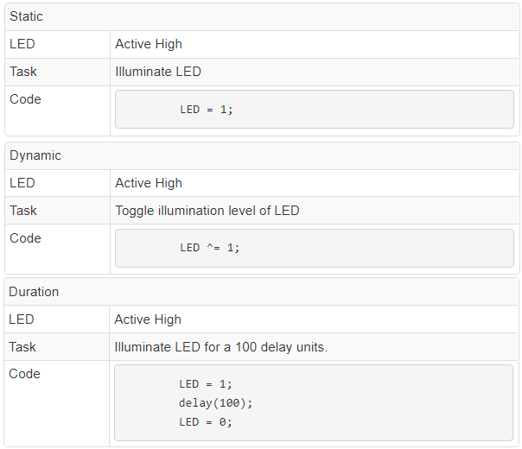

Generating output patterns
To program MCU to control/communicate w/ the outside world, you need a precise sequences of logic activity on GPIO pins.
Assume LED has been aliased via a #define statement to a GPIO pin has been configured as an output and attached to active high LED.

Slide 12
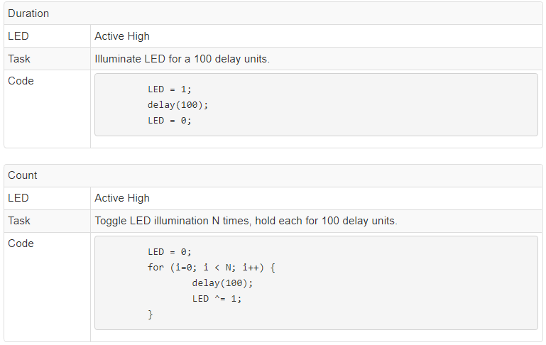
Generating output patterns

Slide 13
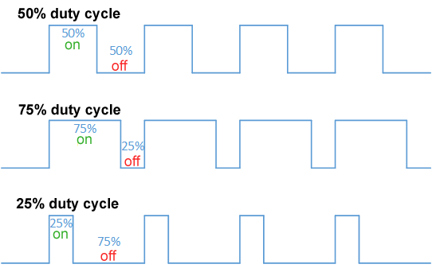
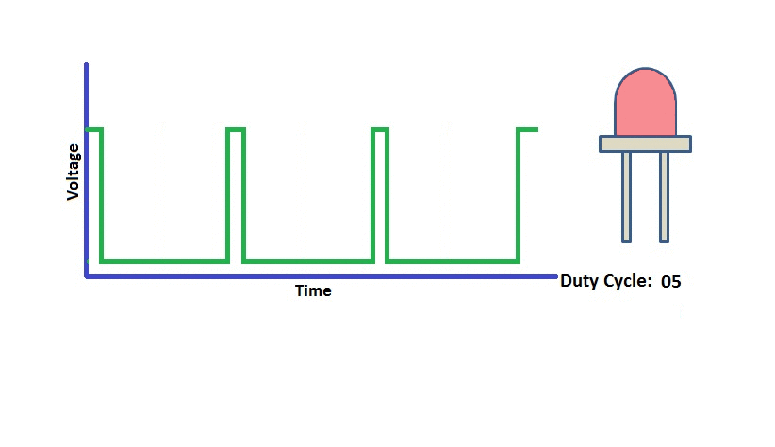
Aside: Duty cycle

Slide 14
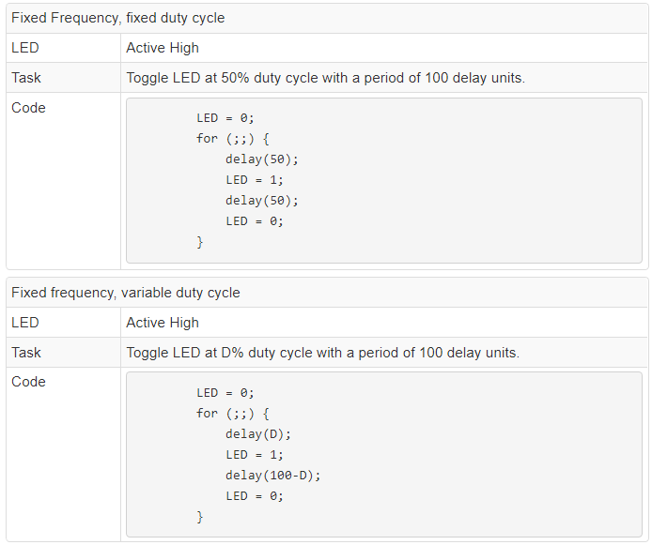
Generating output patterns

Slide 15
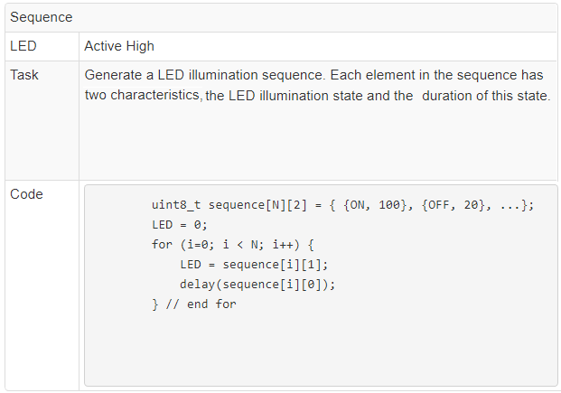
Generating output patterns

