Slide 1



Lecture 09: Timers
Objective:
Understand the operation of the timer and how to use it to create precise delays.

Slide 2
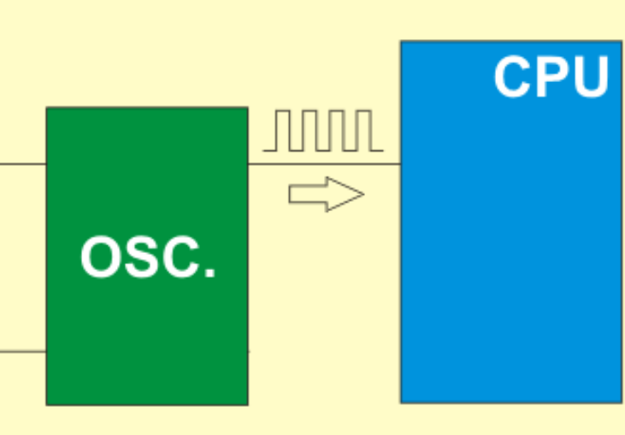
8-bit PIC MCU Oscillator
F_{OSC} is the symbol that is conventionally used for the main oscillator frequency in PIC-land.
Many PICs divide this frequency by 2 or 4
before applying it to the rest of the chip.
The oscillator is the heartbeat or system clock source that makes the device run.
The oscillator module has a wide variety of clock sources and selection features that allow it to be used in many applications.
Clock sources can be supplied from external oscillators, quartz crystal resonators, ceramic resonators, and Resistor-Capacitor (RC) circuits.

Slide 3
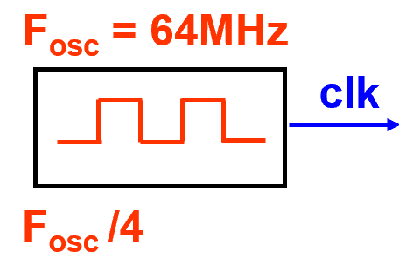
Instruction Clock vs. Oscillator
In a PIC microcontroller, "F_{osc} divided by 4" refers to the instruction clock frequency.
It is calculated by taking the system clock frequency (F_{osc}) and dividing it by 4.
This means that the instruction clock operates at one-fourth the speed of the oscillator clock.

Slide 4
Timer
Timers in a PIC microcontroller are registers that count events, generate waveforms, and introduce delays.
They are used in systems that require precise timing.
How do timers work?
The value of a timer register increases continuously until it reaches 2^{n} - 1 then it starts over at 0.
The timer's clock source provides input signals for the timer to count.
The timer can be expanded by adding a prescaler, which is a second counter that skips clock pulses.

Slide 5
Timer
A subsystem to make precise time measurements. Its core function is ……... counter counts from … to ……., & back to …
The counter value is available in ……... register ……. ……., a variable that you can access in your programs.
The state of the timer is controlled by the ……. ……. bit in the Control Register ……. ……..
Setting TMR0ON starts the timer counting up, clearing TMR0ON stops the timer.
e.g, the following line of code starts the timer running.

Slide 6
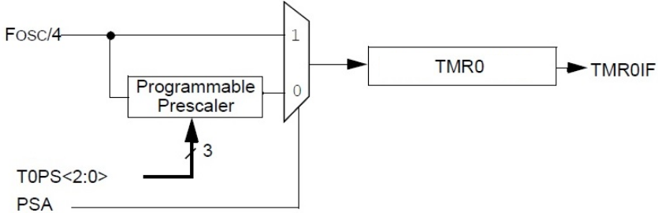

Timer
When it counts up from …… to ……, it is said to ……………...
Roll-over sets the TMR0IF bit in the INTCON register.
This flag stays set until the user clears it in software.
The timer counts up synchronously the main oscillator, F_{osc}, divided by 4.
For the time being we will assume that the Programmable Prescaler is set to ……, meaning that it can be ignored.
Notes:
Fosc is the frequency of the instruction cycle clock, which is the CPU clock
https://www.embeddedrelated.com/showthread/comp.arch.embedded/56644-1.php

Slide 7
The Timer Subsystem
Read: pages around p. 156 of the PIC18F26K22 Data Sheet.
F_{osc} /4 means that on every … rising edge of the main oscillator, the counter counts up by 1.
Since the PIC clock runs at ………, the counter counts up at a rate of … … … ….
So, in 1 sec, the timer counts up … … … … times.
Prescaler
Counter

Slide 8
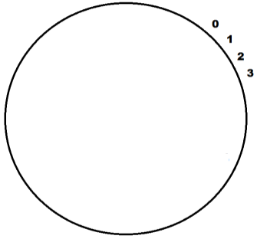


The Timer Subsystem
So, in ……………, the timer
counts up ………………… times.
Each of those counts takes per seconds:
Time interval, 62.5 ns, is the ………………… of the timer, i.e. we cannot measure time intervals w/ accuracy < this value.
2¹⁶-1
X+1
x

Slide 9

The Timer Subsystem
Example: measuring time w/ timer using the following snippet.
How long the while loop statement takes to execute?
The solution to this problem relies on dimensional analysis; i.e. converting units of a quantity without changing its value.
It relies on multiplying by a unity ratio, where the numerator & denominator are same but represented in different terms.
Dimensional analysis allows us to convert the bus clock into the time required to roll-over the timer.

Slide 10
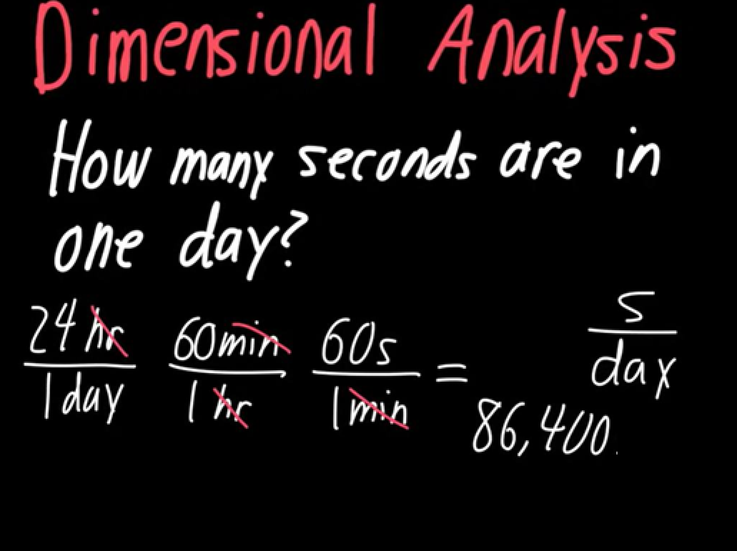
Dimensional Analysis

Slide 11
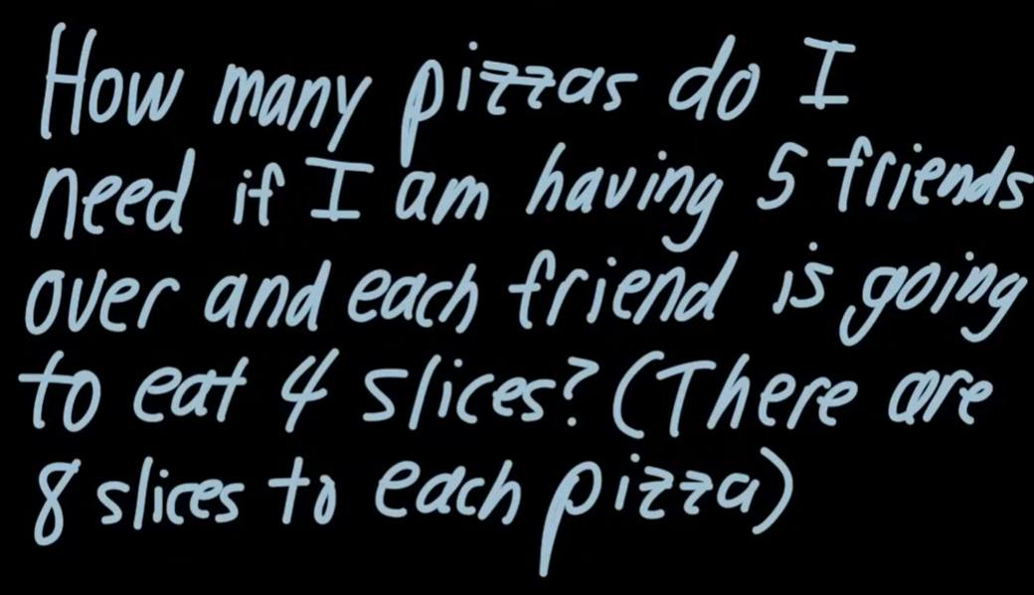
Dimensional Analysis

Slide 12
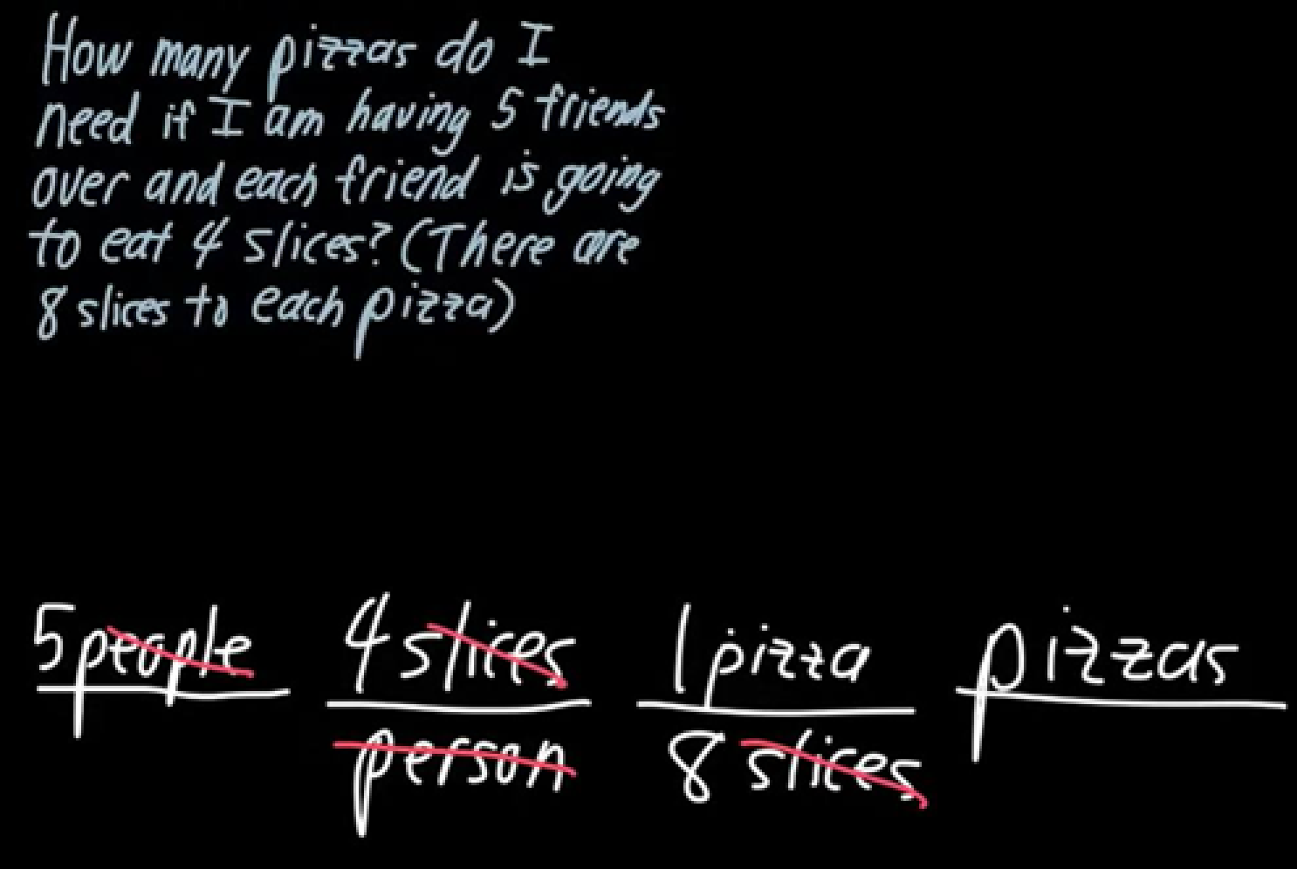
Dimensional Analysis

Slide 13
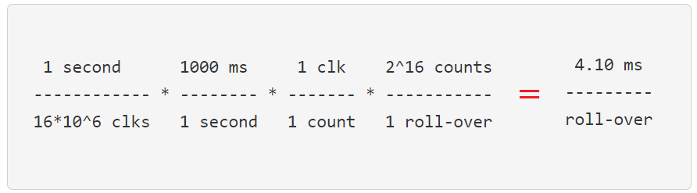
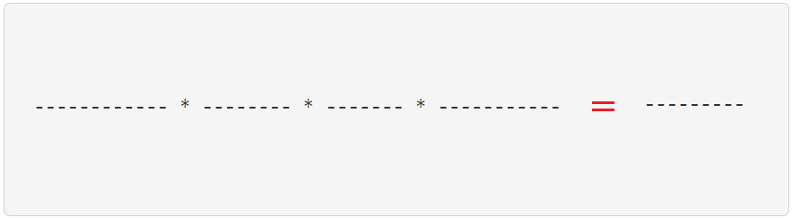
Examples
F_{osc} = 64MHz
Slow down
clk
Prescaler
cnt
Counter
TMR1IF
F_{osc} /4
1:1
The example assumes that counter starts counting from 0.
Let’s say we want to measure how long time (in ms) it takes for the counter to roll-over?

Slide 14
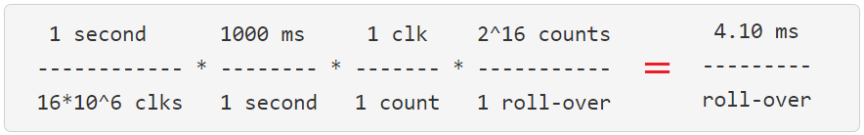
Examples
TMR0 will roll over because TMR0 only required 4.1 ms
4.10 ms sets an upper bound on the time resolution of the 16-bit counter using a 1:1 prescaler.
To measure time intervals longer than this, we could put the delay loop inside a larger counting loop iterates the 4.10 ms.
Another method (next lecture) is to prescale the clock, slowing down the rate at which the counter increments;

Slide 15
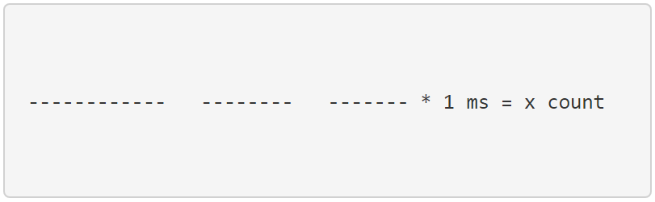
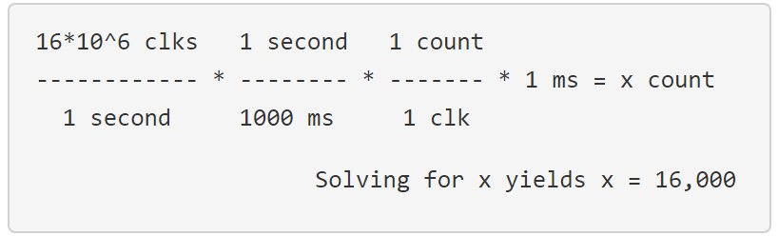
Examples
F_{osc} = 64MHz
Slow down
clk
Prescaler
cnt
Counter
TMR1IF
F_{osc} /4 = 16MHz
1:1
Calculate the number of timer counts that go by during 1 ms.
Here, you need to put information on both sides of the equation and some terms are not unity ratios.

Slide 16
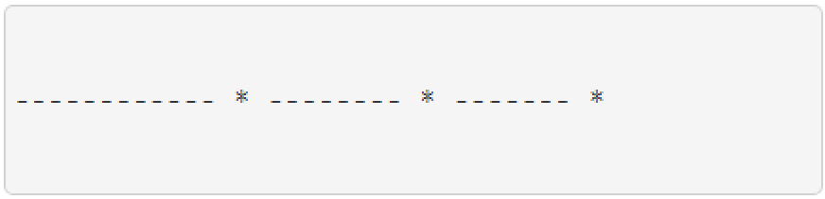
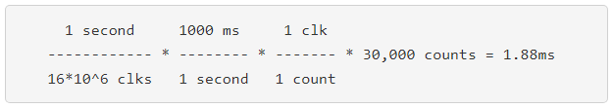
Examples
F_{osc} = 64MHz
Slow down
clk
Prescaler
cnt
Counter
TMR1IF
F_{osc} /4 = 16MHz
1:1
How much time goes by in 30,000 counts?
State your answer in ms and round to 3 significant figures.

Slide 17
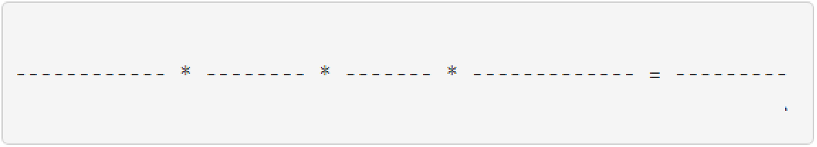
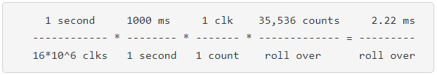

Examples
F_{osc} = 64MHz
Slow down
clk
Prescaler
cnt
Counter
TMR1IF
F_{osc} /4 = 16MHz
1:1
Starting at 30,000, how long will it take TMR0 to roll-over?
State your answer in ms and round to 3 significant figures.

Slide 18

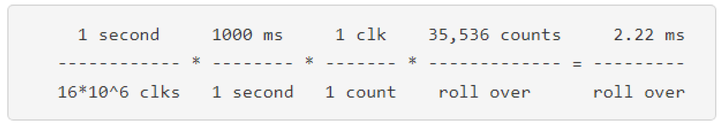
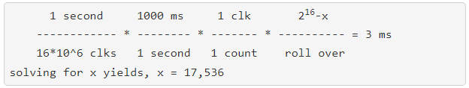
Examples
Previous Ex:
clk
Prescaler
cnt
Counter
TMR1IF
F_{osc} /4 = 16MHz
1:1
What starting value would result in TMR0 rolling over in 3ms?

Slide 19
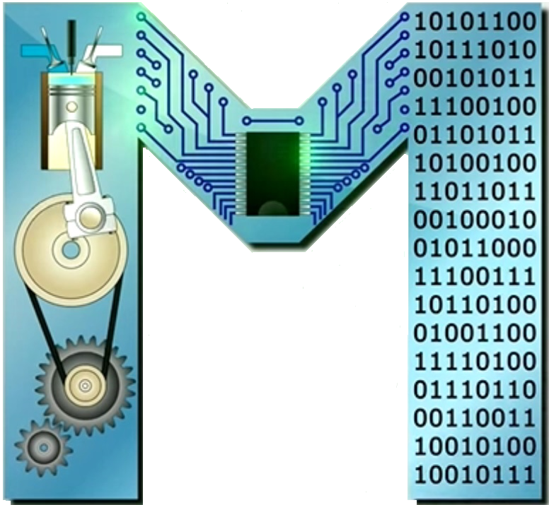
Examples
clk
Prescaler
cnt
Counter
TMR1IF
F_{osc} /4 = 16MHz
1:1
How many TMR0 counts occur in 1.5ms?

Slide 20
Examples
clk
Prescaler
cnt
Counter
TMR1IF
F_{osc} /4 = 16MHz
1:1
Starting at 0, what value would be stored in TMR0 after 10ms?
Step1: compute how many times TMR0 rolls over.
Compare: TMR0 only required 4.1ms (from earlier work) to roll over.

Slide 21
Examples
clk
Prescaler
cnt
Counter
TMR1IF
F_{osc} /4 = 16MHz
1:1
TMR0 counts up to 2¹⁶-1 twice w/ 0.44 of a roll over left. The 2nd part of the problem is to convert this 0.44 roll overs into counts.

