Slide 1



Lecture 10: Timer Prescaler
Objective:
Convert between real time and timer counts and prescalers.

Slide 2
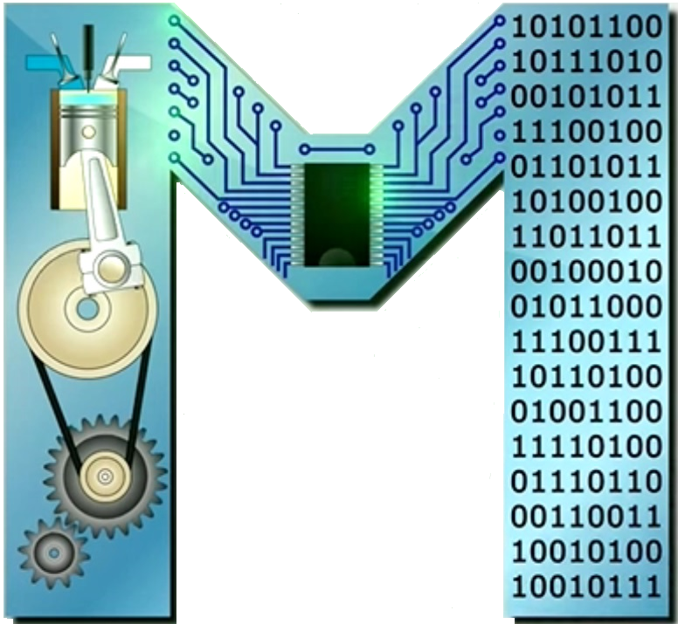
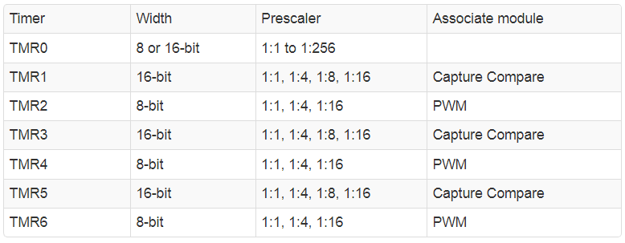
Timers
The PIC has ………. operate on the same principles as TMR0.
Timers TMR2, TMR4, TMR6 are ……….. They count-up from … to …… and then roll-over, and all have different …… …….
We learned that counting from 0 to 2¹⁶ took …… …… ms.
To generate longer delays, the PIC has a build-in mechanism to slow down the count rate of timer: …… …… …….

Slide 3
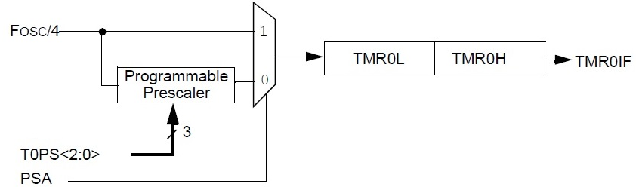
Prescaler
A prescaler is a piece of logic that sits between the bus clock and the timer clock.
The prescaler ………. ………. a prescribed number of bus clocks before issuing a ………. ………. to the timer.
clk
Prescaler
cnt
Counter
TMR0IF
F_{osc} /4 =
1:1

Slide 4
Prescaler
A prescaler is a piece of logic that sits between the bus clock and the timer clock.
To use the prescaler ………. ………. ………. ………. ………. the PSA bit in the T0CON must be ………. ………..
The value of the prescaler is contained inside the TMR0 Control register ………. … register in 3 bits: ………. ………. ………...
The following table describes the relationship btwn the prescaler bits & the prescaler applied to clk before it's sent to the counter.
See page 154 of the PIC18(L)F2X/4XK22 Data Sheet

Slide 5
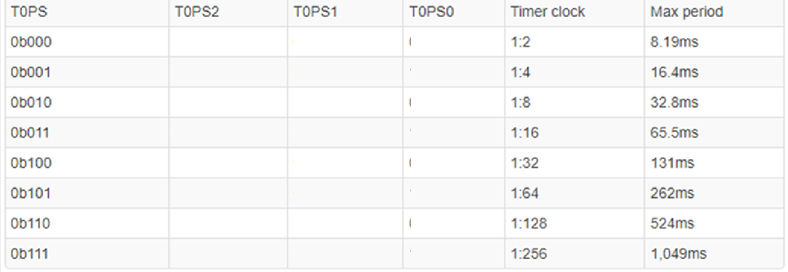
Prescaler
Here are different ways to assign the prescaler value to say ……….
T0CONbits.T0PS2 =……. …….;
T0CONbits.T0PS1 =……. …….;
T0CONbits.T0PS0 =……. …….;
T0CONbits.T0PS = ……. …….;
T0CON = ……. ……. ……..….;
See page 154 of the PIC18(L)F2X/4XK22 Data Sheet

Slide 6
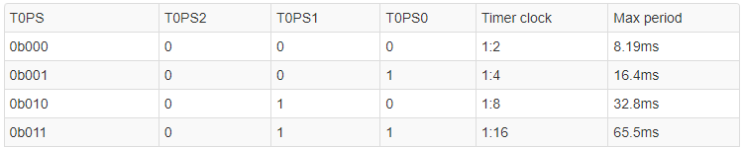
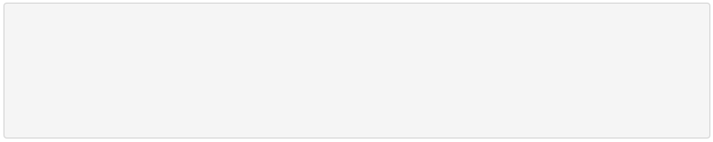
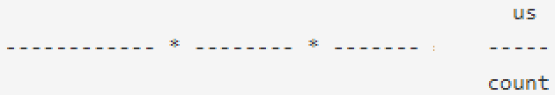
Prescaler
clk
Prescaler
cnt
Counter
TMR0IF
F_{osc} /4 =16MHz
:
the ratio ' : ' tells how many F_{osc}/4 clk cycles it takes to increment the timer.
Example: If you make the assignment T0CONbits.T0PS = 0b011,
How much time goes by (in us) per 1 count?
Solution: ………… timer will count up once every …… F_{osc}/4 cycles.

Slide 7
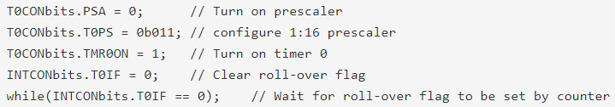
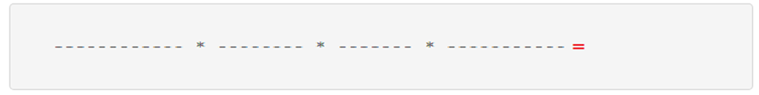
Time Ranges
clk
Prescaler
cnt
Counter
TMR0IF
F_{osc} /4 =16MHz
1:16
A prescaler affects the upper-bound of the timer.
Example: calculate how long in ms the while statement takes to execute; i.e how long it takes the counter to roll-over (if it started at 0).
Always verify that all the units, except those that you want, cancel.
The time required for the counter to go from 0 to 2¹⁶ - 1 and then back to 0 is called ……………………………………………………..

Slide 8
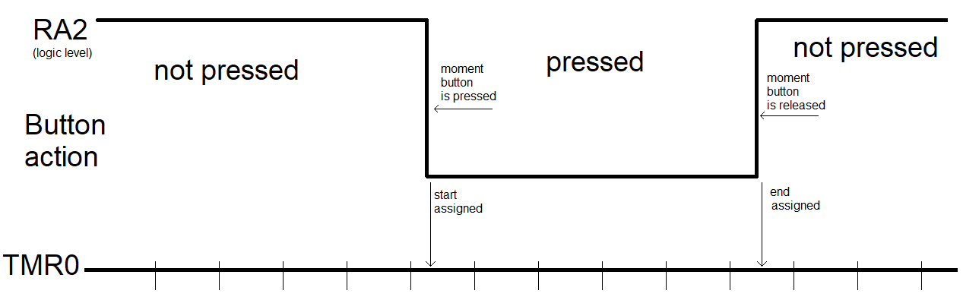
Time Ranges
Active low button (connected to RA2) is pressed for an unknown amount of time, but we know that it is < 200ms
Complete the code to measure the number of counts of the button press.
If the timer starts at 0, the button starts in the unpressed state, and we want to accommodate a 50 ms pulse .
We will employ the general rule that whenever you have a choice of prescalers, use the smallest to get the best timing resolution.

Slide 9
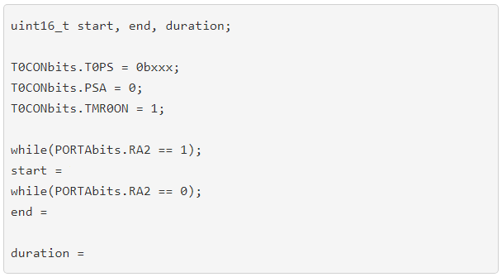
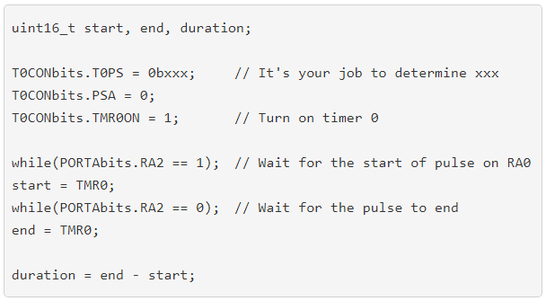
Time Ranges
We should select prescaler that can accommodate a 50 ms pulse. You could also select from 1:16 to 1:256 prescalers to measure the pulse.
We will choose ……… as it has a maximum period of ……… ms.
(See slide 5)

Slide 10
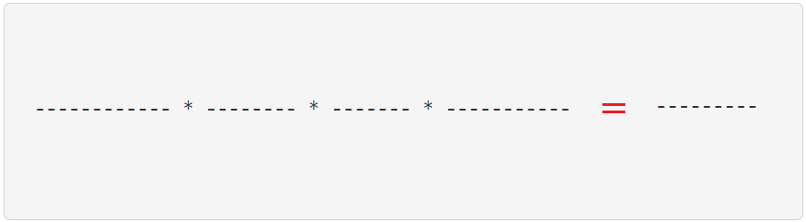
Examples
clk
Prescaler
cnt
Counter
TMR0IF
F_{osc} /4 =16MHz
1:16
How many 1:16 prescaled TMR0 counts go by during 50 ms?
How many times would TMR0 rollover in 100s w/ a 1:128 PS?

Slide 11
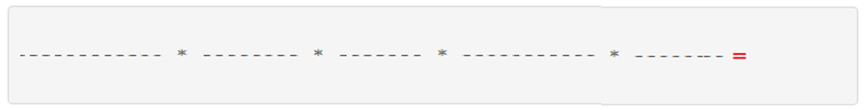
Examples
clk
Prescaler
cnt
Counter
TMR0IF
F_{osc} /4 =16MHz
1:4
Start at 0, what value stored in TMR0 after 450ms runs w/ 1:4 PS?
TMR0 rolls over as it requires 16.4ms to roll over.
The 1st step is to compute how many times TMR0 rolls over.
(See slide 5)

