Slide 1


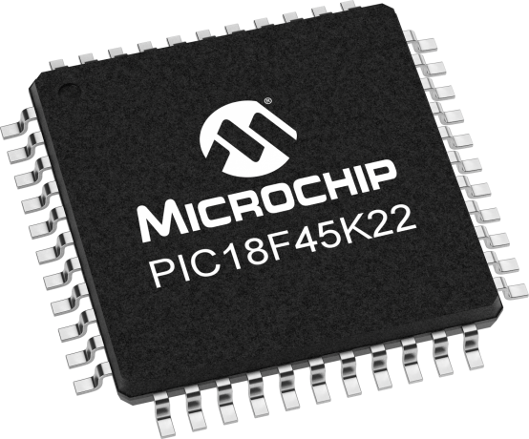
Lecture 11: Interrupts
This is one of the important topics in the course
Objective:
Understand the pieces of code that are required to construct an interrupt.

Slide 2

Hardware Subsystems
Units (inside PIC) not directly related to fetch/execute instruc(s).
e.g. timers and capture/compare/PWM modules. Each has an interrupt flag.
Our programs wait until a flag has been set by H/W to indicate that the subsystem completed some task.
We use interrupt flags to call a special function, ISR.
ISR: it is a function called by H/W. Like any function in your code; e.g. the function that you wrote for ms_delay or us_delay, except that your functions are called by your program.

Slide 3
ISR
ISR is just a special FUNCTION
All the H/W subsystems in the PIC have the ability to call an ISR.
The subsystem is configured so that its IF becomes the signal to stop running main and start running the ISR.
This is done by setting the interrupt enable bit associated with the H/W subsystem.
The H/W (not your program) calls an ISR, your program does not know when ISR will be called, & can’t pass parameters to ISR.
Interrupts represent a powerful capabilities of a MCU.
See p. 107 for more H/W subsystems inside PIC that can generate interrupts.

Slide 4
ISR
H/W sets flag which caused the interrupt; which calls the ISR.
ISRs must clear the flag.
ISRs communicate to main via global variables.
ISRs have no arguments (inputs) or return values.
ISRs use static variables to share values between invocations (calls).
Keep ISR simple and fast. Never put for(;;) inside of an ISR.

Slide 5
ISR
Don’t wait for flags inside ISR.
Don’t use printf inside ISR*.
Be careful calling functions inside ISR.
Delay loops inside ISR are wrong (unless you know what you are doing).

Slide 6
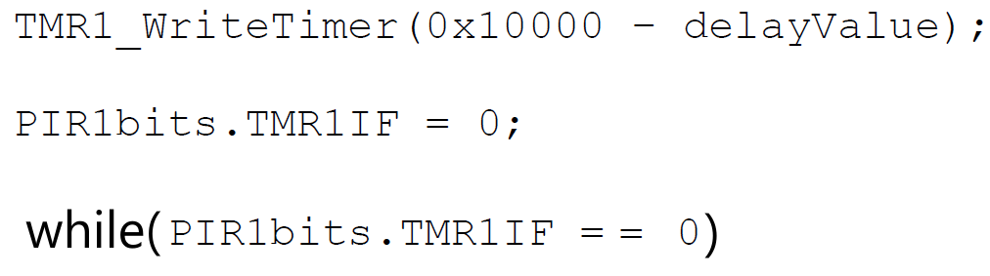
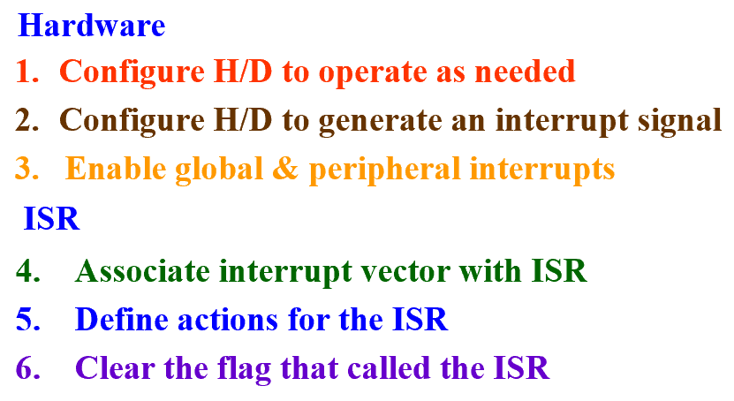
Write an ISR to play a note
Lab03
Lab04

Slide 7
Using Interrupts in Programs
You need 6 components in your program.
Hardware
ISR
  Configure H/D to operate as needed
  Configure H/D to generate an interrupt signal
  Enable global & peripheral interrupts
  Associate interrupt vector with ISR
  Define actions for the ISR
  Clear the flag that called the ISR

Slide 8
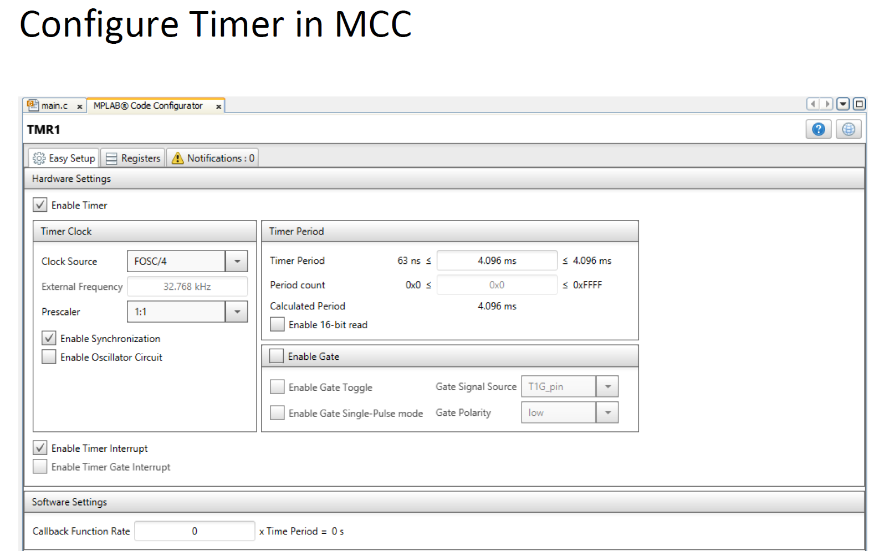
1
2
MPLAB Code Configurator

Slide 9
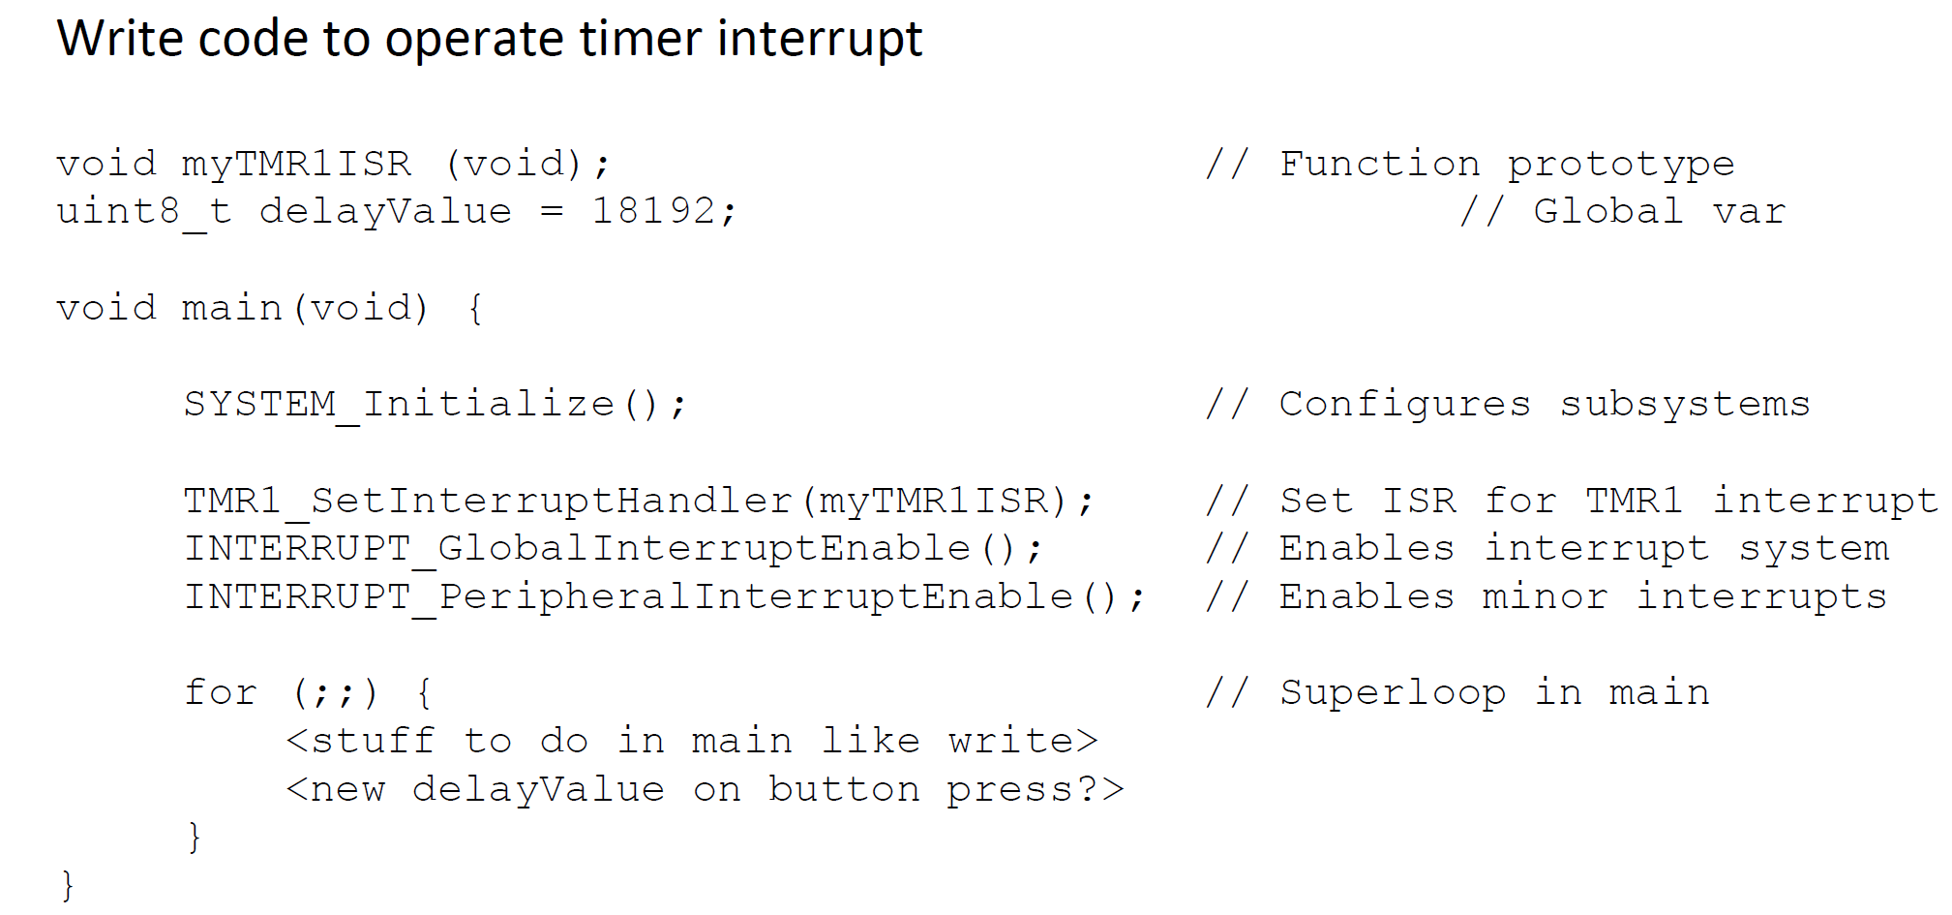
Using Interrupts in Programs
3

Slide 10
Using Interrupts in Programs
4

Slide 11
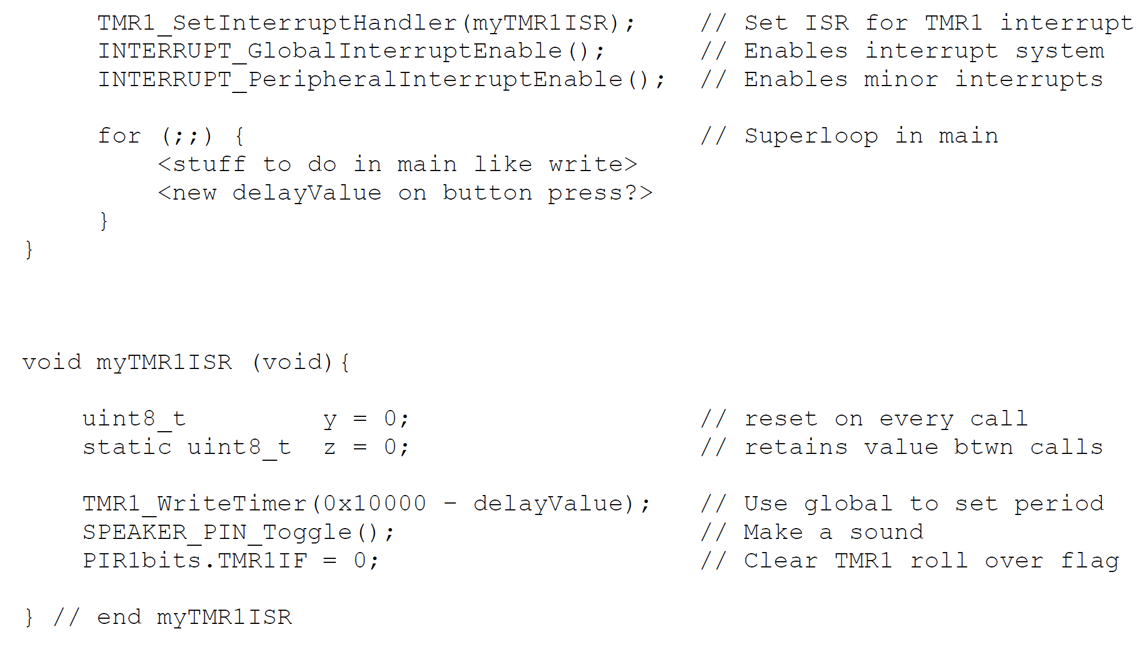
Using Interrupts in Programs
4
3
5

Slide 12
Using Interrupts in Programs
4
3
5
6

Slide 13
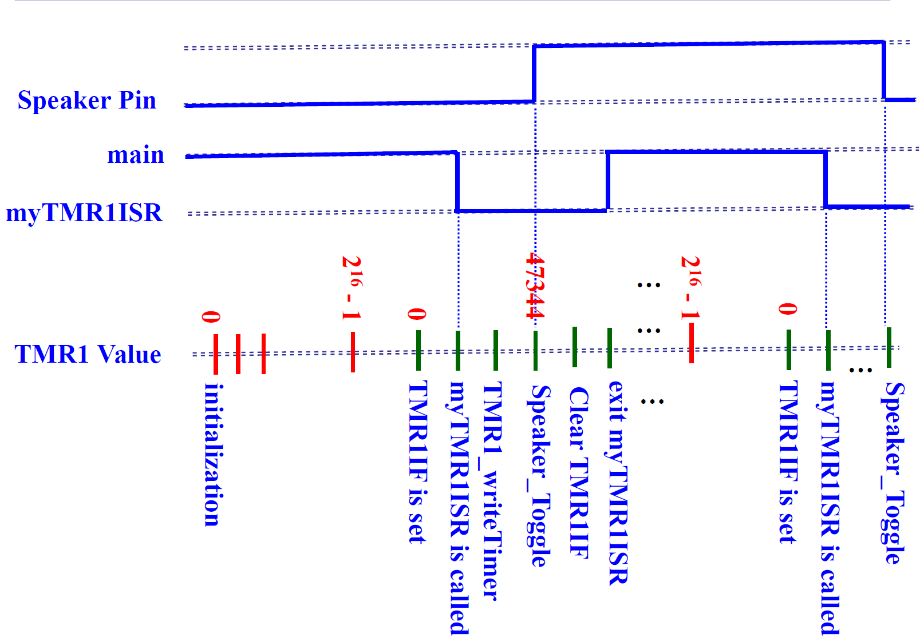
Executing our program

Slide 14
Example Program Design
Hardware
Set up timer 0 w/ 1:1 prescaler (default), & initial value of A739.
Clear the IF (in case it has already been set).
Setting the TMR0IE bit enables timer 0 subsystem to generate an interrupt signal every time the TMR0IF flag is set (rolls-over) *.
Enable Global Interrupts. Setting the GIE bit-field of the INTCON register enable the interrupt feature of the PIC controller.
* According to INTCON register definition (p. 109),

Slide 15
Using Interrupts in Programs
You need 6 components in your program.
Hardware
ISR
  Configure H/D to operate as needed
  Configure H/D to generate an interrupt signal
  Enable global & peripheral interrupts
  Associate interrupt vector with ISR
  Define actions for the ISR
  Clear the flag that called the ISR

Slide 16
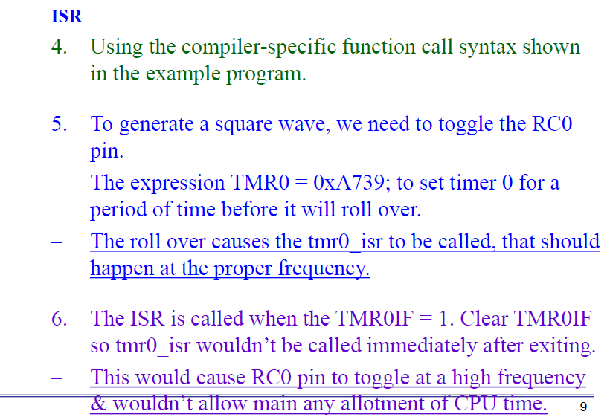
Example Program Design

Slide 17
Example Program Design
Set up timer 0 w/ 1:1 prescaler (default), & initial value of A739.
- Clear the IF in case it has already been set.
Setting the TMR0IE bit enables timer 0 subsystem to generate an interrupt signal every time the TMR0IF flag is set (rolls-over).
Enable global interrupts. Setting the GIE bit-field of the INTCON register enable the interrupt feature of the PIC controller.
  Using the compiler-specific function call syntax shown in the example program.
  To generate a square wave, we need to toggle the RC0 pin.
  - The expression TMR0 = 0xA739; to set timer 0 for a period of time before it will roll over.
  The ISR is called when the TMR0IF = 1. Clear TMR0IF so tmr0_isr wouldn’t be called immediately after exiting.

Slide 18
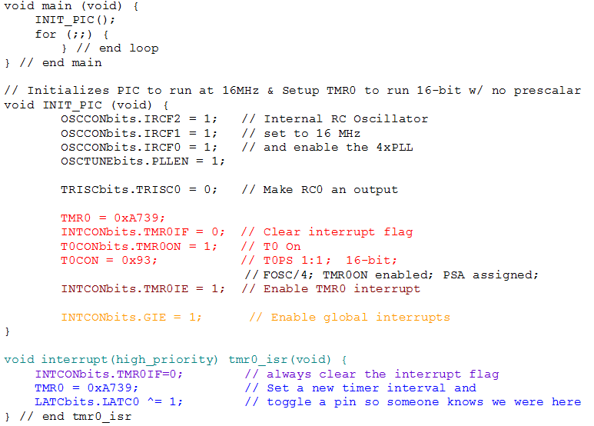
Example Program Design
We verify the prescaler & the starting value for timer 0 are correct in next slide.

Slide 19
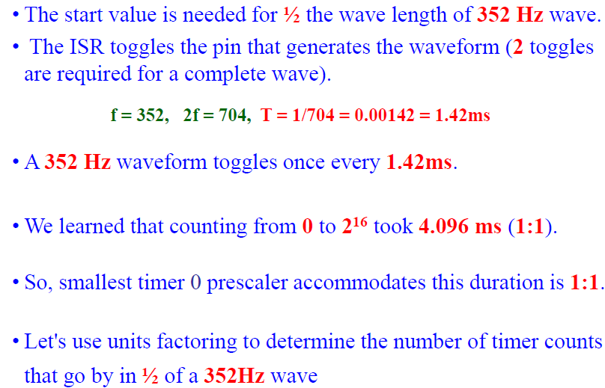
Example Program Design

Slide 20
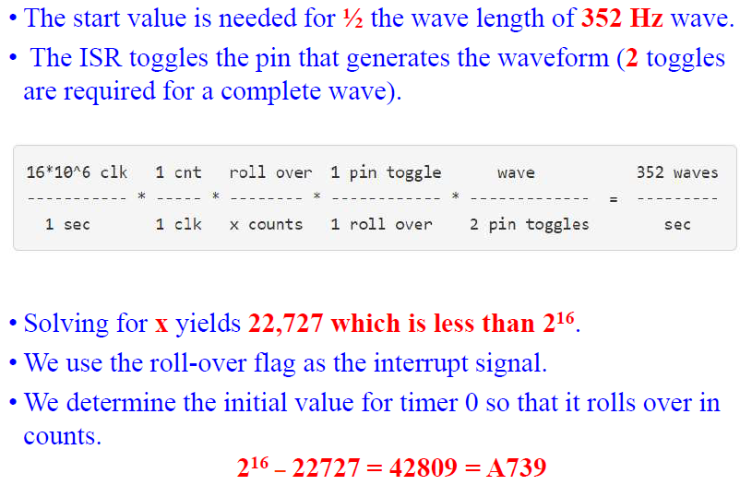
Example Program Design

