Slide 1



Lecture 12: Interrupts
Objective:
Understand the pieces of code that are required to construct an interrupt.

Slide 2

ISR guidelines
The code inside an ISR should be simple.
Never put an infinite loop inside ISR - never get back to main.
Never put a delay that waits for user input inside an ISR.
e.g. while (BUTTON == 0);
Communication btwn ISR & main requires use of global variables.
If ISR needs to retain a value between invocations, use a static variable to be declared inside an ISR.
e.g. static int8 isrCounts = 0;

Slide 3
ISR guidelines
static int8 isrCounts = 0;
Static means that the variable should retain between ISR invocations.
The assignment to 0 only applies to the first call to the ISR
On every subsequent invocation of the ISR, this assignment is ignored and the value from the previous invocation used.
Up to two ISR's can be activated on the PIC at any given time.
Avoid calling function from within an ISR.
Absolute chaos is a best case scenario.

Slide 4
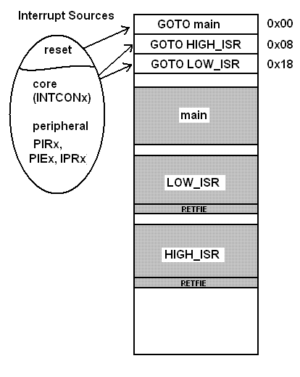
Types of ISRs
There are 3 types of ISRs, main, HIGH_ISR, and LOW_ISR.
When a reset event occurs, the MCU executes the "program" at address 0, which is pointing to main.
When one of the other interrupts occurs, the MCU will execute either the program at address 0x08 or 0x18 depending on how the interrupt priority was configured.
An ISR return from the interrupt using the RETFIE.
It is automatically included in the code in interrupt function.

