Slide 1



Lecture 13: Timer Compare
Objective:
Understand how to generate waveforms using the compare subsystem.
The configuration of the subsystem and associated timers.

Slide 2
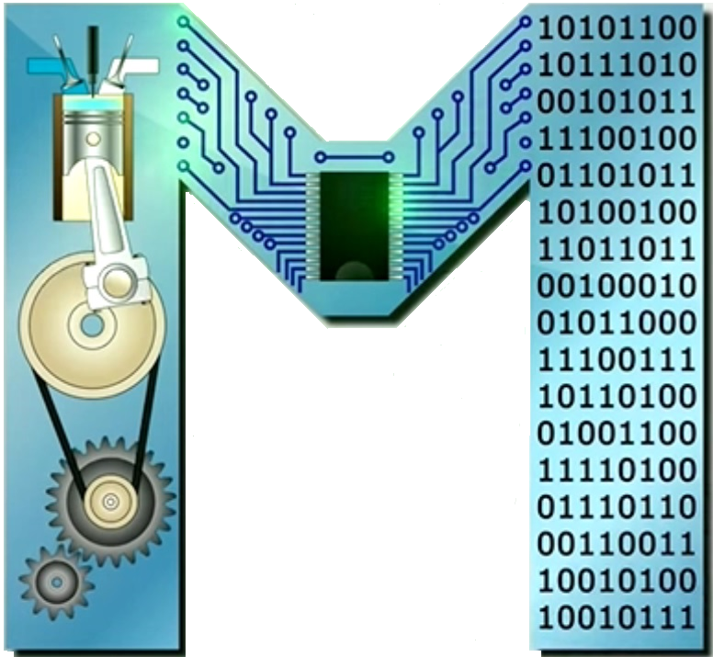
Timer Compare
In our analysis of the timer subsystem we have used prescalers to convert between time and timer counts.
We measured the time interval of a logic pulse on a pin.
Here we focus on generating pulses with specific durations on output pins using a new piece of hardware: the compare module.
The PIC has 5 identical compare modules.
The technical documents use a lower-case "x" as a stand in for the (timer or compare) module number.

Slide 3
Compare Module
In a PIC microcontroller, the "Compare Module" refers to a peripheral that continuously compares the value of a timer counter with a pre-set value, triggering an event (like setting a pin high or generating an interrupt) when the values match, essentially allowing precise timing control for various applications like pulse width modulation (PWM) or generating specific pulse durations.
Function: it constantly monitors the timer counter and compares it to a value stored in a dedicated "Compare Register".
Applications: used for tasks like generating accurate timing pulses, controlling servo motors, creating PWM signals, measuring pulse widths, and triggering events at specific time intervals.

Slide 4
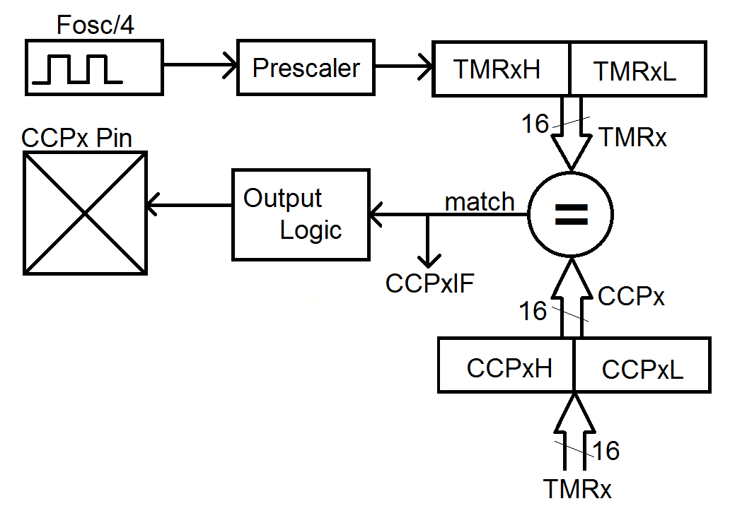
Compare subsystem
The digital architecture of the compare modules are built around:
  a 16-bit timer (TMRx), - a 16-bit capture/compare reg. (CCPx),
  a 16-bit comparator (=), - a I/O pin (CCPx Pin).
When the value in the timer = the value in the CC register, the match signal is set.
So, the CCPxIF bit is set and sends a signal to the output logic box which determines the value on the CCPx pin.

Slide 5
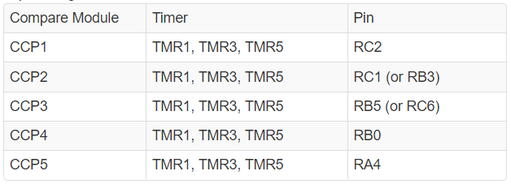
Compare Mudules Configuration
Compare Module may only work with a specific pin (the table).
Modules CCP2 & CCP3 can be configured to use 1 of 2 pins:
MCC: Project Resources tab → System Module →
Registers → CONFIG3H → CCP2MX or CCP3MX
Each of the 5 compare modules can work with any of the timers.
Remember to turn-on the timer before you work w/ CCP module.

Slide 6
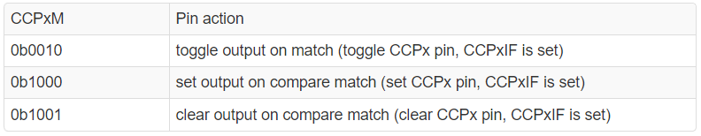
Compare Operation
The I/O pin associated with the compare module performs some action when the timer matches the compare register.
The action is dictated by the CCPxM field of the CCPxCON register according to the following table.
We can use the compare module to generate waveforms.

Slide 7
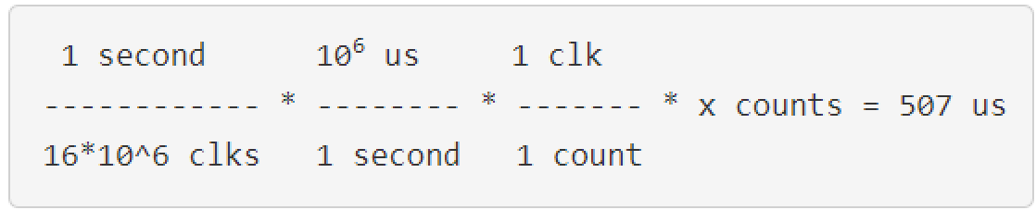
Compare Operation
e.g. to generate a 50% duty-cycle waveform w/ a period of 1014us (987 Hz) and half-period of 507 us (two toggles per square wave period).
From the PS table, we can use a 1:1 PS (8.19 ms max period).
Let’s use dimensional analysis to find # of counts goes by in 8.19 ms.
Solving for x yields 8,112 counts.

Slide 8
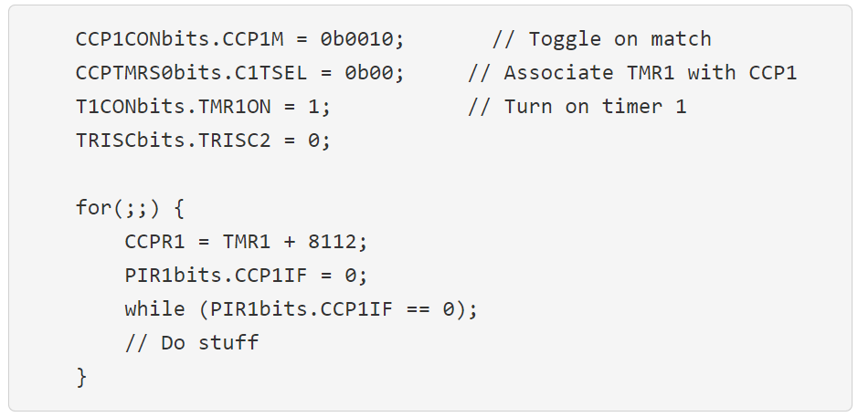
Compare Operation
OPEN PIC DATASHEET
C1TSEL<1:0>: CCP1 Timer Selection bits (pp. 201)
00 = CCP1 – Capture/Compare modes use Timer1, PWM modes use Timer2
PIR1bits.CCPIF (pp. 214) – and then it takes you to page 112
PIR = Peripheral Interrupt Request

Slide 9
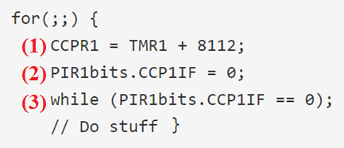
Compare Operation
We calculated that 8,112 counts at a 1:1 prescaler is 507 us
(1) CCPR1 reg. is set 8112 counts ahead to current TMR count.
(2) The CCP1IF flag is cleared before entering the while-loop
(3) while(PIR1bits.CCP1IF == 0); waits for TMR1 to catch up with the value in CCPR1.
it takes 507 us for TMR1 to equal CCPR1. When this happens, the CCPR1 bit of the PIR1 register will be set causing the while-loop to exit.
PIR = Peripheral Interrupt Request

Slide 10
PWM Waveform
PWM are square waves with a constant period that are composed of a time high and time low that can change.
The ratio of the time high to the period, expressed as a percentage, is called the duty cycle.
The average value (measured in volts) of a PWM waveform is the duty cycle multiplied by the amplitude (in volts).
The waveform has a constant period, but the duty cycle increases from left to right.

Slide 11
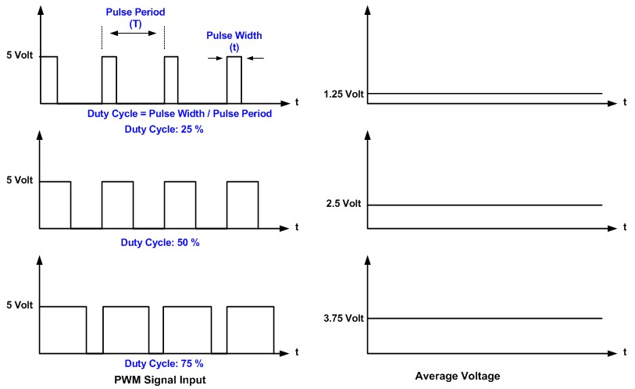
PWM Timing Diagram

Slide 12
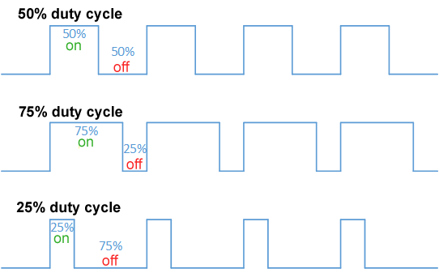

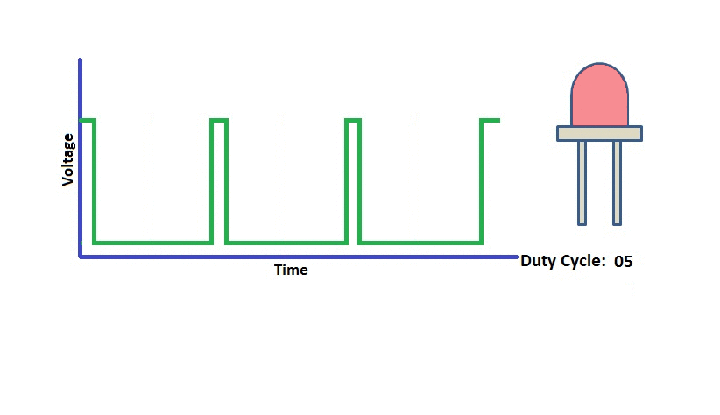
Aside: Duty cycle

Slide 13
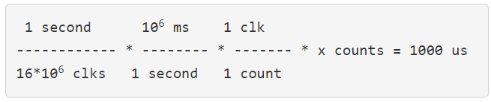
Ex: generating a PWM waveform
Write a code to generate a square wave on RC2 w/ a period of 1000 us.
The duty cycle of the waveform should increase by 10% every time an active low push button attached to RA2 is pressed.
The duty cycle should increase up to 100% when the next button press will reset the duty cycle back to 0%.
We find the PS & TMR counts that to generate a 1000 us delay.
In order to change the duty cycle by 10%, or 10 us, will require adding 1600 counts to the time the waveform is at logic 1.
Solving for x yields 16,000 counts

Slide 14
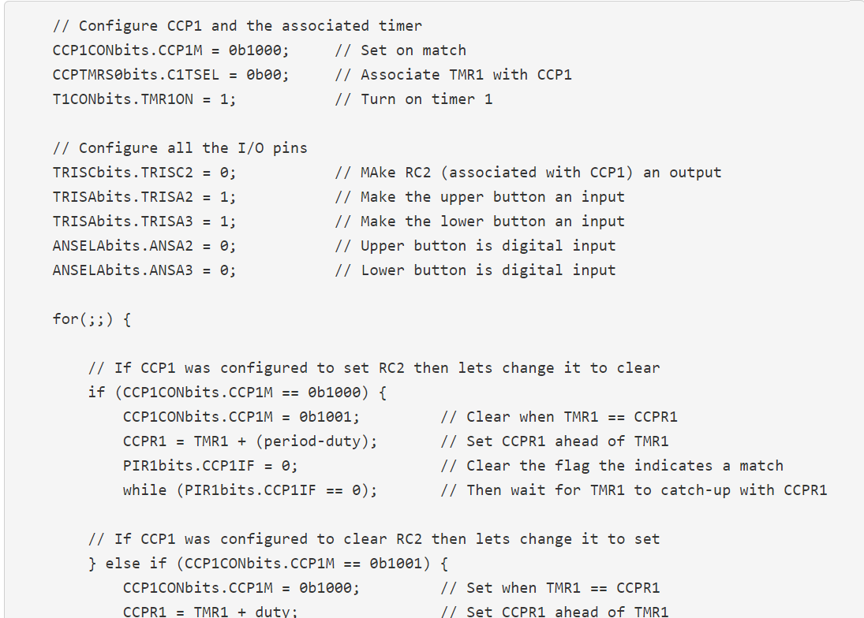
Ex: generating a PWM waveform

Slide 15
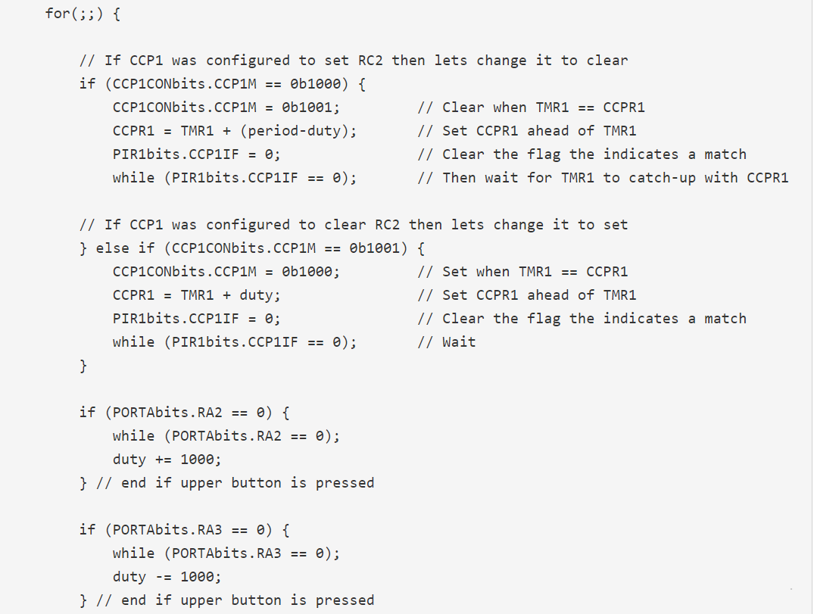
Ex: generating a PWM waveform

