Slide 1



Lecture 14: Timer Compare
Objective:
Last Lecture:
Understand how to generate waveforms using compare subsystem.
Configuration of the subsystem and associated timers.
Today:
How to measure time interval of pin events using the capture subsystem.
Configuration of the subsystem and associated timers.
Configuration of the PWM subsystem to generate PWM waveforms with an arbitrary period and duty cycle.

Slide 2
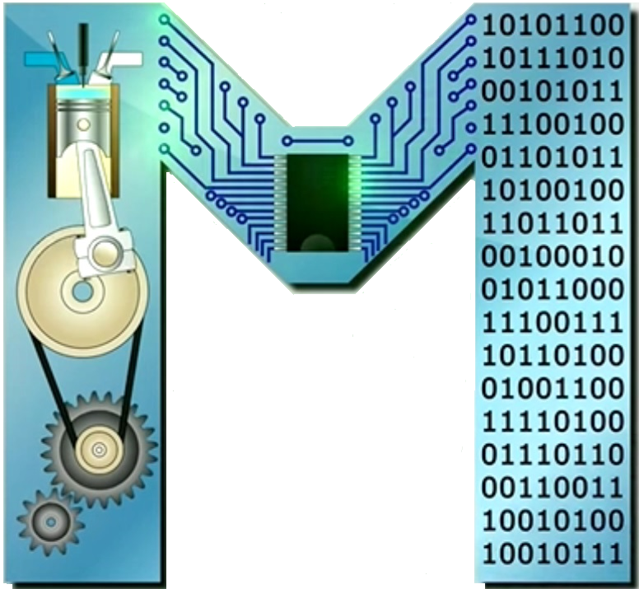
Timer Compare
We have examined 2 components of the TMR subsystem: the 16-bit counter and compare modules.
The compare module looks for a match between TMRx and a value stored in CCPx.
Let’s introduce a TMR capability that allows capturing the TMR when a prescribed event occurs on the associated pin.
This capture feature is represented in the figure below.

Slide 3
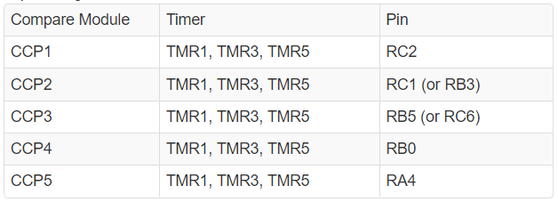
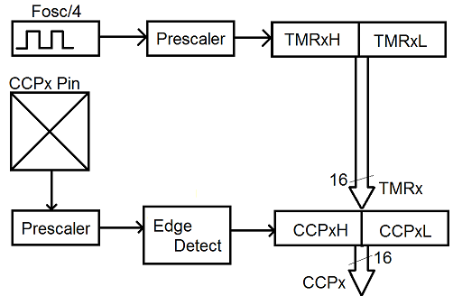
Compare Subsystem
Each capture / compare module is associated with a single pin.
The pin should be configured as input.
The capture subsystem captures the value of TMRx when some prescribed event occurs on the associated pin.
Figure 14-1, page 174

Slide 4
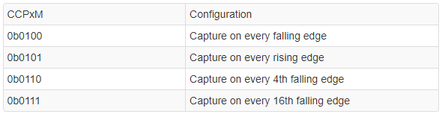
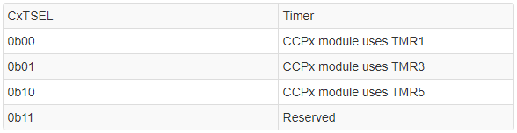
Compare/Capture Subsystem
In order to configure the capture function, we need to configure the Mode Select bits in the CCPx control register *.
The assignment of TMRx to CC channel CCPx is accomplished w/ the CCP timer selection control register 0: CCPTMRS0 **
* and ** pages 200 and 201 of the PIC18(L)F2X/4XK22 Data Sheet

Slide 5
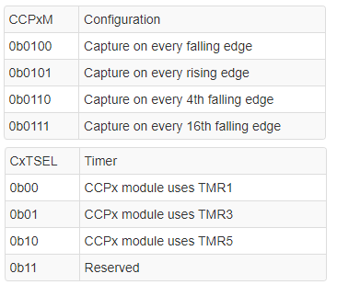
Compare/Capture Subsystem
Here is an example of using CCP1 module.
If you set: CCP1M = 0b0100;
        C1TSEL= 0b00;
then the every falling edge (transition from logic 1 to logic 0) will cause the current TMR1 value to be stored in CCP1.
CCP1 ⬅ TMR1

Slide 6
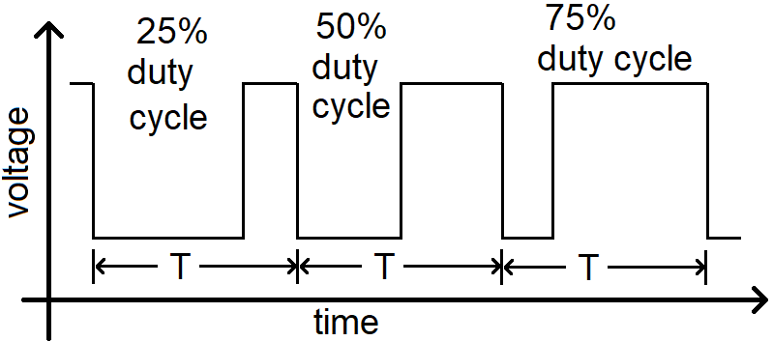
PWM Waveforms
PWM are square waves with a constant period that are composed of a time high and time low that can change.
The ratio of the time high to the period, expressed as a percentage, is called the duty cycle.
The average value (measured in volts) of a PWM waveform is the duty cycle multiplied by the amplitude (in volts).

Slide 7
PWM Waveforms
PWM waveforms are useful to send analog control signals to devices that accept digital inputs.
e.g., drive LED w/ PWM waveform, adjust the illumination level by increasing/decreasing the duty cycle.
The change in the illumination level is typically controlled w/ an analog control signal. Instead, it is delivered as a rapid sequence of digital (0 and 1) signals sent to the LED.
The frequency of the PWM waveform must be higher than the lowest frequency an eye can detect the on/off flicker of an LED.
This is typically around 100Hz, a frequency easily obtainable by most microcontrollers.

Slide 8
PWM Subsystem: HW
The 5 CCP subsystems can be configured in a CC or PWM mode.
The PWM mode is driven by TMR2 or 4 or 6 (8-bit counter).
As opposed to the 16-bit counter used in TMR0, 1, 3 and TMR5.
The PWM subsystem relies on 2 other registers to build the PWM waveform, the PRx and CCPx registers.
The PWM waveform period is determined by how long it takes TMRx to count from 0 to that value contained in the PRx register.
When the TMRx = PRx, TMRx is reset to 0 and starts again counting up towards the value in PRx.
PRx = Period register

Slide 9
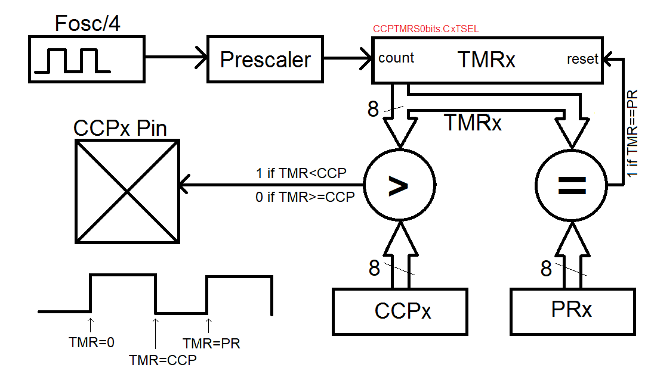
PWM Subsystem: HW
While TMRx < CCPx register, the output of the associated pin = 1. When the TMRx ≥ CCPx, the pin output = logic 0.
CCP timer selection control register 0: CCPTMRS0
when TMRx equals PRx, a reset signal is sent to TMRx resetting it back to zero.

Slide 10
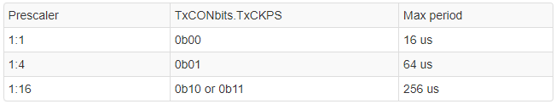
PWM Period
It is determine by the counting frequency of the TMRx and the value contained in PRx.
The PWM module only accepts 8-bit TMR2, TMR4 or TMR6 as a source (they have 1:1, 1:4 and 1:16 ps).
The TxCKPS bits of the TMRxCON register determine which ps is used according to the following assignment:
To get max period

Slide 11
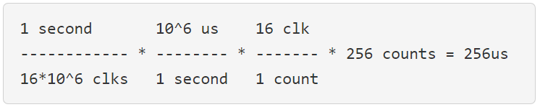
PWM Period
The maximum period of the PWM waveform would be when PRx equals 255. Since the timers start counting at 0, this makes 256 counts.
Example:
for the case above, determine the maximum period of the PWM waveform
As shown in the figure above, when TMRx = PRx, a reset signal is sent to TMRx resetting it back to zero.
So, in order to create a maximum PWM period, PRx should be set to 255.
You should use the units factoring calculation above to determine the PRx value for other PWM period.

Slide 12
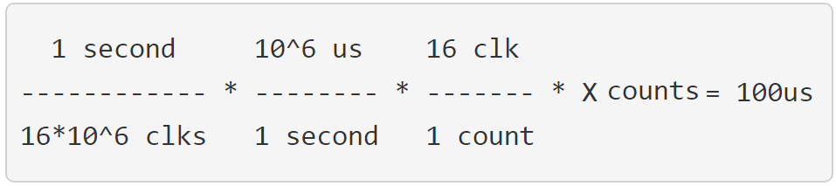

PWM Period
Example: what prescaler and PRx value should you use to create a PWM period of if you wanted a PWM period of 100 us?
Answer: we always default to use smallest ps that achieves the needed period. For 100 us, the table above shows that we need a 1:16 prescaler.
So, in order to create a PWM period of 100 us, PRx should be set to 100.

Slide 13
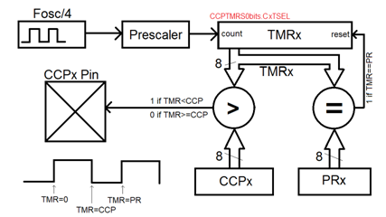
PWM
The TMRx associated with a PWM module counts up from 0 to PRx.
The logic level of the PWM wave is determined by comparing the TMRx value against CCPx.
When TMRx < CCPx, the associated pin = logic 1.
When TMRx is ≥ CCPx, the associated pin = logic 0.

Slide 14
Simple Example
PR4 = 10; PWM Period
CCP2 = 5; 50% Duty cycle
Output
0 1 2 3 4 5 6 7 8 9 10
* More about PRx register pages 167 to xxxx of the PIC18(L)F2X/4XK22 Data Sheet

Slide 15
Simple Example
PR4 = 10; PWM Period
CCP2 = 2; 20% Duty cycle
Output
0 1 2 3 4 5 6 7 8 9 10

Slide 16
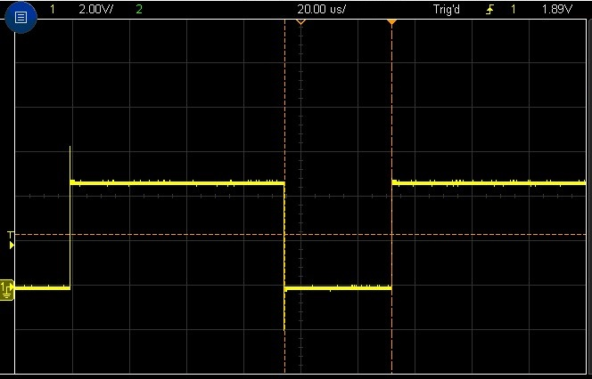
Test Your understanding
If you are to use TMR4, determine the values of the following registers to generate the PWM waveform on RC1 as shown.
T4CONbits.T4CKPS PR4 CCP2
To output on RC1, we use CCP2.
The period of the waveform
5.5 * 20us = 110us
From the max period table for TMRs, we need
1:16 prescaler.
The duty cycle (logic 1) = 3.6 div * (20us/div) = 72 us

Slide 17


Test Your understanding
The period 5.5 * 20us = 110us, w/ 1:16 prescaler, 72 us duty cycle.
To configure the prescaler for TMR4, look up the bit-fields of the T4CON register (Data Sheet, page 171). T4CKPS = 0b10
Dimensional analysis to find the values in PR4 & CCP2 registers.
Now, let's get the look at the duty cycle register, CCP2.
TMR4bits.T4CKPS = 0b10 PR4 = 110; CCP2 = 72;

Slide 18
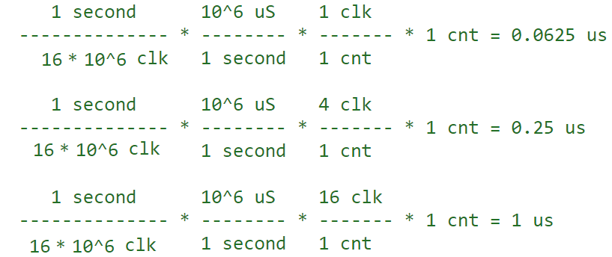
Test Your understanding
What is the resolution of the duty cycle?
i.e., if you increment the CCPx register by 1, how much does this add to the duration of the logic 1 pulse in a single period?
State your solution in us, perform the calculation for each of the three prescalers and show your work (units factoring) for full credit.

