Slide 1


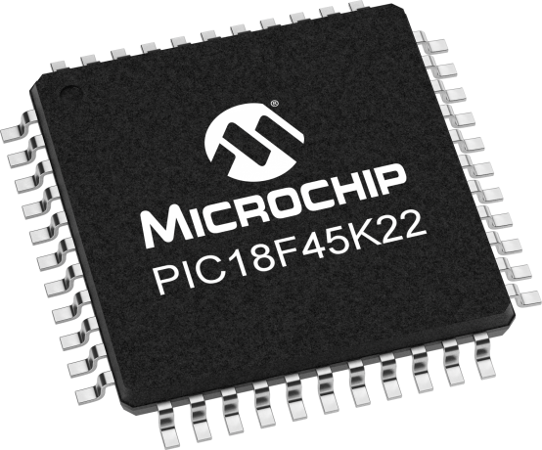
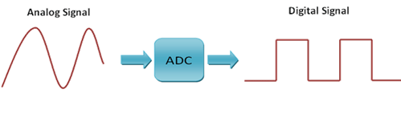
Lecture 16 (19 online):
Analog to Digital Conversion
Objective:
To provide a working understanding of an ADC including: converter resolution, voltage references, & quantization error.

Slide 2
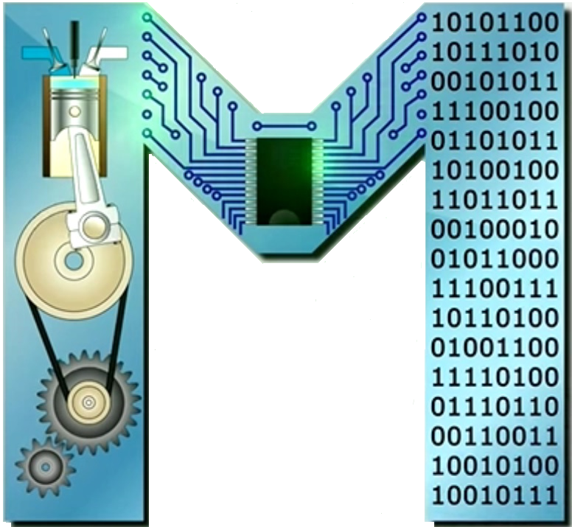
Analog to Digital Converter: ADC
The PIC has an ADC subsystem takes an analog input between …….. and converts this voltage into number between … and ….
The conversion from voltage to number is ratiometric, meaning that the output is directly proportional to the input.
Ratiometric
The ratio of the input voltage to …….. is the same as the ratio of the converted value to ……...
We define …….. as …….., the half step allows the transition from converted value to another to occur at the half-way point.

Slide 3
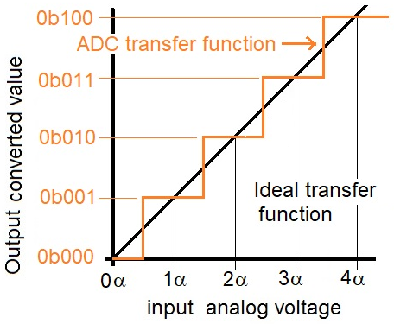
Analog to Digital Converter: ADC
e.g. the 1st half step allows the transition from …….. to …….. to occur at the half-way point between …. & …..
every analog input voltage would have its own unique …….. …….. …….. …….. on the output.
Let's apply the definition of ratiometric in some examples

Slide 4
PIC ADC
Example: if the PIC ADC input is at 1v input, what is the converted value?
Answer:
Example: your program reads a converted value of 842 in the PIC's ADC subsystem. What analog voltage is present on the input?
Answer:

Slide 5
ADC Resolution
It is the number of bits produced in the converted value.
A count is a one unit change in the converted value. So a …….. ADC has …….. counts in its full range.
Changing the resolution, changes the scale on the vertical axis of the ratiometric graph.
To determine converted values, change the "2¹⁰" above with "2^{N}", where N is the resolution
Notes:
The ADC resolution is defined as the smallest incremental voltage that can be recognized and thus causes a change in the digital output.

Slide 6
ADC Resolution
Example: how many bits does the PIC use to represent the converted value?
Answer:
Example: using an ADC w/ 12-bit resolution and a 3.3v reference that has an analog input of 1v, what is the converted value?
Answer:

Slide 7
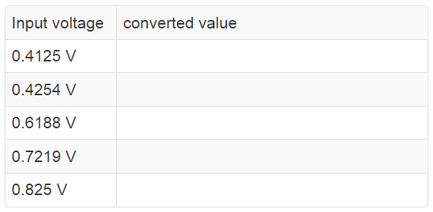
ADC Resolution
Example: a program reads a converted value of 842 on 14-bit ADC using a 3.3v reference. What analog voltage is present on the input?
Answer:
Example: using an ADC w/ 3-bit resolutions, a 3.3 V & 0 V input voltage range, what is the converted value for the following inputs?

Slide 8
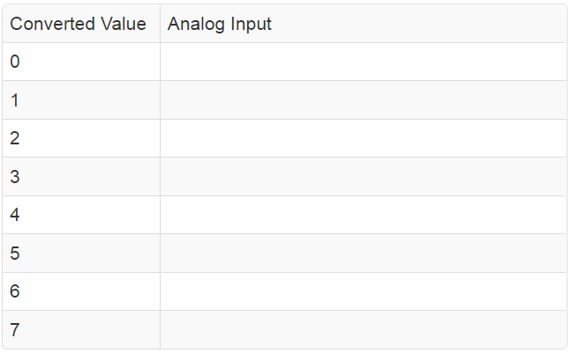
ADC Resolution
Example: using ADC w/ a 3-bit resolutions, a 3.3 V & 0 V voltage reference, what analog input is associated with each of the following converted values?

Slide 9
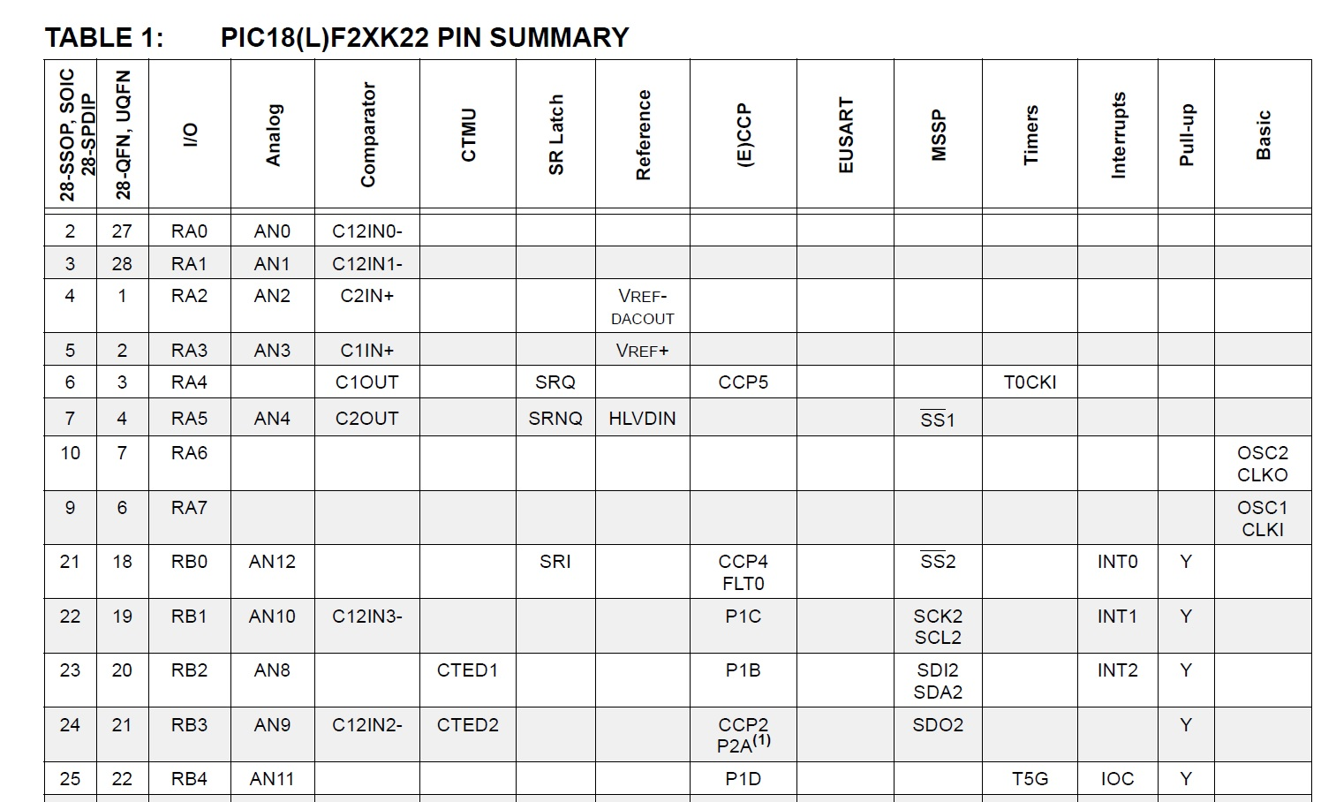
I/O pins
Open Datasheet
Table 2 in PIC18F26K22 Data Sheet: find specific I/O pin in the leftmost column and then go across the row to the find functions.

Slide 10
Voltage references
The min & max voltage for an ADC are called the reference potentials.
You can configure the PIC to use two pins V_{ref}- (……) and V_{ref}+ (……) as the A/D reference potentials.
On the dev. board, these pins are connected to 10kΩ resistors to 3.3v through the two push buttons.
If you did not press the push buttons, you could tie these two pins to other voltages to change the reference potentials on the PIC.
You could do this to decrease the quantization error.

Slide 11
Examples
The PIC has 0v & 3.3v reference potentials, determine the converted value for 2.2V.
Set V_{ref}- = 1v and V_{ref}+ to 3v, determine the converted value for 2.2V.
You are working with a 12-bit ADC with 1V and 3V reference potentials, determine the converted value for 1.8V.

Slide 12
Quantization
Quantization: The process of converting an analog voltage to a digital value.
Quantization error is the amount of rounding error, typically ½ of the least significant bit, or ½ count.
It is the worst case difference between an input voltage and the converted value's corresponding analog input voltage.
The error is how far off can the converted value be in representing the actual analog input.

Slide 13
Quantization Error
Example: using an ADC with a 3-bit resolution w/ 3.3V & 0V reference voltages, apply an input of 0.4254 V.
In a previous example (slide 7) we saw that a 0.4254 V input has a converted value of ……… which is rounded to ……….
……….. when represented corresponds to ………..
……….. when represented corresponds to ………..
The difference is
Quantization Error =
The worst-case quantization error = the maximum rounding error in the converted value for an input voltage.

Slide 14
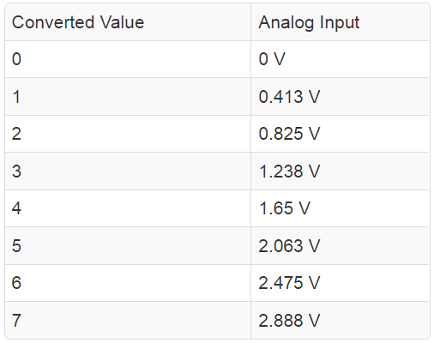
Quantization Error
Let's plot the data we previously created for ADC w/ 3-bit resolutions, 3.3V & 0V input voltage range, what analog input is associated with each of the following converted values?
We found the answer to be:
Next slide figure plots this data as red dots on a graph with the analog input voltage on the horizontal axis and the converted value on the vertical axis.

Slide 15
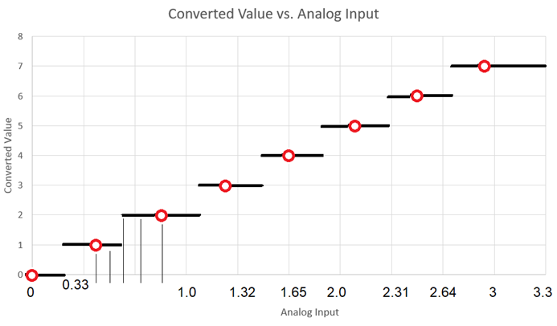
Quantization Error
The black lines represent the converted values rounded to the nearest integer.
The analog input and converted values from a previous question are annotated on the graph.

Slide 16
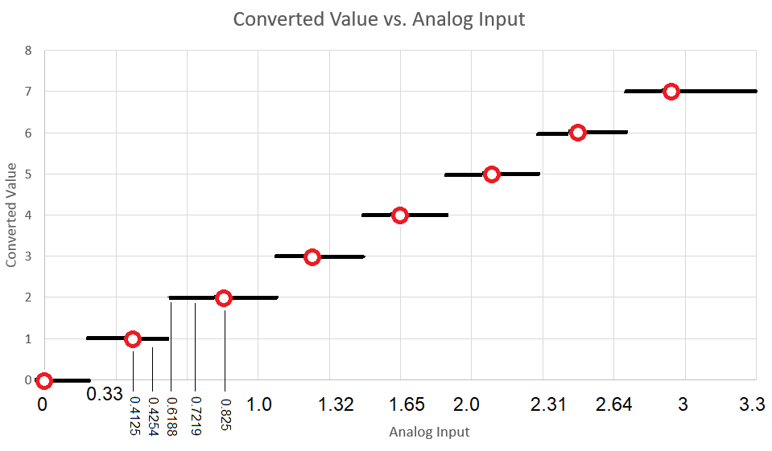
Quantization Error
The max rounding error occurs when the converted value jumps to a new value; e.g. ……. generates a fractional converted value of ……. rounded to ……..
The converted value misrepresents the true converted value by ……….. "bits".

Slide 17
Quantization Error
Since QE is represented in terms of the input voltage, let's ask how much input voltage corresponds to half a bit using our familiar ratiometric equation.

