Slide 1


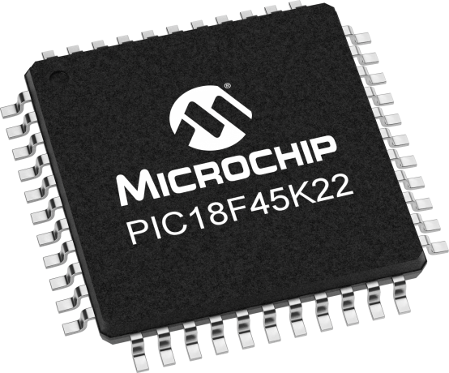
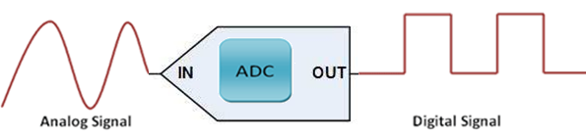
Lecture 20: PIC ADC interface
input
Converted value
Sampling rate, Not F_{OSC}/4
Objectives:
cover the particular attributes of the PIC ADC interface
writing a code to acquire digitized data.

Slide 2

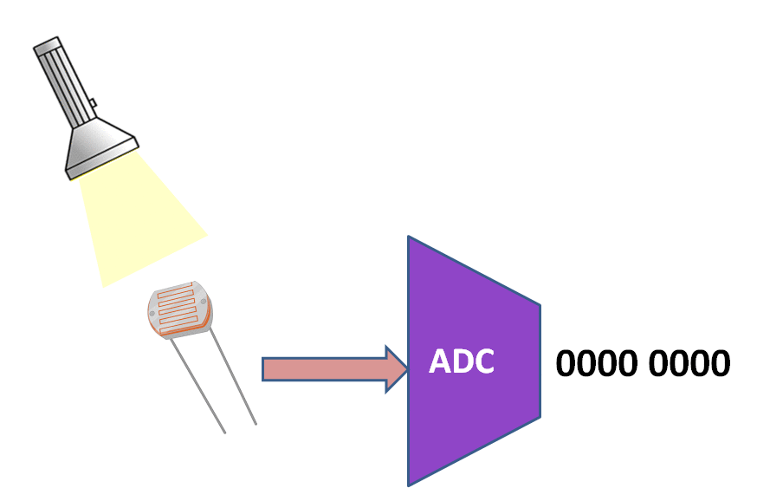
PIC ADC Subsystem: ADCS
Notes:
On this processor, the register that holds the conversion result is 16 bits wide.
A right-justified result means that bits [(N-1):0] (where N is the number of bits of precision) of the register contain the ADC value and the most-significant bits of the register are set to zero.
A left-justified result means that bits [15:(16-N)] of the register hold the result, and bits [(15-N):0] are set to zero.
For example, if your actual conversion result is 0x123, it would be read as 0x0123 if the register was right-justified, and as 0x1230 if it was left-justified.
An advantage of left-justified results (on processors that support it) is that you can take just the most-significant byte of the register, giving you 8-bits of precision instead of the native precision. This can be useful if you don't need the extra precision, or have RAM constraints and want to store a large number of samples.
On the other hand, a right-justified value can be used directly without the scaling that a left-justified value would need.
https://engineering.stackexchange.com/questions/3959/what-are-left-justified-and-right-justified-adc-results

Slide 3
PIC ADC Subsystem: ADCS
To use the ADCS, you feed analog signals into one of the ANx pins.
The successive approximation register (SAR) inside the ADCS performs the actual conversion (analog value → converted value).
PIC has a 10-bit SAR w/ analog mux on the front-end of the SAR to select one of the analog signal to quantize the analog input.
10-bit outputs from the SAR are stored in a pair of 8-bit registers, ADRESH:ADRESL (16 bits)*.
The 10-bit value can be either left or right justified inside the 16 available bits. We will typically left justify the ADC result
*Datasheet page 288: ADC result registers (ADRESL and ADRESH)
Notes:
On this processor, the register that holds the conversion result is 16 bits wide.
A right-justified result means that bits [(N-1):0] (where N is the number of bits of precision) of the register contain the ADC value and the most-significant bits of the register are set to zero.
A left-justified result means that bits [15:(16-N)] of the register hold the result, and bits [(15-N):0] are set to zero.
For example, if your actual conversion result is 0x123, it would be read as 0x0123 if the register was right-justified, and as 0x1230 if it was left-justified.
An advantage of left-justified results (on processors that support it) is that you can take just the most-significant byte of the register, giving you 8-bits of precision instead of the native precision. This can be useful if you don't need the extra precision, or have RAM constraints and want to store a large number of samples.
On the other hand, a right-justified value can be used directly without the scaling that a left-justified value would need.
https://engineering.stackexchange.com/questions/3959/what-are-left-justified-and-right-justified-adc-results

Slide 4
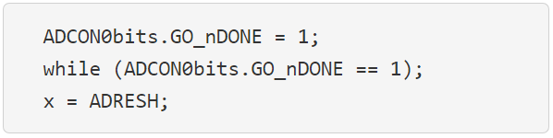
PIC ADC Subsystem: ADCS
ADC conversion starts by setting the following bit
ADCON0bits.GO_nDONE
This bit stays at logic 1 until the conversion is complete. Then the bit will be cleared.
Putting together these concepts yields the following code snippet that will convert

Slide 5
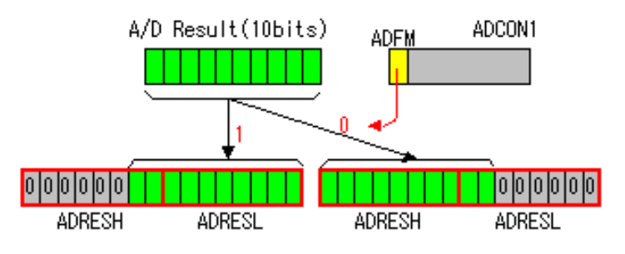
Result of A/D conversion
The ADRESH and ADRESL register pair is the location where the 10 bits A/D result is loaded at the completion of the A/D conversion.
This register pair is 16 bits wide. The A/D module gives the flexibility to left or right justify the 10 bits result in the 10 bits result register.
The A/D Format Select bit (ADFM) of ADCON1 register controls this justification. The extra bits are loaded with 0.
ADFM: ADC Format Select

Slide 6
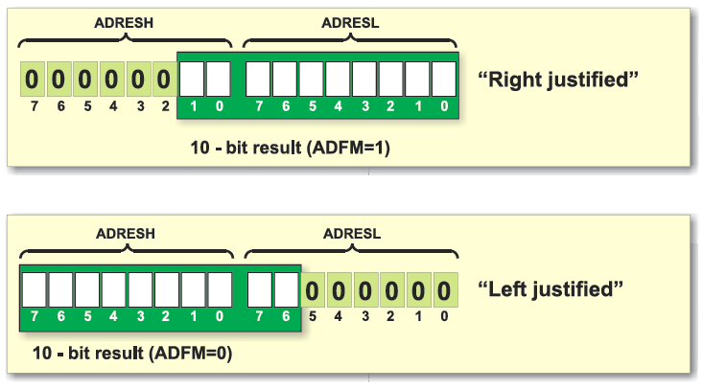
Result of A/D conversion
Setting ADFM to 1: By setting the ADFM bit to 1, you are instructing the ADC module to distribute the ADC result across both ADRESH and ADRESL registers, requiring you to combine both values to get the complete result.
Left justification is generally preferred when you only need the most significant bits of the ADC result and want to access them quickly.
Right justification allows you to access the full resolution of the ADC but requires combining both registers to get the complete value.
Notes:
https://www.google.com/search?q=Example+of+PIC+left%2Fright+justify+ADRESH+ADRESL+&sca_esv=8430180506858e44&rlz=1C1VDKB_enUS1067US1067&biw=1250&bih=651&sxsrf=AHTn8zpI6bPdDHXrbbqGPRhZJFgRoPNioA%3A1740372366673&ei=jvm7Z5XqKLDMkPIPhYvr0Ag&ved=0ahUKEwiV6cSlwNuLAxUwJkQIHYXFGooQ4dUDCBA&uact=5&oq=Example+of+PIC+left%2Fright+justify+ADRESH+ADRESL+&gs_lp=Egxnd3Mtd2l6LXNlcnAiMEV4YW1wbGUgb2YgUElDIGxlZnQvcmlnaHQganVzdGlmeSBBRFJFU0ggQURSRVNMIDIFECEYoAEyBRAhGKABSItoUL4KWJBjcAN4AJABAJgBfqAB-QyqAQQxLjE0uAEDyAEA-AEBmAIPoAKXC8ICCBAAGLADGO8FwgILEAAYgAQYsAMYogTCAgsQABiwAxiiBBiJBcICCBAAGIAEGKIEwgIFEAAY7wXCAggQABiiBBiJBcICChAhGKABGMMEGAqYAwCIBgGQBgWSBwQzLjEyoAfIMA&sclient=gws-wiz-serp

Slide 7
Result of A/D conversion
Left justification (ADFM =0): MSBs of the ADC result are stored in ADRESH.
Useful when you primarily care about the larger significant bits of the ADC value.
Right justification (ADFM =1): LSBs of the ADC result are stored in ADRESH.
May be useful if you need to access the finer details of the ADC result.
Why is this important?
Efficient access to significant bits: when you need to quickly compare ADC values, left justification allows you to access the most important bits directly from ADRESH without needing to manipulate both registers.
Fine-tuning calculations: If you need high precision in your calculations, right justification can give you access to the full range of ADC bits.
Notes:
https://www.google.com/search?q=Example+of+PIC+left%2Fright+justify+ADRESH+ADRESL+&sca_esv=8430180506858e44&rlz=1C1VDKB_enUS1067US1067&biw=1250&bih=651&sxsrf=AHTn8zpI6bPdDHXrbbqGPRhZJFgRoPNioA%3A1740372366673&ei=jvm7Z5XqKLDMkPIPhYvr0Ag&ved=0ahUKEwiV6cSlwNuLAxUwJkQIHYXFGooQ4dUDCBA&uact=5&oq=Example+of+PIC+left%2Fright+justify+ADRESH+ADRESL+&gs_lp=Egxnd3Mtd2l6LXNlcnAiMEV4YW1wbGUgb2YgUElDIGxlZnQvcmlnaHQganVzdGlmeSBBRFJFU0ggQURSRVNMIDIFECEYoAEyBRAhGKABSItoUL4KWJBjcAN4AJABAJgBfqAB-QyqAQQxLjE0uAEDyAEA-AEBmAIPoAKXC8ICCBAAGLADGO8FwgILEAAYgAQYsAMYogTCAgsQABiwAxiiBBiJBcICCBAAGIAEGKIEwgIFEAAY7wXCAggQABiiBBiJBcICChAhGKABGMMEGAqYAwCIBgGQBgWSBwQzLjEyoAfIMA&sclient=gws-wiz-serp

Slide 8
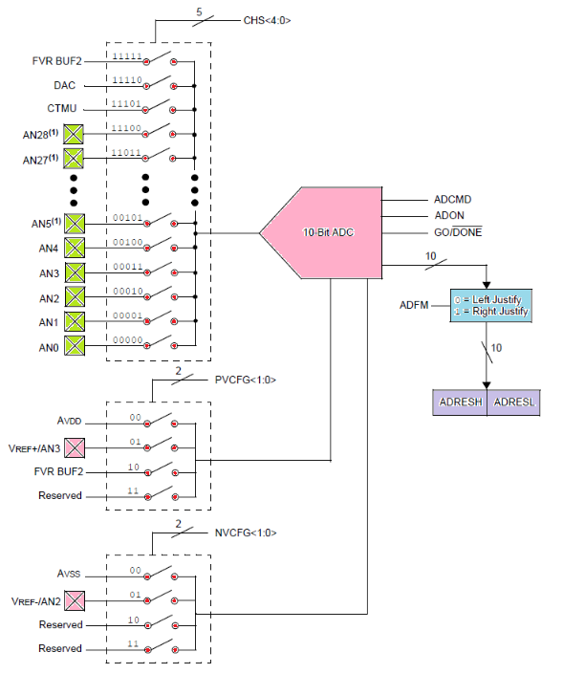
ADC Configuration
• Port configuration
• Channel selection
• ADC voltage reference selection
• ADC conversion clk source
• Interrupt control
• Results formatting
Analog
MUX
*Datasheet page 288
When configuring and using the ADC these functions must be considered
Left/Right
justify
ADC BLOCK DIAGRAM

Slide 9
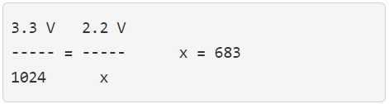
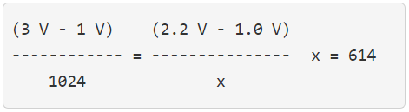
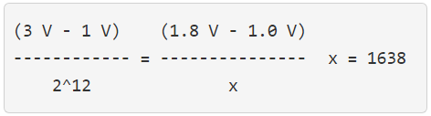
Remember the Examples from last lecture
The PIC has 0v & 3.3v reference potentials, determine the converted value for 2.2V.
Set V_{ref}- = 1v and V_{ref}+ to 3v, determine the converted value for 2.2V.
You are working with a 12-bit ADC with 1V and 3V reference potentials, determine the converted value for 1.8V.

Slide 10
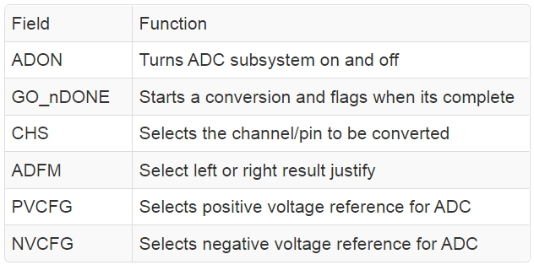
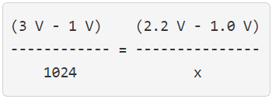
Analog
MUX
*Datasheet page 288
Left/Right
justify

Slide 11
Analog
MUX
*Datasheet page 288
Left/Right
justify

Slide 12
Analog
MUX
*Datasheet page 288
Left/Right
justify

Slide 13
Analog
MUX
*Datasheet page 288
Left/Right
justify

Slide 14
Analog
MUX
*Datasheet page 288
Left/Right
justify

Slide 15
Analog
MUX
*Datasheet page 288
Left/Right
justify

