Slide 1



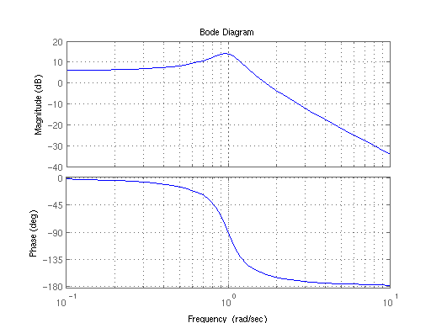
Lecture 23: Antialias filters Bode Plots
Prof. Sager
A Bode Plot is a useful tool that shows the gain and phase response of a given system for different frequencies.

Slide 2

Bode Plot
A Bode plot is a graph of the frequency response of a system. It is usually a combination of a Bode magnitude plot, in dB and a Bode phase expressing the phase shift.
As originally conceived by Hendrik Wade Bode (Bell Labs) in the 1930s, the plot is an asymptotic approximation of the frequency response, using straight line segments.
The dB is a unit of measurement express es the ratio of one value of a physical property to another on a logarithmic scale.

Slide 3
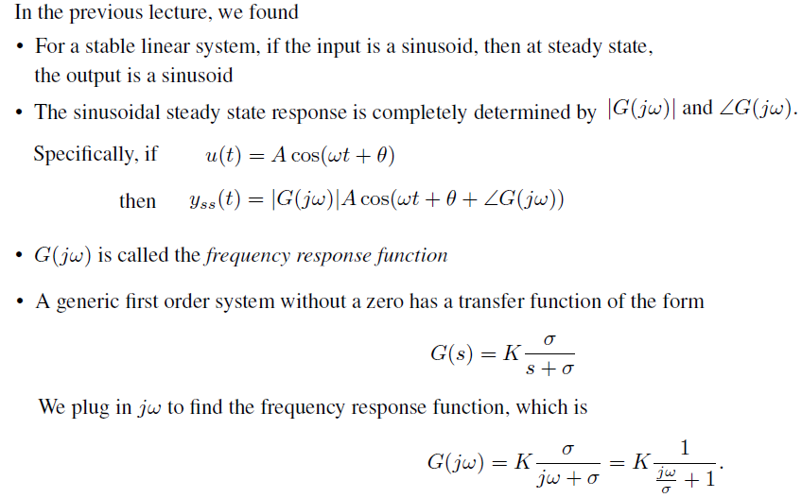
Frequency Response for a First Order System
Above we have defined the Frequency response of a system:

Slide 4
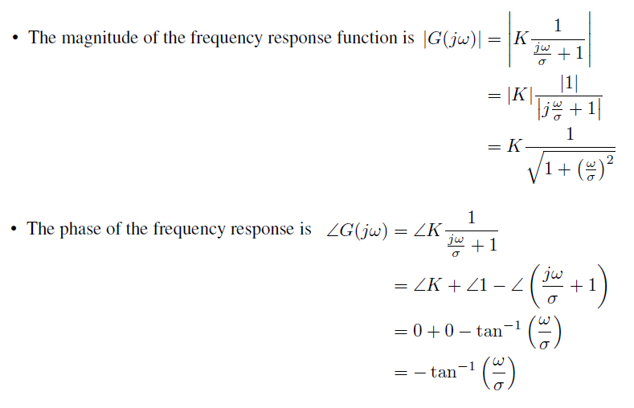
Frequency Response for a First Order System
We plot how |G(jω)| and ∠G(jω) as ω changes. The first thing we note is that in these expressions, ω is always divided by σ.

Slide 5
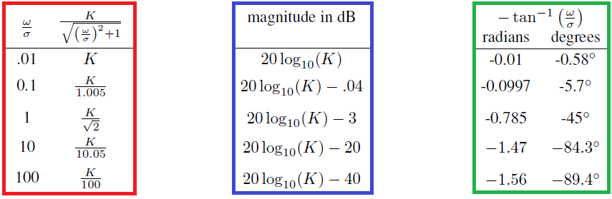
Magnitude and Phase Tables
In the left table, we plug in some different values for ω/σ.
To visualize this data, we will plot |G(jω)| & ∠G(jω) vs. ω with respect to σ.
we utilize a log scale for ω as well as re-scale |G(jω)| in decibels *.
Definition. Given G(jω), the magnitue response in decibels (dB) is
L_{dB} = 20 log10 (|G(jω)|) → as shown in the table to the right
|G(jω)| 20 log10 (|G(jω)|) ∠G(jω)
* The dB is a logarithmic way of describing a ratio. The ratio may be power, sound pressure, voltage etc.

Slide 6
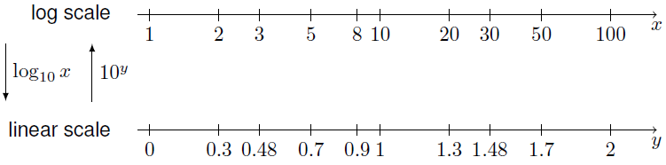
Log scale
A log scale is created by plotting the point x at a distance log₁₀(x) from the origin.
Note that equidistant points are related by a common multiplicative factor, rather than additive factor as is the case in a linear scale.
If we measure the distance from 1 to 10, we see that it is the same distance from 2 to 20 or 10 to 100, since each of these numbers are related by a factor of 10. A factor of 10 in a log scale is called a decade.

Slide 7
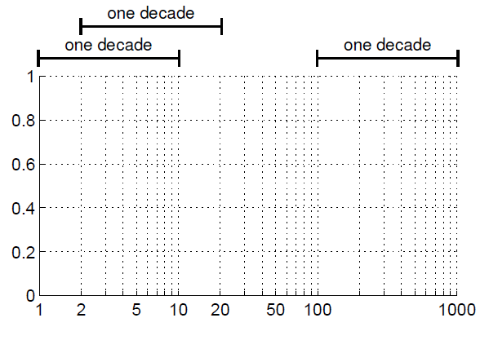
Log scale
Plot with log-scale on x-axis
A factor of 10 in a log scale is called a decade.

Slide 8
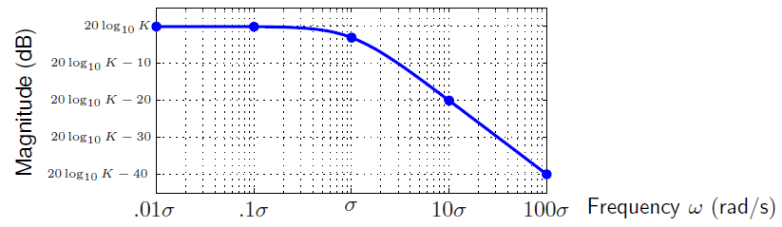
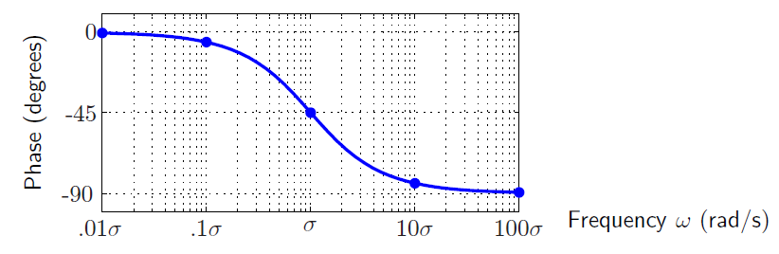
Magnitude Bode plot & Phase Bode plot
The plot of magnitude in decibels vs. frequency in log scale:
The plot of phase in degrees vs. frequency in log scale:

Slide 9
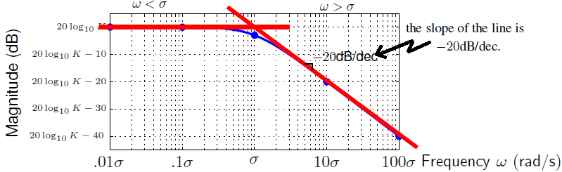
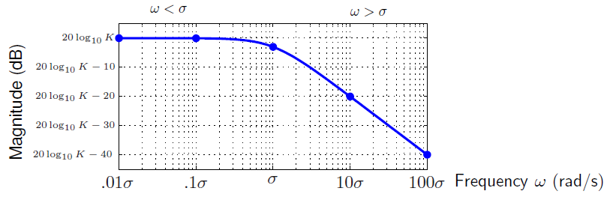
Linear Approximation for Magnitude Bode plot
Bode plots have a lot of structure to them. By breaking them up into different sections, we can sketch an approximate Bode plot.
The magnitude response has two main sections:
a low frequency part that is flat & a high frequency part decreases linearly.
A frequency divides these two sections: the magnitude of the pole σ.
Note that the line for ω>σdecreases by 20 decibels every time the frequency increases by a factor of 10, which is a decade.
So, the slope of the line is -20dB/dec.
linear
approximation
the exact Bode plot

Slide 10
Linear Approximation for Magnitude Bode plot
Bode plots have a lot of structure to them. By breaking them up into different sections, we can sketch an approximate Bode plot.
The magnitude response has two main sections:
a low frequency part that is flat & a high frequency part decreases linearly.
A frequency divides these two sections: the magnitude of the pole σ.
Note that the line for ω>σdecreases by 20 decibels every time the frequency increases by a factor of 10, which is a decade.
So, the slope of the line is -20dB/dec.
linear
approximation
the exact Bode plot

Slide 11
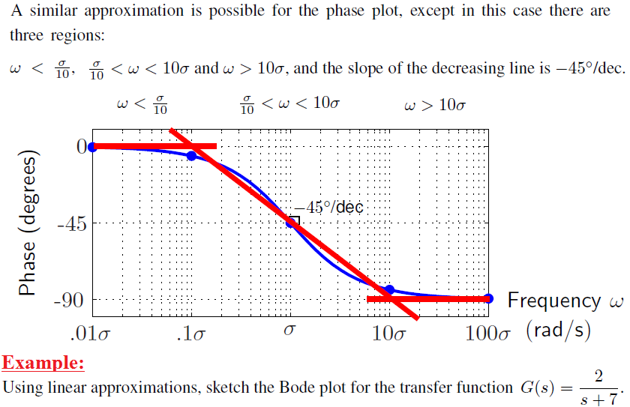
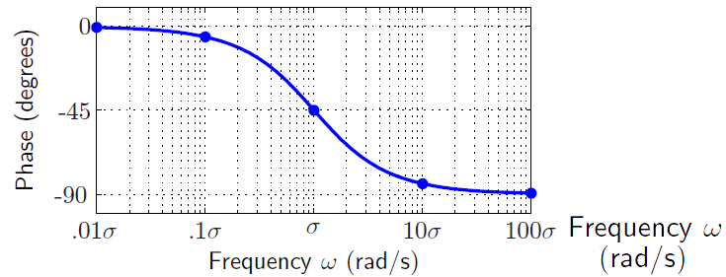
Linear Approximation for Phase Bode plot

Slide 12
Linear Approximation for Phase Bode plot

Slide 13
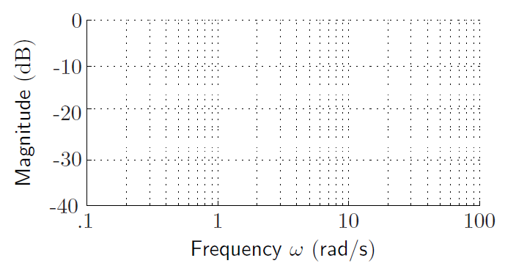
Linear Approximation for Magnitude Bode plot

Slide 14
Linear Approximation for Magnitude Bode plot

Slide 15
Linear Approximation for Magnitude Bode plot

Slide 16
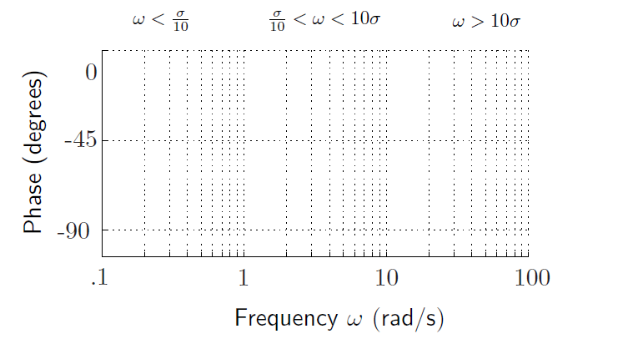
Linear Approximation for Phase Bode plot
The phase Bode plot should be flat one decade before and one decade after 7 rad/s, or before 7/10 = 0.7 rad/s and after 7(10) = 70 rad/s.
In between, it should drop at 45/dec.

Slide 17
Linear Approximation for Phase Bode plot
The phase Bode plot should be flat one decade before and one decade after 7 rad/s, or before 7/10 = 0.7 rad/s and after 7(10) = 70 rad/s.
In between, it should drop at 45/dec.

Slide 18
Linear Approximation for Phase Bode plot
The phase Bode plot should be flat one decade before and one decade after 7 rad/s, or before 7/10 = 0.7 rad/s and after 7(10) = 70 rad/s.
In between, it should drop at 45/dec.

Slide 19
Linear Approximation for Phase Bode plot
The phase Bode plot should be flat one decade before and one decade after 7 rad/s, or before 7/10 = 0.7 rad/s and after 7(10) = 70 rad/s.
In between, it should drop at 45/dec.

Slide 20
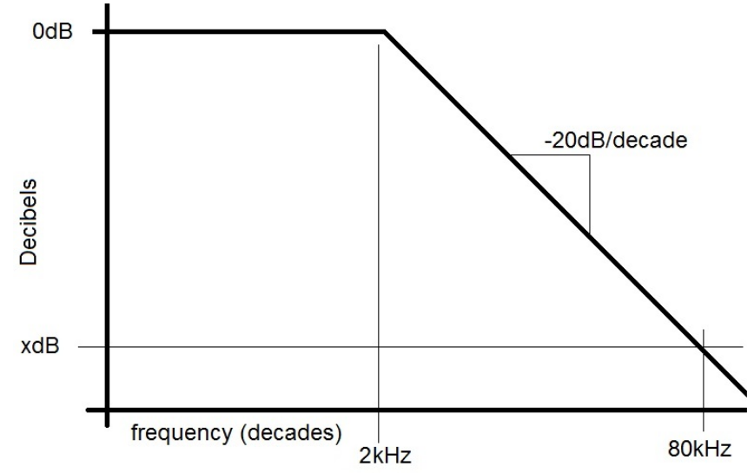
Decades
A first-order LPF has ω = 2kHz. Describe the attenuation of an 80kHz input signal in decibels and as a ratio of output voltage to input voltage.

Slide 21
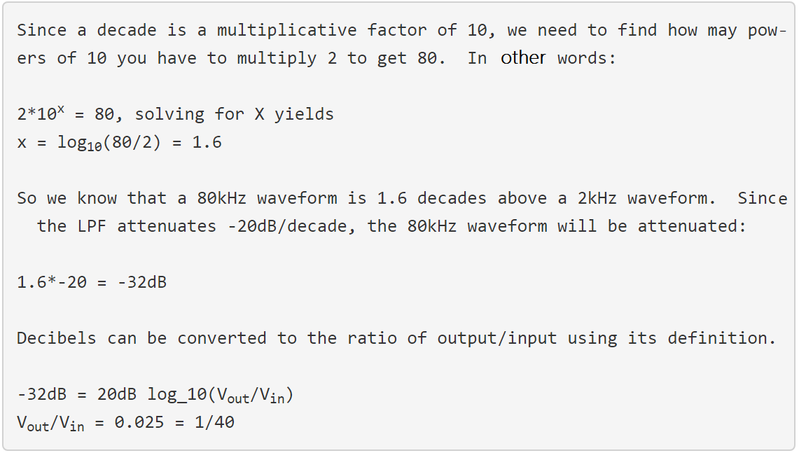

Decades
A first-order LPF has ω = 2kHz. Describe the attenuation of an 80kHz input signal in decibels and as a ratio of output voltage to input voltage.

Slide 22
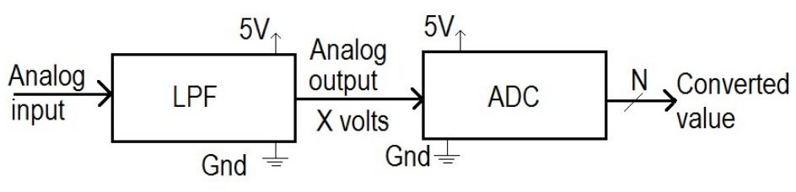
N-bit ADC convert
To attenuate a full scale input to a voltage that has a converted value below 1/2 LSB. How many dB will be required to achieve this?

Slide 23
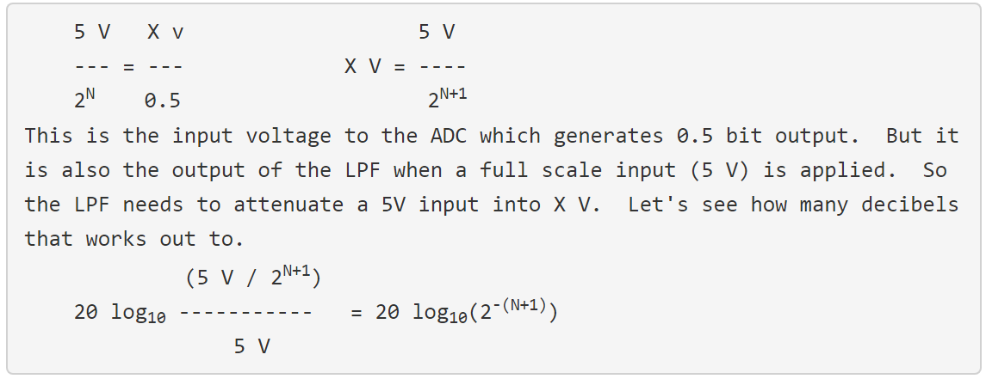
N- bit ADC convert
To attenuate a full scale input to a voltage that has a converted value below 1/2 LSB. How many dB will be required to achieve this?
Solution:
The LPF needs to reduce a full scale (5 V) input to a voltage X that has a converted value of 0.5 bits.
We have already looked at this concept when we covered quantization error.

