Slide 1


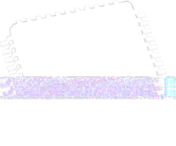
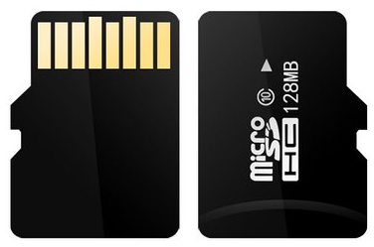
Lecture 23: Passive/Active Filters
Memory cards

Slide 2

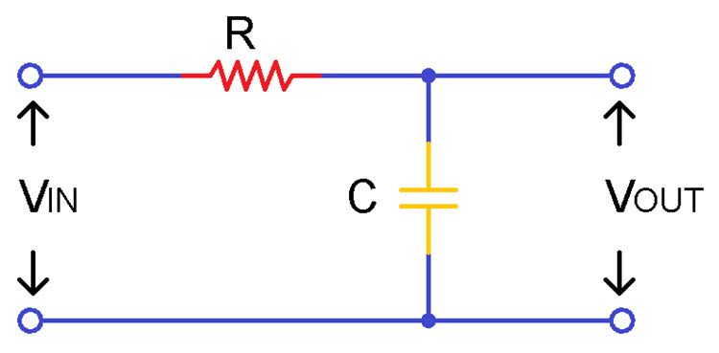
Passive Low Pass Filter
A Low Pass Filter circuit which is designed by passive components is referred as passive low pass filter.
The cut-off frequency of a passive low pass filter is given as
f_{C} = 1/(2πRC)

Slide 3
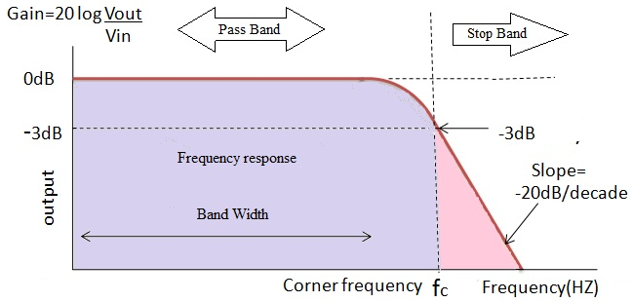
Passive Low Pass Filter
Passive low pass filter Gain at cut-off frequency is given as A = (1/√2)^{n}

Slide 4
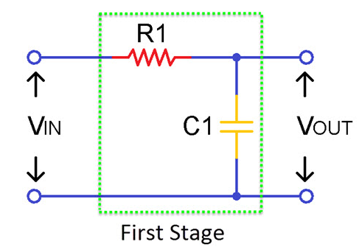
2nd Order Passive LPF
Sometimes a single stage may not enough to remove all unwanted frequencies then 2nd order filter is used.
The cut-off frequency of second order low pass filter is given as
f_{C} = 1/ (2π√(R1C1))

Slide 5
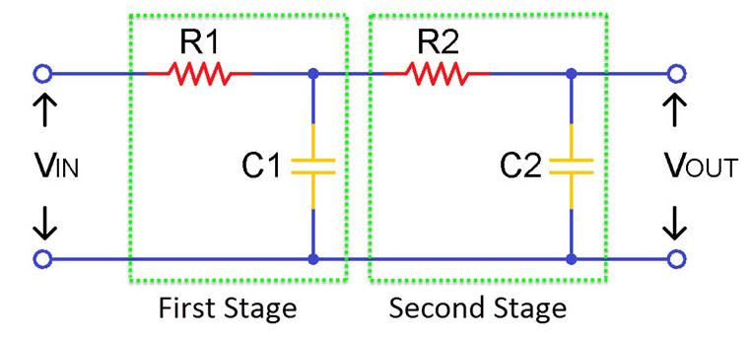
2nd Order Passive LPF
Sometimes a single stage may not enough to remove all unwanted frequencies then 2nd order filter is used.
The cut-off frequency of second order low pass filter is given as
f_{C} = 1/ (2π√(R1C1R2C2))

Slide 6
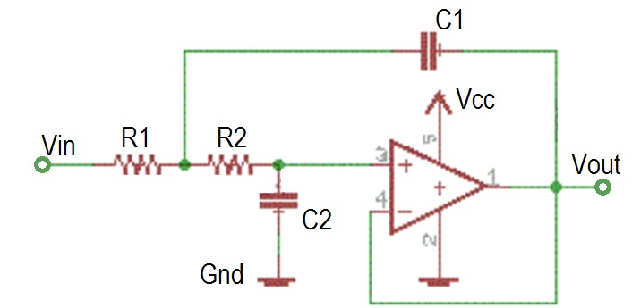
Active Low Pass Filter
The main drawback of a passive filter is that it loads the signal source with its impedance.
An active filter decreases this and produces better results.
The most common active filter is a 2nd order Sallen-Key filter.
It has a pair RC elements, each serving the role of a single first order low-pass filter.
It is called a "Sallen-Key filter" because it was first described and developed by researchers R.P. Sallen and E.L. Key from MIT's Lincoln Laboratory in 1955

Slide 7
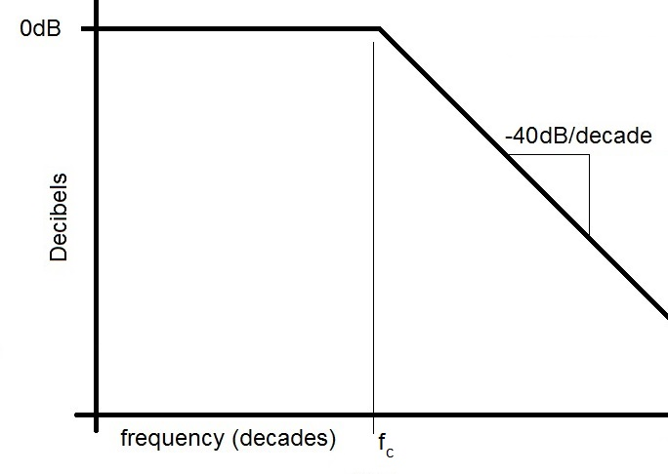
Active Low Pass Filter
The main drawback of a passive filter is that it loads the signal source with its impedance.
An active filter decreases this and produces better results.
The most common active filter is a 2nd order Sallen-Key filter.
It has a pair RC elements, each serving the role of a single first order low-pass filter.

Slide 8
Memory Card
History: the first SD card was introduced in 1999 by Toshiba, SanDisk, and Panasonic. The "SD" logo was originally designed for a DVD format.
Capacity: the first SD cards had 8 MB of memory, while microSD cards can now store up to 1 TB.
Speed: the speed of SD cards has increased nearly 100 times since the first SD card was introduced.
Form factor: the asymmetrical shape of SD cards prevents them from being inserted upside down.
Pin layout: full-size SD cards have nine pins, while microSD cards have eight. Faster cards have a new pin layout on the second row.
Compatibility: SD cards are compatible with many devices, including gaming consoles, car stereos, and action cameras.
Notes:
https://www.studentcompanion.net/en/interfacing-sd-card-fat32-system-with-pic-microcontroller-mikroc/
https://blog.acelaboratory.com/pc-3000-flash-circuit-board-and-msd-card-preparing-and-soldering.html
https://components101.com/misc/microsd-card-pinout-datasheet

Slide 9
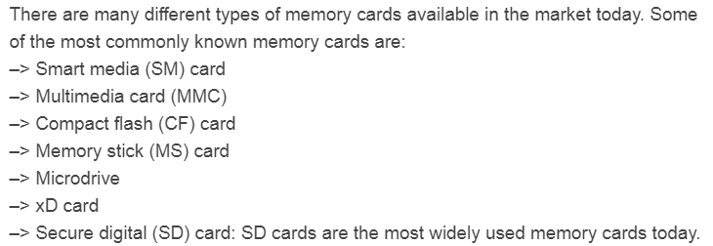
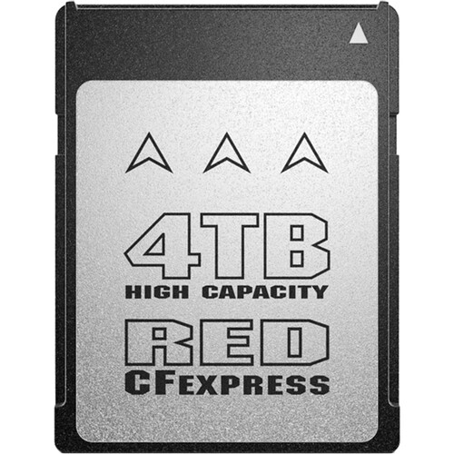
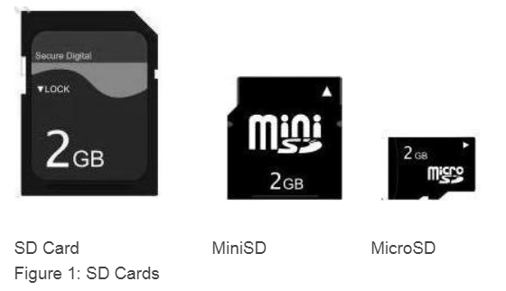
Memory Card
$1,499.99
Notes:
https://www.studentcompanion.net/en/interfacing-sd-card-fat32-system-with-pic-microcontroller-mikroc/
https://blog.acelaboratory.com/pc-3000-flash-circuit-board-and-msd-card-preparing-and-soldering.html
https://components101.com/misc/microsd-card-pinout-datasheet

Slide 10
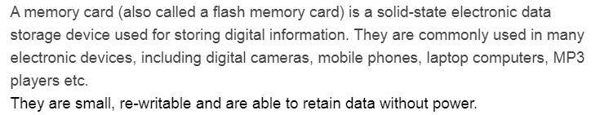
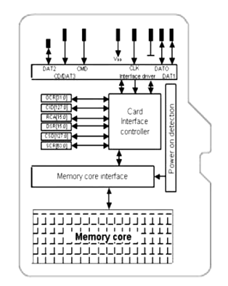
SD Card
Notes:
https://www.studentcompanion.net/en/interfacing-sd-card-fat32-system-with-pic-microcontroller-mikroc/
https://blog.acelaboratory.com/pc-3000-flash-circuit-board-and-msd-card-preparing-and-soldering.html
https://components101.com/misc/microsd-card-pinout-datasheet

Slide 11
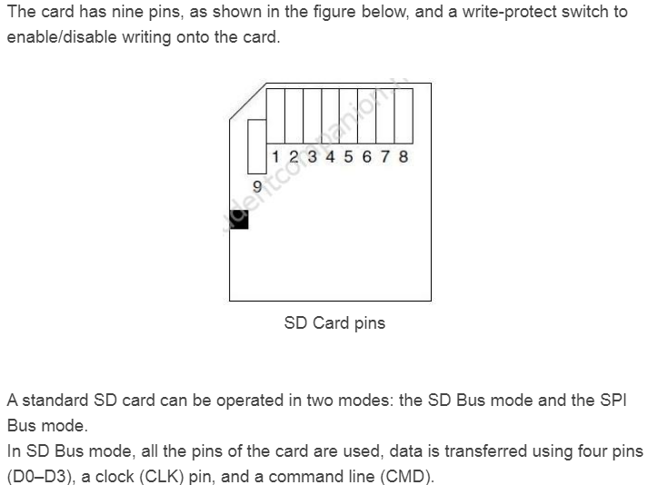
Serial Peripheral Interface
Notes:
https://www.studentcompanion.net/en/interfacing-sd-card-fat32-system-with-pic-microcontroller-mikroc/
https://blog.acelaboratory.com/pc-3000-flash-circuit-board-and-msd-card-preparing-and-soldering.html
https://components101.com/misc/microsd-card-pinout-datasheet

Slide 12
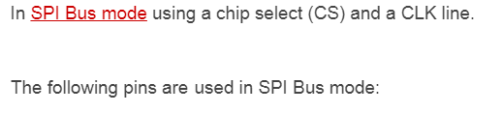
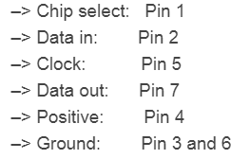
Notes:
https://www.studentcompanion.net/en/interfacing-sd-card-fat32-system-with-pic-microcontroller-mikroc/
https://blog.acelaboratory.com/pc-3000-flash-circuit-board-and-msd-card-preparing-and-soldering.html
https://components101.com/misc/microsd-card-pinout-datasheet

Slide 13
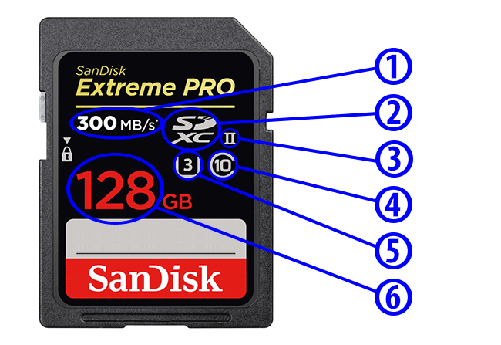
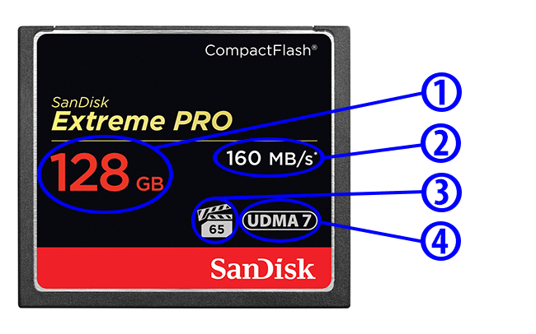
Maximum Read Speed
Type of SD Memory Card
UHS Bus Speed
SD Speed Class
UHS Speed Class
Memory Card Capacity
Memory Card Capacity
Maximum Read Speed
Minimum Write Speed
Ultra DMA Mode
Notes:
https://photographylife.com/understanding-memory-cards

