Slide 1


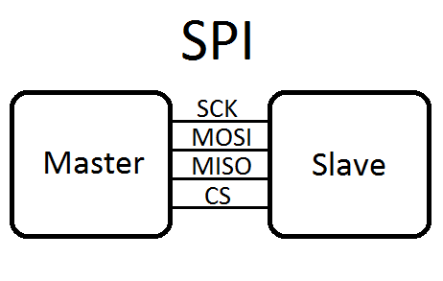
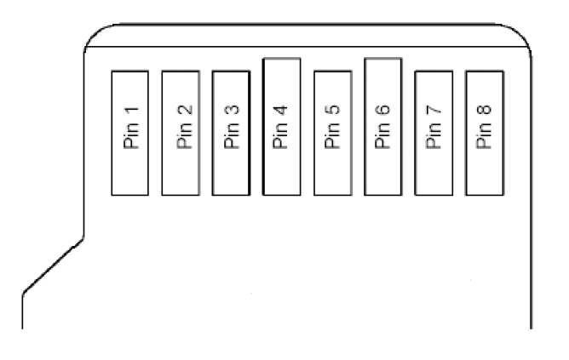
Microcomputer Architecture & Interfacing
Data acquisition

Slide 2

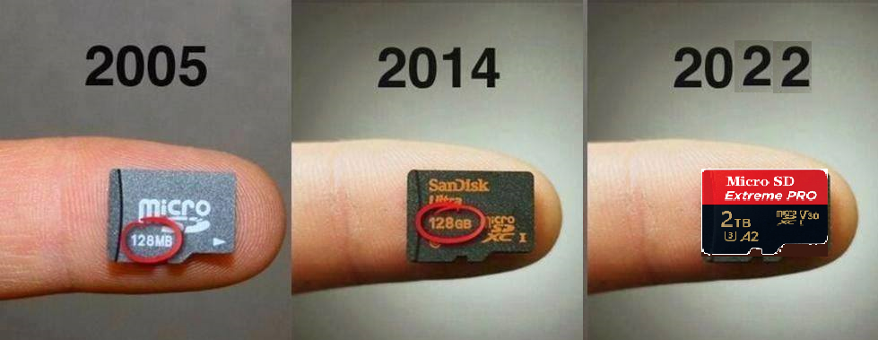
Data Acquisition
Objective
  To familiarize you with the SD Card and its SPI interface.
  To measure the time required to complete read/write operations to the SD Card.
Serial Peripheral Interface

Slide 3
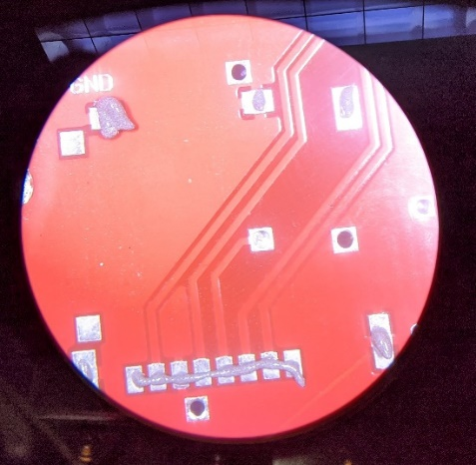
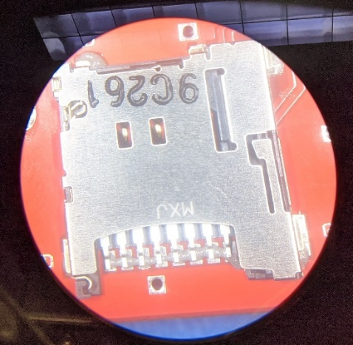
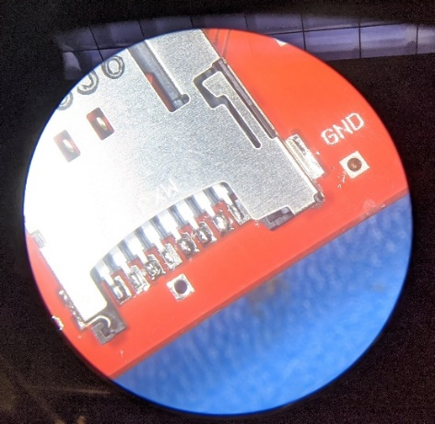
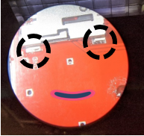
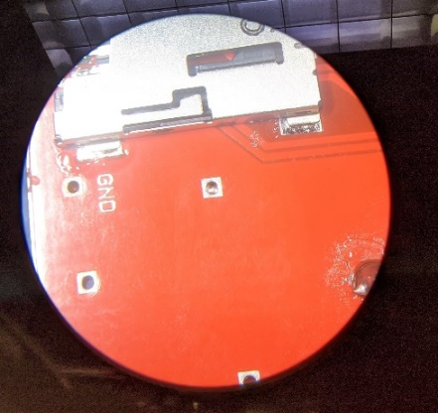
Attach SD card holder to the board
Reflowing solder paste with a soldering iron is the most effective way to connect the SD card holder to the board.
Solder the SD card tabs to the board.
They are the mechanical connection between the SD card and board.

Slide 4


Attach SD card holder to the board
Reflowing solder paste with a soldering iron is the most effective way to connect the SD card holder to the board.
It is ready for you
Solder the SD card tabs to the board.
They are the mechanical connection between the SD card and board.

Slide 5
Lab 9 Assignment
Lab8: understand how samples are recorded from the mic.
Lab9: create an application to fill the SD CARD w/ audio data.
Lab10: play the stored audio data back through the speaker.
Double Buffering Technique:
Collect mic samples & store them in the BlueBuffer.
During that the RedBuffer is being sent out to the SD CARD over an SPI bus.
Once BlueBuffer is full and RedBuffer has been sent, their roles are swapped.
BlueBuffer is then sent to the SDCARD & new mic samples are sent to the RedBuffer.

Slide 6
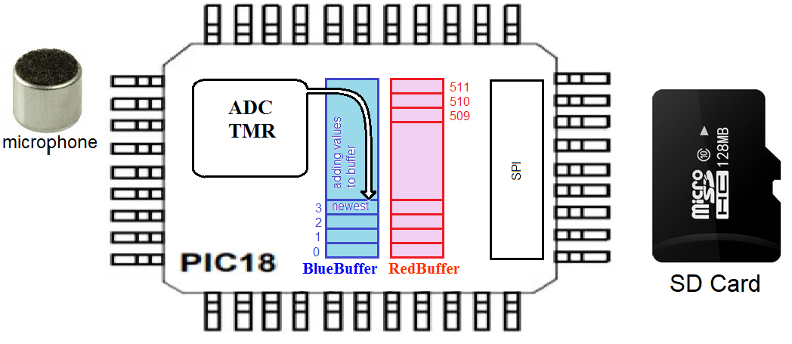
Double Buffering Technique
The general flow of data from the microphone into the SDCARD
mic samples → BlueBuffer while RedBuffer → SDCARD
BlueBuffer → SDCARD while mic samples → RedBuffer.

Slide 7
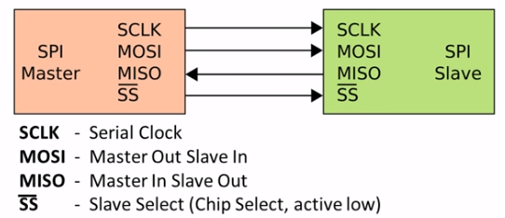
Serial Peripheral Interface: SPI
SPI is one of the most widely used interfaces between MCU and peripheral ICs.
It is synchronous serial communication interface specification used for short-distance communication, primarily in embedded systems.
The SPI bus allows 1 bit data line by 2-channel (Data In and Out).
It was developed by Motorola in mid-1980s and has become a de facto standard.
Notes:
The SPI is a synchronous serial communication interface specification used for short-distance communication, primarily in embedded systems.
The interface was developed by Motorola in the mid-1980s and has become a de facto standard.
Typical applications include Secure Digital cards and liquid crystal displays.
https://electrosome.com/spi/

Slide 8
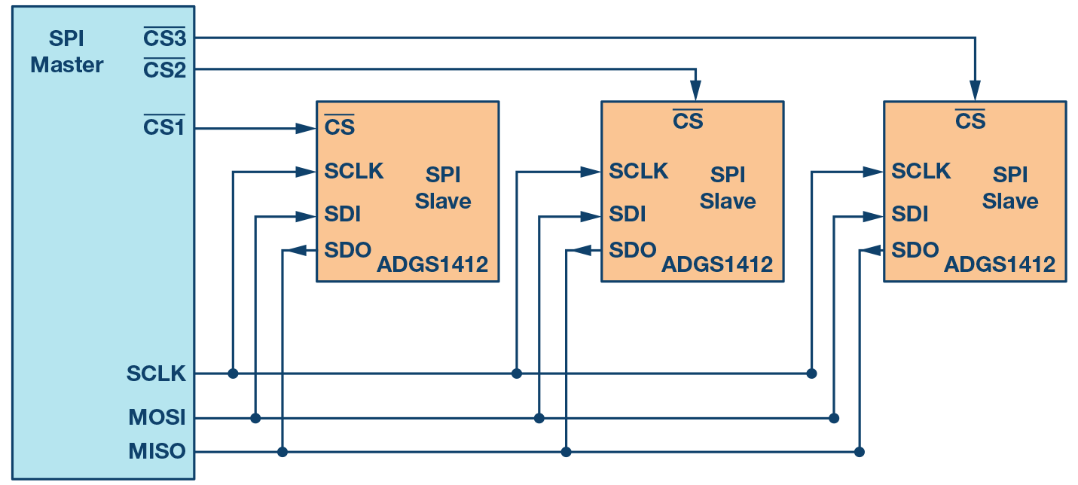
Serial Peripheral Interface: SPI
When multiple slave devices are used, an independent slave select line is connected from master to each slave device as below
Master will select only one slave at a time. Mostly slave devices will be equipped with tri-state outputs.
So when not selected, their output lines appears disconnected.
Notes:
The SPI is a synchronous serial communication interface specification used for short-distance communication, primarily in embedded systems.
The interface was developed by Motorola in the mid-1980s and has become a de facto standard.
Typical applications include Secure Digital cards and liquid crystal displays.
https://electrosome.com/spi/

Slide 9
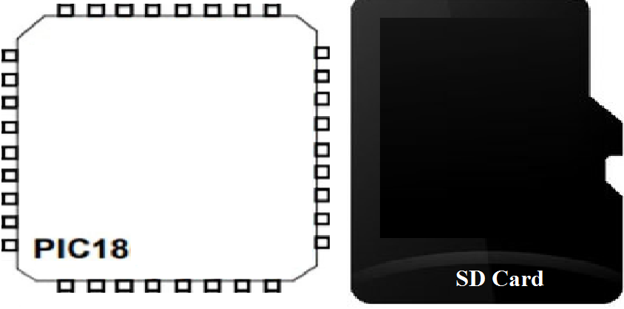
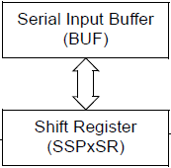
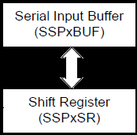
SPI Master/Slave Connection
RB4/CS
CS
RB3/SDO
SDI
RB2/SDI
SDO
See figure 15-5 in PIC datasheet to read more about this.
SSP, SYNCHRONOUS SERIAL PORT
SDO serial data out/ SDI serial data input / Chip Select, Active low

Slide 10
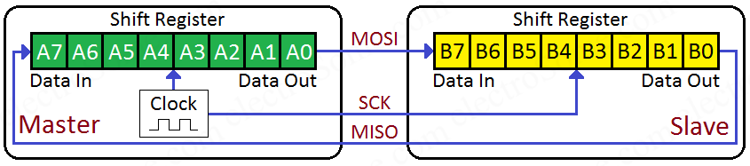
SPI Master/Slave Connection
The master generates clk when it wants to write data to a slave device.
After 8 clk pulses data in M device (A₇ - A₀) is transferred to S device and data in the S device (B₇ - B₀) is transferred to the M device.
Buffer Register is omitted in the figure above.

Slide 11
SPI Master Mode
The master can initiate the data transfer at any time as it controls the SCKx line.
The master determines when the slave (Figure 15-5) is to broadcast data by the software.
The data is transmitted/received as soon as the SSPxBUF register is written to.
If the SPI is only going to receive, the SDOx output could be disabled (programmed as an input).
The SSPxSR register will continue to shift in the signal present on the SDIx pin at the programmed clock rate.

Slide 12
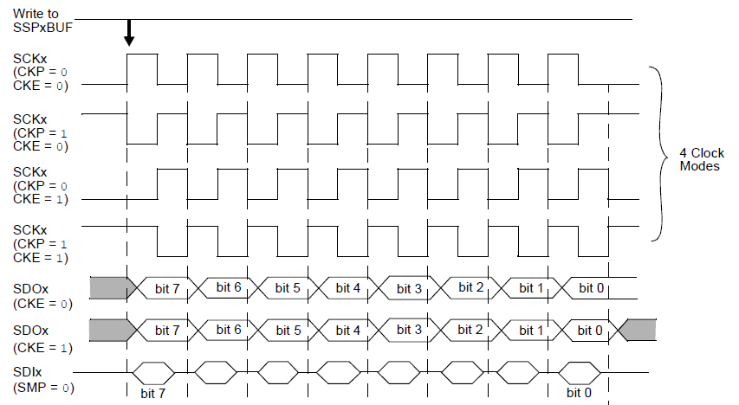
SPI Mode Waveform
The clock polarity is selected by appropriately programming the CKP bit of the SSPxCON1 register and the CKE bit of the SSPxSTAT register.
FIGURE 15-6: p. 210

