Slide 1


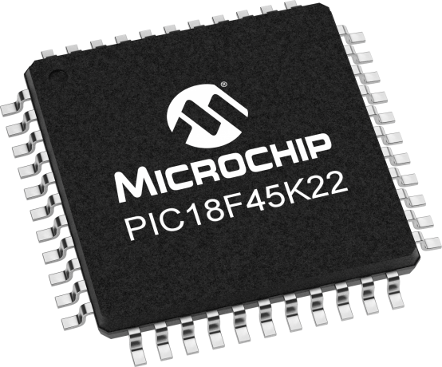
Lecture 25 (online 27):
Multiplication by constants
Prof. Sager
Objective:
Understand how to use shift and add to multiply a variable by integer and fractional constants.

Slide 2

Multiplication by constants
When you add two numbers the result can have at most one more digit than the operands.
For example, the 2-digit operands "50" when added to itself, 50 + 50 = 100 yields a 3-digit result.
This result generalizes as follows. The sum of a pair of N-digit numbers generates a result with at most N+1 digits.
Trying to "squeeze" a N+1 digit sum into a N-digit variable will generate an illegal result and a condition we call overflow.

Slide 3
Multiplication by constants
Multiplication is fundamentally different, the product of two numbers generates a result that can have up to two times the number of digits as the operands.
For example, the 2-digit operands "50" when multiplied by itself, 50 * 50 = 2500 yields a 4-digit result.
This result generalizes as follows. The product of a pair of N-digit numbers generates a result with at most 2*N digits.
Trying to "squeeze" a 2*N digit product into a N-digit variable will generate an illegal result and a condition we call overflow.

Slide 4
Multiplication by constants
You can multiply a binary number by a power-of-2 by shifting it left one bit.
Given a 4-bit binary number B = b3 b2 b1 b0.
These four bits are interpreted to have the value:
b3*2^3 + b2*2^2 + b1*2^1 + b0*2^0
Shifting B left one bit produces b3 b2 b1 b0 0.
These five bits are interpreted to have the value:
b3*2^4 + b2*2^3 + b1*2^2 + b0*2^1 + 0*2^0 =
2*(b3*2^3 + b2*2^2 + b1*2^1 + b0*2^0) = 2*B
A similar argument can be made that shifting a binary number to the right divides it by 2.

Slide 5
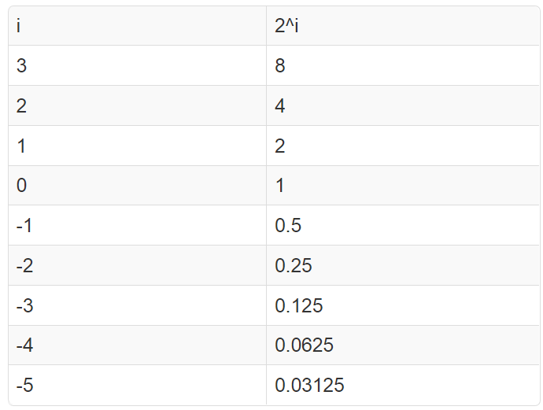
Multiplication by constants
The following table will come in handy during the next exercises.

Slide 6
Multiplication by constants
Here we multiply an 8-bit integer, called x8, or a 16-bit integer, denoted x16, by a constant and put the result into a variable y8, y16, y24, or y32 depending on the size of the result.
Multiply x8 by 8 and put the result into a variable y16.
y16 = x8 << 3;
Multiply x8 by 10 and put the result into a variable y16.
y16 = (x8 << 3) + (x8 << 1); i.e. 10*x = (8 + 2)*x = 8*x + 2*x

Slide 7
Multiplication by constants
Multiply x8 by 21 and put the result into a variable y16.
y16 = (x8 << 4) + (x8 << 2) + x8;
i.e 21*x = (16 + 4 + 1)*x = 16*x + 4*x + x
Multiply x8 by 7 and put the result into a variable y16.
y16 = (x8 << 3) - x8;
i.e 7*x = (8 - 1)*x = 8*x - 1*x
Multiply x8 by 8.5 and put the result into a variable y16.
y16 = (x8 << 3) + (x8 >> 1);
i.e 8.5x = (8 + 0.5)*x = 8*x + 0.5*x

Slide 8
Multiplication by constants
What is the smallest power of 2 such that when it is multiplied by 0.65625 yields an integer?
0.65625 * 32 = 21
In other words we have expressed 0.65625 as a ratio (21/32) where the denominator is a power of two.
Multiply x8 by 0.65625 and put the result into a variable y8.
y8 = (x8*21 ) >> 5;
This works because 0.65625*x = 21*x/32
y16 = (x8 << 4) + (x8 << 2) + x8;

Slide 9
Multiplication by constants
Multiply x8 by 0.6 and put the result into a variable y8.
0.6*x (almost) = 154*x/256.
Your answer may use multiplication by a constant.
y8 = (x8*154 ) >> 8;

Slide 10
Multiplication by constants
There are two points to make.
1- Error: when working with 8-bit values, you should expect more than your fair share of error.
2- Overflow: when computing these values, there might be intermediate values that occupy more than 8-bits. Most of the time the compiler will protect you when you perform this computation in one line of code as shown.
In general, you should exercise great care when developing algorithms as overflow cases can be very difficult to debug.

