Slide 1


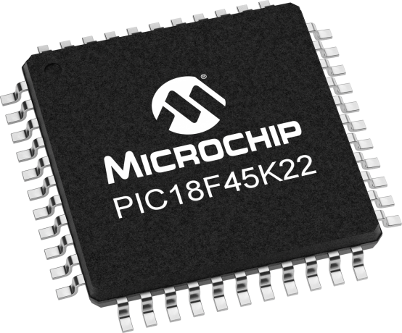
Lecture 28: Fixed Point Numbers
Prof. Sager
Objective:
Introduction to Fixed Point Format.
Online Conversion Calculator: https://www.rapidtables.com/convert/number/binary-to-decimal.html?x=10101110

Slide 2

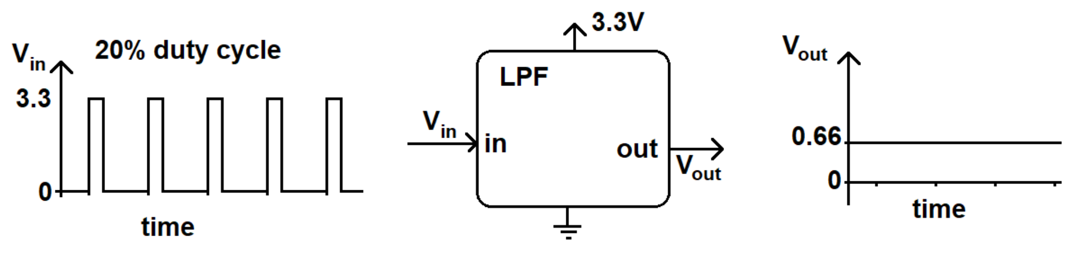
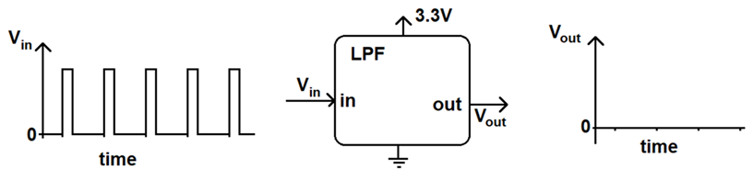
Direct Digital Synthesis (DDS)
DDSis a digitally-controlled method of generating multiple frequencies from a reference frequency source.
DDS is a technique that allows you to produce some periodic waveform with a finely adjustable frequency.
In future we will focus on generating sine waves.
For example, a 3.3V PWM waveform with a 20% duty cycle will have a LPF output of 20% of 3.3V or 0.2*3.3V = 0.66V.

Slide 3
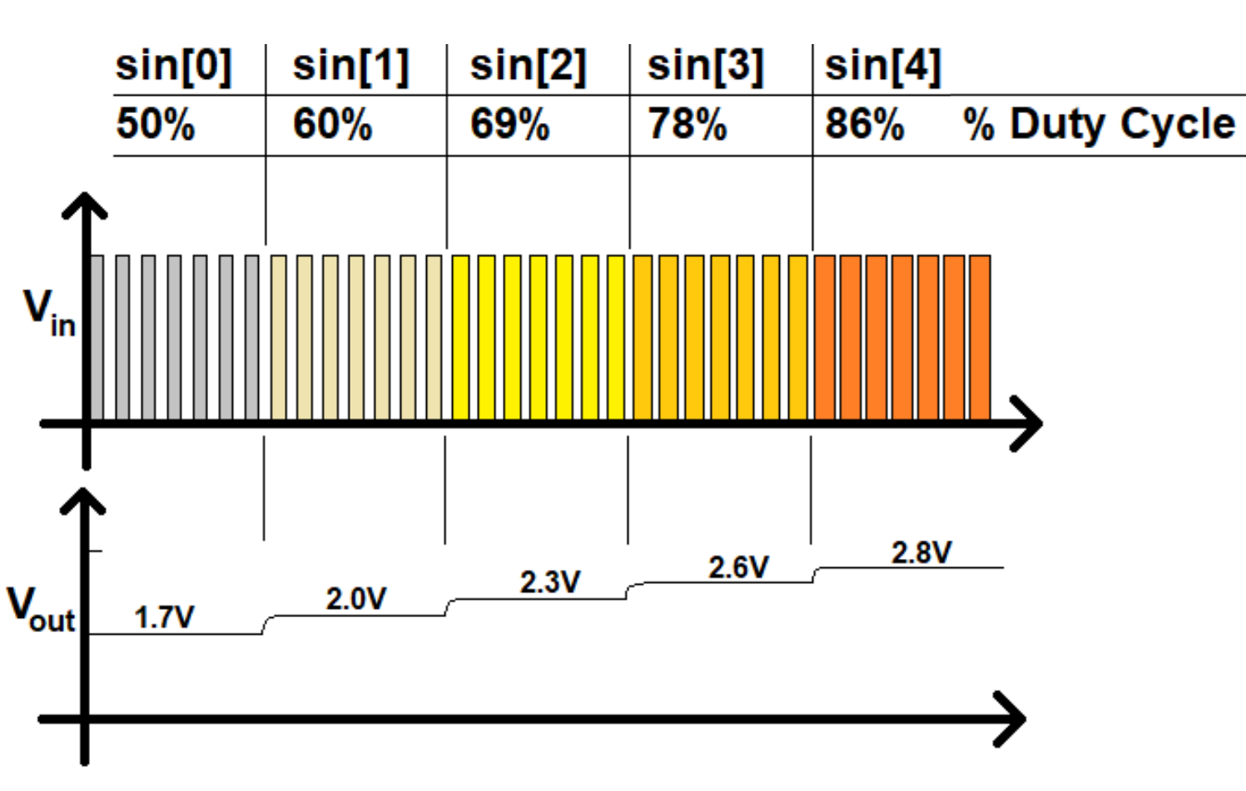
DDS

Slide 4
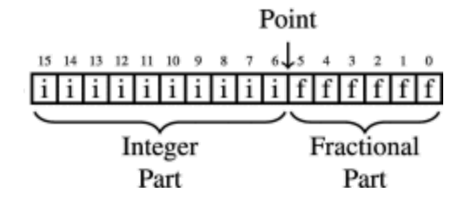
Fixed Point Format Numbers: FPF, n.m format
In Lab11, we are going to create a function generator using a process called Direct Digital Synthesis.
Today we are going to talk about the first step in the foundation behind Direct Digital Synthesis and they all revolve around Fixed Point Format numbers.
A Fixed Point Format number has n + m bits.

Slide 5
Fixed Point Format: FPF, n.m format
Binary numbering is a positional numbering system: digit position determines the magnitude.
Every digit is given an index, describing the position of the digit in the number.
The digit to the left of the decimal point has index 0. It increases to the left and decreases to the right.
To the right of the decimal point the digits have a -ve index.
The value of a number is: value = sum (d_{i} × base^{index})

Slide 6
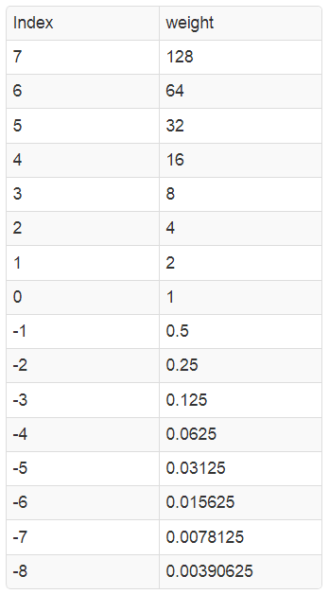
Fixed Point Format: FPF, n.m format
These powers of 2 table should help you in your conversions.
We will not explicitly write the dp.
We will come to an agreement where the dp goes before-hand using dot notation.

Slide 7
Fixed Point Format: FPF, n.m format
A fixed point value with N integer bits and M fractional bits will be described as a "N.M format number"
Example: represent the value 6.75 as a 4.4 format number.
6 = (0110)₂
0.75 = 2⁻¹ + 2⁻² = (0.11)₂.
So as a 4.4 format number, 6.75 = 0110.1100
We have a strong preference for N.M format numbers where N+M is 8, 16, or 32 (they fit into our standard data-type sizes).

Slide 8
Fixed Point Format: FPF, n.m format
Let explain the general idea first
Example: What value does 01001010 equal when interpreted as a 6.2 format number?
Answer:
The dp format in the binary representation is 010010.10
The whole number portion is (010010)₂ = 18
The binary fraction is (0.10)₂ = 0.5
So when you interpret 0b0100 1010 as a 6.2 format number its value is 18.5

Slide 9
Fixed Point Format: FPF, n.m format
Example:What value does 01001010 equal when interpreted as a 2.6 format number?
Answer:
The dp format in the binary representation is 01.001010
The whole number portion is (01)₂ = 1
The binary fraction is (0.001010)₂ which is 0.15625
So when you interpret 0b0100 1010 as a 2.6 format number its value is 1.15625

Slide 10
Fixed Point Format: FPF, n.m format
Example: represent 12.3125 as a 4.4 format number.
Answer:
The most intuitive way to arrive at an answer is to represent 12.3125 as the sum of powers of 2.
12.3125 = 2³+2²+2⁻³+2⁻⁴ = 1100.0011
While an intuitive route to the solution, this not the easiest way to arrive at the solution, not by a long shot.
Let's explore an alternative.

Slide 11
Fixed Point Format: FPF, n.m format
Example: represent 12.3125 as a 4.4 format number.
Find 12.3125 × 2⁴ = 197
Represent 197 in binary yielding 11000011.
Finally, to get back to our original: divide the binary form of 197 by 16 = 2⁴.
All we need to do is to shift the dp of the binary representation left by 4-bits.
This will yield 1100.0011, a 4.4 format number.

Slide 12
Summary
To convert a decimal number D into a N.M format number:
Check that the integer part of D is less than 2^{N}. If not, you cannot "fit" D into a N.M format number.
Multiply D and 2^{M} to get B.
Round B to the closest integer.
Represent B in binary.
Divide B by 2^{M} by shifting the decimal point in B M-bits to the left.

Slide 13
Fixed Point Format: FPF, n.m format
Q. Determine 3.5 FPF for 3.72?
D × 2^{M} = B.
Round B to the closest integer.
Represent B in binary.
Shift the dp in B M-bits.
3.72 X 2⁵ = 1 1 . ? ? ? ? ? ?
3.72 X 2⁵ = 119.04 = 119
119 = 0 1 1 1 0 1 1 1. /32
3.72 = 0 1 1 . 1 0 1 1 1.

Slide 14
Fixed Point Format: FPF, n.m format
Q. Assume a 16-bit fixed point representation in 6.10 notation. Determine the representation for 5.44
D × 2^{M} = B.
Round B to the closest integer.
Represent B in binary.
Shift left the dp in B M-bits.
5.44 X 2¹⁰ = 5571
5571 = 0001 0101 1100 0011
0001 01.01 1100 0011

Slide 15
Fixed Point Format: FPF, n.m format
Q. Interpret 1000 1101 as 2.6 FPF number.
10.00 1101 = X
1000 1101. = X × 2⁶
1000 1101. = 141 (using the calculator)
141 = X × 2⁶
141 = X × 64
X = 141/64 = 2.203125

Slide 16
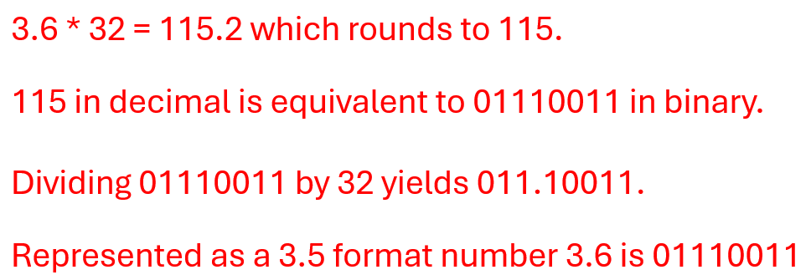
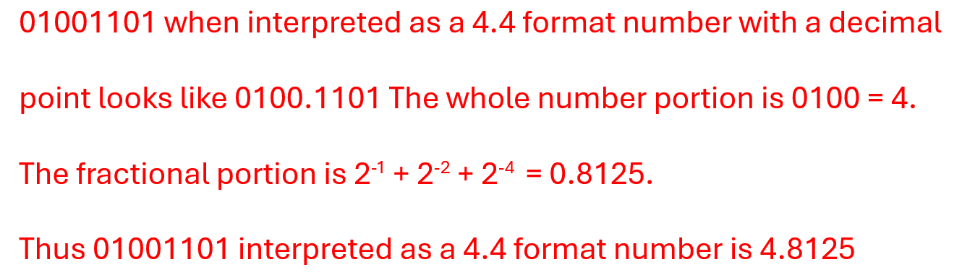
Test Your Understanding
What is the 3.5 format numbering representation of decimal 3.6?
Interpret 01001101 as a 4.4 format number.

Slide 17
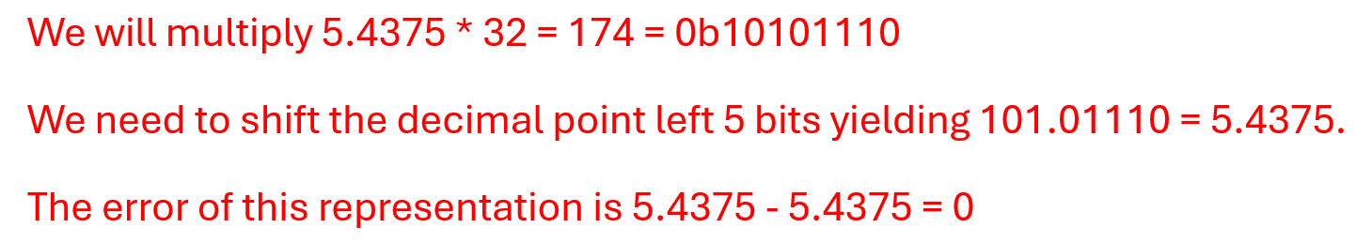
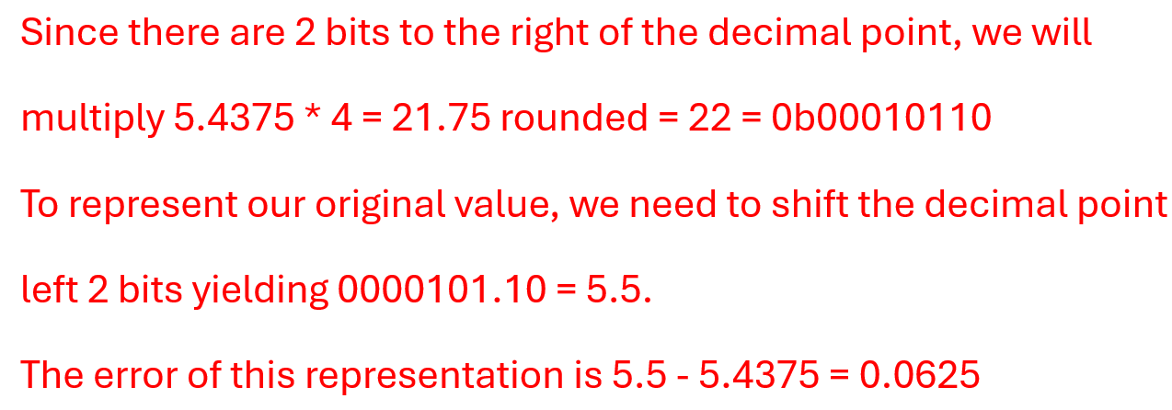
Test Your Understanding
Determine the representation of 5.4375 as a 3.5 format number. Also calculate the error of this representation.
Determine the representation of 5.4375 as a 6.2 format number. Also calculate the error of this representation.

