Slide 1


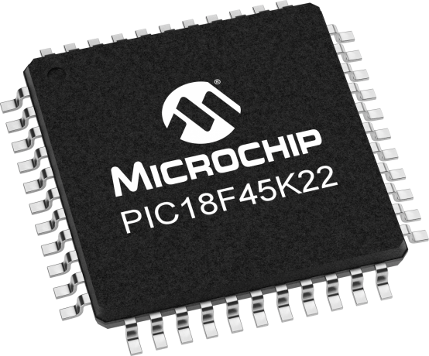
Lecture 29: DDS
Prof. Sager
Objective:
Introduction to the concept of DDS to use it to motivate the introduction of FPF.

Slide 2

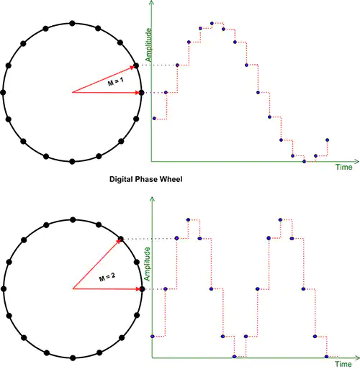
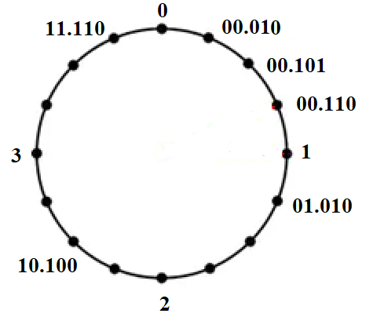
Direct Digital Synthesis: DDS
It is a digitally-controlled method of generating multiple frequencies from a reference frequency source.
It is a technique that allows producing some periodic waveform with a finely
adjustable frequency
(e.g. generating sine waves).

Slide 3
DDS: how it works?
A stable clock drives a programmable-read-only memory (PROM) that stores a digital representation of a waveform (like a sine wave).
By changing the phase increment (the value stored in a phase register), you can change the frequency of the generated waveform.
The integer part of the phase accumulator output is used as the address to the ROM containing the waveform.
A digital-to-analog converter (DAC) then converts the digital signal into an analog waveform.

Slide 4
Benefits of DDS
Precise frequency control: DDS allows for fine-grained control over frequency and phase.
Fast switching: DDS devices can switch between output frequencies quickly.
Broad frequency range: DDS can operate over a wide spectrum of frequencies.
Compact and low-power: DDS devices are typically compact and require less power than traditional analog synthesizers.

Slide 5
Applications of DDS
Signal generation.
Local oscillators in communication systems.
Function generators.
Mixers, modulators, and sound synthesizers.
Part of a digital phase-locked loop.
Notes:
While both oscillators and function generators produce periodic waveforms, a function generator can produce a wider variety of waveforms (like sine, square, triangle, and sawtooth) while an oscillator typically generates only a single type, often sine or square waves.

Slide 6
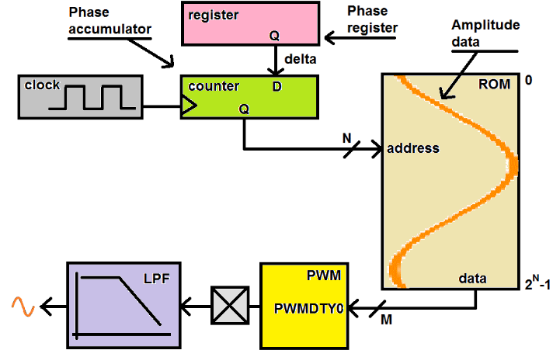
Direct Digital Synthesis: DDS
This is not F_{OSC}/4
It is the ISR
calling rate
(10 KHz)
PI
ROM = Array
Address = index
n+m
The ROM contains a digitized version
of your periodic waveform.
the stored values of a sinusoid are shown in orange
CLK source
PA
It is the update rate of the DDS system
& entirely determined by your code.
PA=PA+PI
Every clock period, the Phase accumulator is incremented by the value contained in the Phase register, (we call this value Phase Increment, PI).
255
DAC
0
We call the value contained in the Phase register Phase Increment, PI.
Changing the PI, changes the freq of the waveform generated by the DDS system.
The integer part (more on this later) of the PA is used as the address to a ROM.
The output from the ROM is feed into a duty cycle register (PWMDTY) of the PWM subsystem.

Slide 7
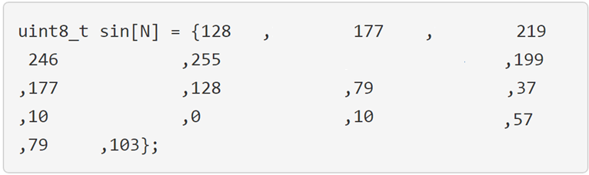
Direct Digital Synthesis: DDS
Example: a 16-entry ROM given as a C-code snippet.
The amplitude of this sine wave starts at 128 & does not finish at 128.
i.e. the sine wave does not complete a full wave, instead it ends at 103, one value short of completing a full wave.
The PA will roll-over from 15 to 0, forming a correct transition from 103 (the end of one wave) to 128 (the start of next wave).
The array does not end at 128!

Slide 8
Direct Digital Synthesis: DDS
Example: a 16-entry ROM given as a C-code snippet.
To fill the DDS ROM w/ this 16 entries, the address for the ROM would be 4-bit bits wide (addresses between 0 and 15).
The ROM would be 8-bits wide so that it could accommodate the range of values between 0 - 255.

Slide 9
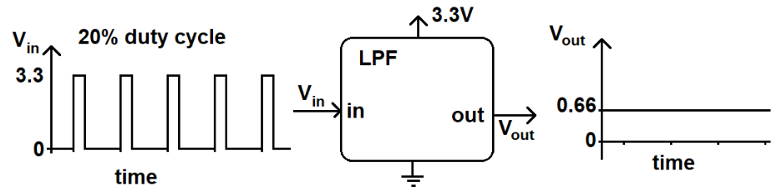
Direct Digital Synthesis: DDS
DAC
The output from the ROM is feed into a duty cycle register (PWMDTY) of the PWM subsystem.
The PWM output is sent to a LPF which averages the PWM waveform.
So, a 3.3V PWM waveform with a 20% duty cycle will have a LPF output of 20% of 3.3V or 0.2*3.3V = 0.66V.
This produces a reasonably good analog value.

Slide 10
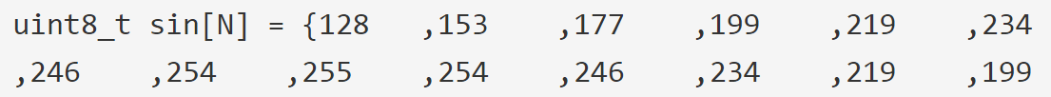
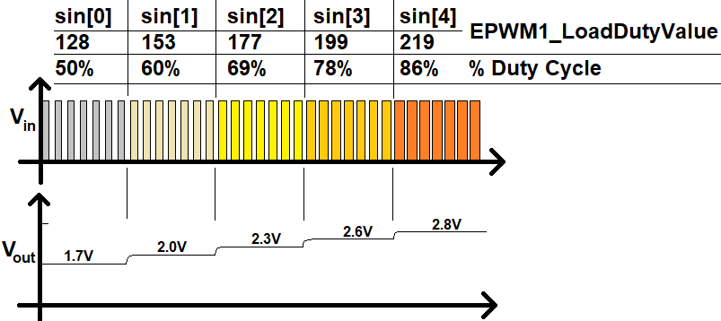
Direct Digital Synthesis: DDS
The DDS algorithm strings together a series of these analog values to produce an analog waveform as shown in the image below.
128/255 = 1.66 =1.7
Let's look at math that relates the PI to the frequency of the output waveform.

Slide 11
Phase Increment, PI
Example:
The update rate = 10us, PI = 1, and 64 words ROM. Find Period of the wave form.
This means that every 10us, the address to the ROM would increase by 1.
It follows that it would take 64*10us = 640us to go from the start (address 0) to the end (address 63) of the ROM.
In those 640us you would generate 1 wave of the sinusoid.
The reciprocal of 1/640us wave is 1,563 waves per second or 1.563kHz.
Now let's change the PI to 2 while leaving the update rate alone.

Slide 12
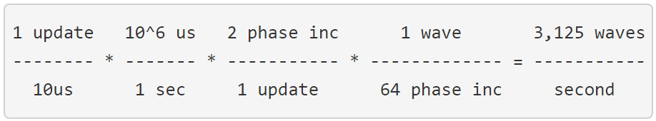
Phase Increment
Now it would only take you 32*10us = 320us to go from the start to the end of the ROM.
Thus the period of the wave would be 320us or a frequency of 3.125kHz.
Since we will be working with more complex calculations, let's use dimensional analysis to arrive at this result.
For now, we allow fractional PIs and fractional values for the PA, assuming that the output of the phase accumulator is truncated to an integer before being used as the address to the ROM.
We will return to this assumption later and see how this can be accomplished in hardware.

Slide 13
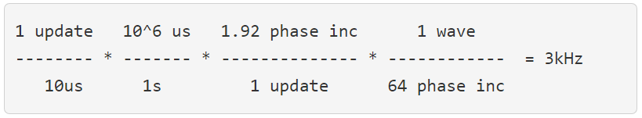
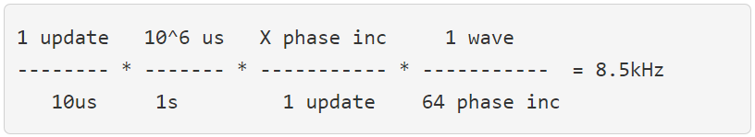

Phase Increment
Problem:
A DDS system with an update rate of 10us, a 64 entry ROM, and a phase increment of 1.92. Find the frequency of the output waveform.
Problem:
A DDS system with an update rate of 10us, a 64 entry ROM. Find the phase increment to generate a 8.5kHz wave.

