Slide 1


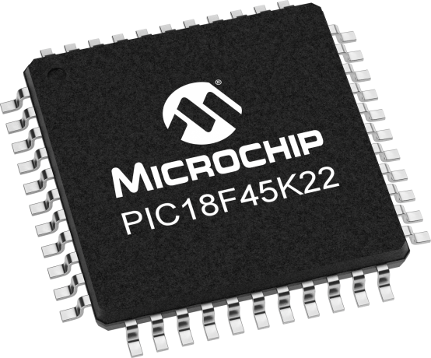
Lecture 30: DDS Examples
Prof. Sager
Objective:
Understanding how to adjust DDS parameters to generate waveforms with varying frequencies given a table size and update rates.

Slide 2

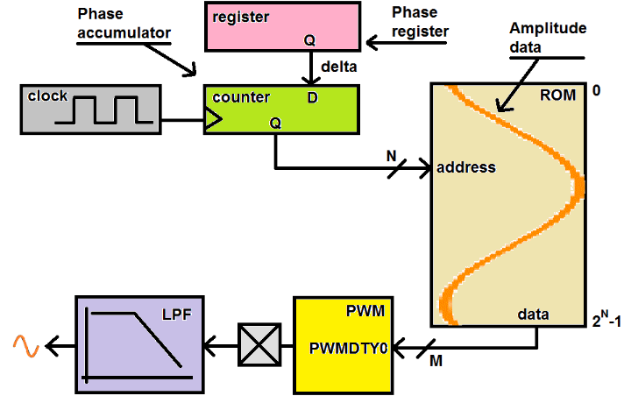
Direct Digital Synthesis: DDS
This is not F_{OSC}/4
It is the ISR
calling rate
(10 KHz)
PI
ROM = Array
Address = index
n+m
The ROM contains a digitized version
of your periodic waveform.
the stored values of a sinusoid are shown in orange
CLK source
PA
It is the update rate of the DDS system
& entirely determined by your code.
PA=PA+PI
255
Every clock period, the Phase accumulator is incremented by the value contained in the Phase register, (we call this value Phase Increment, PI).
DAC
0
We call the value contained in the Phase register Phase Increment, PI.
Changing the PI, changes the freq of the waveform generated by the DDS system.
The integer part of the PA is used as the address to a ROM.
The output from the ROM is feed into a duty cycle register (PWMDTY) of the PWM subsystem.

Slide 3
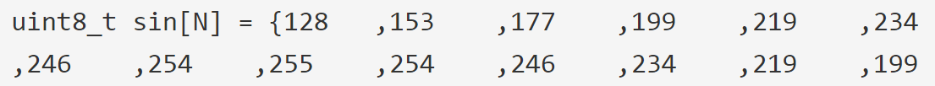
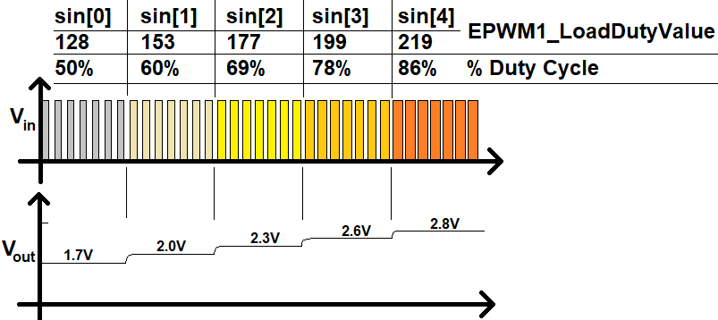
Direct Digital Synthesis: DDS
The DDS algorithm strings together a series of these analog values to produce an analog waveform as shown in the image below.
128/255 = 1.66 =1.7
Let's look at math that relates the PI to the frequency of the output waveform.

Slide 4
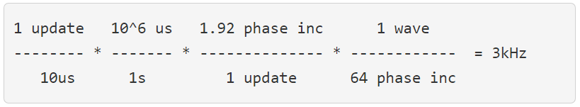
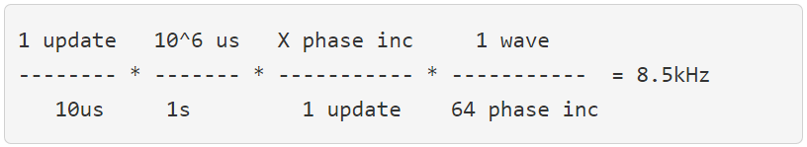

Phase Increment
Problem:
A DDS system with an update rate of 10us, a 64 entry ROM, and a phase increment of 1.92. Find the frequency of the output waveform.
Problem:
A DDS system with an update rate of 10us, a 64 entry ROM. Find the phase increment to generate a 8.5kHz wave.

Slide 5

DDS
Given a DDS system with an update rate of 10us, a 8 entry ROM, and a 3.5 format fixed point phase increment, what phase increment generates a frequency of 20kHz?
X = 1.6
1.6*2⁵ = 51.2 = 51 = 0011 0011
X = 1.6 = 001.00011 = 0x33

Slide 6

DDS
Given a DDS system with an update rate of 10us, a 8 entry ROM, and a 3.5 format fixed point phase increment, what phase increment generates a frequency of 120kHz?
Solving for X yields 9.6 = 10 = 1010
9.6 value cannot be represented as a 3.5 format number because 3.5 format numbers are in the range [0 to 7.97]
7.97 = 111.11111

Slide 7

DDS
Given a DDS system with an update rate of 10us and a 64 entry ROM, What is the lowest frequency waveform you can create with a 6.2 format fixed point phase increment?
The key to this solution is using the fixed-point format to make the smallest possible phase increment = 000000.01 = 0.25

Slide 8
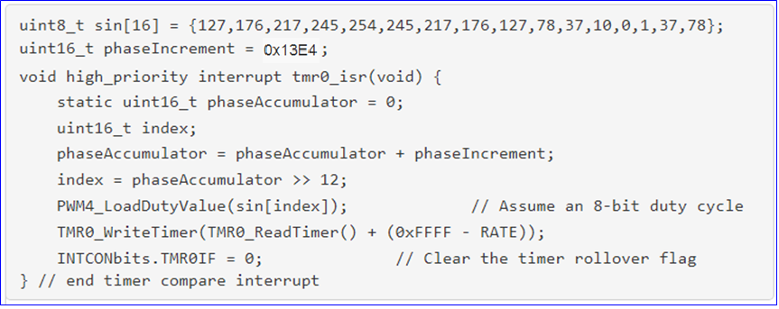
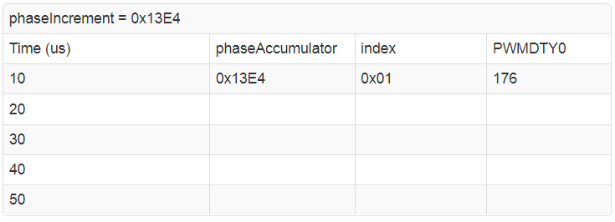
DDS
For example, let’s say that we needed PI to be13E4
Use the algorithm to complete the table
0x27C8 0x02 217
0x3BAC 0x03 245
0x4F90 0x04 254
0x6374 0x06 217

