Slide 1


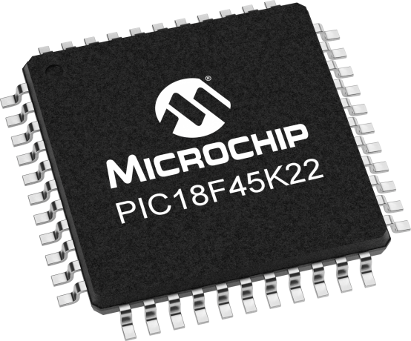
Lecture 31: Look up Table (LUT)
Prof. Sager
Objective:
Introducing a look-up table to interpolate values between table elements.

Slide 2

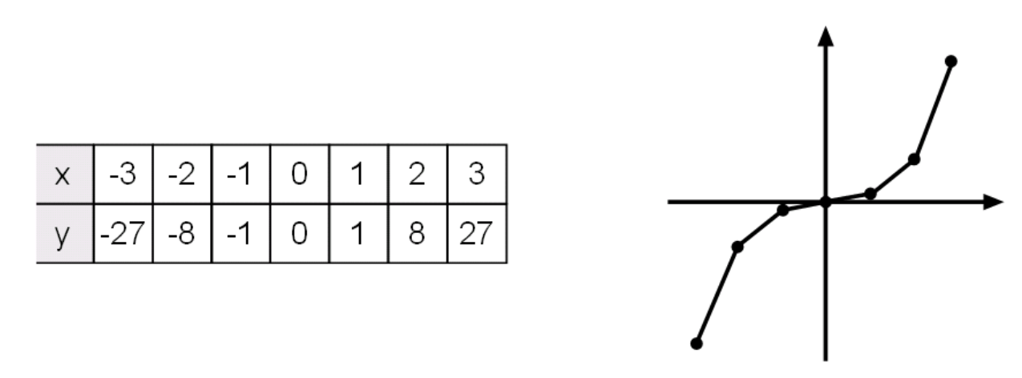
Embedded Programming: Lookup Tables
Lookup tables or truth tables are used to implement a single logic function by storing the correct output logic state in a memory location that corresponds to each particular combination of input variables.
A lookup table is an array of data that maps input values to output values, thereby approximating a mathematical function.
Given a set of input values, a lookup operation retrieves the corresponding output values from the table.

Slide 3
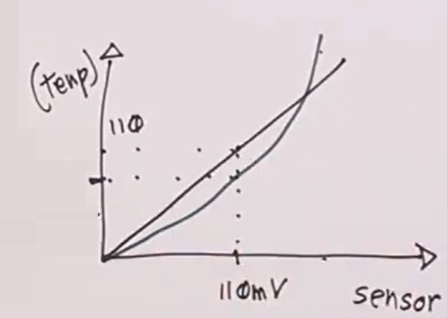
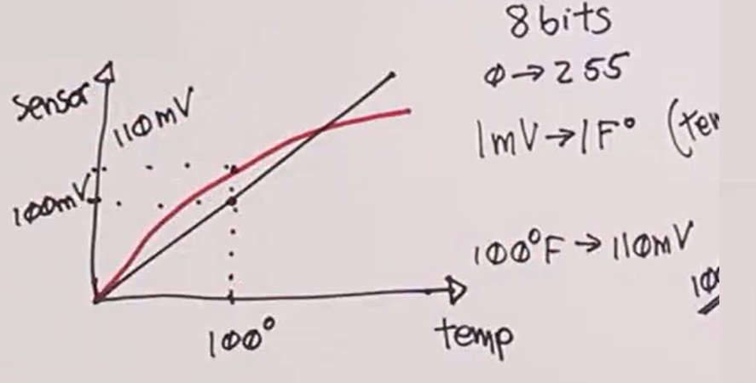
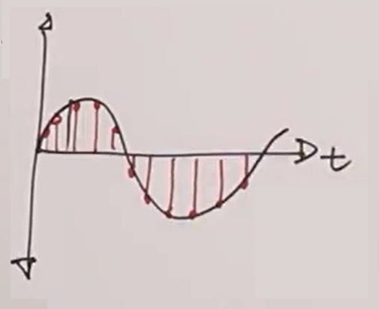
Embedded Programming: Lookup Tables
Correct nonlinearity through inverse relationship
Look up Table: trading memory for computation speed.
It can be used for error correction/linearization
X = read_temp_table();
It can be used for Wave table: e.g. DDS, temp = table[X];
V = A sin (2Πft)
port = wave_table[i++];

Slide 4
LUT
If you wanted to compute the SQRT(X) using the PIC, and you were lucky to have a compiler provides this function.
If you did not have such a library, you would have to figure out a way to compute the SQRT.
One approach would be to enumerate every possible value of x and its square root, and then look-up a SQRT in the table (go to the row corresponding to X).
To reduce the amount of used space, eliminate some entries, accept some error by using the closest x in the table or use interpolation.
Interpolation is creating missing data by using the average of two values.
This average is also referred to as linear interpolation.

Slide 5
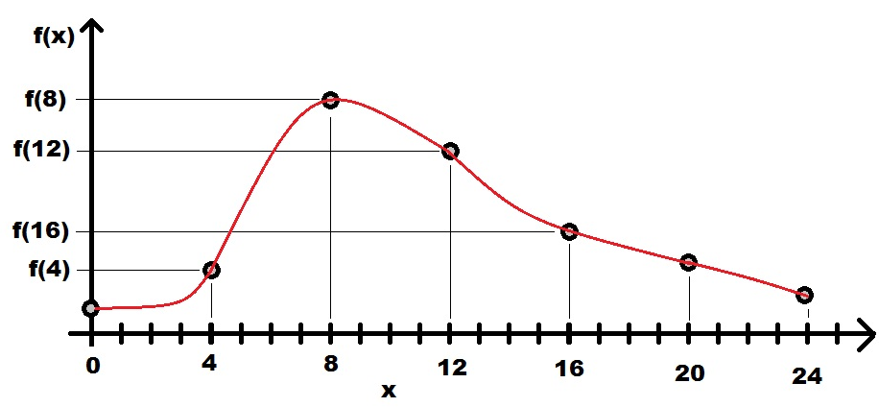
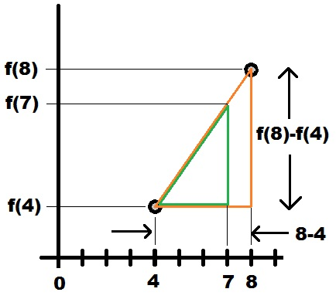
Example
On left, a plot of some function f(x) shown in red, and we stored every 4th value of f(x) at x = 0, 4, 8, 12, 16, 20, & 24. Use these values to compute the value of f(7).
Approximate the actual red function f(x) between x=4 and x=8 as a straight line between x=4 and x=8 shown in orange at right.
This forms the hypotenuse of the orange right triangle.
To determine the value of f(7) we take a portion of the orange hypotenuse between x=4 and x=7 forming the hypotenuse of a smaller green right triangle.
Notes:
hīˈpätnˌ(y)o͞os

Slide 6
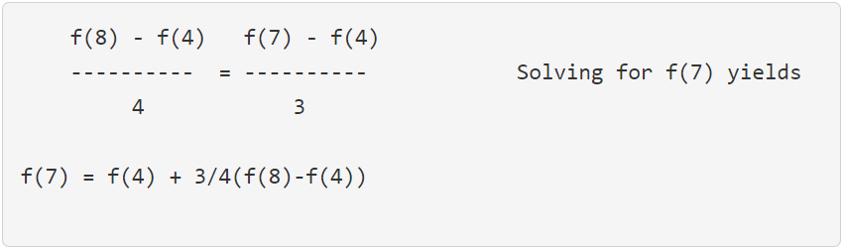
Example
The height of the orange triangle is f(8)-f(4), and the base length is 8-4=4.
For the green triangle, the height is f(7)-f(4) and a base length is 7-4=3.
The triangles are similar triangles, the ratios height to base is equal. Doing the math provides the equality.
Let’s extract some general concepts and turn it into code.

Slide 7
Firmware concepts
Store the values of f(0), f(4), f(8), ... f(24) into an array.
Given x=7, how do we get the index of f(4) or f(8) to use in calculation?
Since we sampled the function f(x) at every fourth value, We need to know which “4th value" is 7 closest to.
7/4 = 1 ¾ = 1
so we use index 1, i.e. f(4).
this 1 + 1 gives the next stored value, i.e. f(8)
Looking at the above expression for f(7) all we need is a way to compute the "3/4".
This expression describes how far along through the "fourth value" we have traversed.
The following firmware formalizes these observations.

Slide 8
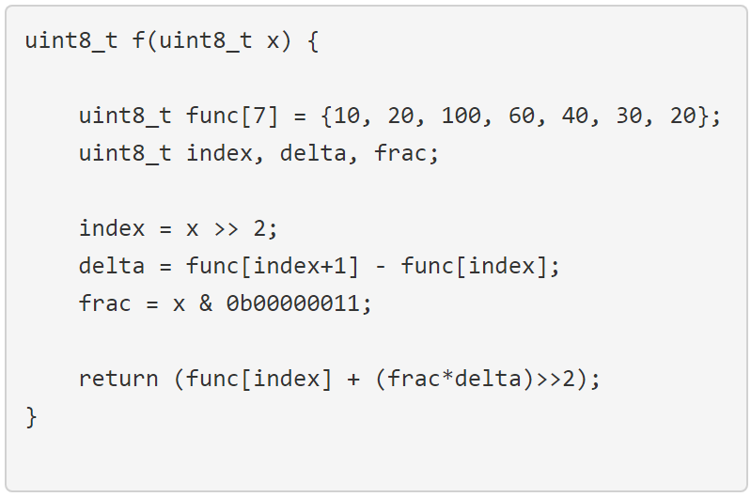
Firmware concepts
uint8_t values between 0 and 255
compute index 7/4 (x/2²) and discard the fraction.
We can do this by shifting 7 right by 2 bits.
We ignored delta could be -ve.
To compute the fraction ¾: Step1: mask off the LS 2 bits of x.
Step2: divide by 4 inside the return statement

Slide 9
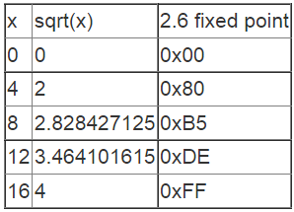
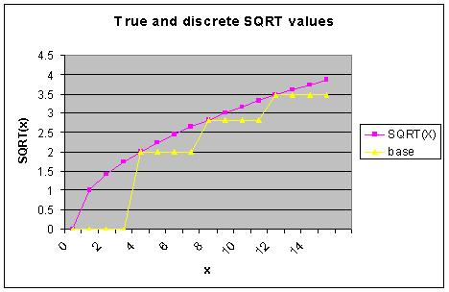
Square Root
Lets examine how to determine SQRT.
The purple curve shows the true value of SQRT (for the integers 0-15).
The yellow represents the SQRT for 4 equally spaced values (shown in the table).
3.99
So, we can use 2 bits for all
integer parts in this column
if we use 2.6 FPF

Slide 10
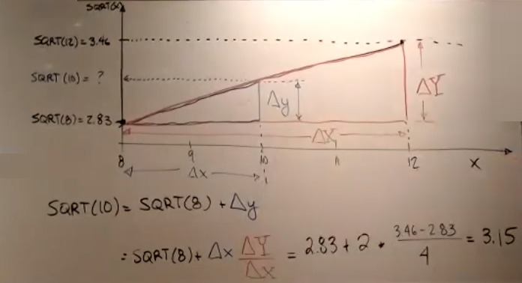
Square Root

Slide 11
Firmware for square root
Assume the i/p is a 4-bit integer in the range 0-15. So, the o/p would be between 0.0 and 3.99 (include some fractional).
Since 8-bit is the norm for PIC, let’s say we needed to use 8-bit o/p.
Since the whole number portion of the answer is in the range 0-3, we could have 2 whole number of bits and 6 fractional bits.
What should be format if we include 4.0 in the square root table?
4.0, cannot be represented as a 2.6 format it requires 3.5 format.
If we accept the approximation: 4.0 as 2.6 format, 0b11111111.
Allowing for this small error in a single representation gains us an extra decimal point for every output, let’s accept this.

Slide 12
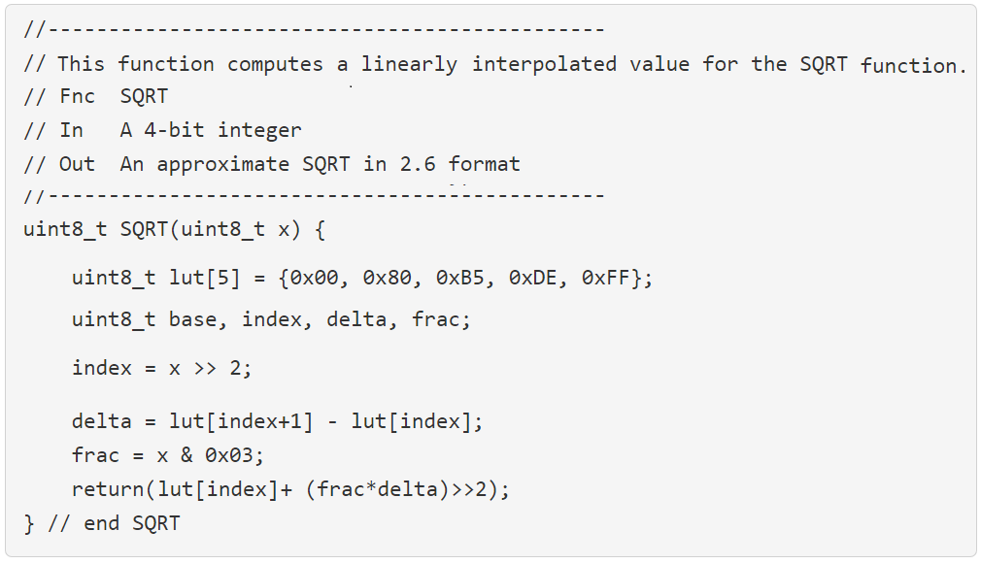
Firmware concepts

Slide 13
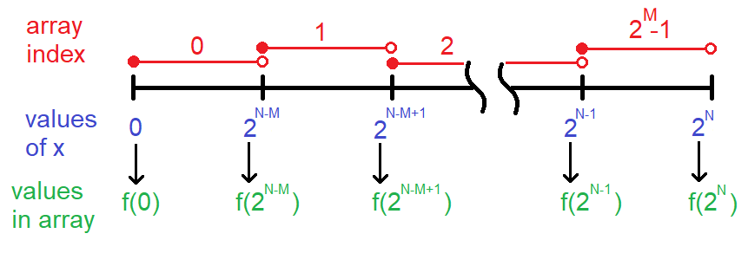
General theory
The operations performed in the LUT function depends on:
# of different possible i/p’s, 2^{N}. In SQRT function, N = 4.
# of entries in the array, 2M+1. In SQRT function, 5 entries in the array.

Slide 14
General theory
Some observations:
The red lines below the array index numbers show the interval of x values associated with that array index.
These intervals are closed on the left and open on the right. So, for example, the inputs [0 … 2^{N-M-1}] are associated with f(0).

Slide 15
General theory
The last value of x, the blue 2^{N} is not a legal input to the function and exists to provide a bookend for interpolation in the last interval.
The last value store in the array f(2^{N}) is the bookend value for interpolation in the last interval.
Each array index interval has 2^{N-M} values of x in it.

