Slide 1


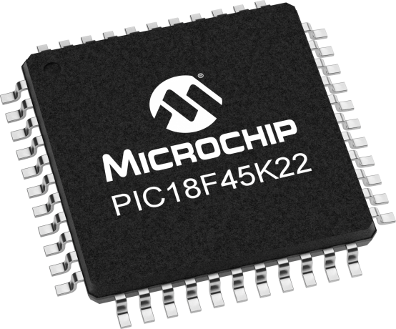
      Frequency resolution
      Multiplication by constants examples
      LUT examples

Slide 2

Frequency Resolution
Now let's examine some performance metrics associated with a DDS system.
One of the most important one is the frequency resolution; the smallest change possible with a DDS setup.
We need to introduce the concept of consecutive representations for fixed-point numbers.
Two fixed-point numbers will be said to have consecutive representations if one of them can be derived by adding binary 0000001 to the other.

Slide 3
Frequency Resolution
For example, in a 4.4 format numbers 0010 1101 and 0010 1100 are consecutive representations
(since you can add binary 00000001 to the second number and
arrive at the first number)
0010 1101 and 0010 1110 are not consecutive representations.

Slide 4
Frequency Resolution
Question: Given a 4.12 format number what is the change in value between consecutive representations in 4.12 format and in decimal?
Answer: Given two consectutive representations of 4.12 numbers, the difference between them will always be 0000.000000000001 or 2⁻¹². This works out to 244*10⁻⁶.

Slide 5
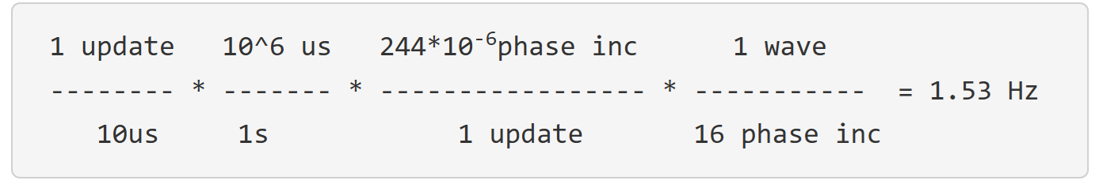
Frequency Resolution
Question: Given a 4.12 format number for the phaseIncrement and phaseAccumulator, a 10us update rate, and a 16 entry ROM, what is the frequency change between consectutive representations of the phaseIncrement?
Answer: From the previous question we know that the difference between consecutive 4.12 numbers is 0000.000000000001 or 2⁻¹² = 244*10⁻⁶. Using this difference as the phase increment in our DDS equations yields:

Slide 6
Frequency Resolution
This is a general result, there will always be 1.53Hz difference between consecutive representation.
This value is so important, it is given a name, frequency resolution.
The frequency resolution of a DDS system is the frequency change between consecutive representations of the phase increment.
The frequency resolutions is affected by
    update rate,
    fixed point format of the phase increment
    ROM size.

Slide 7
Frequency Resolution
Let's see how one of these factors affects the frequency resolution of our DDS algorithm
Question: Let's change the datatype of phaseIncrement and phaseAccumulator from int16 to int8. What is the frequency resolution of the resulting algorithm?
Answer: Our phase increment will no longer be a 4.12 format number because these 16-bits will not fit into an int8. Since we need 4 integer bits to access the ROM, this leaves only 4 fractional bits. Thus, the phase increment is a 4.4 format number.
The change in value between consecutive 4.4 representations is 0000.0001 = 2⁻⁴ = 0.0625

Slide 8
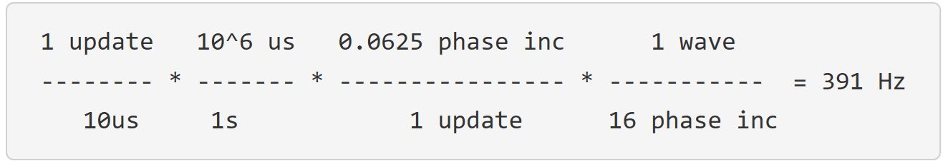
Frequency Resolution
Now we can use our DDS equation to determine the frequency resolution using the phase increment between consecutive representations of the phase increment.

Slide 9
      Examples
Example 1
Multiply x8 by 10 and put the result into a variable y16.
y16 = (x8 << 3) + (x8 << 1);
i.e. 10*x = (8 + 2)*x = 8*x + 2*x

Slide 10
Example 2
Multiply x8 by 21 and put the result into a variable y16.
y16 = (x8 << 4) + (x8 << 2) + x8;
i.e 21*x = (16 + 4 + 1)*x = 16*x + 4*x + x

Slide 11
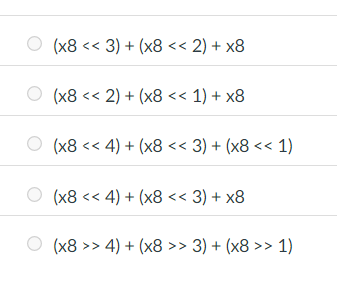
Example 3
Which of the following multiples an integer x8 by 13?

Slide 12
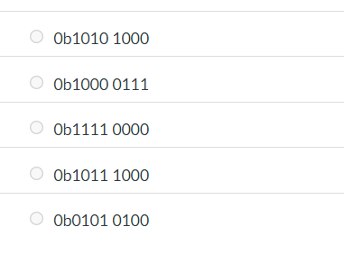
Example 4
Represent 1.3125 as a 1.7 FPF number in binary. The space in answer is to help you read the values correctly.
1.0101 1.0101000 1010 1000

Slide 13
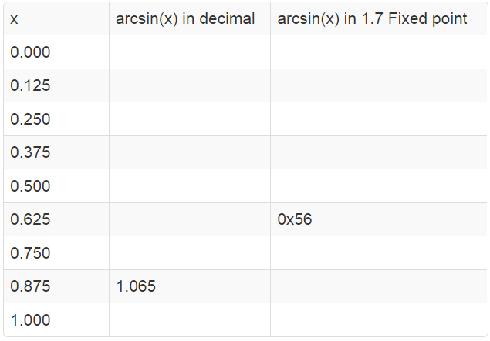
Example 5
Create LUT for the arcsin by completing the following table.
0.00 | 0x00
0.125 | 0x10
0.253 | 0x31
0.384 | 0x31
0.524 | 0x43
0.675
0.848 | 0x6D
 | 0x88
1.571 | 0xC9
https://www.rapidtables.com/convert/number/decimal-to-binary.html
https://www.rapidtables.com/calc/math/Arcsin_Calculator.html

Slide 14
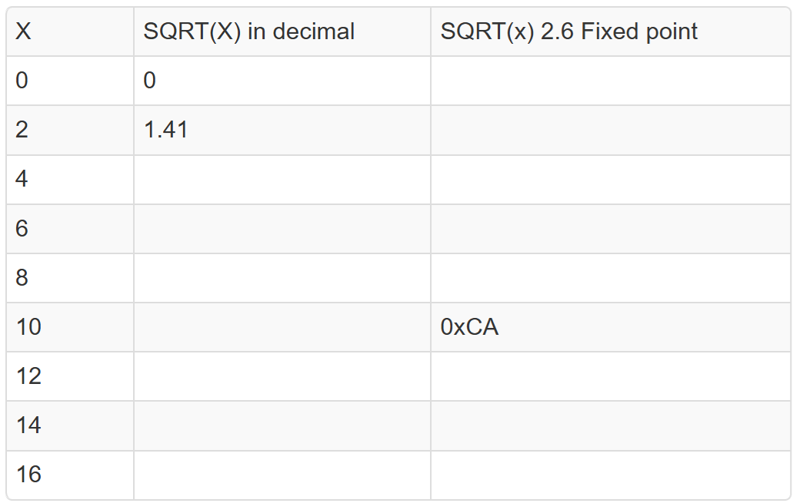
Example 6
Complete the square root LUT so that it has 9 entries.
 | 0x00
 | 0x5B
2.00 | 0x80
2.45 | 0x9D
2.83 | 0xB5
3.16
3.46 | 0xDE
3.74 | 0xEF
4.00 | 0xFF

Slide 15
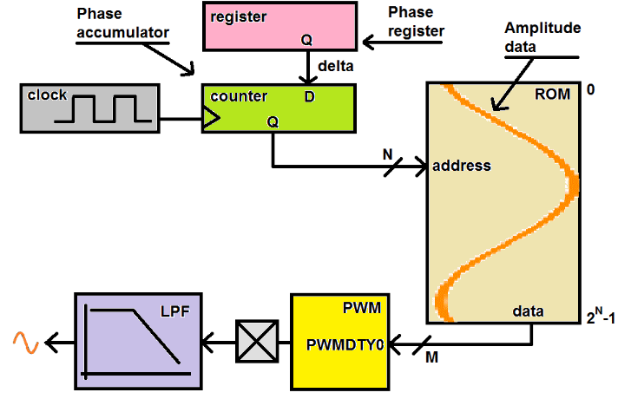
DDS: From Lecture 29
This is not F_{OSC}/4
It is the ISR
calling rate
(10 KHz)
PI
ROM = Array
Address = index
n+m
The ROM contains a digitized version
of your periodic waveform.
the stored values of a sinusoid are shown in orange
CLK source
PA
It is the update rate of the DDS system
& entirely determined by your code.
PA=PA+PI
Every clock period, the Phase accumulator is incremented by the value contained in the Phase register, (we call this value Phase Increment, PI).
255
DAC
0
We call the value contained in the Phase register Phase Increment, PI.
Changing the PI, changes the freq of the waveform generated by the DDS system.
The integer part (more on this later) of the PA is used as the address to a ROM.
The output from the ROM is feed into a duty cycle register (PWMDTY) of the PWM subsystem.

Slide 16
Example 7
Earlier we got:

Slide 17
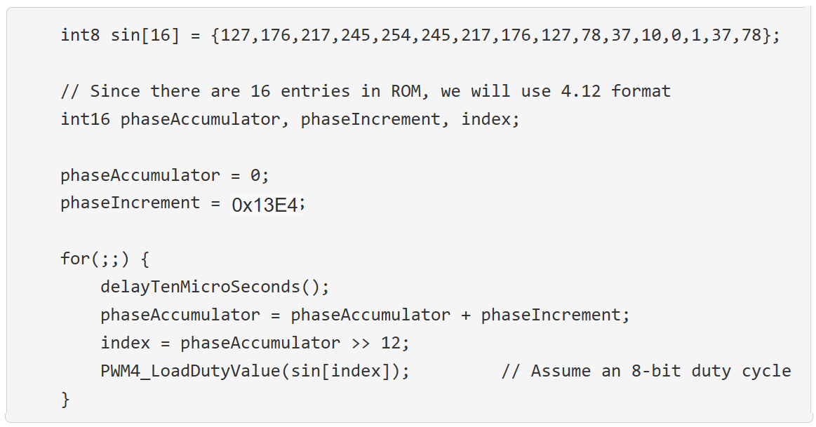
Example 7
Assume that we implemented DDS as following:

Slide 18
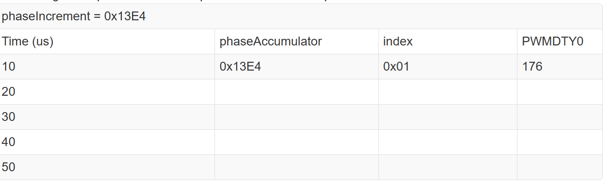
Example 7
Use the algorithm in the previous slide to complete the following table:
0x27C8 0x02 217
0x3BAC 0x03 245
0x4F90 0x04 254
0x6374 0x06 217

Slide 19
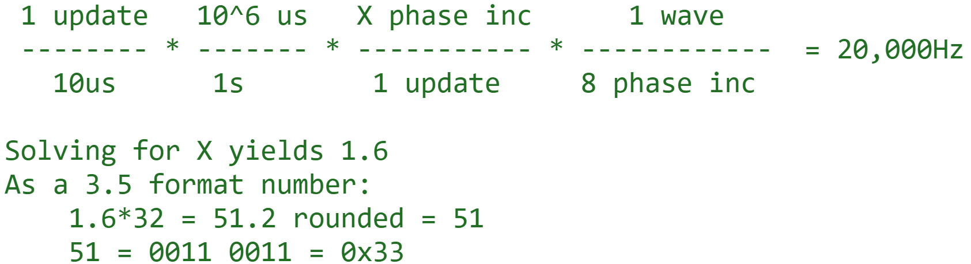
Example 8
Given a DDS system with an update rate of 10us, a 8 entry ROM, and a 3.5 format fixed point phase increment, what phase increment generates a frequency of 20kHz?

Slide 20
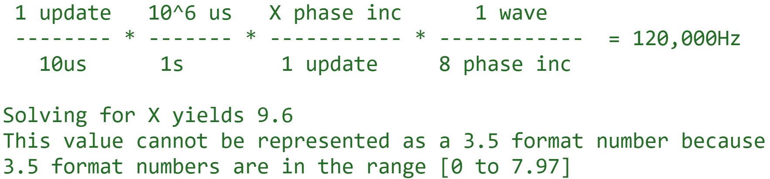
Example 9
Given a DDS system with an update rate of 10us, a 8 entry ROM, and a 3.5 format fixed point phase increment, what phase increment generates a frequency of 120kHz?

