Slide 1


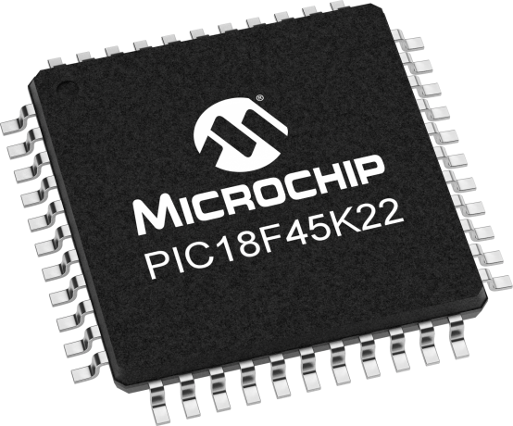
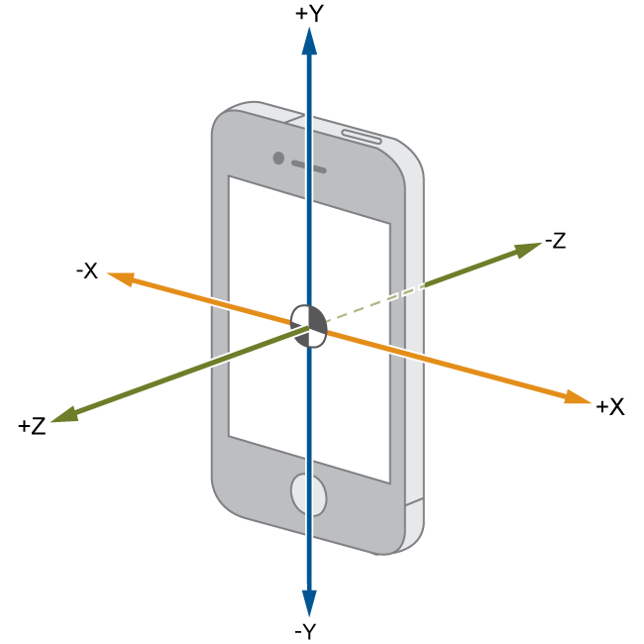
Lecture 33: Accelerometers & gyroscope
MPU in MPU6050 stands for
Motion Processing Unit

Slide 2

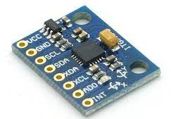
GY-521 Module
The GY-521 module is a breakout board for the MPU-6050 MEMS (Microelectromechanical systems).
MPU-6050
It is a 6 DOF or a 6 axis sensor, which means that it gives six values as output.
3 from the accelerometer and 3 from the gyroscope.
The MPU 6050 is a sensor based on MEMS (Micro Electro Mechanical Systems) technology.
Notes:
DOF = Degrees of Freedom

Slide 3
MPU-6050
MPU-6050 has two datasheets:
1. The Product Specification: it describes:
    the electrical characteristics of the MPU-6050.
    the architecture of the chip.
    the communication interface.
    the sensor performance.
  So, it tells you what the chip can do.
2. The Register Maps & Descriptions: tells how to get data from the MPU-6050. You will need to interface to the internal registers.
You should download both these documents by looking up the MPU-6050 in Digikey (part number 1428-1007-1-ND).

Slide 4
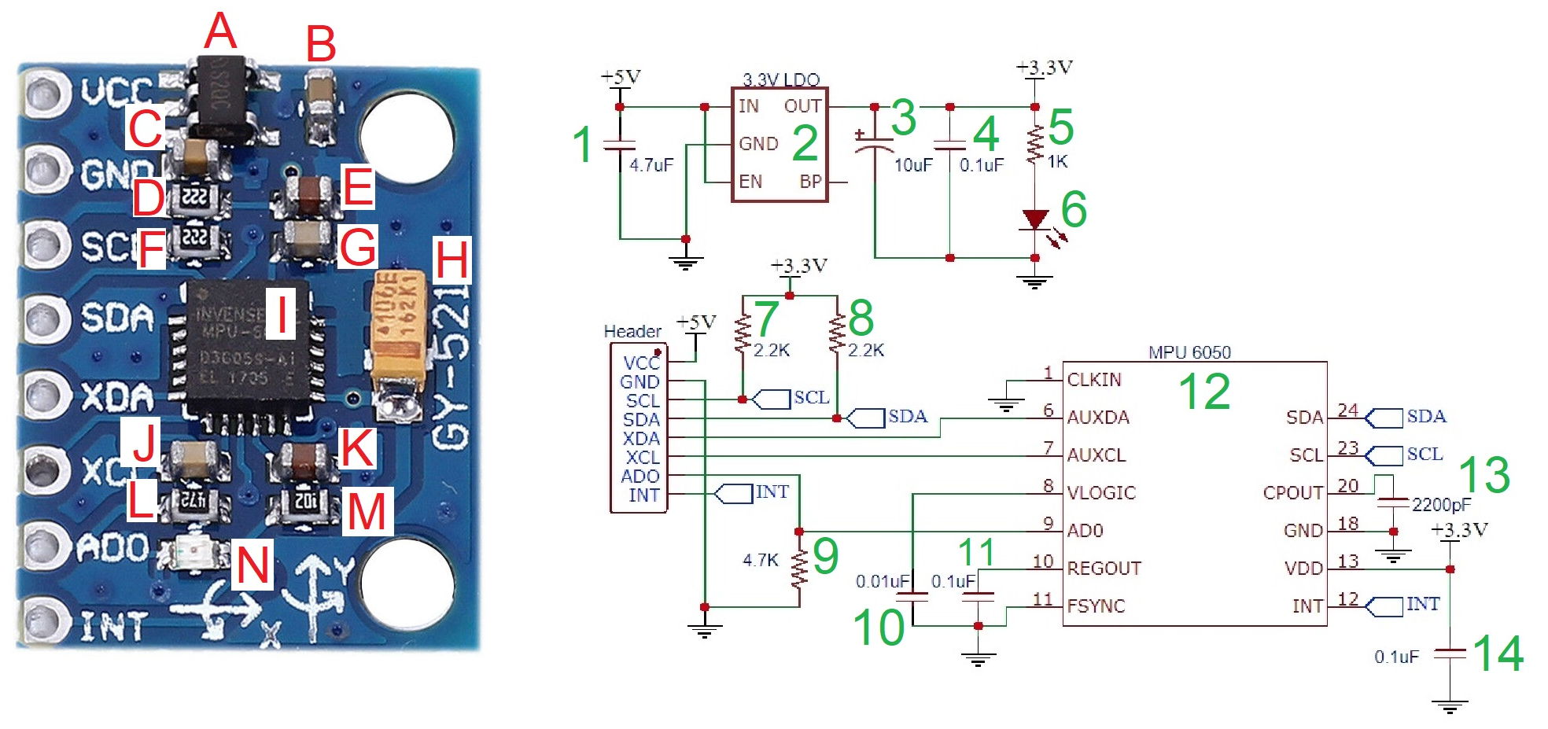
MPU-6050
You will explore of this handy little board by closely examining the components on it and how they are interconnected.
You will match each component on the board with its corresponding component on the schematic.

Slide 5
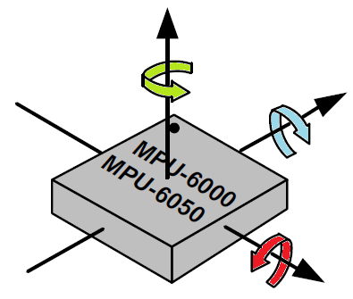
MPU-6050
The MPU-6050 contains a 3-axis accelerometer and 3-axis gyroscope.
It can measure:
  accelerations along 3 perpendicular axes and
  the rate of rotation along 3 perpendicular axes.
These axis are aligned with the faces of the device package.

Slide 6
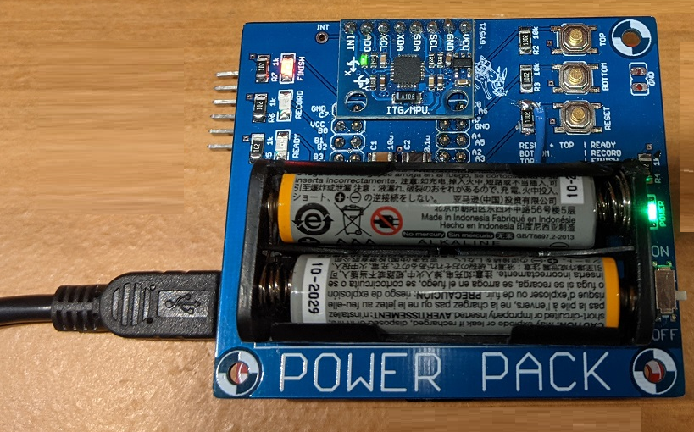
MPU-6050
You could relate the directions of 6050 axes to the directions of which the daughter board can be moved.
Up and down are not shown in the image.
Forward
Left
Right
Back
Notes:
moving the board up off the desk or pushing it down

Slide 7
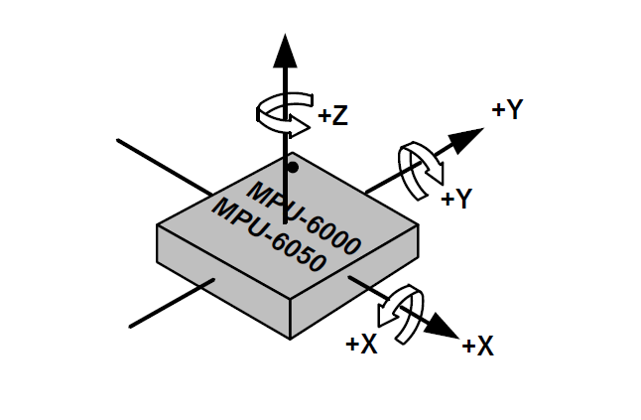
MPU
In the MPU6000 Datasheet, look for the Orientation of Axes section. Use the information here to add "+X", "+Y" and "+Z" to the three axis and three rotational directions to the image below. P21.
Notes:
https://learn.sparkfun.com/tutorials/accelerometer-basics/all

Slide 8
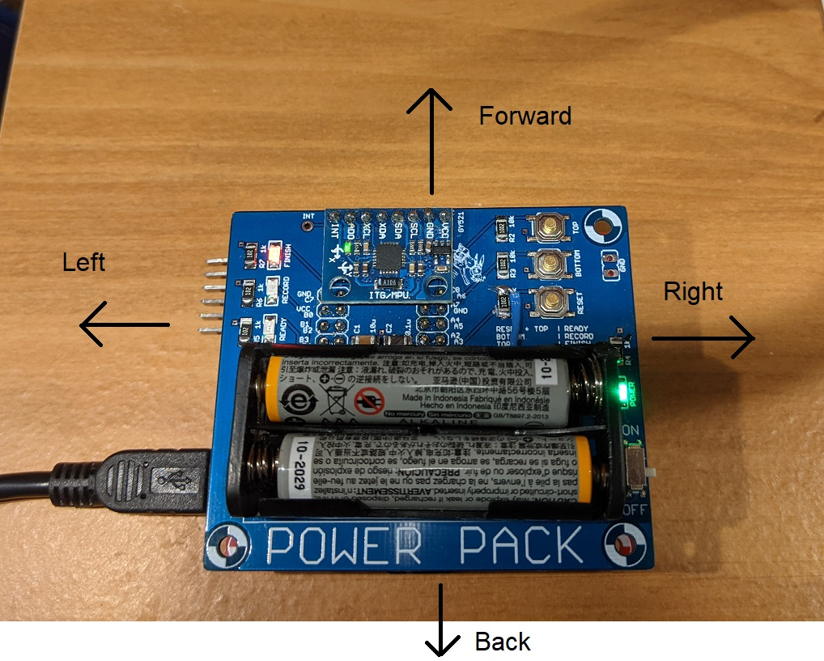
MPU
Find the white dot indicating pin 1 on the MPU-6050 chip.
Hold the daughter board in front of you so that you can read the white silk screen "POWER PACK".
Relate the directions of the MPU-6050 axis, explored in the previous question, to the directions of the daughter board can be moved: forward, back, left, right, up, down.
Axis | Direction
+X | Back
-X | Front
+Y | Right
-Y | Left
+Z | Up
-Z | Down
Notes:
https://learn.sparkfun.com/tutorials/accelerometer-basics/all

Slide 9
MPU
Axis | Direction
+X | Back
-X | Front
+Y | Right
-Y | Left
+Z | Up
-Z | Down
Notes:
https://learn.sparkfun.com/tutorials/accelerometer-basics/all

Slide 10
MPU
In the MPU-6050 Product Specification document (P.7), look for the MPU-60X0 Overview section.
What is the difference between the serial interface of the MPU-6000 and MPU-6050?
The MPU-6000 has both a SPI and I2C interface whereas the MPU-6050 only has an I2C interface.
I2C (or I²C—Inter-Integrated Circuit) or SPI (Serial Peripheral Interface)
Both conceived in the 1980s—SPI by Motorola and I2C by Philips (now NXP). SPI exists as a de facto standard, while I2C is more formalized. Both are synchronous protocols, appropriate for short distance communications, and they generally operate in the 3.3 or 5V range.

Slide 11
MPU Function
How the MPU reports acceleration and rotation rates?
It measures the amount of acceleration along each of its 3 axis using the units of g's, equivalent gravitational force. 1g is the force felt by a stationary object on the surface of Earth.
It measures the rotational velocity around each of its 3 axis using the units of °/s. If you turn around once, you have turned, 360°.
If you turn around in half a second, your rotational rate is 720°/s.
If it takes you 2 seconds to turn around, your rotational rate is 180°/s.
The MPU-6050 has upper and lower limits on the acceleration and rotational rates that it can measure.
Notes:
https://learn.sparkfun.com/tutorials/accelerometer-basics/all

Slide 12
MPU Function
The upper and lower limits on the acceleration and rotational rates (that it can measure) are configurable.
This allows maximizing the sensitivity for particular application.
Look in Register Maps & Description document to complete the following table. Note, the top row is the name of the register (P14&15).
ACCEL_CONFIG |  | GYRO_CONFIG
AFS_SEL[1:0] | Full Scale Range | FS_SEL[1:0] | Full Scale Range
0b00 | +/- 2gs | 0b00 | +/- 250 °/s
0b01 | +/- 4gs | 0b01 | +/- 500 °/s
0b10 | +/- 8gs | 0b10 | +/- 1000 °/s
0b11 | +/- 16gs | 0b11 | +/- 2000 °/s
Notes:
https://learn.sparkfun.com/tutorials/accelerometer-basics/all

Slide 13
What is an Accelerometer?
A devices that measures acceleration, which is the rate of change of the velocity of an object.
They measure in m/s² or in G-forces (g). A single G-force for us here on planet Earth is equivalent to 9.8 m/s²,
This does vary slightly with elevation.
Accelerometers are useful for sensing vibrations in systems or for orientation applications.
Notes:
https://learn.sparkfun.com/tutorials/accelerometer-basics/all

Slide 14
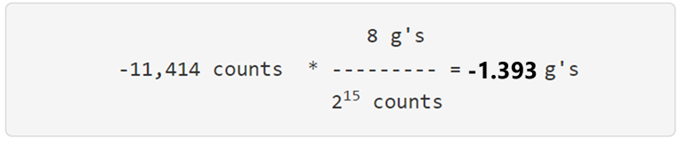
Accelerometer in the MPU
It outputs a 16-bit 2's complement value proportional to the measured g-force. Since g-force occurs in two directions.
To convert the numerical output from the accelerometer into g-force, you need to know the full scale range (FSR).
Example: MPU configured w/ FSR of ±8g and outputs the value 0xD36A as the acceleration counts. Interpret this as g’s units.
0xD36A counts, interpreted as a 16-bit 2's complement value is equal to -11,414 counts.
switch the windows calculator to scientific mode to get any fractional digits.
Notes:
https://learn.sparkfun.com/tutorials/accelerometer-basics/all

