Slide 1


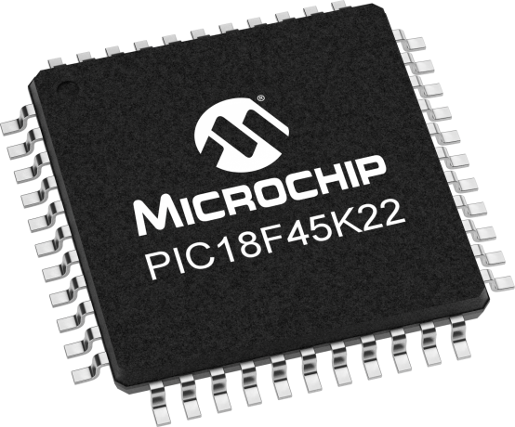
Lecture 35:
Accelerometers & gyroscope
MPU in MPU6050
Guidelines for calculations
Notes:
The terms "yaw," "pitch," and "roll" originate from the description of aircraft rotations in three-dimensional space.
These terms are used to describe the orientation and movement of an aircraft around its three main axes.
https://lastminuteengineers.com/mpu6050-accel-gyro-arduino-tutorial/

Slide 2

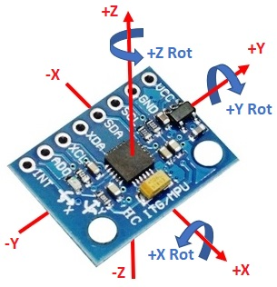
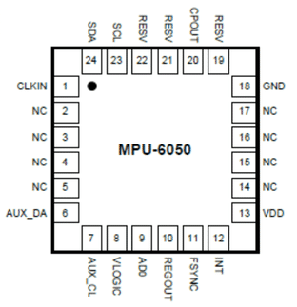
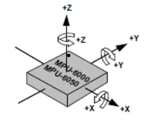
Guidelines for calculations
Let’s put the MPU into different static (non-moving) orientations and determine the numerical output of the registers.
We interpret these values based on the FSR settings.
It is important to remember that the g-force is a vectored component along each of the MPU-6050's axes.
If you tilt the MPU, the earth's gravitational force will be some vector component along each of the 3-axes.
FSR: Full Scale Range
Notes:
https://learn.sparkfun.com/tutorials/accelerometer-basics/all

Slide 3
Guidelines for calculations
To calculate how much force is applied along each of the MPU-6050's axis, calculate the vector projection of the force of 1-g.
i.e. multiplying the 1g of force by the appropriate sin or cosine.
An axis experiences +ve force when its axis is pointing away from the direction of the force (the value for g’s will be +ve).
If the axis points in the force direction, the value for g’s is -ve
Notes:
https://learn.sparkfun.com/tutorials/accelerometer-basics/all

Slide 4
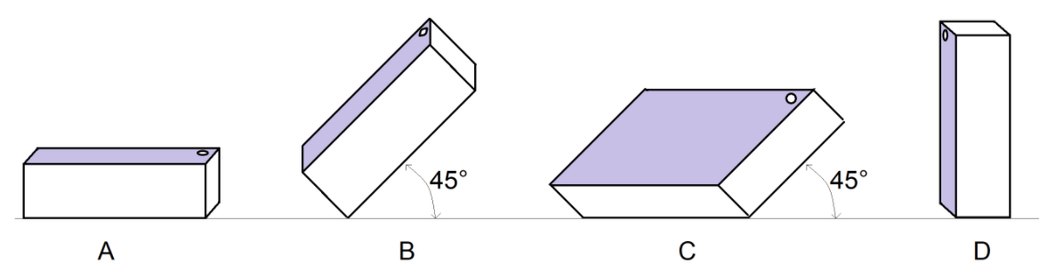
Accelerometer in the MPU
In the pictures, the MPU’s been drawn in different orientations.
The purple surface is the top of the MPU-6050 and the circle is the white dot.
The MPU is upright in diagrams A, B, C, D.
Calculate the expected MPU output in counts and g's assuming that the MPU is configured with a full scale range of ±2 g's
Notes:
https://learn.sparkfun.com/tutorials/accelerometer-basics/all

Slide 5
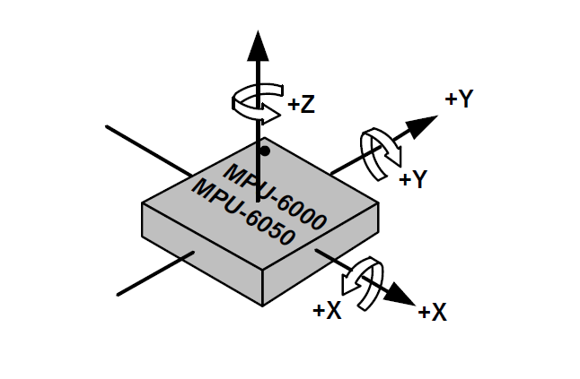
Accelerometer in the MPU
Calculate the expected MPU output in counts and g's assuming that the MPU is configured with a full scale range of ±2 g's
 | X g’s | X 16-bit 2’s | Y g’s | Y 16-bit 2’s | Z g’s | Z 16-bit 2’s
A | 0 | 0x0000 | 0 | 0x0000 | 1 | 0x4000
B | 0 | 0x0000 | 1*sin(45°) | 0x2D41 | 1*cos(45°) | 0x2D41
C | 1*sin(45°) | 0xAD41 | 0 | 0x0000 | 1*cos(45°) | 0x2D41
D | 0 | 0x0000 | 1 | 0x4000 | 0 | 0x0000
As we use 16 two’s complements bits to represent +/- 2 g’s, this means that 0x0000 will represent 0 g’s, 0x7FFF will represent +2g’s, and 0x8000 will represent -2 g’s. This corresponds to 4g’s per 16 bits which means each LSB is worth about 61 ug’s (4/(2^16)).
These values will be useful for the rest of the calculations.
Notes:
https://learn.sparkfun.com/tutorials/accelerometer-basics/all

Slide 6
Accelerometer in the MPU
Calculate the expected MPU output in counts and g's assuming that the MPU is configured with a full scale range of ±2 g's
 | X g’s | X 16-bit 2’s | Y g’s | Y 16-bit 2’s | Z g’s | Z 16-bit 2’s
A | 0 | 0x0000 | 0 | 0x0000 | 1 | 0x4000
B | 0 | 0x0000 | 1*sin(45°) | 0x2D41 | 1*cos(45°) | 0x2D41
C | 1*sin(45°) | 0xAD41 | 0 | 0x0000 | 1*cos(45°) | 0x2D41
D | 0 | 0x0000 | 1 | 0x4000 | 0 | 0x0000
A: For A, the MPU is lying flat with the Z-axis pointing straight up. This means that the X and Y axis are experiencing 0 g’s while the Z axis is experiencing 1 entire positive g. Dividing 1g by 61ug/LSB yields 16384 (in 16bits two’s complement) which corresponds to 0x4000 (in hex).
Notes:
https://learn.sparkfun.com/tutorials/accelerometer-basics/all

Slide 7
Accelerometer in the MPU
Calculate the expected MPU output in counts and g's assuming that the MPU is configured with a full scale range of ±2 g's
 | X g’s | X 16-bit 2’s | Y g’s | Y 16-bit 2’s | Z g’s | Z 16-bit 2’s
A | 0 | 0x0000 | 0 | 0x0000 | 1 | 0x4000
B | 0 | 0x0000 | 1*sin(45°) | 0x2D41 | 1*cos(45°) | 0x2D41
C | 1*sin(45°) | 0xAD41 | 0 | 0x0000 | 1*cos(45°) | 0x2D41
D | 0 | 0x0000 | 1 | 0x4000 | 0 | 0x0000
B: For B, both the Y and Z axis experience a portion of a positive g. By doing some simple trigonometry we can calculate that each will experience 0.707 g’s. Dividing 0.707g by 61ug/LSB yields 11585 g’s which corresponds to 0x2D41 for both the Y and X axis.
Notes:
https://learn.sparkfun.com/tutorials/accelerometer-basics/all

Slide 8
Accelerometer in the MPU
Calculate the expected MPU output in counts and g's assuming that the MPU is configured with a full scale range of ±2 g's
 | X g’s | X 16-bit 2’s | Y g’s | Y 16-bit 2’s | Z g’s | Z 16-bit 2’s
A | 0 | 0x0000 | 0 | 0x0000 | 1 | 0x4000
B | 0 | 0x0000 | 1*sin(45°) | 0x2D41 | 1*cos(45°) | 0x2D41
C | 1*sin(45°) | 0xAD41 | 0 | 0x0000 | 1*cos(45°) | 0x2D41
D | 0 | 0x0000 | 1 | 0x4000 | 0 | 0x0000
C: Like B, this situation shows the X and Z axis experience a portion of a g, except the X axis experiences a negative amount of g. X is experiencing a negative value because its axis is pointing downward in the direction of the force of gravity. Converting -.707 g’s to 16-bit two’s complement will yield 0xAD41.
Notes:
https://learn.sparkfun.com/tutorials/accelerometer-basics/all

Slide 9
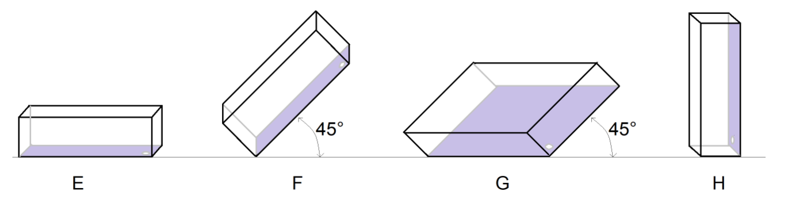
Accelerometer in the MPU
The purple surface is the top of the MPU-6050 and the circle is the white dot. As a result, the MPU-6050 is upright in diagrams A, B, C, D and is upside down in E, F, G, and H.
 | X g’s | X 16-bit 2’s | Y g’s | Y 16-bit 2’s | Z g’s | Z 16-bit 2’s
E | 0 | 0x0000 | 0 | 0x0000 | -1 | 0xC000
F | 0 | 0x0000 | 1*sin(45°) | 0x2D41 | -1*cos(45°) | 0xAD41
G | 1*sin(45°) | 0x2D41 | 0 | 0x0000 | -1*cos(45°) | 0xAD41
H | 0 | 0x0000 | -1 | 0xC000 | 0 | 0x0000
Notes:
https://learn.sparkfun.com/tutorials/accelerometer-basics/all

Slide 10
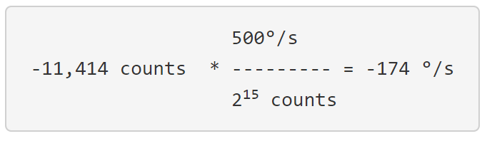
Rate Gyroscope
It outputs a 16-bit 2's complement value proportional to the measured angular velocity around each axis over the FSR.
MPU w/ ±500°/s FSR, the largest +ve 16-bit 2's complement value is 2¹⁵, the largest -ve is -2¹⁵.
Example, an MPU outputs the value 0xD36A as the angular
velocity around its Z-axis.
0xD36A, interpreted as a 16-bit 2's complement value is equal to -11,414 counts.
Notes:
https://learn.sparkfun.com/tutorials/accelerometer-basics/all

Slide 11
Rate Gyroscope Example
Example, let’s calculate the angular displacement of the rate
gyroscope measured an angular velocity for some duration.
angular displacement = angular velocity × the duration
Assuming an MPU configured w/ ±500°/s FSR. fill the table.
Gyroscope output | Angular velocity ^{O}/s | Duration seconds | Angular displacement
0xD36A | -174 | 0.1 | -17.4°
0x3E31 | 243 | 0.2 | 49°
0xB2C4 | -302 | 0.06 | -17.4°
0x199A | 100°/s | 0.25 | 25°
0xF6AE | -36.4°/s | 0.6 | -21.8°
0xE94B | -88.7 | 0.3 | -26.6°
0xD36A = 1101 0011 0110 1011
1101 0011 0110 1011 = ??
0010 1100 1001 0101 = 11,413
1101 0011 0110 1011 = -11,413
11,413 × 500/(2^15) = -174º
Notes:
https://learn.sparkfun.com/tutorials/accelerometer-basics/all

Slide 12
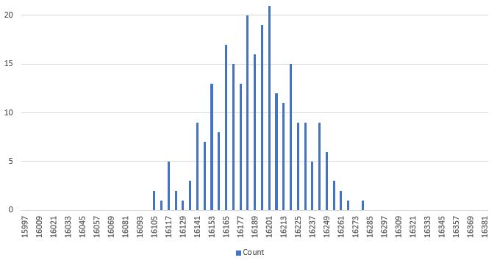
Digital Low Pass Filter
The output of the MPU-6050 shows variation, i.e. noise.
The samples over time, usually fall on a normal distribution.
This histogram was created from 256 acceleration samples.
The RMS noise of the MPU-6050 is equal to the standard deviation of this Normal distribution.
Notes:
https://learn.sparkfun.com/tutorials/accelerometer-basics/all

Slide 13
Digital Low Pass Filter
MPU-6050 comes with a configurable DLPF averages N accelerations samples and outputs the average.
This reduces the rate at which samples are produced, but the error goes down. This reduction in measurement rate is described in terms of bandwidth.
The bandwidth describes the fastest signal that the MPU-6050 can accurately measure.
Assume that we are recording the acceleration of the MPU-6050 as it is being moved up and down in a sinusoidal fashion.
As acceleration is 2nd derivative of position, the 2nd derivative of a sinusoid is a sinusoid.
Notes:
https://learn.sparkfun.com/tutorials/accelerometer-basics/all

Slide 14
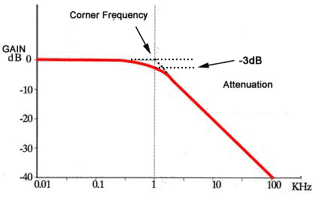
Digital Low Pass Filter
At low frequencies, the MPU faithfully measures and reports its acceleration.
As the frequency is increased, the reported accelerations becomes lower than the actual acceleration.
The frequency at which the reported acceleration is 0.707 times smaller than the actual acceleration is called the bandwidth.
This ratio of output to input of 0.707 is equivalent to -3dB of attenuation between the input and output signals.
The relationship between the bandwidth and RMS noise is characterized by a parameter called the Power Spectral Density, PSD.
Notes:
https://learn.sparkfun.com/tutorials/accelerometer-basics/all

Slide 15
Digital Low Pass Filter
Look at Product Specification document (P.13), the units are µg/Hz^{0.5} and its value is 400.
RMS Noise = PSD × √(bandwidth).
Using this let’s complete the table. Look in the Register Maps document for the CONFIG register (P.13).
Use the information in the DLPF table to complete the Bandwidth column in the table below.
Convert the RMS noise (µg) value into ADC counts assuming a ±2 g FSR.
Notes:
https://learn.sparkfun.com/tutorials/accelerometer-basics/all

Slide 16
Digital Low Pass Filter
  RMS Noise = PSD × √(bandwidth)
  RMS Noise = 400 µg/Hz^{0.5}× √(bandwidth) = 400 × 260^{0.5} = 6,450 µg
  2 g’s
  x counts * -------------- = 0.06450 g’s ➔ x = 105.6768 counts
  2¹⁵ counts
DLPF_CFG | Bandwidth (Hz) | RMS Noise (ug) | RMS Noise (counts) | RMS Noise (measured counts)
0 | 260 | 6,450 | 106 | 120
1 | 184 | 5,430 | 89 | 73
2 | 94 | 3,878 | 64 | 66
3 | 44 | 2,650 | 43 | 38
4 | 21 | 1,830 | 30 | 29
5 | 10 | 1,260 | 21 | 19
6 | 5 | 890 | 15 | 12
Notes:
https://learn.sparkfun.com/tutorials/accelerometer-basics/all

