Slide 1
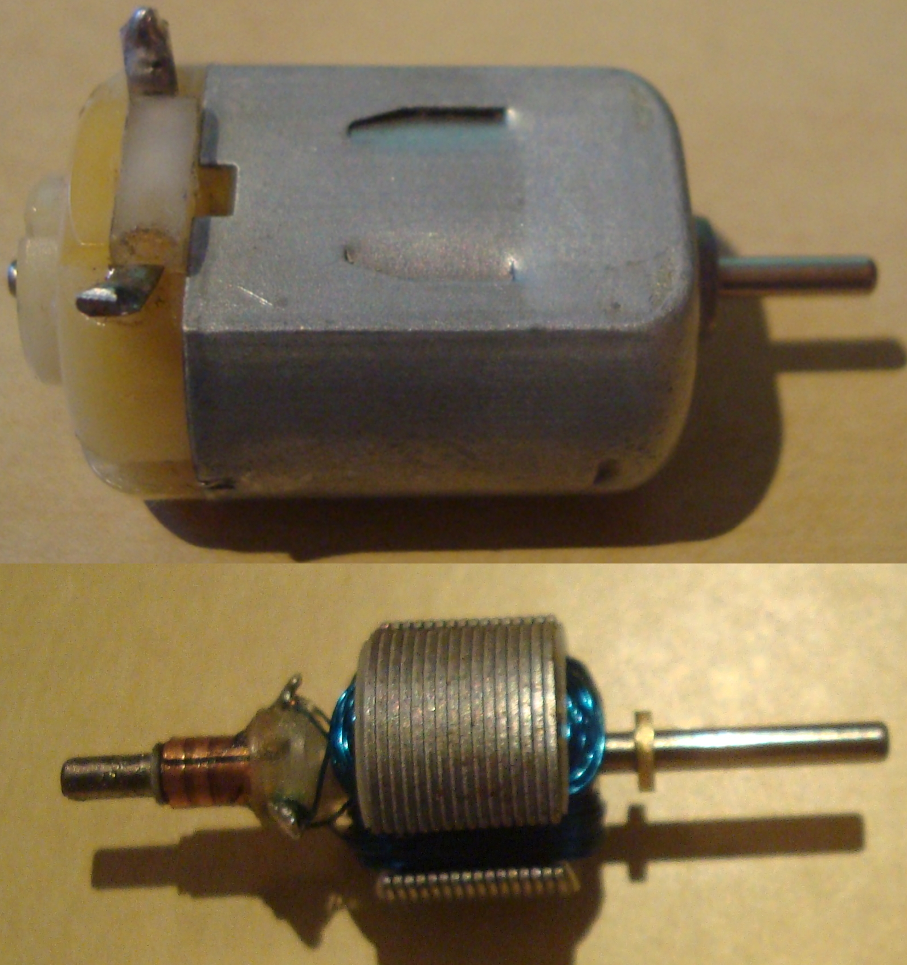
Motor in housing
Armature Coil
Rotor

