Slide 1
Lecture 14: Higher Order System Response
Introduction to Feedback Control Systems
Section D (Johnson)
Fall 2017

Slide 2
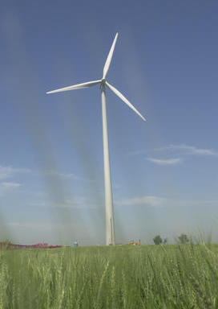
Matlab demo, part 2: wind turbine rotational speed
Compared to the 1st order transfer function given earlier, a more realistic description of the relationship between the wind speed u and a wind turbine’s rotational speed ω is given by the 3rd order transfer function
Compared to the first order example from Lecture 12, we want to understand what are the impacts of
  The additional poles
  The additional zeros
  The DC gain

Slide 3
Ungraded clicker quiz: higher order systems
Given the system
which one (or none) of the following is an acceptable approximation using our dominant pole rules of thumb?
A)
B)
C)
D) None of the above

Slide 4
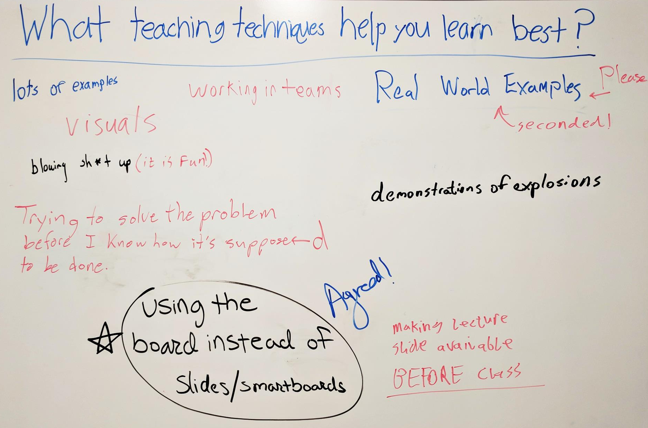
What teaching techniques help you learn best?

Slide 5


(In)stability: SpaceX Falcon 9 Crash Landing
…
  http://www.wired.com/2015/04/analysis-falcon-9-crash-landing/

