Slide 1
Lecture 27: Bode Plots IV
Introduction to Feedback Control Systems
Section D (Johnson)
Fall 2016

Slide 2
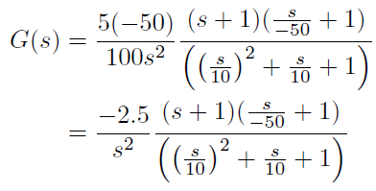
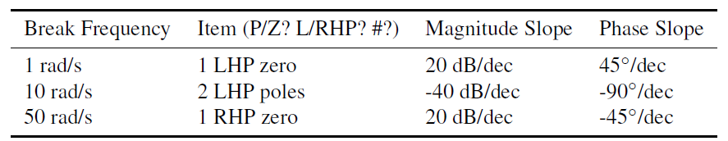
Review: Systematic method for plotting Bode plots
Step 1: TF → Bode form:
Step 2: Create table of important info
Step 3: Find low frequency values of magnitude & phase (L27 example: ω = 1 rad/s → s = j)
Step 4: Sketch magnitude plot
Step 5: Mark on phase plot where slope is non-zero
Step 6: Sketch phase plot, starting from lowest frequencies and adding non-zero slopes when within range

Slide 3
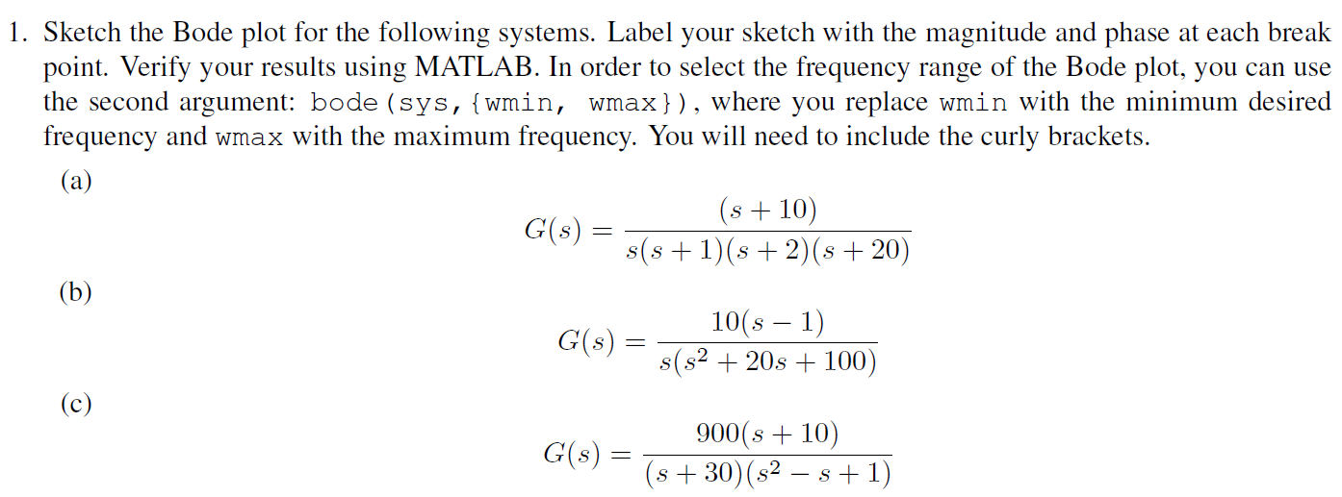
Bode sketching: Quiz Yourself

