Slide 1
Lecture 29: Nyquist Stability Analysis
Introduction to Feedback Control Systems
Section D (Johnson)
Fall 2016

Slide 2
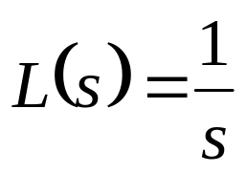
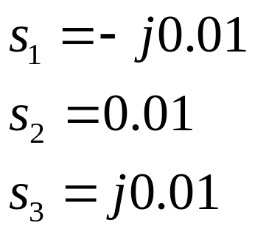




What if L(s) has a pole on the imaginary axis?
Assume a simple case:
What are |L(s)| and ∠ L(s) for
Im(s)
Im(L(s))
Re(s)
Re(L(s))
Note: plots have different scales

