Slide 1
Lecture 11: Motors and Hydraulic Actuators
Introduction to Feedback Control Systems
Section D (Johnson)
Fall 2017

Slide 2
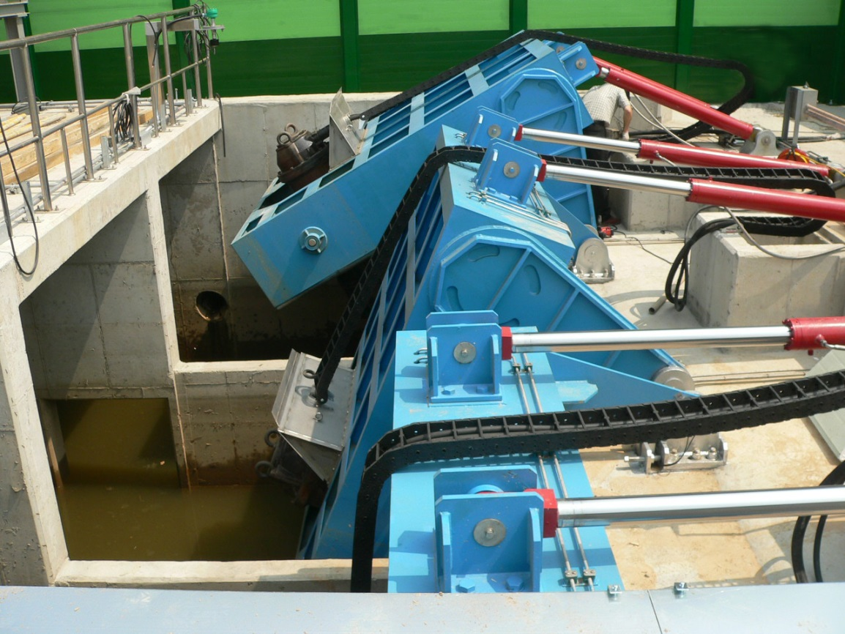
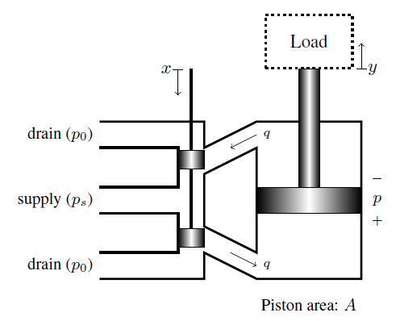
Hydraulic actuators
http://www.gobizkorea.com/att/cat/hasuh/tp_html/img/hasuh_cat_919830_large_img1_2.jpg

Slide 3
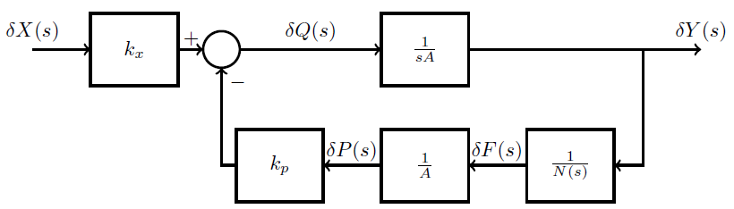
Hydraulic actuator block diagram
Get students to derive
from

