Slide 1
Lecture 12: First Order Response
Introduction to Feedback Control Systems
Section D (Johnson)
Fall 2017

Slide 2
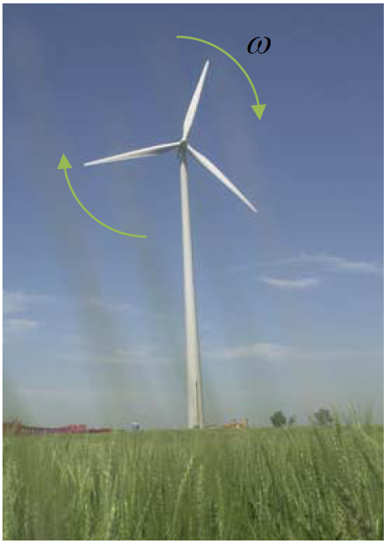
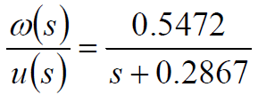
Wind turbine example
The transfer function from wind speed u [m/s] to rotational speed ω [rpm] of a wind turbine is given by
Predict how long it will take for ω to go from 10% to 90% of its final value in response to a step change in u.
Predict when ω will reach within 1% of its final value and stay there in response to the same step change in u.
Use Matlab to confirm your answers.

