Slide 1
Lecture 13: Second Order System Response
Introduction to Feedback Control Systems
Section D (Johnson)
Fall 2017

Slide 2
Ungraded Clicker Exercise 1
Use the quadratic formula to find the poles of
as a function of the damping ratio ζ and natural frequency ω_{n}.

Slide 3
Ungraded Clicker Exercise 2
If the poles of G(s) in rectangular coordinates are given by
what is the magnitude when converted to polar coordinates?

Slide 4
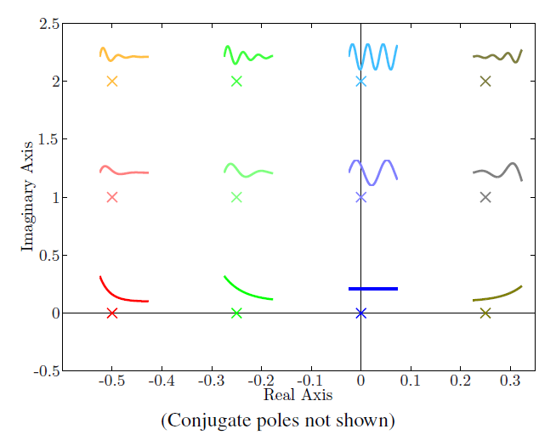
Effects of Damping Ratio ζ and Natural Frequency ω_{n}
ζ < 0 → unstable
Decreasing ζ (ζ > 0)
Increasing ω_{n}

