Slide 1
Lecture 20: Introduction to Root Locus
Introduction to Feedback Control Systems
Section D (Johnson)
Fall 2017

Slide 2
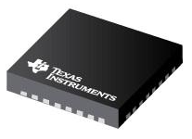
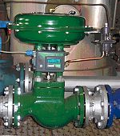
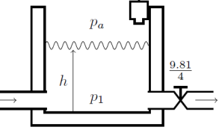
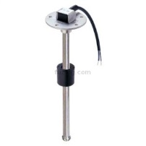
Proportional control of a water tank (2)
u
(digital)
v_{u}
(physical)
q_{in}
(physical)
Plant (physical)
Controller (digital)
D/A
Converter
Valve (physical)
h_{ref}
(digital
bits)
e
(digital
bits)
h
(physical)
C(s)
h₀
(digital bits)
v_{s} (physical)
A/D
Converter
Sensor (physical)
Computer-based systems
Physical systems

Slide 3
Proportional control of a water tank - simplified
Plant
Controller
Valve
R(s)
E(s)
U(s)
Y(s)
C(s)
C(s)
G(s)
H(s)
Sensor
Define the “loop gain” (not closed loop gain) as L(s) = C(s)G(s)H(s), i.e., the product of all blocks in the forward and feedback paths.
For C(s) = K (proportional control), this is the figure on p. 1 on Lecture 20.

Slide 4
Ungraded clicker exercises – root locus rules (1)
If the loop gain is given by and the system is proper, how many loci will you have?
  Order of N(s)
  Order of D(s)
  Order of N(s) + order of D(s)
Where do loci start (K = 0) and end (K = ∞)?
  Loci start at the open loop poles (roots of D(s)) and end at the open loop zeros (roots of N(s)).
  Loci start at the closed loop poles (roots of T(s) = Y(s)/R(s)) and end at the closed loop zeros.

Slide 5
Ungraded clicker exercises – root locus rules (2)
If the loop gain is given by , where on the real axis will you have loci?
  To the left of an odd number of poles and zeros of L(s) (i.e., roots of N(s) and D(s))
  Whenever there is an odd number of poles and zeros of L(s) to the right of the locus.
  To the left of an odd number of real poles and zeros of L(s) (i.e., real roots of N(s) and D(s))
  Whenever there is an odd number of real poles and zeros of L(s) to the right of the locus.
On your Exam 2 note card, don’t forget the last rule (asymptote centers and angles

Slide 6
Video lectures
https://www.youtube.com/watch?v=eTVddYCeiKI
https://www.youtube.com/watch?v=jb_FiP5tKig (watch through Rule 8, which ends at around 11:20)
Could be used for flipped classes; follows reasonably closely with our Intro to Root Locus lecture

