Slide 1
Lecture 19: PID Control
Introduction to Feedback Control Systems
Section D (Johnson)
Fall 2017

Slide 2
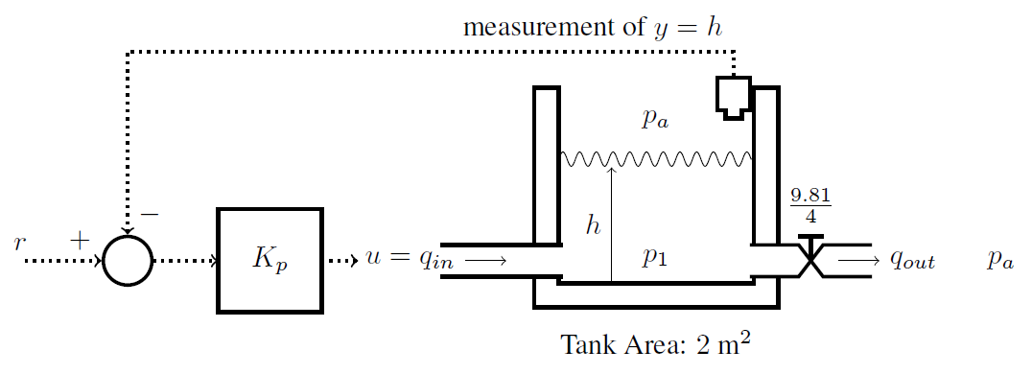
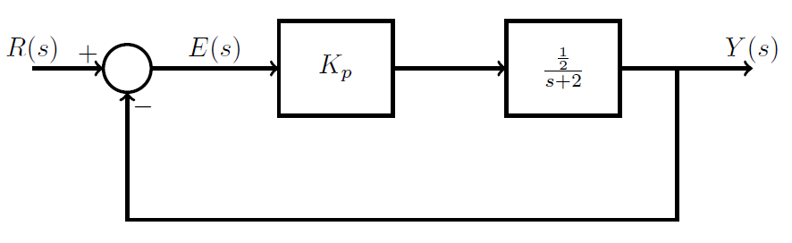
Proportional control of a water tank
Symbolic representation

Slide 3
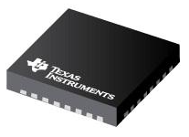
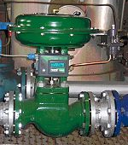

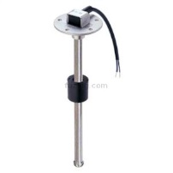
Proportional control of a water tank (2)
u
(digital)
v_{u}
(physical)
q_{in}
(physical)
Plant (physical)
Controller (digital)
D/A
Converter
Valve (physical)
h_{ref}
(digital
bits)
e
(digital
bits)
h
(physical)
C(s)
h₀
(digital bits)
v_{s} (physical)
Microcontroller implementation: see Lecture 19 Appendix
A/D
Converter
Sensor (physical)
Computer-based systems
Physical systems

