Slide 1
Lecture 28: Nyquist Stability Theorem
Introduction to Feedback Control Systems
Section D (Johnson)
Fall 2016

Slide 2
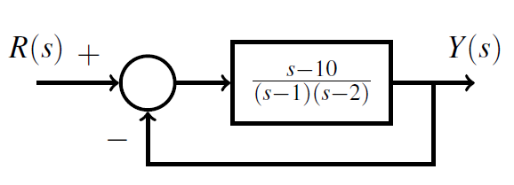
Nyquist Example (Lecture 28 Supplement)
Use Nyquist analysis to determine if the closed loop system below is stable:
Looking at the phase Bode plot of G(s) below (and correlating it with the magnitude one), is it possible for the Nyquist plot to encircle the point -1+j0?

Slide 3
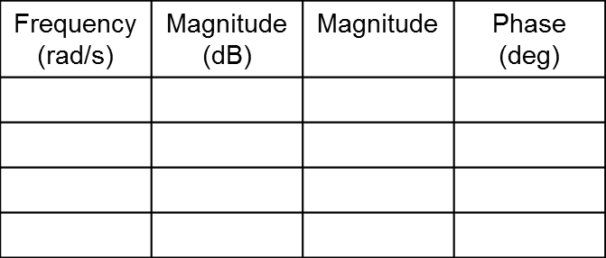
Lecture 28 Supplement (Active Learning)
0 RHP C.L. poles (C.L. stable)

Slide 4
What if L(s) has a pole on the imaginary axis?
Assume a simple case:
What are |L(s)| and ∠ L(s) for
Im(s)
Im(L(s))
Re(s)
Re(L(s))
Note: plots have different scales

