Slide 1
Lecture 1: Modeling Mechanical Systems
Introduction to Feedback Control Systems
Section D (Johnson)
Fall 2017

Slide 2
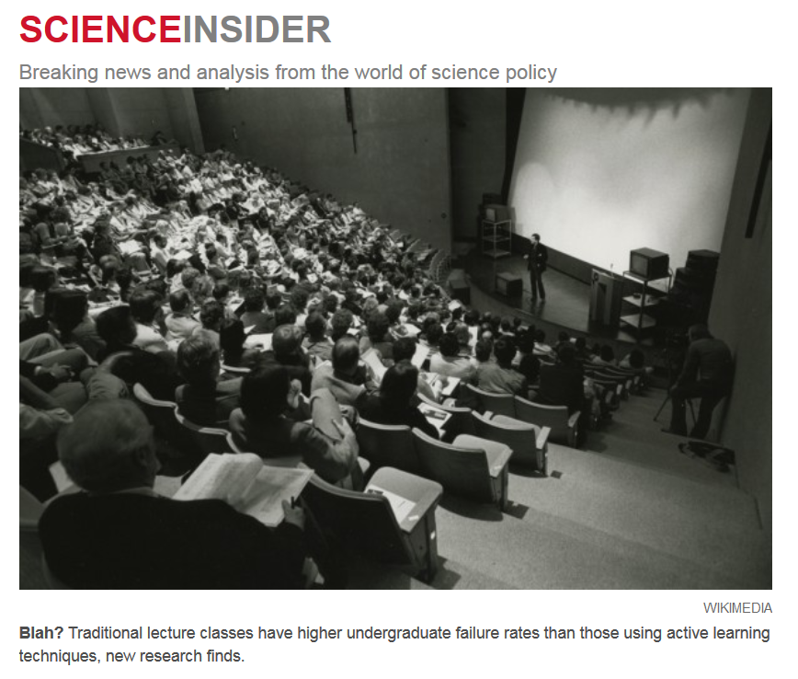

Quote of the Day
“Lectures Aren't Just
Boring, They're Ineffective,
Too, Study Finds”
  http://news.sciencemag.org/education/2014/05/lectures-arent-just-boring-theyre-ineffective-too-study-finds

Slide 3
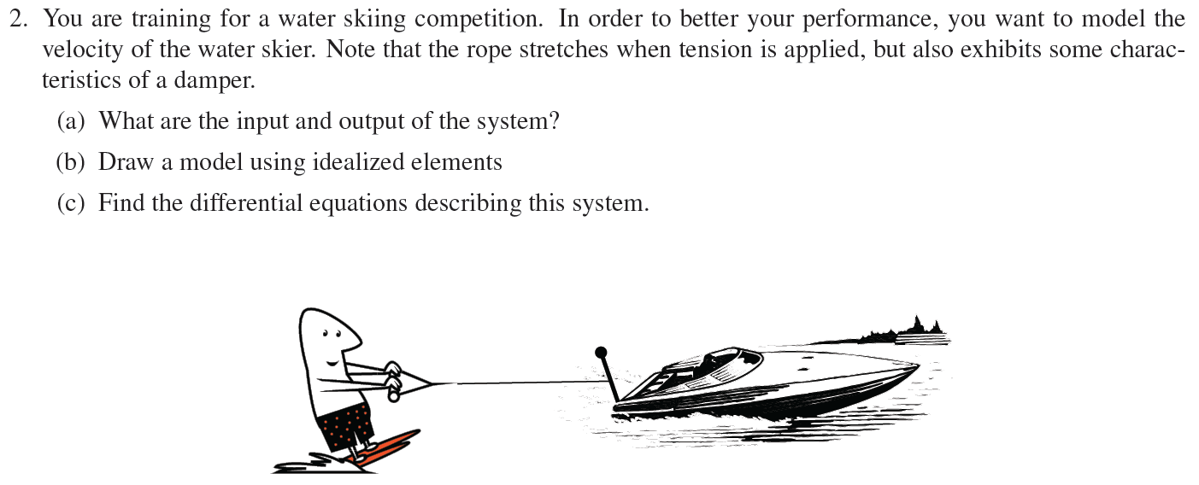
Active Learning #1: “Quiz Yourself” example

Slide 4
Active Learning #2: Problem Setting
Consider again the water skier example from earlier.
  Can you articulate a “problem” that you are being asked to solve as an engineer?
  Can you infer anything about the problem’s author by the way the problem is stated?
  How could problem definition constrain or open opportunities for the solution?

