Slide 1
Lecture 31: Systems with Time Delay
Introduction to Feedback Control Systems
Section D (Johnson)
Fall 2016

Slide 2
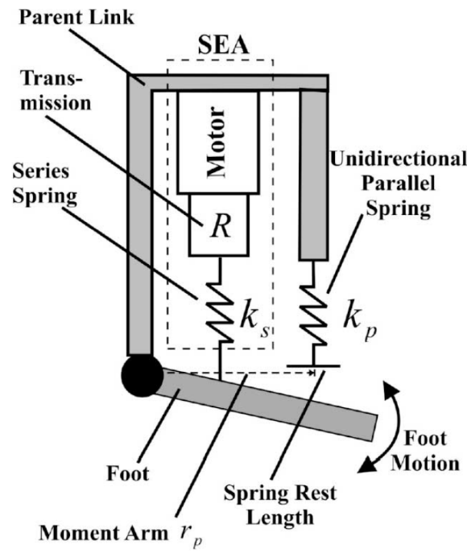
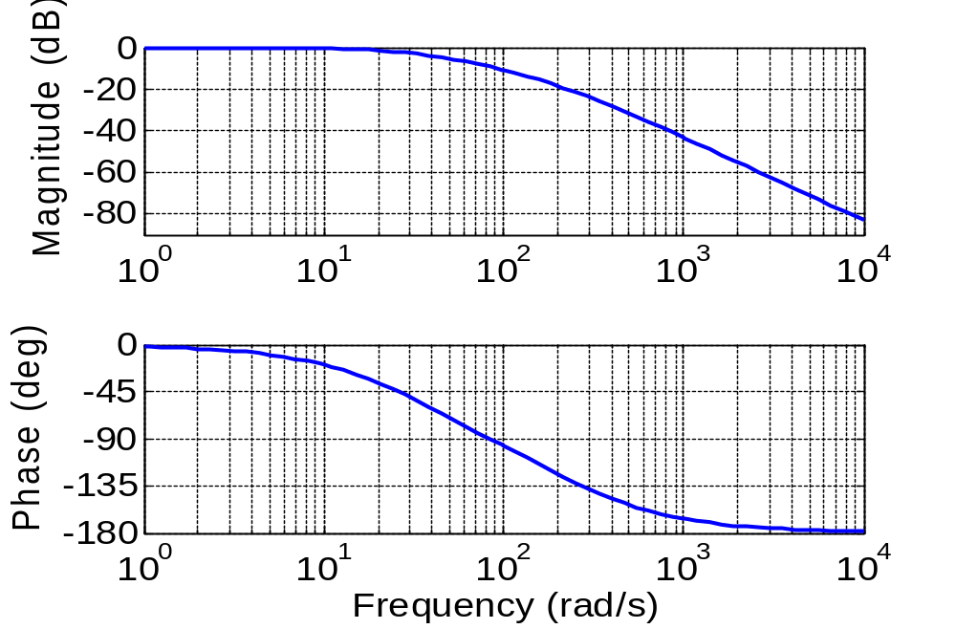
Impact of Time Delay on Active Prosthetic
Original Bode plot (from maximum motor force to maximum spring force):
What are the GM and PM?
Samuel Au, Jeff Weber, Hugh Herr, “Powered Ankle-Foot Prosthesis Improves Walking Metabolic Economy,” IEEE Trans. on Robotics, Vol. 25, No. 1, Feb. 2009.

Slide 3
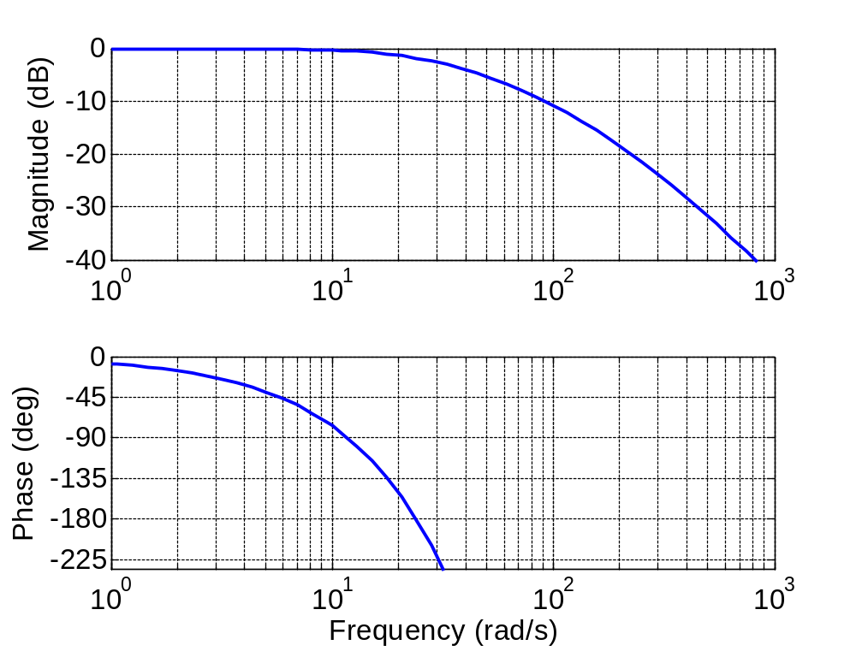
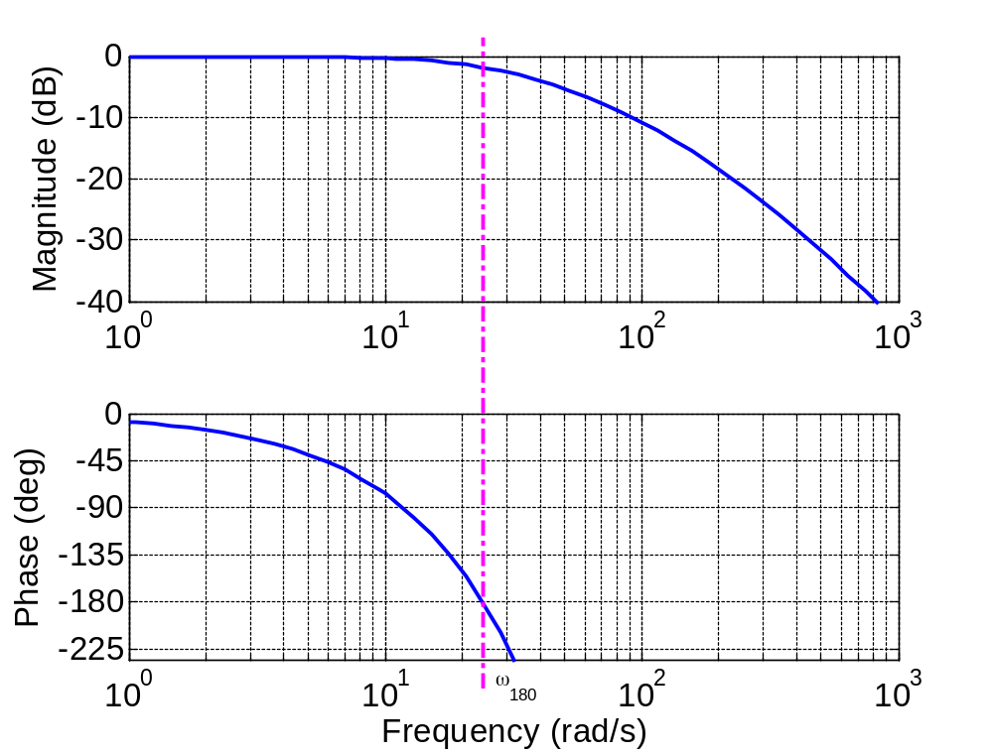
Impact of Time Delay on Active Prosthetic (2)
Active prosthetic Bode plot with 0.1 s time delay:
What is the impact on the GM and PM?

