Slide 1
Poll everywhere
PollEv.com/kathrynjohns083

Slide 2
Poll Everywhere Exercise (1/4)
What is the Laplace transform of the following differential equation with the given initial conditions?
A)
B)
C)
D) None of the above

Slide 3
Poll Everywhere Exercise (2/4)
If
which of the following is the appropriate partial fraction expansion for use in solving the differential equation?
A)
B)
C)
D) None of the above

Slide 4
Poll Everywhere Exercise (3/4)
If
solve for C.
A)
B)
C)
D) None of the above

Slide 5
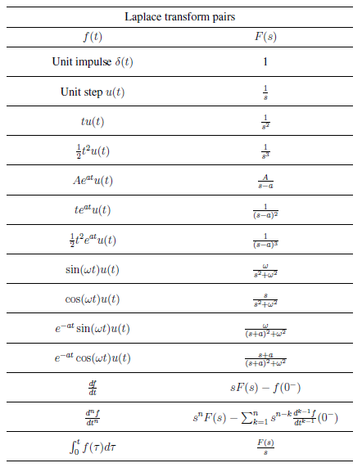
Poll Everywhere Exercise (4/4)
Since A = 1, B = -1, and C = -2, we have
What is v_{out}(t)?
A)
B)
C)
D) None of the above

