Slide 1
Lecture 8: Mechanical Impedance
Introduction to Feedback Control Systems
Section D (Johnson)
Fall 2017

Slide 2
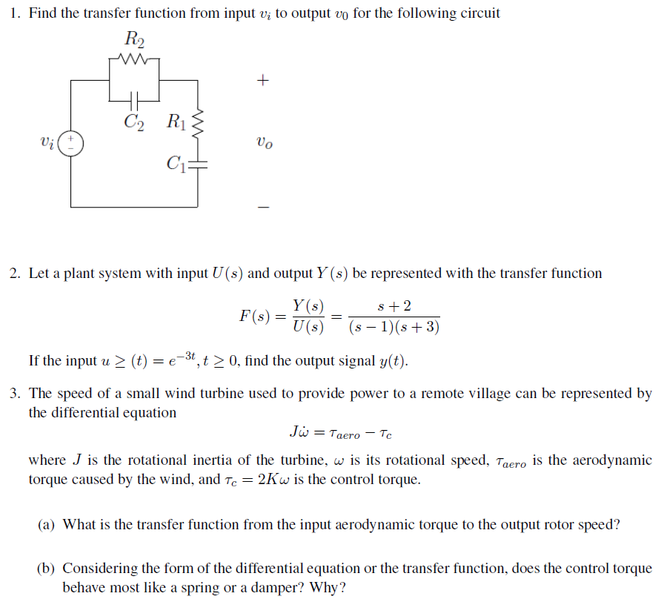

Wind Turbine Example
Recall from Thursday, 9/7 handout:
Given that rotational speed is the time derivative of rotational position, i.e., use impedance-based concepts to find the transfer function from aerodynamic torque τ(s) to rotational position θ(s). Consider the following steps:
Sketch the ideal element diagram. Since , does the control torque act like a spring or a damper? How many ideal elements would you use?
Sketch all necessary nodes
Connect the node(s) to ground using the impedances of the components.
Add the source (is torque a through variable or an across variable? does that mean you’re using a current source or a voltage source?)
Use circuit methods to find the transfer function.

Slide 3
Problem setting (for project)
Consider again the wind turbine impedance problem
  Can you state a “problem” that finding this transfer function is the first step toward solving?
  Can you discern anything about the author of the original problem by the way it is written?

