Slide 1
Large-Scale Agile Transformations
A Systematic Literature Review
Kim Dikert, Maria Paasivaara, Casper Lassenius

Slide 2
Research questions
RQ1: Why do large organizations initiate an agile transformation?
RQ2: How do large scale agile transformations usually proceed; do transformations exhibit patterns?
RQ3: What are typical challenges in a large scale agile transformation process?
RQ4: What are typical success factors in the process?
9.6.2014

Slide 3
Definition of large scale
50 people
6 teams
The organization must be of this size at the start of the transformation
9.6.2014

Slide 4
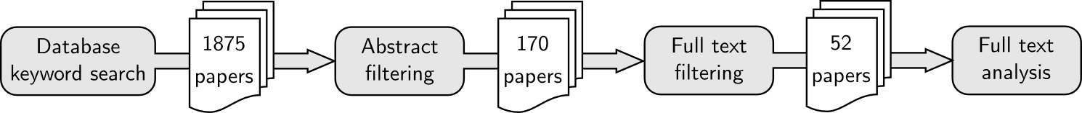
Research process
Abstract and full text filtering was performed by two researchers
All unclear cases were resolved by discussion
In difficult border line cases a third researcher was consulted
9.6.2014

Slide 5
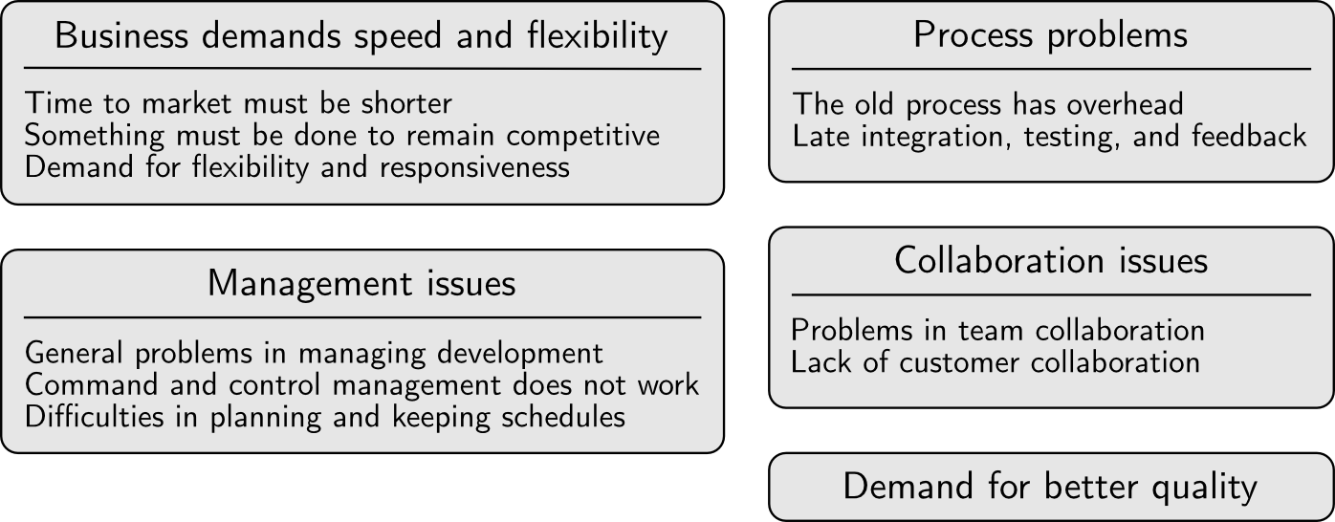
Reasons to change
9.6.2014

Slide 6
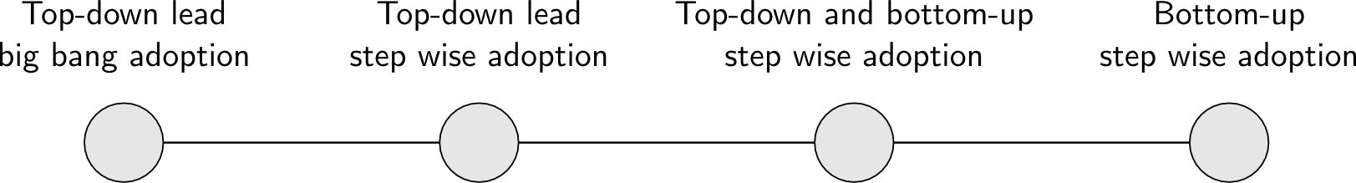
Transformation processes
9.6.2014

Slide 7
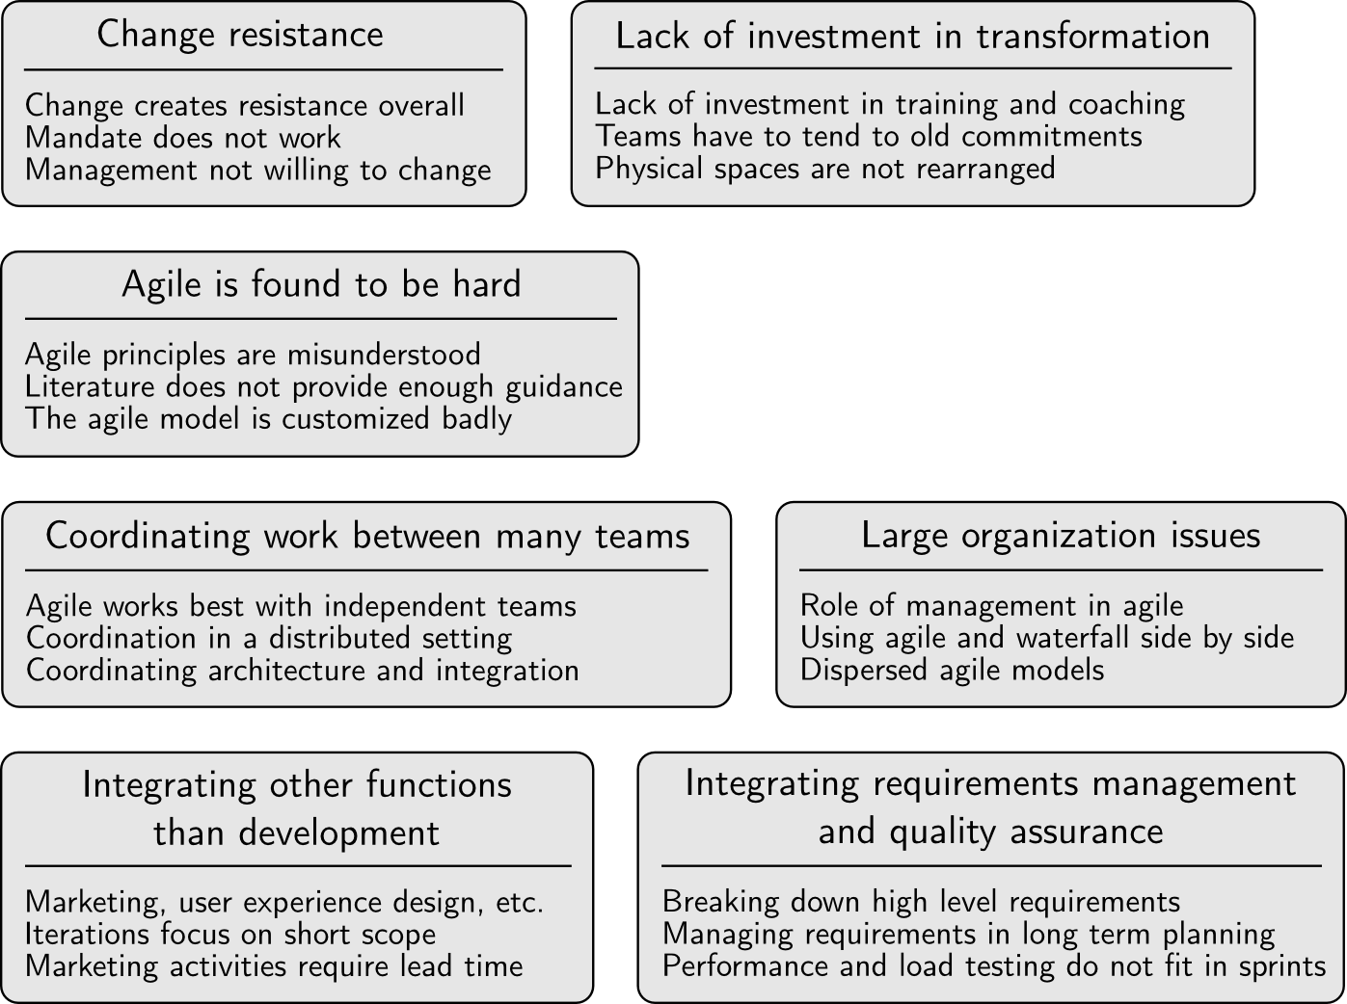
Challenges
9.6.2014

Slide 8
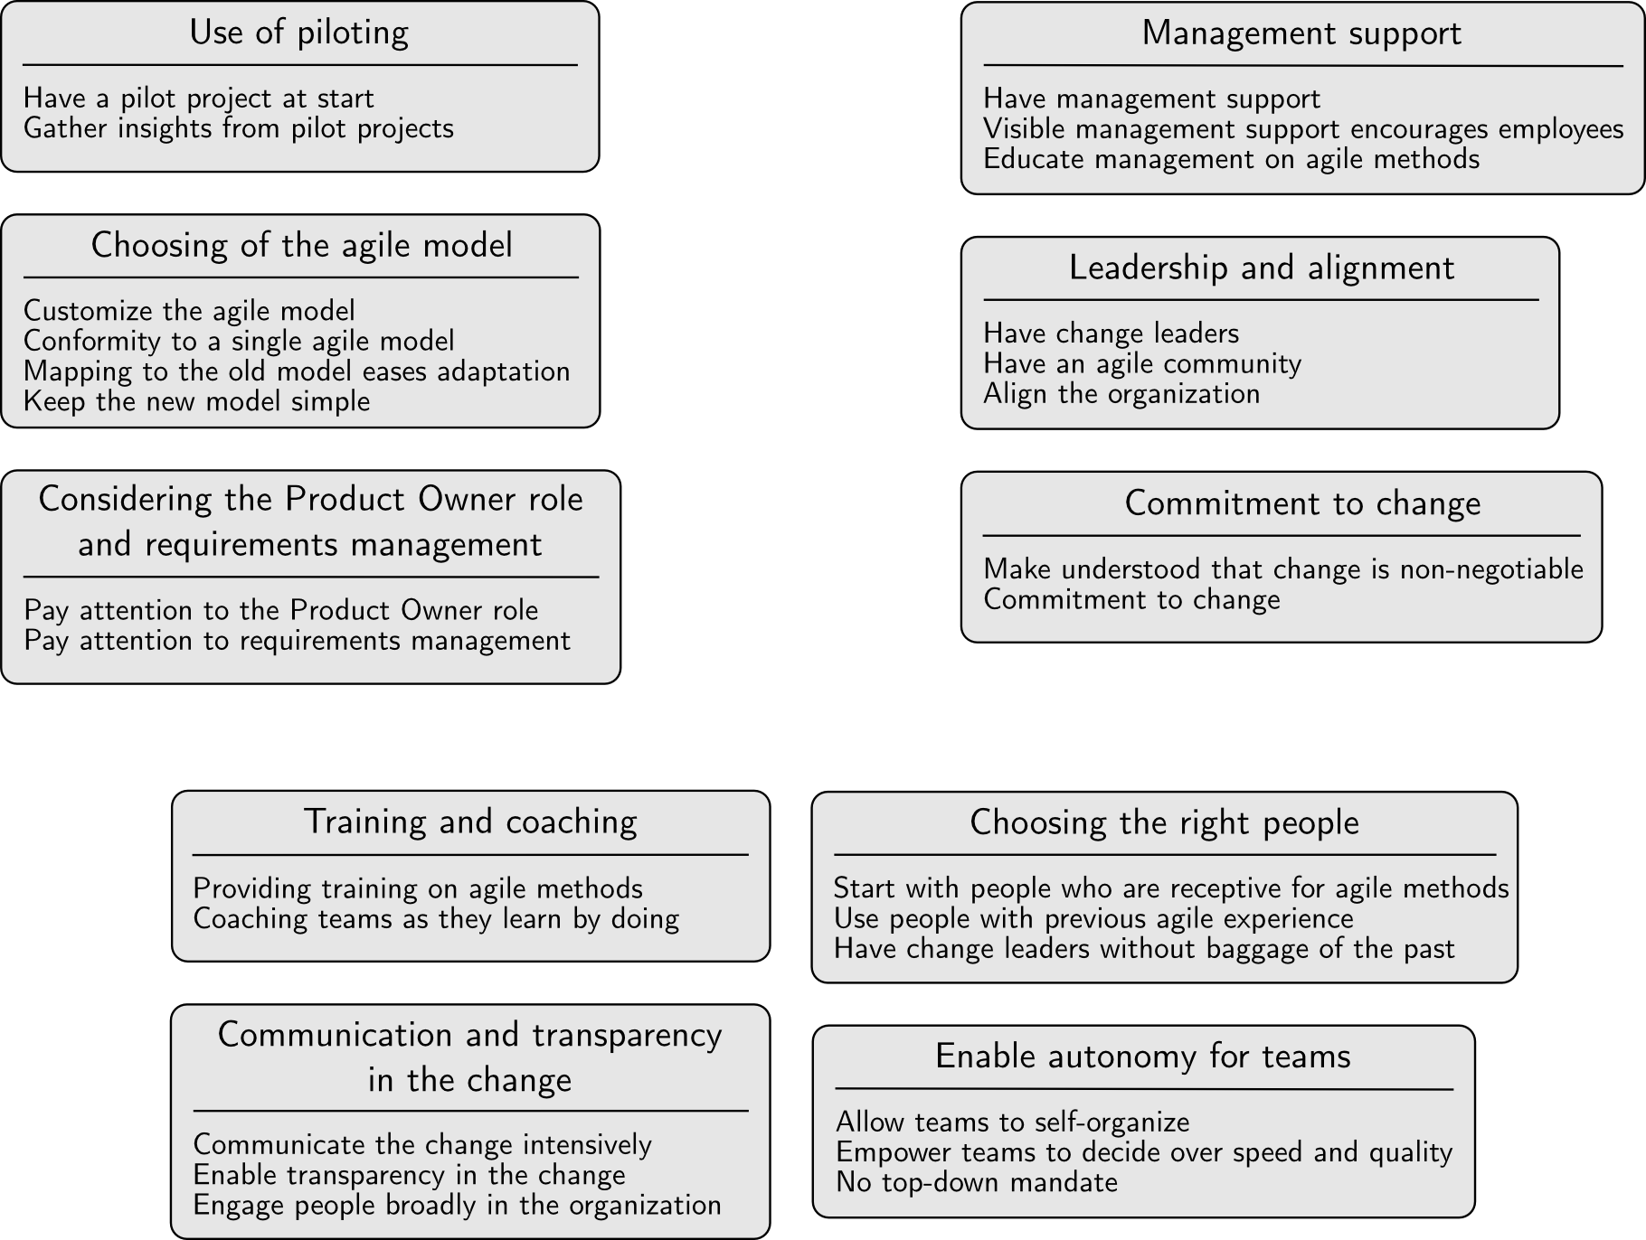
Success factors
9.6.2014

