Slide 1
Agile transformation in large organizations
Systematic Literature Review

Slide 2
Presentation outline
Research questions
Research method
Overview of included cases
RQ1: Reasons to change
RQ2: How does transformation happen
RQ3: Challenges in transformation
RQ4: Success factors in transformation

Slide 3
Research Questions
RQ1: Why do large organizations initiate an agile transformation?
RQ2: How do large scale agile transformations usually proceed; do transformations exhibit patterns?
RQ3: What are typical challenges in a large scale agile transformation process?
RQ4: What are typical success factors in the process?

Slide 4
What is large scale?
In this study:
50 people
6 teams
The organization must be of this size at start

Slide 5
Research process
Database
keyword search
1874
Abstract
filtering
170
Full text
filtering
52
Full text
analysis
papers
papers
papers
Abstract and full text filtering performed by two researchers
All unclear cases were resolved by discussion
In difficult border line cases a third researcher was consulted

Slide 6
Research process: Full text analysis
Grounded theory
Open coding along research questions
Codes arranged into categories
The coding guideline was validated between two researchers: 2/3 overlap in found concepts

Slide 7
Research process limitations
Primary sources mostly experience reports
Primary sources mostly without research method
Quantitative interpretations are avoided in results

Slide 8
Overview of included cases
Time of publications and transformations
14
12
10
8
Publications
6
Transformations started
4
2
0
2001 2002 2003 2004 2005 2006 2007 2008 2009 2010 2011 2012 2013
Organization size in primary studies
Organization size in persons
Organization size in teams
10000
100
1000
10
100
10
1

Slide 9
Overview of included cases
Business areas | Number of cases
Online services for consumers and business | 9
Telecommunications | 7
Enterprise management | 5
Banking and financial services | 4
Healthcare | 3
IT services | 2
Government, Information security | 2
Not specified | 10
Total | 42
Agile methods | Number of cases
Scrum | 25
Extreme Programming (XP) | 4
Scrum and XP | 5
Other | 4
Combining Lean to an agile method | 6
Not specified | 1

Slide 10
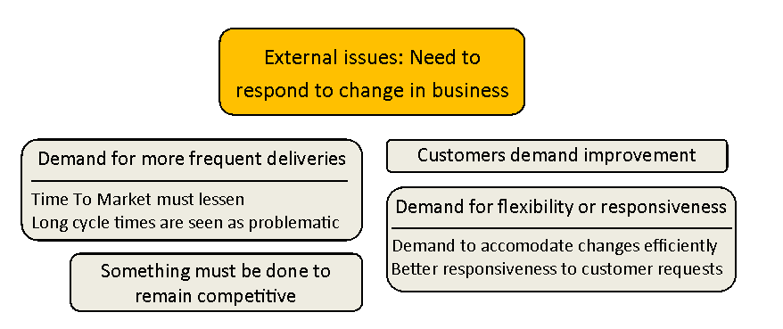
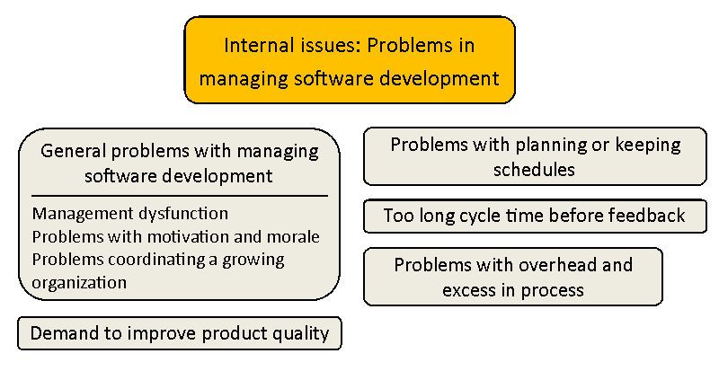
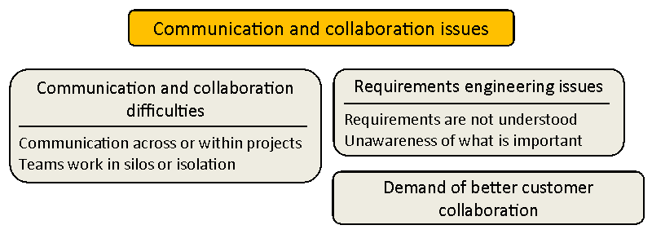
RQ1: Reasons to change

Slide 11
RQ2: How does transformation happen
Big bang transformation
Top-down
transformation
Bottom-up
transformation
Stepwise transformation

Slide 12
RQ2: How does transformation happen
Factors in transformation
Training
Use of external consultants
Coaching
Pilot program
Seminars, workshops, other public events
Agile community

Slide 13
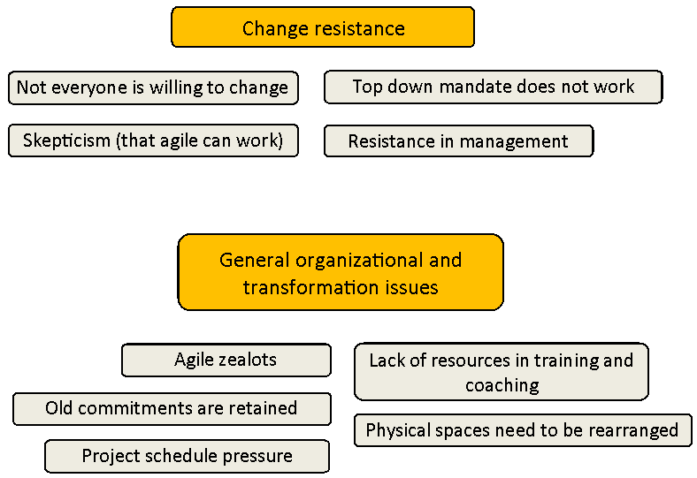
RQ3: Challenges in transformation

Slide 14
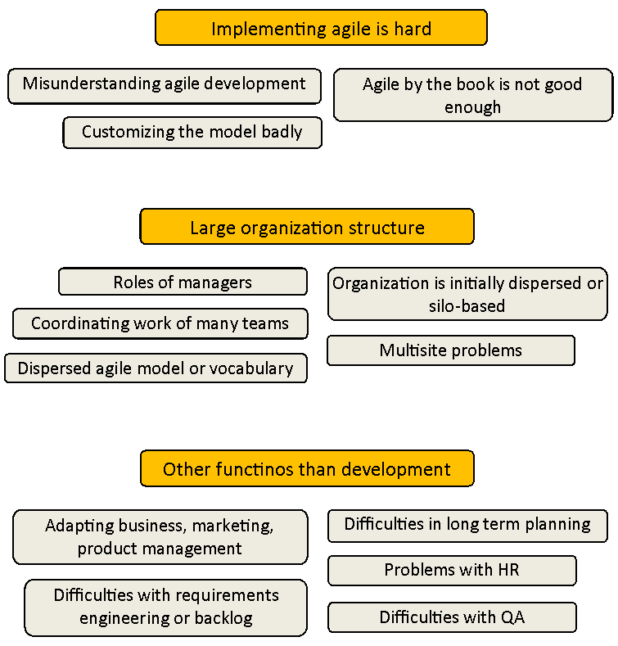
RQ3: Challenges in transformation

Slide 15
RQ4: Success factors
Urgency and commitment
  Commit strongly
  Make change necessary
  Communicating the change
A change leading coalition
  Change leaders
  Management support
Choose the agile model well
  Map to the old model
  Conformity to one model
  Empower teams

Slide 16
RQ4: Success factors
Support transformation and learning
  Coaching
  Training
Pilot project
  Create a positive experience
People factors
  Avoid top-down mandate
  Have trust in people
  Have social events

Slide 17
Conclusion
Results support previous theory
Future research: Compare to change leadership and organizational research

