Slide 1



High-Temperature Fermionic Gibbs States are Convex-Gaussian
Akshar Ramkumar, Yiyi Cai, Yu Tong, Jiaqing Jiang
January 27, 2026

Slide 2
Outline
Death of entanglement in spin systems

Slide 3
Outline
Death of entanglement in spin systems
Fermionic systems
Convex-Gaussian states

Slide 4
Outline
Death of entanglement in spin systems
Fermionic systems
Convex-Gaussian states
Proof ideas

Slide 5
Outline
Death of entanglement in spin systems
Fermionic systems
Convex-Gaussian states
Proof ideas
Future work
Open questions

Slide 6
Gibbs States

Slide 7
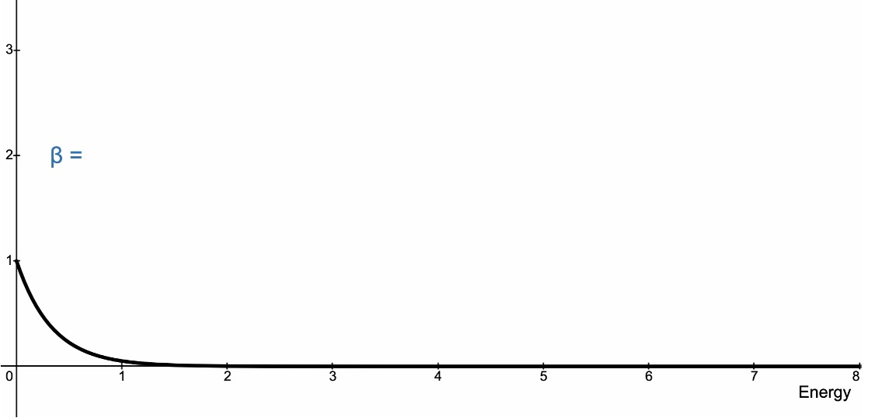

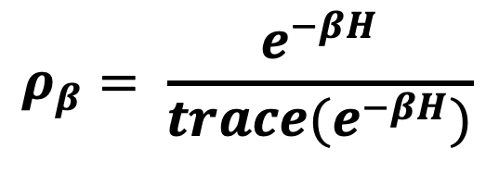
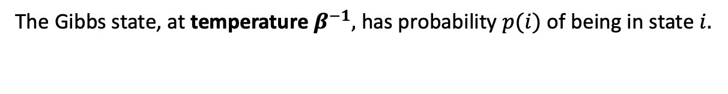
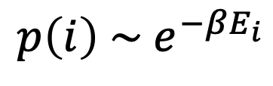
Gibbs State of Hamiltonian $H$
$$p\left(i\right) \sim e^{−βE_{i}}$$
$$ρ_{β}= \frac{e^{−βH}}{trace(e^{−βH})}$$
The Gibbs state, at temperature $β^{−1},$ has probability $p(i)$ of being in state $i.$

Slide 8
Why the Gibbs state?
The Gibbs state is the state of thermal equilibrium at temperature β⁻¹.

Slide 9
Why the Gibbs state?
The Gibbs state is the state of thermal equilibrium at temperature β⁻¹.
At very low temperatures, the Gibbs state will be close to the ground state of the system.

Slide 10
Why the Gibbs state?
The Gibbs state is the state of thermal equilibrium at temperature β⁻¹.
At very low temperatures, the Gibbs state will be close to the ground state of the system.
Meanwhile, at high temperatures, the Gibbs state is the maximally mixed state.

Slide 11


Why the Gibbs state?
The Gibbs state is the state of thermal equilibrium at temperature β⁻¹.
At very low temperatures, the Gibbs state will be close to the ground state of the system.
Meanwhile, at high temperatures, the Gibbs state is the maximally mixed state.
For what temperatures are Gibbs states…
Quantumly preparable?
Classically preparable?
Entangled?

Slide 12
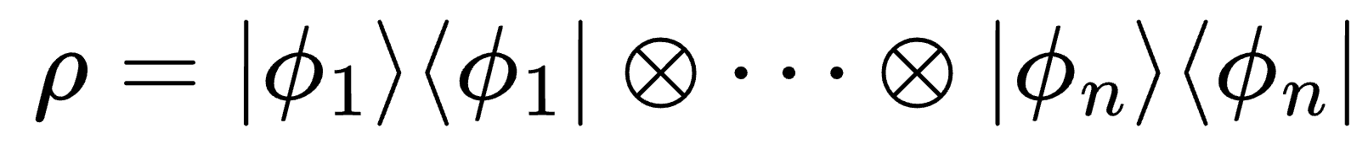
Unentangled States
A₁
A₂
A₃
A₄
A₅
Commuting, spatially separated observables
A₆
A₇
A₈
A₉
A₁₀

Slide 13
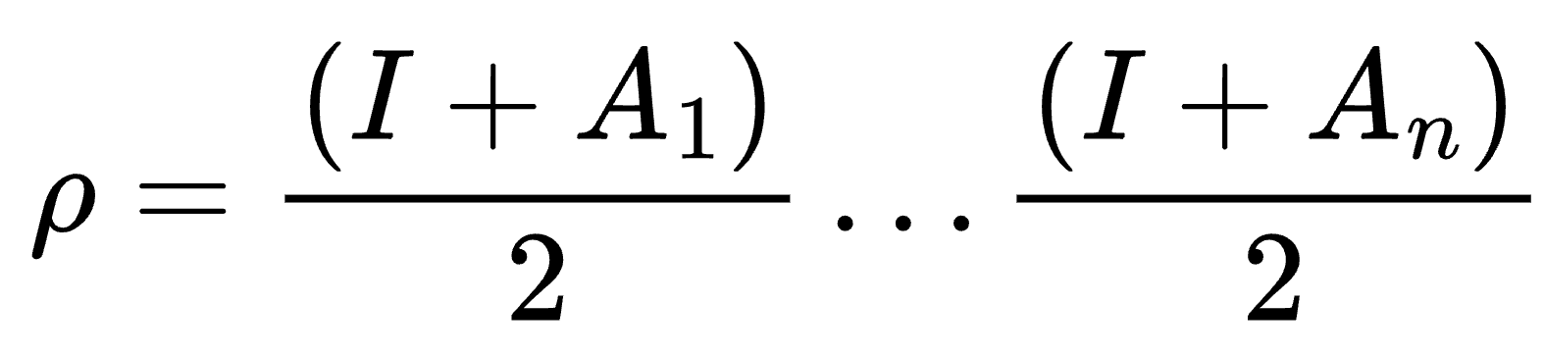
Unentangled States
A₁
A₂
A₃
A₄
A₅
Commuting, spatially separated observables
A₆
A₇
A₈
A₉
A₁₀

Slide 14
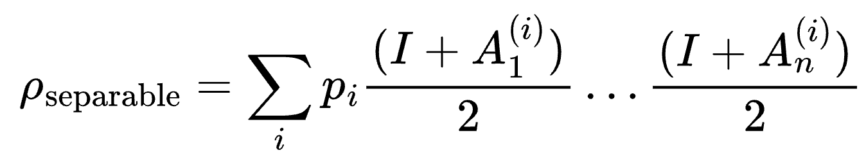
Unentangled States
A₁
A₂
A₃
A₄
A₅
Commuting, spatially separated observables
A₆
A₇
A₈
A₉
A₁₀

Slide 15
So… are Gibbs states entangled?
Quantum states
separable

Slide 16
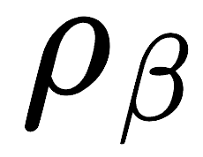
So… are Gibbs states entangled?
Quantum states
separable
0
β_{s}
β

Slide 17
So… are Gibbs states entangled?
Quantum states
separable
0
β_{s}
β

Slide 18
So… are Gibbs states entangled?
Quantum states
Important!
For general systems, β_{s}⁻¹ can have a poor dependence on system size.
separable
0
β_{s}
β

Slide 19
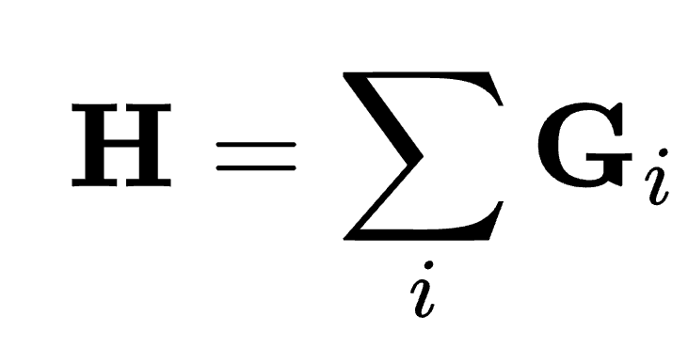
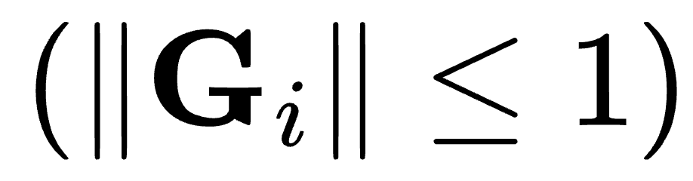
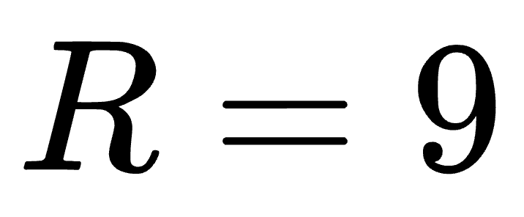
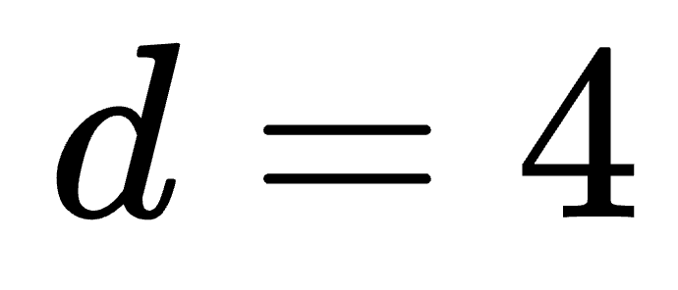
Local Hamiltonians (R, d)

Slide 20
Death of Entanglement
Theorem [BLMT24]. Let H have locality R, d. Then the critical separability temperature β_{s}⁻¹ satisfies β_{s}⁻¹ ≲ Rd.
1. A. Bakshi, A. Liu, A. Moitra, E. Tang, High-Temperature Gibbs States are Unentangled and Efficiently Preparable.

Slide 21
Death of Entanglement
Theorem [BLMT24]. Let H have locality R, d. Then the critical separability temperature β_{s}⁻¹ satisfies β_{s}⁻¹ ≲ Rd.
Theorem [BLMT24]. The Gibbs state of H can be sampled efficiently for temperature β⁻¹ ≳ Rd².
1. A. Bakshi, A. Liu, A. Moitra, E. Tang, High-Temperature Gibbs States are Unentangled and Efficiently Preparable.

Slide 22
Fermionic Systems

Slide 23
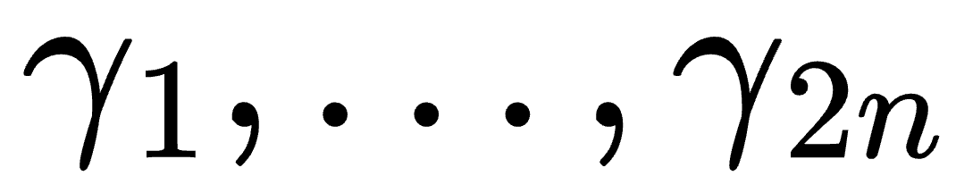
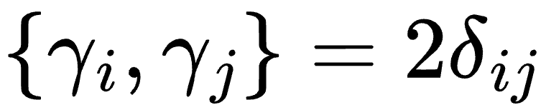
Majorana Operators
In fermionic systems, express observables in terms of Majorana operators .
Commutation relations: .

Slide 24
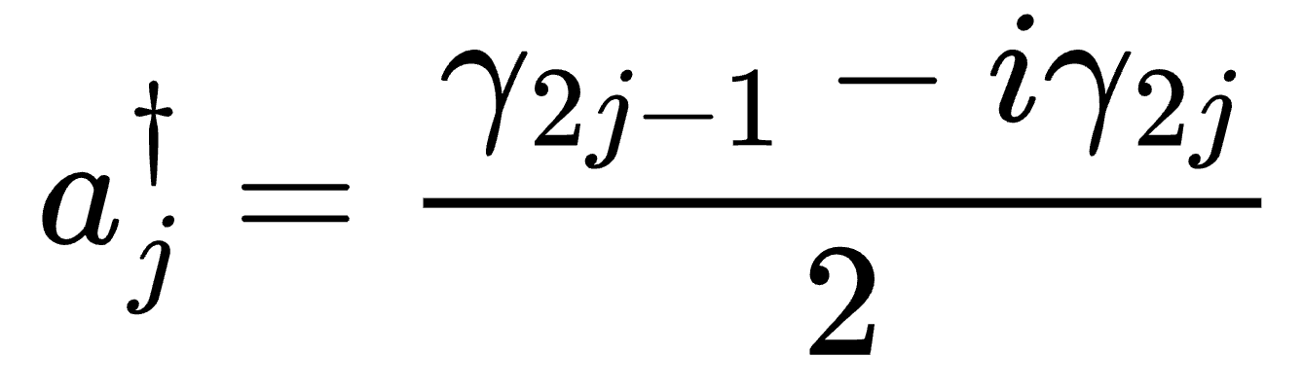
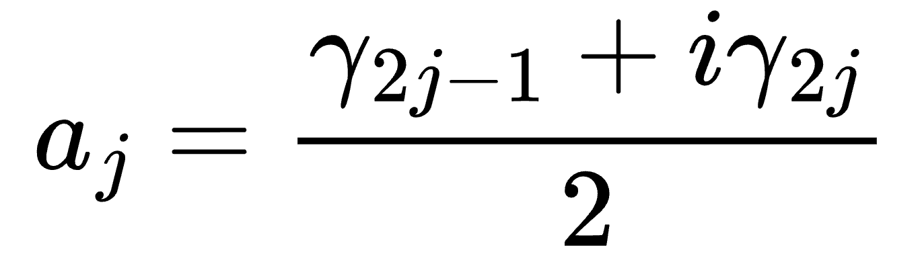
Majorana Operators
In fermionic systems, express observables in terms of Majorana operators .
Commutation relations: .

Slide 25
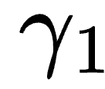
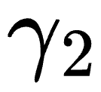
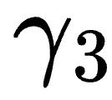
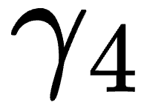
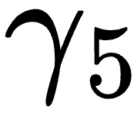
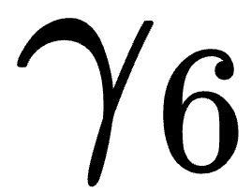
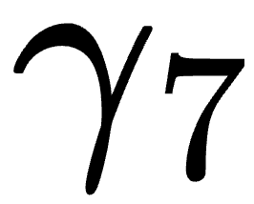
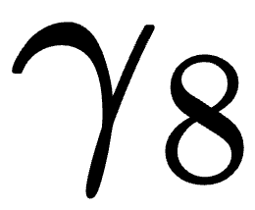
Majorana Operators
In fermionic systems, express observables in terms of Majorana operators .
Commutation relations: .

Slide 26
Majorana Operators
In fermionic systems, express observables in terms of Majorana operators .
Commutation relations: .
These operators do not commute: no separation.

Slide 27
Majorana Operators
In fermionic systems, express observables in terms of Majorana operators .
Commutation relations: .
These operators do not commute: no separation.

Slide 28
Majorana Operators
In fermionic systems, express observables in terms of Majorana operators .
Commutation relations: .
These operators do not commute: no separation.
Fermions correspond to two Majoranas, and iγ_{2j-1}γ_{2j} is the fermionic parity. The observables commute!

Slide 29
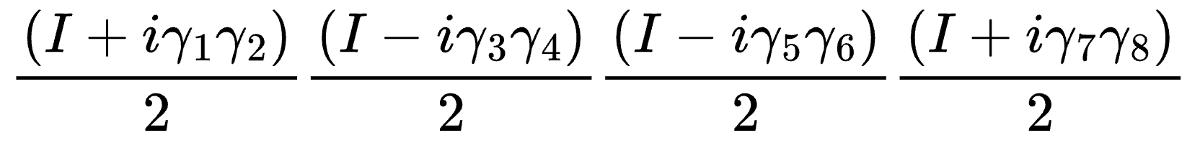
Pure Gaussian States
Ex.

Slide 30
Pure Gaussian States
Ex.
1
0
0
1

Slide 31
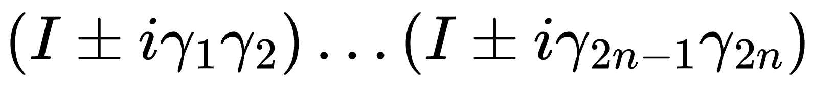
Pure Gaussian States
Ex.
In general:
1
0
0
1

Slide 32
Pure Gaussian States
Ex.
In general:
These states are analogously “separable!”
1
0
0
1

Slide 33
Pure Gaussian States

Slide 34
Pure Gaussian States

Slide 35
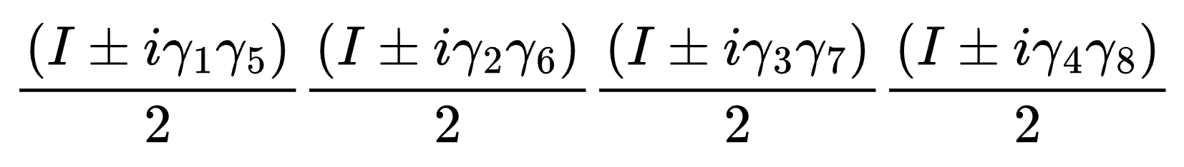
Pure Gaussian States

Slide 36
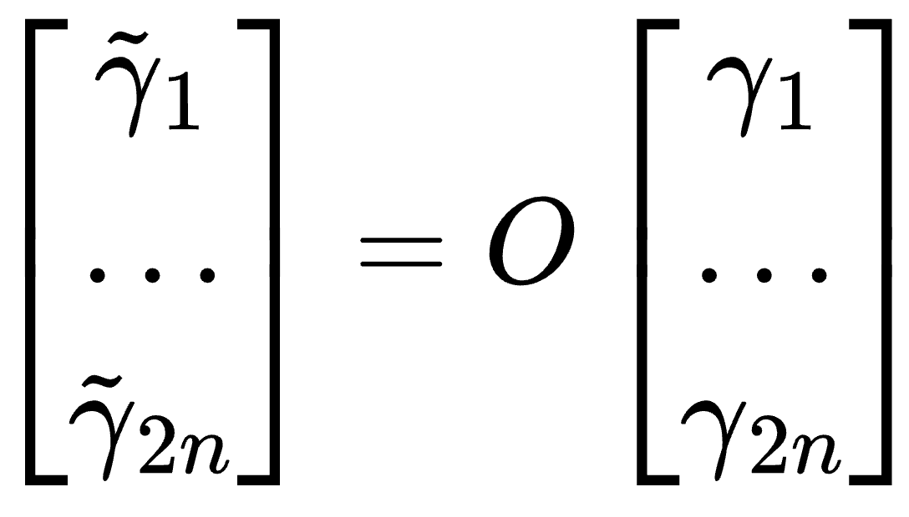
Pure Gaussian States

Slide 37
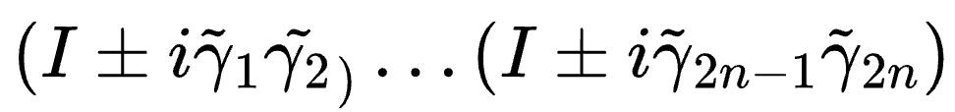
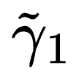
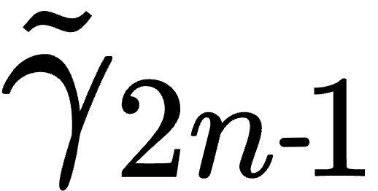
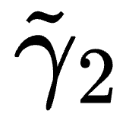
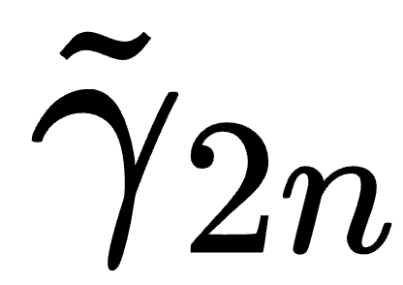
Pure Gaussian States
…

Slide 38
Pure Gaussian States
Convex-Gaussian states are mixtures of these pure Gaussian states!
A reasonable analog of separable mixed states.
…

Slide 39
Local Hamiltonians (R, d)

Slide 40
Main Result
Theorem. Let fermionic H have locality R, d. Then the critical temperature β_{g} satisfies β_{g}⁻¹ ≲ Rd.
Theorem. The Gibbs state of fermionic H can be sampled efficiently for temperature β⁻¹ ≳ Rd².

Slide 41
Observations
High-temperature fermionic Gibbs states are classically simulable!

Slide 42
Observations
High-temperature fermionic Gibbs states are classically simulable!
The nature of the algorithm crucially utilizes different choices of fermionic modes to describe the Gibbs state.

Slide 43
Observations
High-temperature fermionic Gibbs states are classically simulable!
The nature of the algorithm crucially utilizes different choices of fermionic modes to describe the Gibbs state.
We also prove that for SYK fermionic Hamiltonians (non-local), high-temperature Gibbs states are not convex-Gaussian.

Slide 44
Proof Ideas

Slide 45
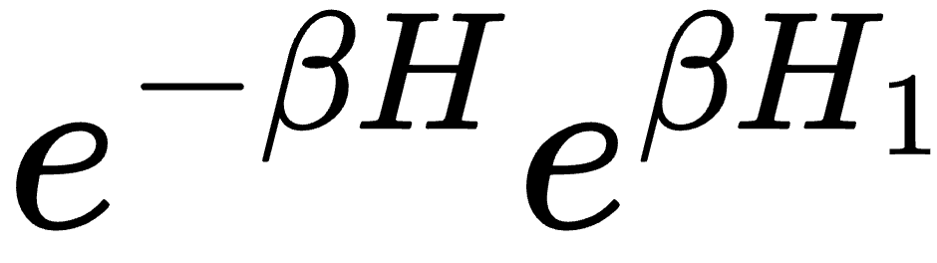
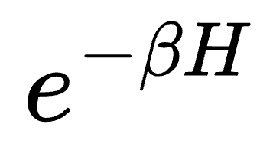
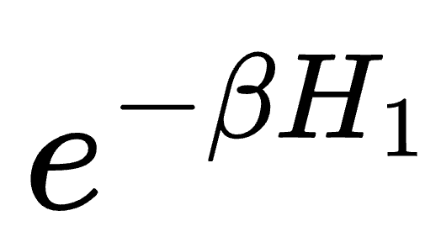
Extending to the Gibbs State

Slide 46
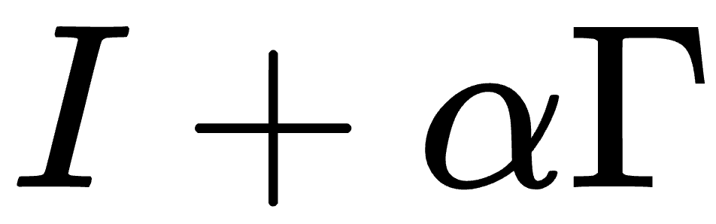
Extending to the Gibbs State
Sampled perturbation

Slide 47
Extending to the Gibbs State

Slide 48
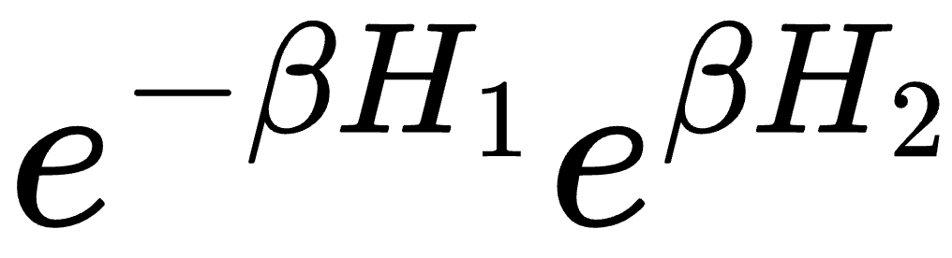
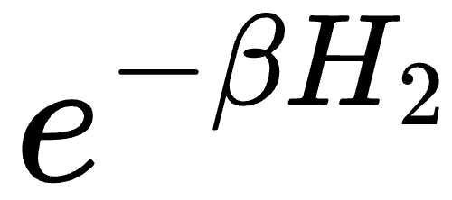
Extending to the Gibbs State

Slide 49
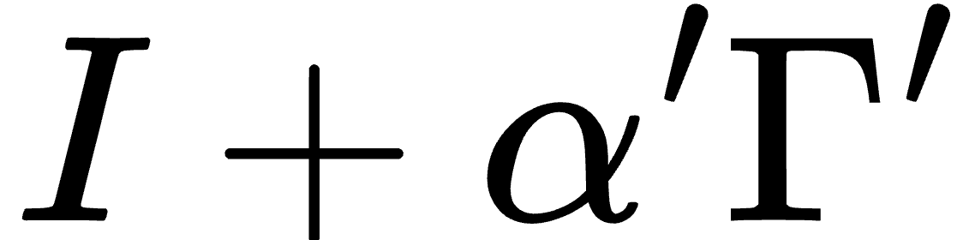
Extending to the Gibbs State

Slide 50
Extending to the Gibbs State

Slide 51
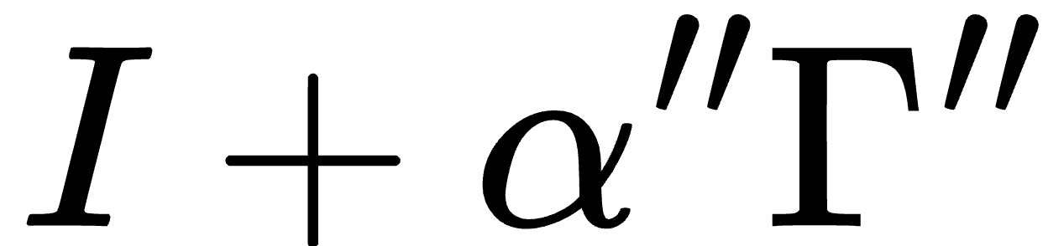
Extending to the Gibbs State

Slide 52
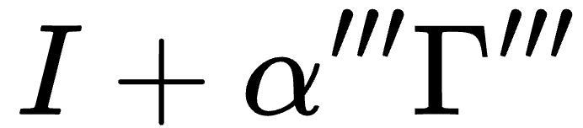
Extending to the Gibbs State
Pinning a fermion
Decreases support of perturbation!

Slide 53

Extending to the Gibbs State
Pinning a fermion
Decreases support of perturbation!
…

Slide 54
Extending to the Gibbs State
…

Slide 55
Extending to the Gibbs State
Fermionic pairing is adaptively
chosen!
…

Slide 56

Further Work
Convex-Gaussianity in weakly interacting systems?
For any temperature, varying interaction strength 𝜀, when does the Gibbs state become convex-Gaussian?
Is there a difference with spin systems here?

Slide 57
Thank you! Questions?

