Slide 1
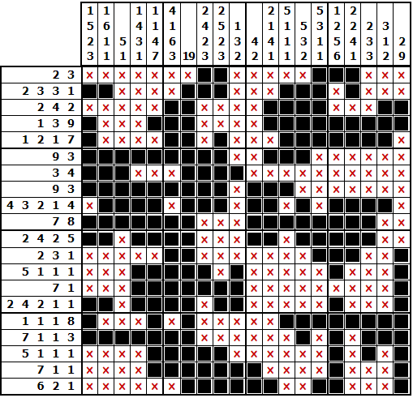
Solution
Created using https://www.puzzle-nonograms.com/

