Slide 1
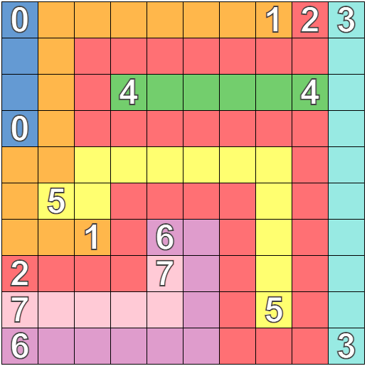
Solution
Created using https://numberlinks.puzzlebaron.com/play.php

